Slide 1
The American Revolution
vs.
The French Revolution
A presentation by Kevin T. Brady, Ph.D.

Slide 2
Pennsylvania Academic Standards for History
Grade Three - History
8.2.3.B. Identify and describe primary documents, material artifacts and historic sites important in Pennsylvania history.
Documents, Writings and Oral Traditions (e.g., Penn’s Charter, Pennsylvania “Declaration of Rights”)
8.3.3.B. Identify contributions of individuals and groups to United States history.
George Washington
Thomas Jefferson
Abraham Lincoln
Theodore Roosevelt
Franklin D. Roosevelt

Slide 3
Pennsylvania Academic Standards for History
Grade Six - History
8.3.6.B. Identify and explain primary documents, material artifacts and historic sites important in United States history from Beginnings to 1824.
Documents (e.g., Mayflower Compact, Northwest Ordinance, Washington’s Farewell Address)
18th Century Writings and Communications (e.g., Paine’s Common Sense; Franklin’s “Join, or die,” Henry’s “Give me liberty or give me death”)
Grade Twelve – World History
8.3.12.D. Evaluate how conflict and cooperation among social groups and
organizations impacted world history from 1450 to Present in Africa, Americas, Asia and Europe.
Domestic Instability
Ethnic and Racial Relations
Labor Relations
Immigration and Migration
Military Conflicts

Slide 4
Similarities
America
Landed élites, merchants, Middle Class
Changed Governments
Republicanism
France
Bourgeoisie
Changed Governments
Republicanism

Slide 5
Differences
America
Life
Liberty
Property
(Pursuit of Happiness)
or (Social Happiness, i.e., an end in itself -- civic virtues of courage, moderation, and justice)
France
Liberty
Equality
Fraternity

Slide 6
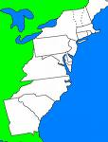
America
Settler Republics, to
Quasi-independent republics, to
Loose union of republics, to
Stronger union of republics

Slide 7
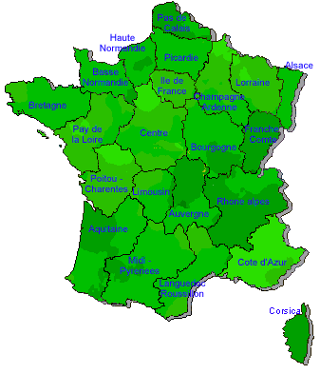
France
Absolute Monarchy, to
Republic, to
Dictatorships, to
Empire

Slide 8
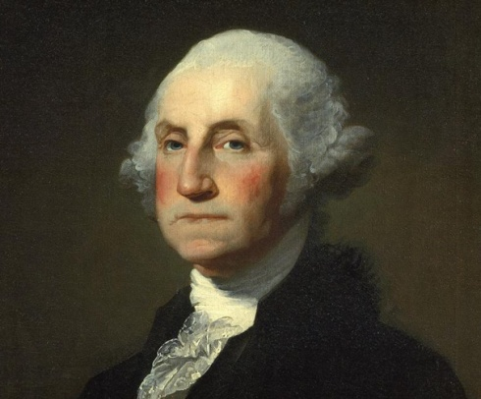
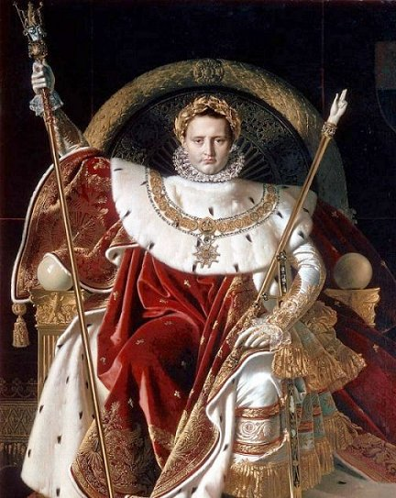
Trajectory in 11 years
AMERICA
Declaration of Independence to the Constitution
FRANCE
Beheading a King to crowning an Emperor

Slide 9
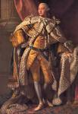
Differences
America had a quarrel with the “present” King
The King had violated their traditions and English Law
France overthrew an entire government
An entire social structure
An entire way of life

Slide 10
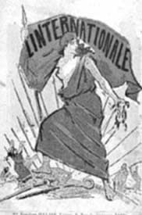
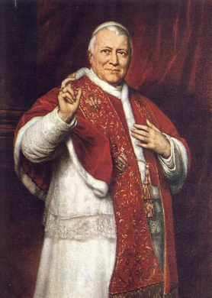
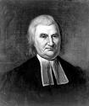
Religion
France overthrew Christianity and the Catholic Church structure
They then created a new secular state religion the “Cult of Reason,” then “The Cult of the Supreme Being.”
Most American Christian denominations supported the American Revolution
Christianity stayed strong after the Patriot victory

Slide 11
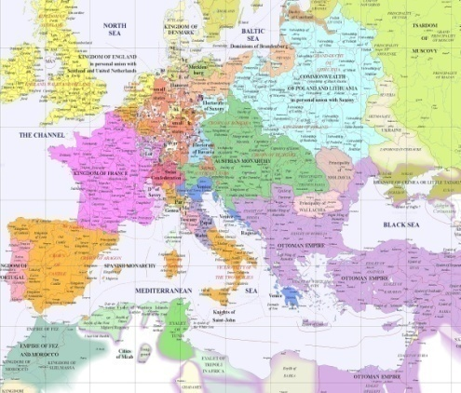
War
America invaded Canada to get the Canadians on its side
It didn’t work
One short attempt
France went to war with all of Europe
Worked to spread the revolution
War lasted 23 years

Slide 12
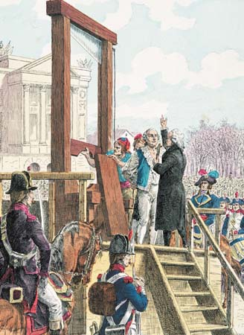
Goals
America
Independence from Britain
Create a new government
Free republics
Consent of the governed
France
Destroy old Ancein Régime – the old order.

Slide 13
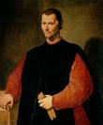
Anglo-Scottish view
Man is bad and corrupt
From Christianity
Fallen nature of man
From Machiavelli
“Man is Wicked” (without Christian chance of redemption and grace)
Virtue is in the institutions
We can improve conditions and institutions, rather than man

Slide 14
Jean Jacques Rousseau the basis for much of the later Franco-German thought
Man is good
The Noble Savage
Society is bad
Institutions are corrupt
“Man was born free, but everywhere he is in chains.”

Slide 15
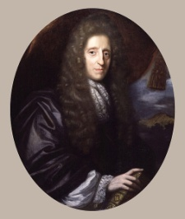
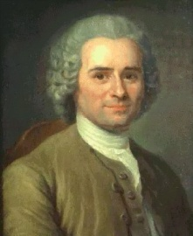
Philosophical
American
John Locke
Natural Law – Enlightenment
Reason
Consent of the Governed
Machiavelli
Institutions
Balance through tension
Man is wicked
Christianity
Man is fallen
Liberty
French
Jean Jacques Rousseau
Romantic
Emotion
General Will
General Will
State control
Man is good
Society is evil
Equality

Slide 16
Consequences
America
Life
Liberty
Property
Individual Rights & Private Property
France
Liberty
Equality
Fraternity
Coercion & Collectivism

Slide 17
Consequences
Consent of the Governed
Free Elections
Division of Power
Peaceful Transfer of Power
General Will
Coercion
Centralization of Power
Dictatorial Power

Slide 18
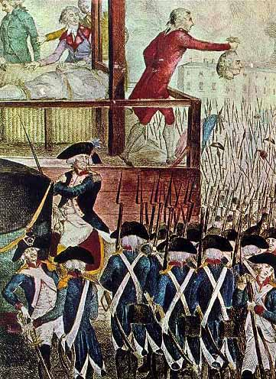
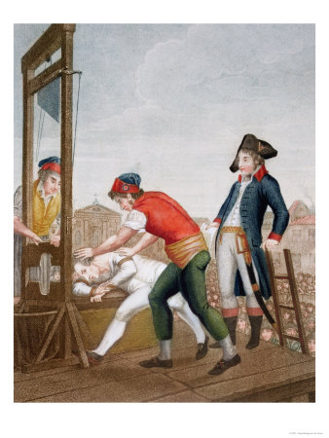
Maximilian Robespierre
A doctrinaire disciple of Rousseau
The Reign of Terror — 1792–1794
Guillotined 40,000 persons who were “inauthentic” to the revolution
Robespierre is then guillotined for being inauthentic

Slide 19
Rousseauian Autonomous Freedom
In the Social Contract (1762), “In order that the social compact may not be an empty formula, it tacitly includes the undertaking, which alone can give force to the rest, that whoever refuses to obey the general will shall be compelled to do so by the whole body. This means nothing less than that he will be forced to be free.”

Slide 20
Rousseau’s Autonomous Freedom
He pushed for freedom from the institutions of society — church, family, class, community.
The STATE would be the redeemer.
By destroying all social ties, the state would liberate the person from all allegiance to anything except the STATE.
He said, “Each citizen would then be completely free of all his fellow men, and absolutely depended on the state.”

Slide 21
In Anglo-American tradition:
Liberty is freedom from state power
Governments were formed to protect people’s rights and property

Slide 22
Consequences:
Rousseau gives birth to the modern idea of REVOLUTION — not the overthrow of a government, but the complete destruct of the existing order
The revolutionaries will build a new, perfect order, with new type human beings — The NEW MAN

Slide 23
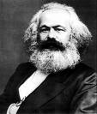
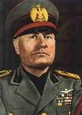
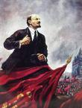
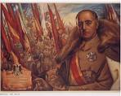
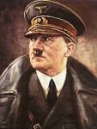
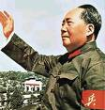
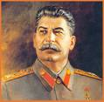
Further Consequences of the “Ideal Society”
Marx
Lenin
Stalin
Mussolini
Hitler
Mao
Pol Pot

