Slide 1
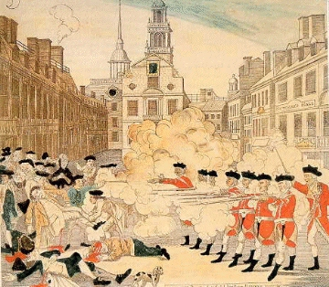
RIPPED FROM THE HEADLINES
A Case Study Approach
Find the STORY BEHIND THE STORY
THE BOSTON MASSACRE
What happened?
Who was involved and what are the details of their story?
Where did it happen?
What is the current status of the story?
Why did it happen?
How accurate was the original story?
IT IS ALL IN THE DETAILS!!!

Slide 2
Suggested Research Guidelines
Let the research and new information guide your direction.
Pick the most interesting leads and individuals.
What may seem simple is usually very complex in its details and characters.
Remember to take notes and develop your story on the specific case study that you identify.
The story is in the depth of your research on specific details and cases rather than a broad approach on many topics or individuals. FOLLOW THE STORY!
Maintain your level of interest! When it seems that you have hit a dead end read more and follow your leads.
This is discovery at its best! Unravel the story and find out…….
WHAT REALLY HAPPENED?
Please Note: Each topic area, person, event, location, etc., throughout this presentation is a CASE STUDY for students to investigate.

Slide 3
Suggested Instructional Strategies
ENGAGE students in the topic via news headlines or short video
Provide enough BACKGROUND INFORMATION for students to get a sense of the issue
Generally DEFINE THE PEOPLE, PLACES, EVENTS, etc., that are the main components of the story
Assign these main components of the story to GROUPS of students for research
Illustrate the GEOGRAPHIC AREA and have students work individually with desk maps to locate and define the area of focus. Assign this research to one group, which will report back to the class.
Students must locate an ORIGINAL NEWS SOURCE that covered their assigned topic
Provide COMPUTER RESEARCH SESSIONS for students to examine their assigned components and research their selected person, place, event, etc.
Each group of students REPORTS BACK to the class on the details of their research and the class builds a narrative about…..BEST DONE IN PAIRS
WHAT REALLY HAPPENED?

Slide 4
POSSIBLE ASSESSMENT
This activity includes the following elements:
Original News Story
Student Research on the People/Places/Events Involved in the Story
Geographic Locations and Information
Reconstructed Student Narratives of the Story
Possible Assessment:
Compare and Contrast the Original Story with the Reconstructed Narrative (Individually or In Groups)
One Group Reports on the Geographic Information
These reports can be done in a digital format, and those pieces could be constructed into a video presentation illustrating… WHAT REALLY HAPPENED?

Slide 5
Time Line
1756-63
French and Indian War.
1763
Proc Line
1765
Stamp Act
1766
Stamp Act Repeal
1766
Same Day Declaratory Act Passed
1767
Townsend Duties Repealed 1770
1770
Boston Massacre
1774
Intoler-
able Acts
1774
First Continental Congress

Slide 6
Binary Paideia: American Revolution
Society | Time Period | Society
British Empire | American Revolution | Patriots
King in Parliament | Politeia/Regime | Assemblies/Congress
Aristocracy/Gentry | Politeuma/Ruling Class | White male landowners
Glorious Revolution | Paideia/What makes a society what it is | Republicanism, Charters, John Locke's Two Treatises
Loyalty | Virtue/ The highest moral excellence | Liberty

Slide 7
Timeline: http://law2.umkc.edu/faculty/projects/ftrials/bostonmassacre/bostonchronology.html
1767: The Townshend Revenue Act of 1767 authorizes the use of writs in order to locate goods subject to custom duties. The Act is detested by many Bostonians
May 9, 1768: Hancock's sloop Liberty arrives in Boston with a cargo of wine. A customs official is temporarily held hostage as the wine is unloaded without payment of the required custom duties. Liberty is seized June 10. Customs officials attacked by rioters
Sept. 28,1768 Two regiments of British regulars land in Boston to deal with growing unrest. They are quartered in various public places throughout the city.
March 2, 1770: Civilians and British soldiers clash at John Gray's Ropewalk One of the soldiers involved in the fighting is Matthew Killroy, later convicted of manslaughter in the Boston Massacre trial.
March 5, 1770: A crowd of Bostonians begins throwing chunks of ice, oyster shells, piece of coal and other objects at a British guard near the Custom House. Captain Thomas Preston orders the main guard out to protect the sentry and restore order. After a soldier is hit with a stick, he yells "fire!" and shoots into the crowd. Other shots follow. When the shooting stops, five civilians lay mortally wounded.

Slide 8
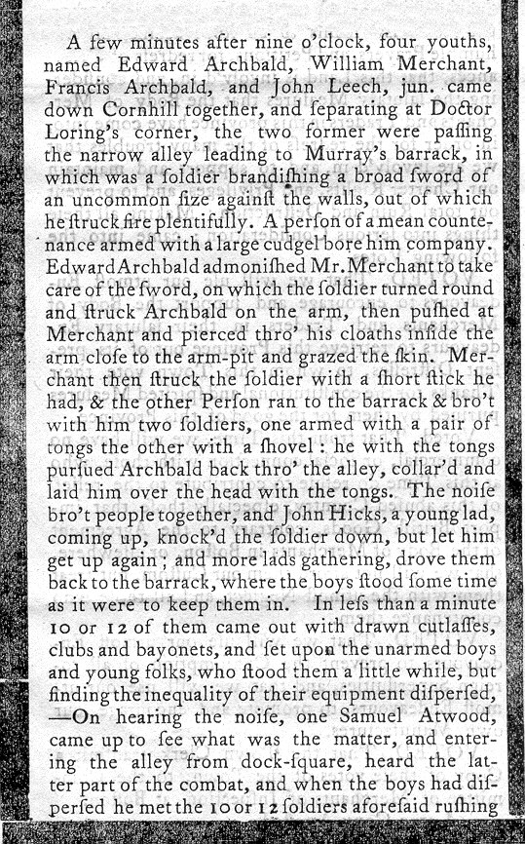
http://www.earlyamerica.com/review/winter96/massacre/massacrepage1.htm
BOSTON GAZETTE
MARCH 12, 1770
If you were living in Boston at the time, this is what you would have read in the Boston Gazette and Country Journal in its edition of Monday, March 12, 1770.

Slide 9
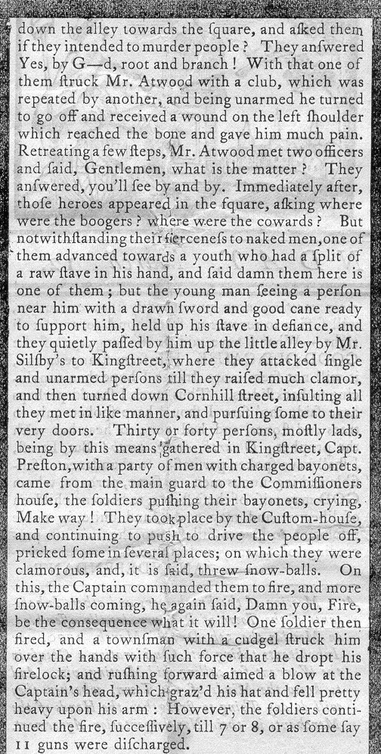
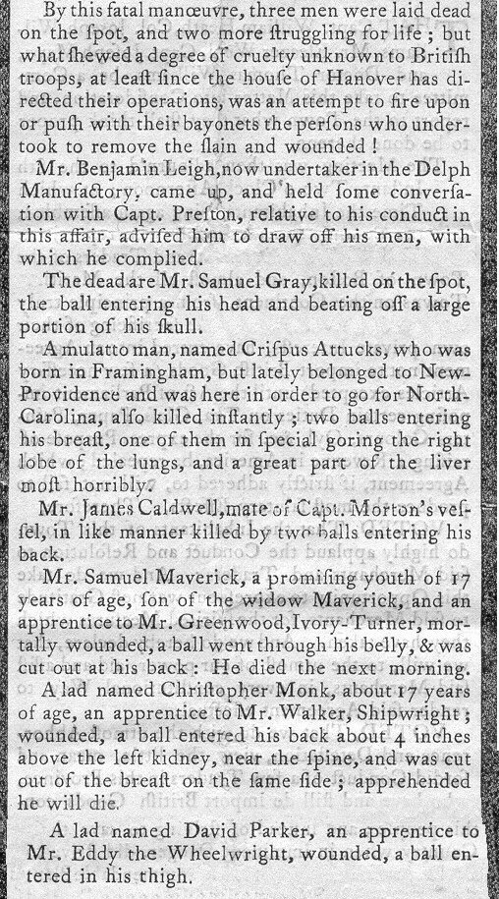

Slide 10
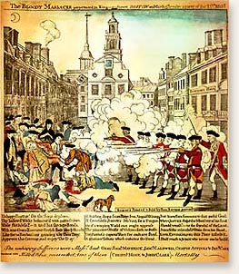
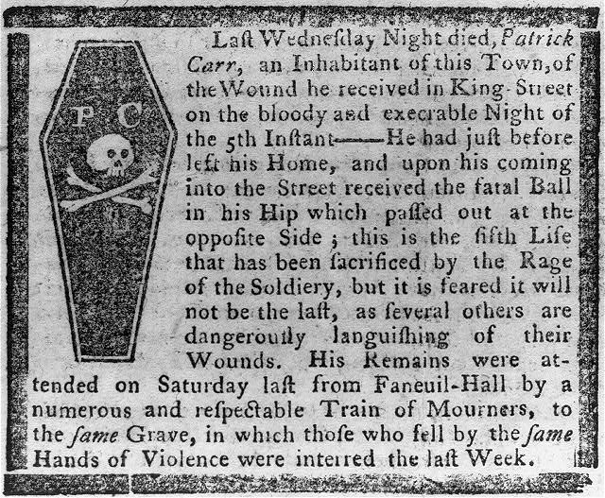
Boston Gazette 1770
Have Two Students
ARTIST
The Boston Gazette
Or Its Prints
A: Author
R: Reason
T: To Whom
I: Immediate Effect
S: Subsequent Effects
T: Time Period

Slide 11
Paul Revere’s
“The Bloody Massacre on King Street”

Slide 12
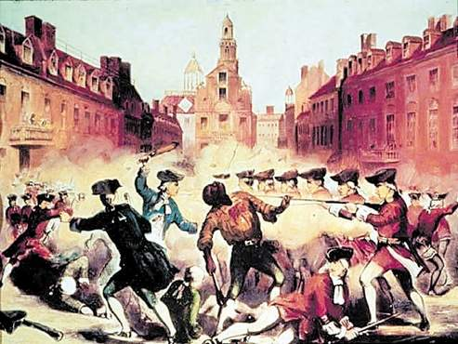
John Pufford’s 1856 lithograph depicts the Boston Massacre, where Attucks was killed March 5, 1770

Slide 13
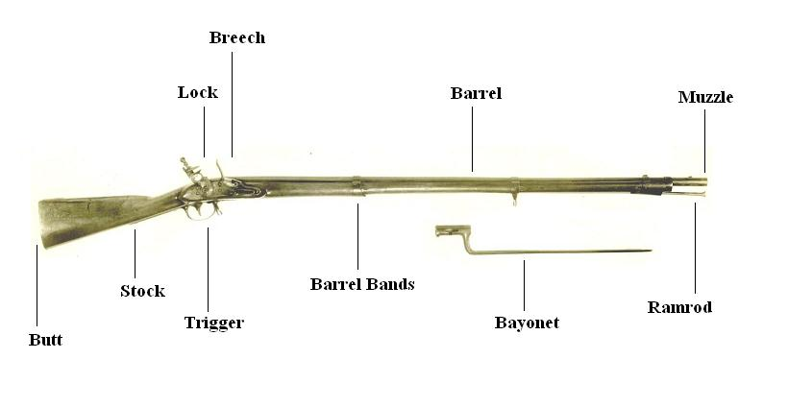
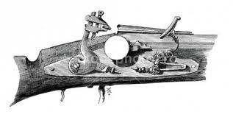
Cudgel: A Club
Musket
Brandishing: To Wave Something in a Threatening Manner
Firelock
Broad Sword
Notes:
This 19th century lithograph is a variation of Revere's famous engraving. Produced soon before the American Civil War, this image emphasizes Crispus Attucks, who had by then become an important symbol for abolitionists. (John Bufford after William L. Champey, circa 1856)

