Slide 1
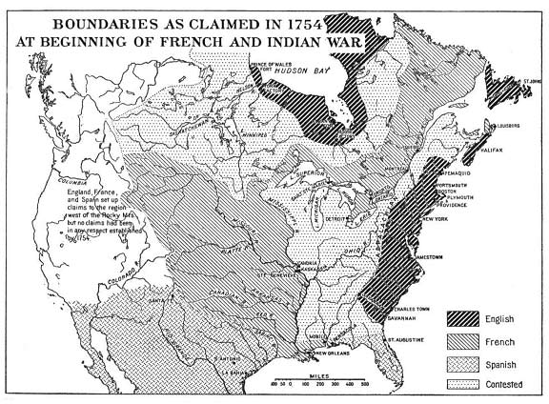

Slide 2
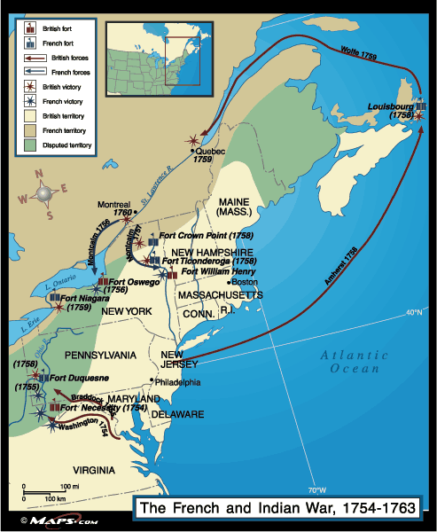

Slide 3
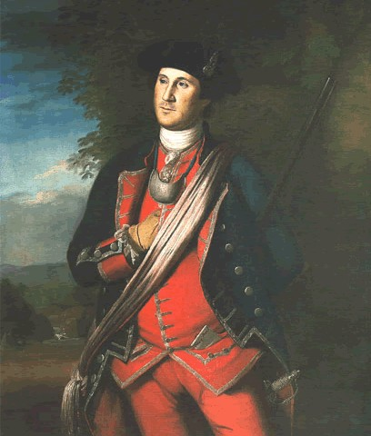
Notes:
Earliest authenticated portrait of GW, 1772 (Charles Wilson Peale). Virginia regimentals.

Slide 4
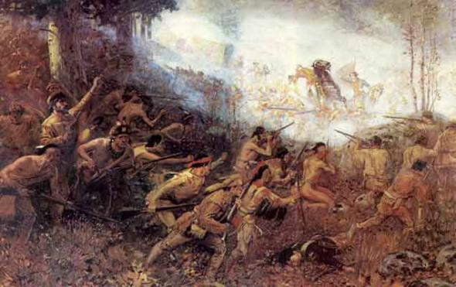
Notes:
Braddock’s defeat; Washington at his side. (State Historical Society of Wisconsin)

Slide 5
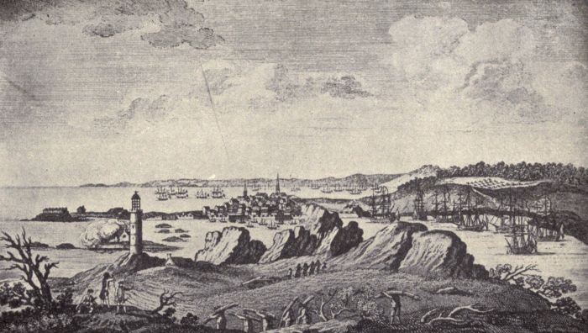
Notes:
View of Louisbourg, 1758

Slide 6
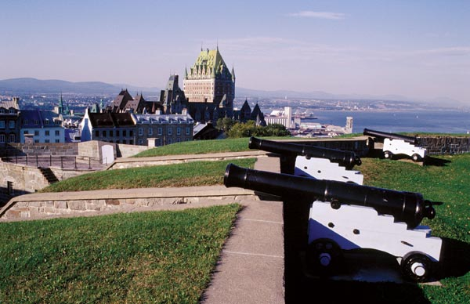
Notes:
Understanding Montcalm’s sense of security

Slide 7
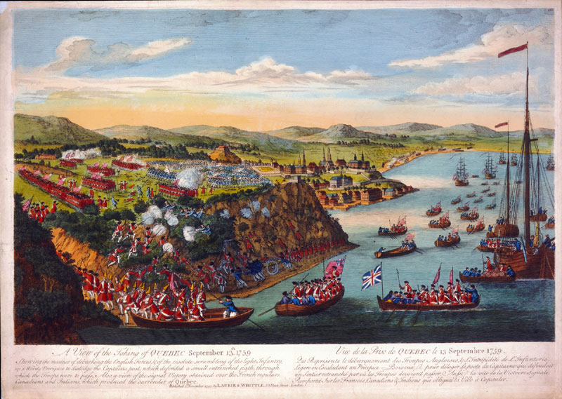
Notes:
Battle of Quebec

Slide 8
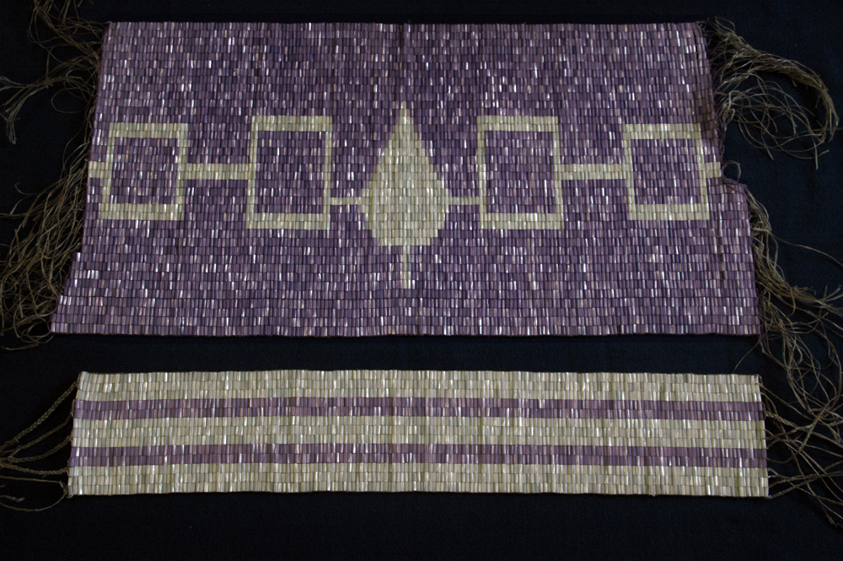
Notes:
Five Nations covenant belt

Slide 9
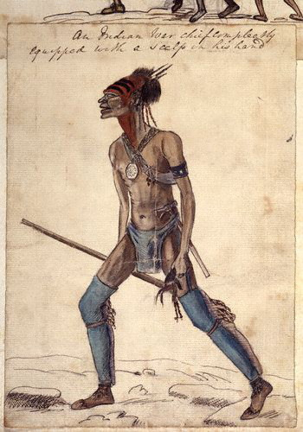
Notes:
“An Indian Chief completely equipped with a scalp in his hand” George Townshend, 1758

Slide 10
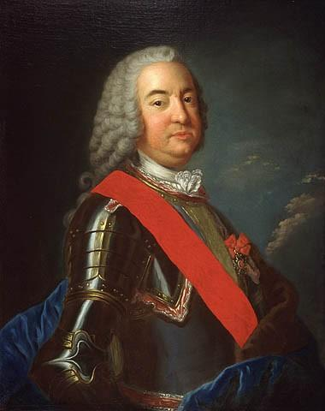
Notes:
Governor General Vaudreuil

Slide 11
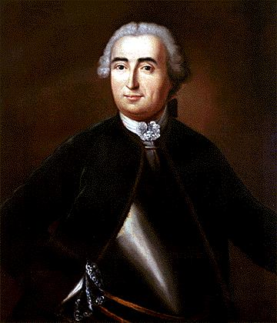
Notes:
General Montcalm

Slide 12
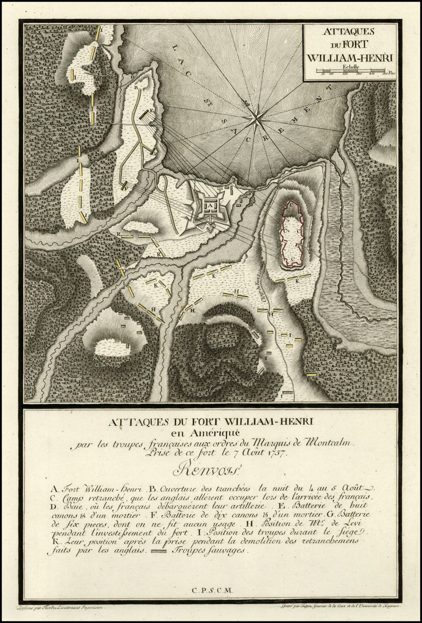

Slide 13
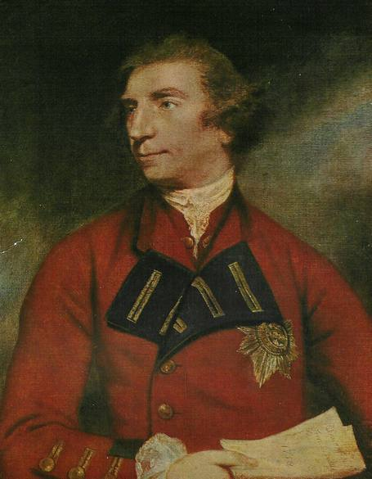
Notes:
Lord Jeffery Amherst, wearing the Star of a knight of the order of the Bath, an honor he was awarded in 1761. Joshua Reynolds. National Gallery of Canada.

