Slide 1
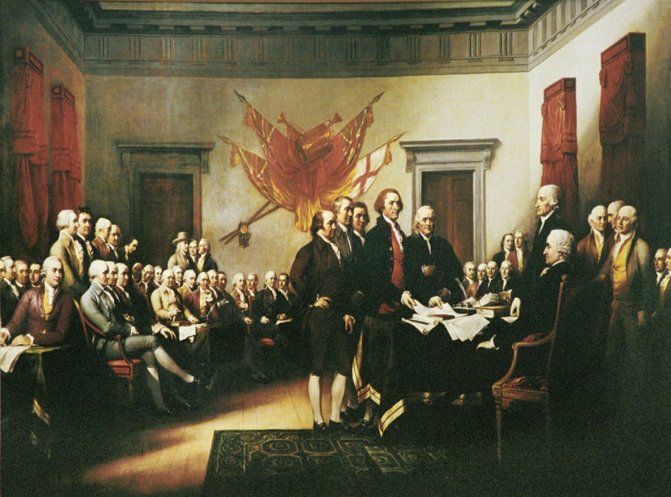
The Declaration of Independence
Propaganda or a Birth Certificate?
A presentation by Kevin T. Brady, Ph.D.

Slide 2
Pennsylvania Academic Standards for History
Grade Three - History
8.2.3.B. Identify and describe primary documents, material artifacts and historic sites important in Pennsylvania history.
Documents, Writings and Oral Traditions (e.g., Penn’s Charter, Pennsylvania “Declaration of Rights”)
8.3.3.B. Identify contributions of individuals and groups to United States history.
George Washington
Thomas Jefferson
Abraham Lincoln
Theodore Roosevelt
Franklin D. Roosevelt

Slide 3
Pennsylvania Academic Standards for History
Grade Six - History
8.3.6.B. B. Identify and explain primary documents, material artifacts and historic sites important in United States history from Beginnings to 1824.
Documents (e.g., Mayflower Compact, Northwest Ordinance, Washington’s Farewell Address)
18th Century Writings and Communications (e.g., Paine’s Common Sense; Franklin’s “Join, or die,” Henry’s “Give me liberty or give me death”)

Slide 4
A Practical Document with Three Purposes
State Reason for Independence
Theory of Government
Declaration of War

Slide 5
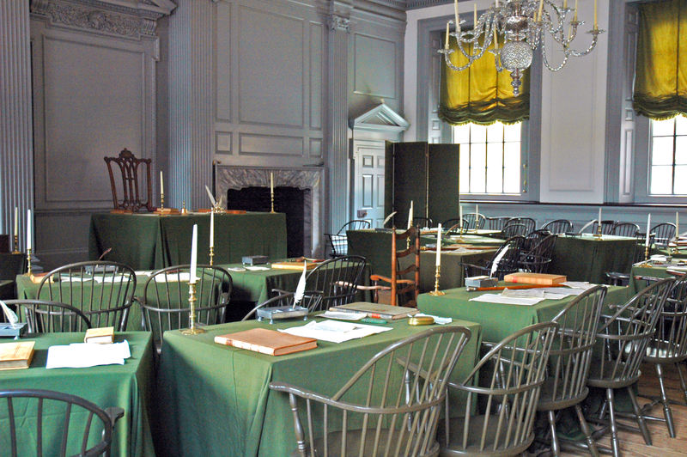
State Reason for Independence
Twenty-seven reasons
British had violated the natural rights of man
It pictures King George III as a tyrant
Colonists had been patient and long suffering

Slide 6
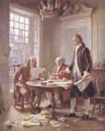
Theory of Government
Democracy
All men are created equal
Unalienable rights
Government exists to secure
those rights
Power comes from the consent of the governed
It is the people’s natural right to overthrow a tyrannical government

Slide 7
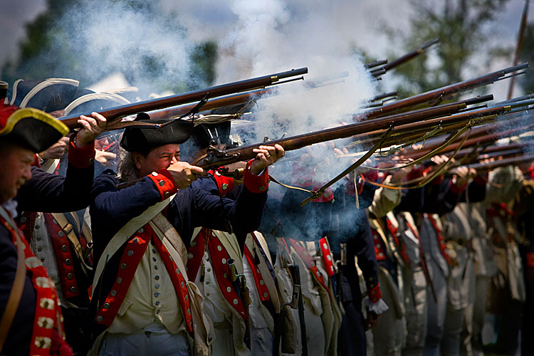
Declaration of War
Announces that war exists
If patriots lost, they would be tried as traitors
They risked everything

Slide 8
We hold these truths to be self-evident, that all men are created equal, that they are endowed by their Creator with certain unalienable Rights, that among these are Life, Liberty and the pursuit of Happiness.

Slide 9
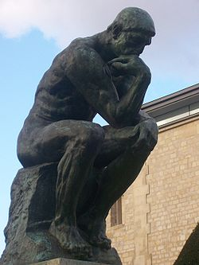
Natural Rights?????
What does that mean?

Slide 10
Aristotle (and Plato and Cicero)
argued that morality is not conventional, but natural.
There is a natural law that must be obeyed whether it is written down by legislative authorities or not. This is the essence of classical natural law theory.

Slide 11
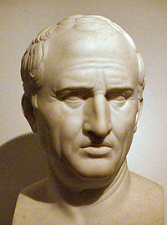
Cicero
106–43 BC
“True law is right reason in agreement with nature; it is of universal application, unchanging and everlasting. . . . Whoever is disobedient is fleeing from himself
and denying his human nature . . . ”

Slide 12
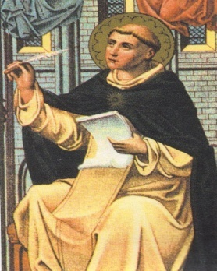
Thomas Aquinas
1225–1274
Eternal Law → All the laws of the universe
Natural Law → The portion of the eternal law that man can know through “reason”
Man-made Law → Laws or regulations like traffic ordinances
Divine Law → Law only known through revelation (religious faith)

Slide 13
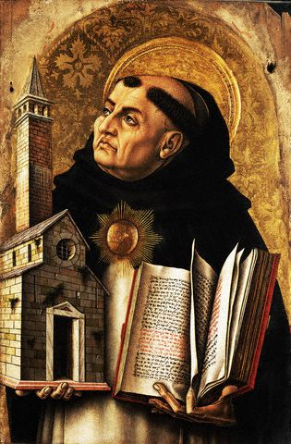
Aquinas establishes that non-Christians can learn “Natural Law” through reason
This dramatically changes Christian thought
Original Sin affects the soul, not the mind

Slide 14
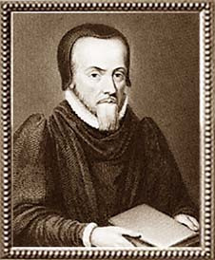
Richard Hooker 1554–1600
Richard Hooker brings the Natural Law tradition to Anglican England
He makes Aquinas
acceptable to Anglicans

Slide 15
Protestants from Luther on rejected Natural Law.
Truth only comes from Divine Revelation as revealed to be consistent with Scripture.
Humans had original sin, which meant that their soul, mind, and body were corrupted by sin.
Human reason was corrupt and could not be trusted.

Slide 16
Aquinas brought Aristotelian Natural Law back into the Western tradition
Hooker allows it to stay in the Anglican (English) tradition
Very contrary to Puritan and Presbyterian Protestant doctrine

Slide 17
Algernon Sidney 1623–1683
Sidney adheres more to the ancient view of “Natural Law”
more than Locke does→
Man is a political animal.
Man’s natural state is within a society.

Slide 18
Sidney writes Discourses Concerning Government to counter Robert Filmer’s Patriarcha, which supports the heredity monarchy.
Both men use Hooker extensively to make
their arguments.
Hooker is the authority

Slide 19
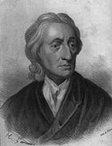
John Locke 1632–1704
Locke uses Hooker as a beginning
Hooker’s view on Natural Law was the accepted norm in Stuart England
Protestant dissenters rejected Natural Law
Locke began with Hooker to launch his new view of Natural Law

Slide 20
Locke followed Thomas Hobbes’ notion that man was a solitary being in the State of Nature
Natural Rights with the individual
Counters the Ancients, Aquinas, Hooker, and Sidney→ that Man is a political animal.
Natural Rights within a society

Slide 21
Natural Law moves from:
DUTIES
to
RIGHTS

Slide 22
John Locke
Continues the Move away from Christianity
God gave man the EARTH
God gave man REASON
Natural Providence is a Reflection of Divine Providence

Slide 23
ANCIENTS and CHRISTIANS
Humans only have use of things on Earth
Stewardship

Slide 24
Every Man Has Property in His Own Person
Major Paradigm Shift
The Labor or Work of my hands are mine ---- My Property
Common land becomes “my land.”
“I work it. It’s mine!”

Slide 25
GENESIS 1:28
CHRISTIANS and JEWS
Be fruitful and multiply and replenish the Earth . . .
BACON and LOCKE
. . . and subdue it.

Slide 26
In America, Lockean Thought
Justifies colonization
Justifies taking Indian land
Justifies homesteads and settlements

Slide 27
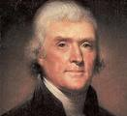
Thomas Jefferson (1743–1826)
LIFE
LIBERTY
PROPERTY
Pursuit of happiness

Slide 28
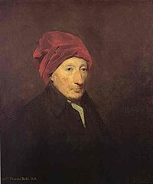
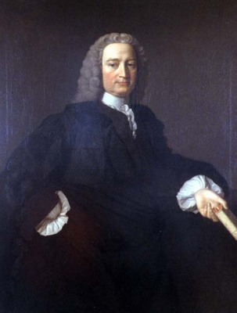
Borrowing from the Scots
Jefferson borrowed Thomas Reid’s idea of “self-evident truths” for the U.S. Declaration of Independence.
Jefferson was also influenced by Francis Hutcheson (1694–1746), who saw the ultimate goal of liberty as happiness, prompting him to add “the pursuit of happiness” to his list of the inalienable rights of man.

Slide 29
Are these inalienable rights?
Where do they come from?
Is the purpose of government to protect them?
Life
Liberty
Pursuit of Happiness

Slide 30
All Men Are Created Equal
Did Jefferson miss the boat?
What should he have included in the Declaration?
What would have happened if he had changed the words?

Slide 31
EQUALITY
Did Jefferson invent it?
Where did it come from?

Slide 32
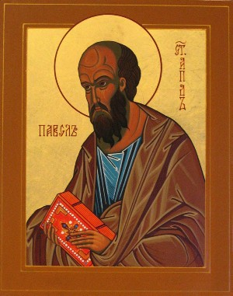
Paul of Tarsus d. circa 67 A.D.
There is neither Jew nor Greek, slave nor free, male nor female, for you are all one in Christ Jesus.
Was equality a common Jewish belief at the time?

Slide 33
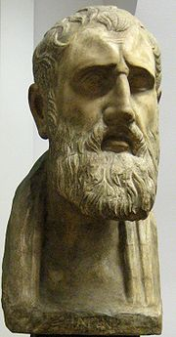
The Stoics
Stoics advocated the brotherhood of humanity and the natural equality of all human beings
Zeno of Citium, 344-262 B.C.

Slide 34
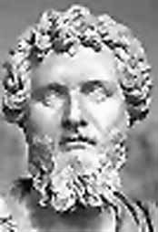
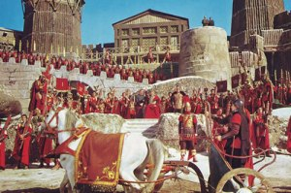
Domitius Ulpianus (170–228 A.D.)
Men by Nature are equal

Slide 35
Thomas Hobbes 1588–1679 Leviathan 1651
Nature hath made men so equal in the faculties of body and mind as that, though there be found one man sometimes manifestly stronger in body or of quicker mind than another, yet when all is reckoned together the difference between man and man is not so considerable as that one man can thereupon claim to himself any benefit to which another may not pretend as well as he. For as to the strength of body, the weakest has strength enough to kill the strongest, either by secret machination or by confederacy with others that are in the same danger with himself.

Slide 36
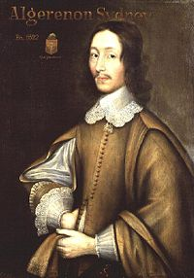
Algernon Sidney 1623–1683
“That Hayward, Blackwood, Barclay, and others who have bravely vindicated the rights of kings in this point, do with one consent admit, as an unquestionable truth, and assent unto the natural liberty and equality of mankind. . . . ” 1698

Slide 37
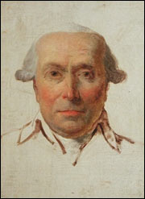
Filippo Mazzie 1730–1816 Virginia Gazette 1775
All men are by nature equally free and independent. Such equality is necessary in order to create a free government. All men must be equal to each other in natural law …

Slide 38
George Mason 1725-1792 Virginia Declaration of Rights, June 1776
That all men are by nature equally free and independent, and have certain inherent rights, of which, when they enter into a state of society, they cannot, by any compact, deprive or divest their posterity; namely, the enjoyment of life and liberty, with the means of acquiring and possessing property, and pursuing and obtaining happiness and safety.

Slide 39
What Does Equality Mean Today?
Equality under the law?
Equality of opportunity?
To what extent?
Equality of result?
To what extent?

