Slide 1

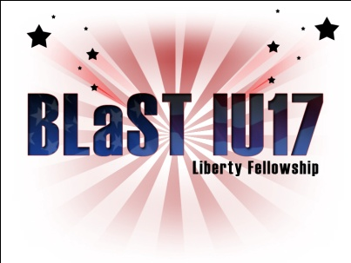

The American Revolution
The World Turned Upside Down
BLaST IU17- April 7th, 2011
A presentation by Kevin T. Brady, Ph.D.

Slide 2
Pennsylvania Academic Standards for History
Grade Three - History
  8.2.3.B. Identify and describe primary documents, material artifacts and historic sites important in Pennsylvania history.
    Documents, Writings and Oral Traditions (e.g., Penn’s Charter, Pennsylvania “Declaration of Rights”)
  8.3.3.B. Identify contributions of individuals and groups to United States history.
    George Washington
    Thomas Jefferson
    Abraham Lincoln
    Theodore Roosevelt
    Franklin D. Roosevelt
Notes:
2

Slide 3
Pennsylvania Academic Standards for History
  Grade Six - History
  8.3.6.D. Identify and explain conflict and cooperation among social groups and organizations in United States history from Beginnings to 1824
    Military Conflicts (e.g., French and Indian War, American
    Revolutionary War, War of 1812)

Slide 4
From the French and Indian War
Colonists emerge with a sense of military power.
The Revolution starts here.

Slide 5
Colonists
Bore the brunt of battle at first
Fought side-by-side with the British
20,000 Americans under arms

Slide 6
Also, shattered myth of British invincibility in the minds of the colonists
Friction between British officers and the militia
They called the colonists savages
  Yankee Doodle Dandy
Colonists still traded with the French and Spanish
Militia would only fight in their home colony
Some colonies would not fight or send money
William Pitt had to bribe colonies to participate

Slide 7
Colonial Disunity in 1756
Elites vs. backwoods
Puritans, Quakers, Anglicans, Presbyterians, Baptists, etc.
English, Irish, Germans, etc.
Geographic: North vs. South, Tidewater vs. Mountains

Slide 8
Soldiers learn they have a lot in common when they fought together
American militia vs. British
Similar to American ethnics during World War II

Slide 9
1763 - Colonies no longer needed British protection from the French
1763 former French ally, Chief Pontiac, revolted against British rule in the Ohio Valley
Frontiersmen quickly retaliated
Ulster Irish Presbyterian frontiersmen poured into the Ohio Valley
That’s why they had fought the French
Daniel Boone was already in Tennessee and Kentucky

Slide 10
King George III issues the Proclamation of 1763
No British settlement beyond the Appalachians
  To prevent Indian uprising
British allies, the Iroquois, were looking to encroach into the Ohio Valley
1765 —frontier families poured into the Ohio Valley anyway
They resented the Proclamation and the King

Slide 11
British look to Americans to help pay for the war
The British people were overtaxed
1764 Sugar Act
Currency Act
Quartering Act
Stamp Act of 1765
Declaratory Act
Townshend Acts (indirect taxes)
Writs of Assistance
Tea Act of 1773
Intolerable Acts
Quebec Acts (allowed religious freedom for French Catholics)

Slide 12
Intolerable (or Coercive) Acts
Because of the famous Boston Tea Party
  British closed Boston to all shipping until the tea was paid for
  Revoked Massachusetts’ charter of 1691
    No more town meetings
  New Quartering Act – Bostonians had to provide food and shelter to troops sent to enforce the laws
  British sent those accused of violating the law to England for trial

Slide 13
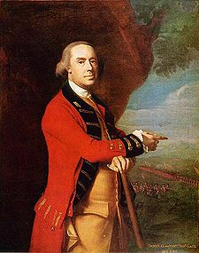
British General Gage was sent to Massachusetts with the Redcoats
He was appointed military governor

Slide 14
Continental Congress
September 1774
  Congress tells colonies to mobilize for war
  Gates moves troops east to Boston
    He employs spies
    Benjamin Church informs Gates the colonists have stored guns at Concord

Slide 15
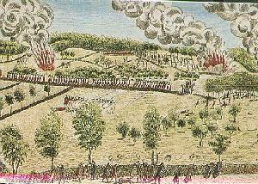
The Shot Heard ’round the World
Audacious
Unbelievable
Incredible
Outrageous
Insane

Slide 16
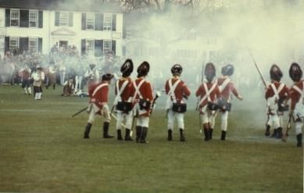
Lexington and Concord
April 19, 1775
Massachusetts
This was the first engagement of the Revolutionary War and came to be known as the “Shot Heard ’round the World.”
The British were marching toward Concord to capture weapons the militia had been collecting.
Paul Revere and William Dawes helped warn the countryside of the British approach. Contrary to common belief, they did not yell “The British are coming!” Since everyone was British at the time, the riders announced that “The regulars are coming!”
When the British arrived at Lexington Green they ordered the militia to disperse. No one knows who fired the first shot, but when the firing began, the militia began to retreat.
The British marched on to Concord where they burned the few supplies they could find. Seeing this, the militiamen believed the British were burning Concord and began to line the road back to Boston. The British would lose more than 250 men on the way back to Boston.
Paul Revere was actually at Lexington Green and gave two different accounts of the battle. In the first, he claims to have seen smoke coming from the tree line where several militiamen had gathered. In an account Revere gave years later, he claimed to have witnessed the British firing on the colonists.
Cicero © 2007

Slide 17
The Odds
2.5 million population
  20% enslaved
No navy
No army
8 million population
The biggest navy in the world
An inured standing army

Slide 18
Colonists thought God was on their side
They were fighting for LIBERTY
The war had an ideology
Not just a European dynastic squabble

Slide 19
The British had serious problems
They thought the militia was weak
They never made a distinction between militia and wartime units
They believed the rebels were a very small minority
British counted on a large loyalist backing (but only had around 20%)

Slide 20
More Problems:
Divided Centralized Colonies – No strategic heart
They had major logistics and manpower problems
3,000 miles across the Atlantic
  Includes, difficult communication
Cumbersome administration bureaucracy
Staffed with incompetent patronage appointees
Little coordination between departments
Bad roads in America
During the French and Indian War, Americans fed the Brits – not now.
British foraging became pillaging
  Drove many colonists to the Patriot cause

Slide 21
And More:
British did not have full support at home
William Pitt, Edmund Burke, Isaac Barre, John Wilkes and merchants were against the war.
Difficult recruiting
They had to hire 30,000 Germans (not mercenaries)
They used slaves and mobilized Indian tribes
Unsure Parliament vacillated between conciliation and coercion

Slide 22
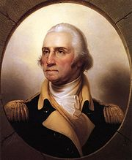
General George Washington

Slide 23
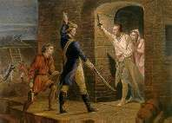
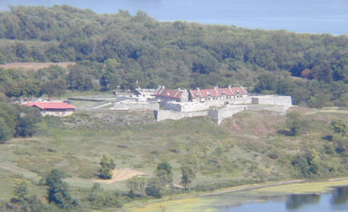
Ticonderoga
May 10, 1775
New York
With the outbreak of hostilities in Boston, two separate groups set out to capture Fort Ticonderoga in order to use the cannons it contained to lift the siege of Boston.
One group from Vermont was led by Ethan Allen. His group of rough backwoodsmen were known as the Green Mountain Boys. The other group was led by Benedict Arnold. When the two groups met along the way, Arnold and Allen agreed to share command.
The Americans were able to get to the front gates of the fort before a British guard saw them and aimed his weapon at them. The soldier’s musket misfired and the fort was taken without another shot being fired.
General Knox had the cannons transported to Boston and set on the surrounding hills.
The British promptly left Boston!
When the British commander refused to open the door Ethan Allen reportedly said, “Come out you old rat!”
Fort Ticonderoga commanded the approaches to the Hudson River.

Slide 24
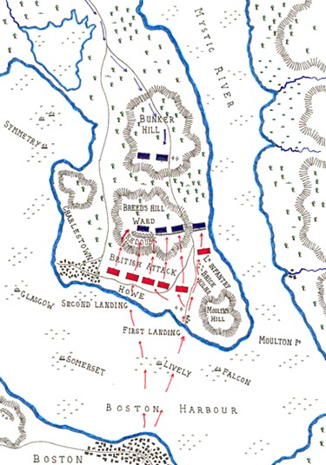
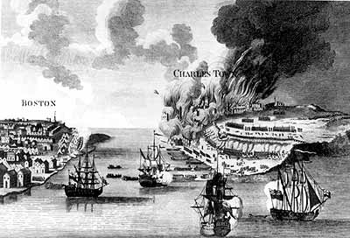
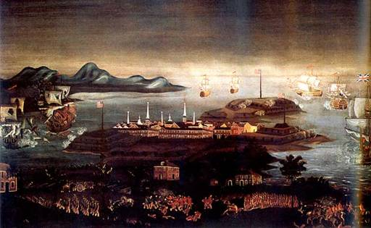
Battle of Bunker Hill, 1775

Slide 25
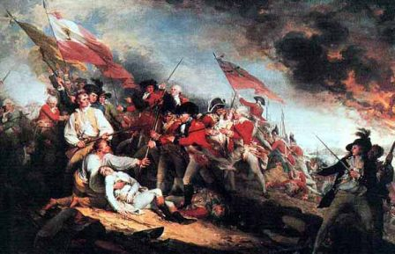
Patriot Militia in Action:
Breed’s Hill, June 17, 1775
The Death of Dr. Warren
“The Martyr of Bunker Hill”
Fighting from behind stout field works, New England
militiamen stood their ground and held off two British
assaults, retreating before a third only after their
ammunition gave out.

Slide 26
Patriots go on the offensive
Ethan Allen and Benedict Arnold go after Canada!
French Canadians do not rise against the British
Remember the Quartering Act

Slide 27
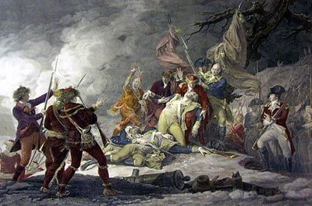
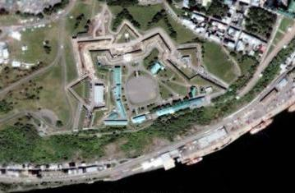
Quebec
December 31, 1775
Canada
While General Washington was blockading Boston, General Montgomery and Benedict Arnold led armies up Lake Champlain into Canada.
The purpose of the invasion of Canada was in part to bring the Canadian population into the war on the American side.
The two armies attacked Quebec from opposite directions. While Montgomery’s troops were forced back by heavy grapeshot (one of which killed Montgomery), Arnold’s men entered the other side of the city. Arnold was wounded in a fierce British counterattack and his troops were forced to retreat.
The British lost only 20 men to the
Americans, who lost 500.
The death of General Montgomery
Satellite image of the fortifications at Quebec
Cicero © 2007

Slide 28
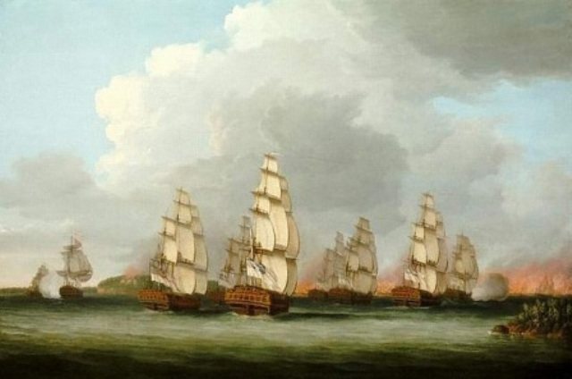
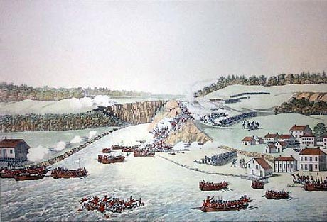
Battle of New York
August 26-October 28, 1776
New York
In 1776, the British set forth to subdue the colonies. They began the effort by recapturing New York. First, they drove Washington off Long Island; then, from lower Harlem. After this initiative, Washington retreated to White Plains, where for the first time he was able to hold off the British forces. The British, then again, outmaneuvered Washington. Washington was forced to retreat to New Jersey.
The British used their navy to keep the Americans guessing as to where they would attack.
Cicero © 2007

Slide 29
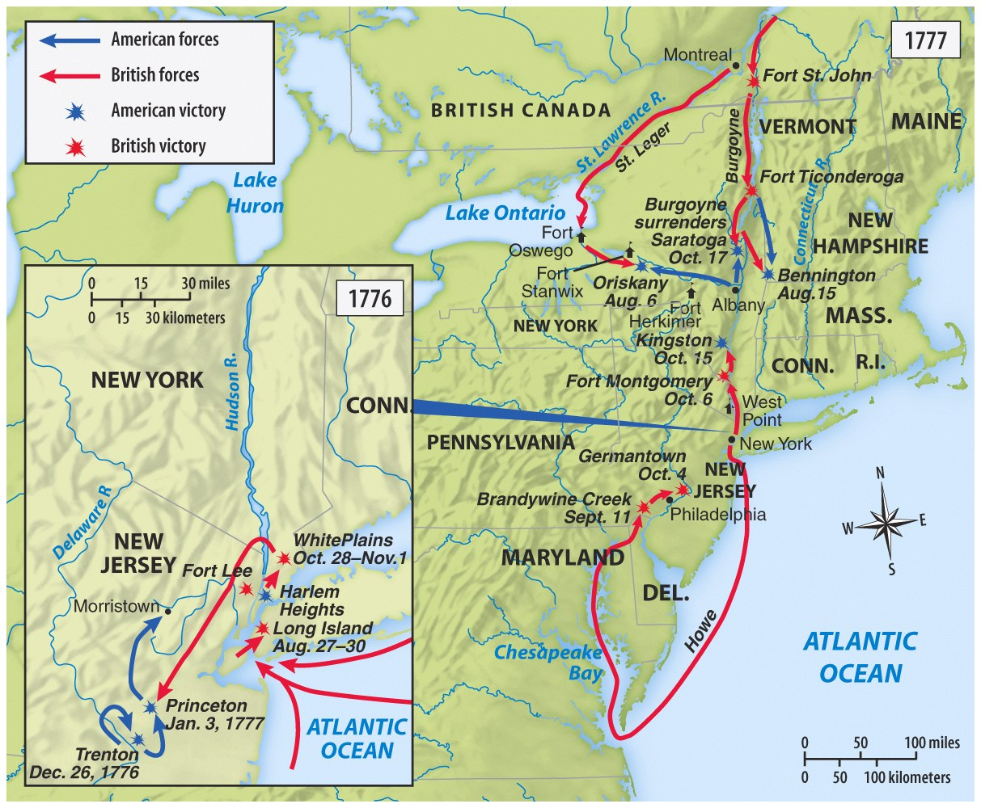
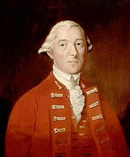
Classical British Strategy
1776-1781
Divide
and Conquer

Slide 30
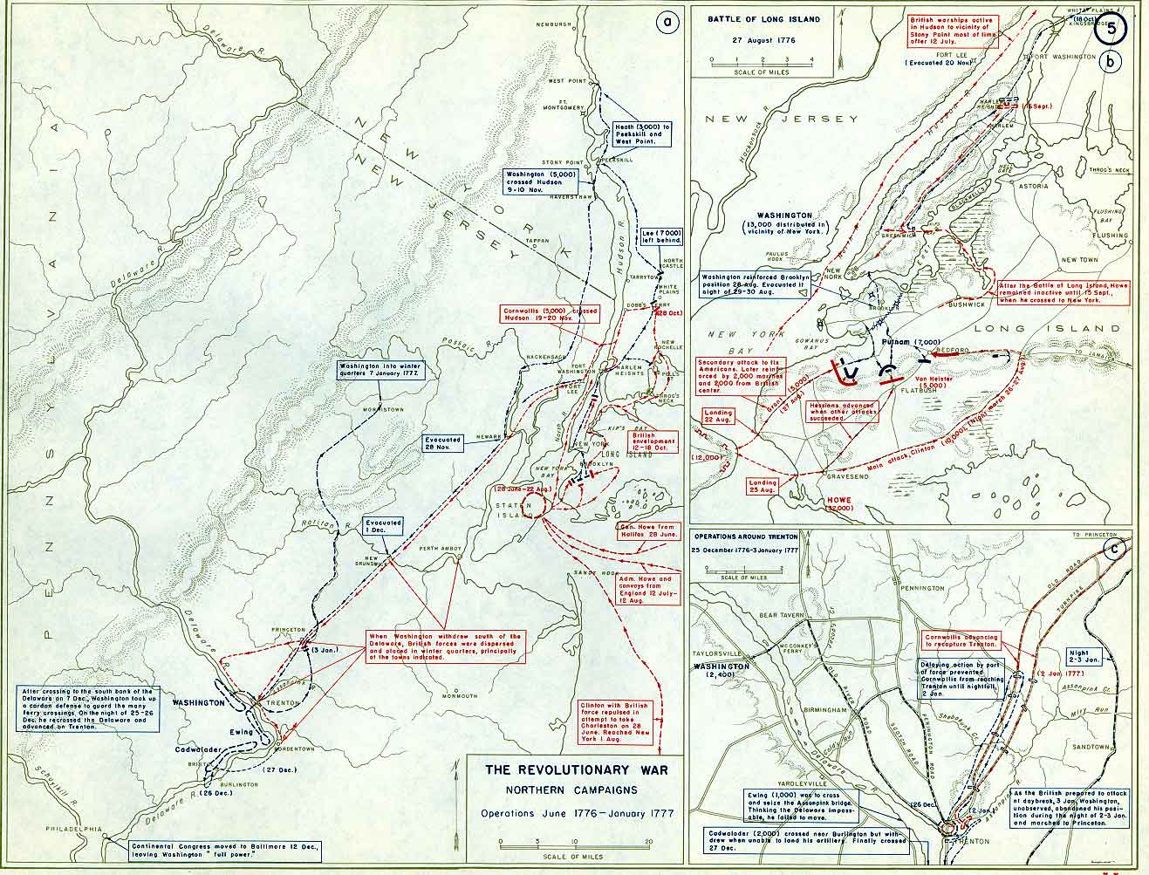

Slide 31
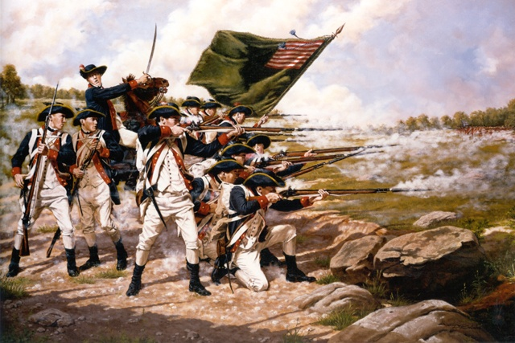
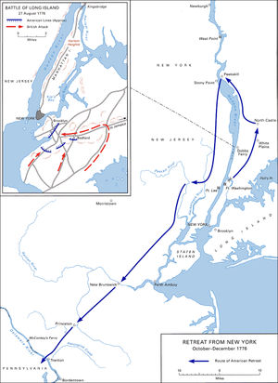
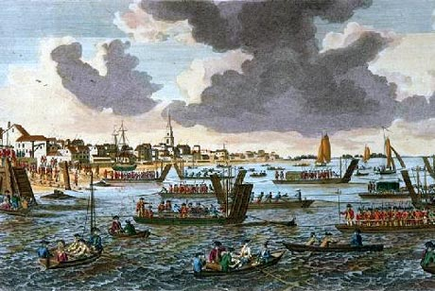

Slide 32
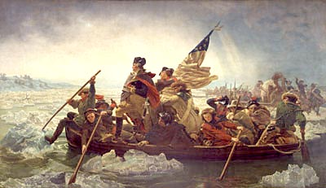
George Washington Crossing The Delaware, Emanuel Leutze 1851
What Is Wrong With This Picture?
Picture Prompts

Slide 33
Picture Prompts
What Is Wrong With This Picture?
The flag shown was not created until June 1777. The Grand Union flag would have been carried at the time.

Slide 34
Picture Prompts
What Is Wrong With This Picture?
The boat was the wrong size and model. The actual boats used had higher sides and were much bigger.

Slide 35
Picture Prompts
What Is Wrong With This Picture?
Washington is shown standing heroically in the front of the boat. He probably would have been sitting to keep from falling into the water.

Slide 36
Picture Prompts
What Is Wrong With This Picture?
While the Delaware did freeze over in the winter, it was too early to see much ice in the river, let alone ice the size shown.

Slide 37
Picture Prompts
What Is Wrong With This Picture?
While the sun is shown rising in the distance, the crossing actually took place in the middle of the night.

Slide 38
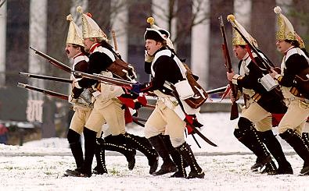
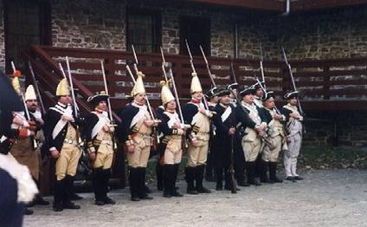
Trenton
December 26, 1776
New Jersey
In late 1776, the American Army was at a low point. To make things worse, the enlistments of much of Washington’s army were about to expire.
Washington decided that he needed a quick victory to raise the morale of the soldiers and the country.
On the night of December 25, the American army crossed the ice-filled Delaware River and led a surprise attack on the Hessian regiment occupying the city of Trenton.
The Hessians were caught off guard and defeated in about 30 minutes.
The Americans captured much needed supplies, including more than 50 artillery pieces.
Ironically the Hessian commander, Colonel Raul, had been given a message warning him of Washington’s plans the night before, but he had not bothered to have the note translated because he was busy playing cards. The note was found on his body after he was mortally wounded in the battle.
Hessian Soldiers
Hessian Barracks at Trenton
Cicero © 2007

Slide 39
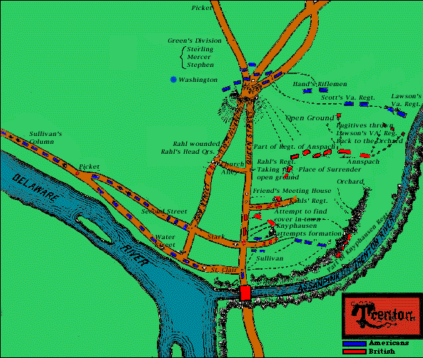

Slide 40
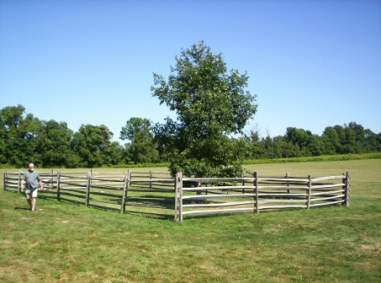
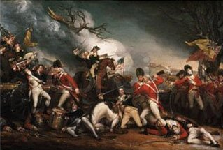
Princeton
January 3, 1777
New Jersey
With his easy victory at Trenton, Washington decided to press his luck and attack the army that was sent to aid the Hessians at Trenton. This army was led by Lord Cornwallis.
Washington’s plan called for him to withdraw from Trenton as the British advanced into the city, move around the British forces (this is called flanking your enemy) and attack their rear.
The resulting attack took place in an orchard outside of Princeton, New Jersey.
American General Hugh Mercer was caught behind enemy lines and bayoneted by the British.
General Washington rode up and rallied his men. During this time Washington actually rode between the lines just as the British were firing a volley at the Americans. When the smoke cleared Washington rode out of the smoke untouched!
The Americans’ counterattack forced the British from the field.
“Son of Mercer’s Oak” Spot where Mercer fell in battle
The Death of General Mercer
Cicero © 2007

Slide 41
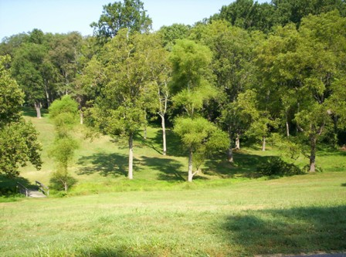
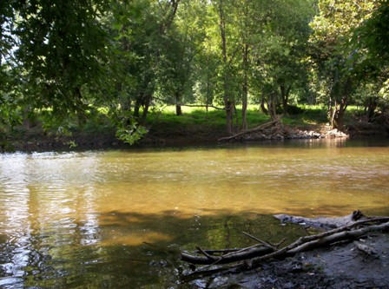
Brandywine
September 11, 1777
Pennsylvania
Generals: Major General Sir William Howe and General George Washington.
General Howe had landed in the Chesapeake and was marching toward Philadelphia. In an attempt to stop him, Washington set up defensive positions at Chad’s Ford (today Chadds Ford)
The Americans were outflanked when the British crossed a ford that Washington was unaware of. Washington was forced to flee with his army to Chester.
The British saw 550 killed and wounded. The Americans lost around 1,000 killed, wounded and captured. Among the wounded was Marquis de Lafayette.
Spot on the Brandywine Creek where General Washington was in the sights of a British sniper. The soldier refused to fire because Washington was unarmed.
Cicero © 2007

Slide 42
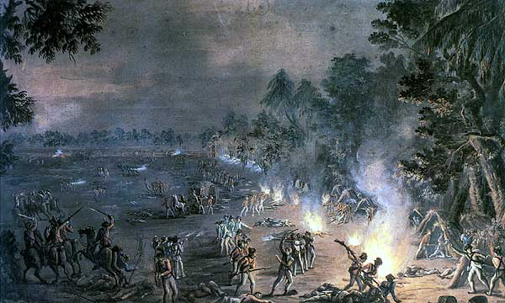
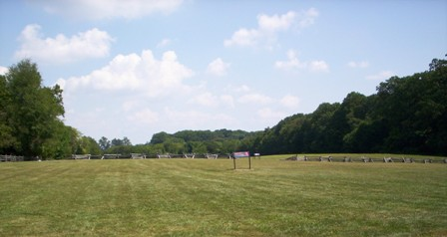
Paoli
September 20-21, 1777
Pennsylvania
The British led this night attack hoping to surprise the American encampment.
At Major General Charles Grey’s direction the flints had been removed from his men’s muskets to ensure that no shots gave prior warning to the Americans. The attack was to be at the point of the bayonet. The general thereby acquired the nickname of “No flints” Grey.
Major General Anthony Wayne commanded the Americans.
About 200 Americans were killed or captured in the battle. Fifty others who surrendered were bayoneted by the British. Thus, the “Paoli Massacre.”
Views of the Paoli battlefield in 1777 and today
Cicero © 2007

Slide 43
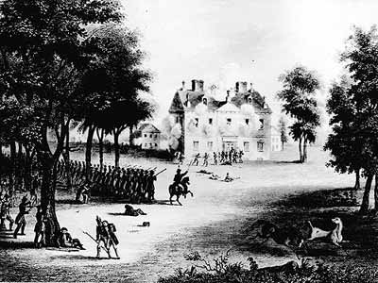
Germantown
October 4, 1777
Cicero
Pennsylvania
History Beyond The Textbook
After the American defeats at Brandywine and Paoli, the British occupied Philadelphia but did not control the Delaware River.
Before the British could take Forts Mifflin and Mercer and get resupplied, Washington saw one last chance to defeat the British at Germantown.
Washington attempted to outflank the British and crush them against the Schuylkill River.
The Americans were held up when about 150 British soldiers ran into a large stone home called the Chew House. The British were able to hold off the Americans and the attack began to fizzle.
The Americans withdrew to Valley Forge and began constructing their winter quarters.
The British regiment responsible for the Paoli Massacre ran into the Chew House. Continental soldiers looking for revenge stopped to attack the house.
Cicero © 2007

Slide 44
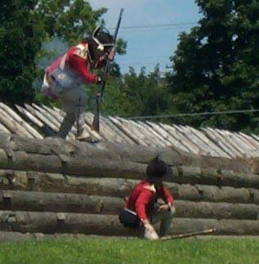
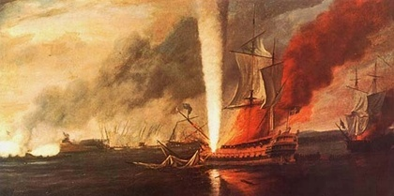
Defending the Delaware River
September-November 1777
By the fall of 1777, the British had gained control of the rebel capital of Philadelphia. While they had control of the land, they did not control the Delaware River. Control of the river was a crucial part of the British strategy. In order to hold Philadelphia they had to bring in supplies using the river. The rebels knew this fact well and made a point of holding onto the approaches to Philadelphia. To accomplish this, the Americans took up positions at Fort Mifflin on the Pennsylvania side and Fort Mercer on the New Jersey side of the Delaware. They also constructed a series of cheveaux-de-frise, or large pikes tipped with iron that would tear in to any ship that tried to sail past them. The British laid siege to the Americans held up in Fort Mifflin and assaulted Fort Mercer but were unsuccessful. Finally, running low on ammunition, the Americans at Fort Mifflin were forced to abandon their positions and make their way to Fort Mercer across the Delaware. Fort Mercer would soon be abandoned as well.
Unlike Fort Mifflin, Fort Mercer did not have heavy, brick walls. It consisted of a series of retrenchments, made from sharpened wooden pikes and dirt.
British warship Augusta takes a direct hit to its powder room, November 1777
Cicero © 2007

Slide 45
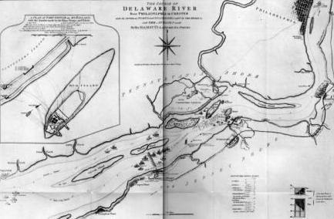
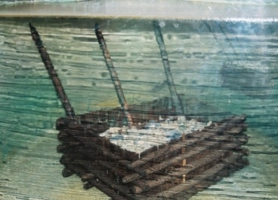
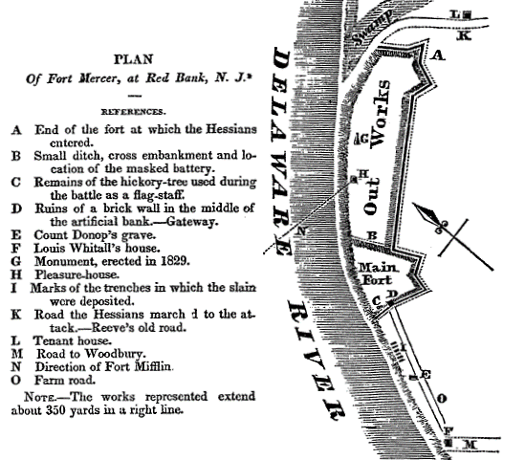
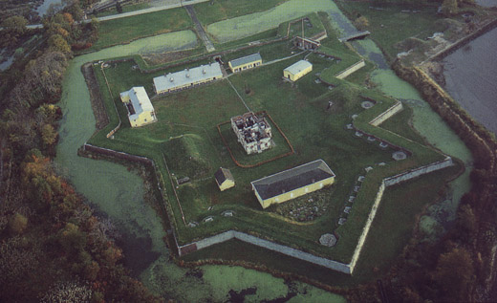
Cheveaux-de-Frise
Plans for
Fort Mercer
Fort Mifflin
(Fort Mudd)
Cicero © 2007

Slide 46
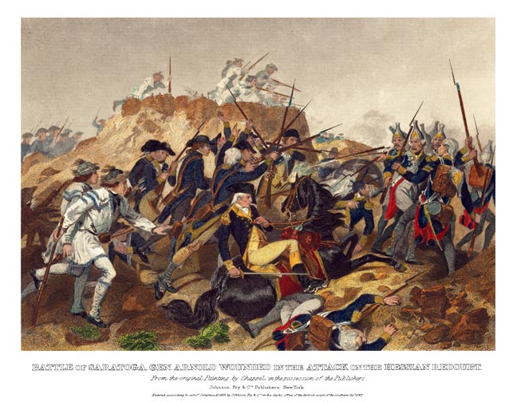
Saratoga
September 19 and October 7, 1777

Slide 47
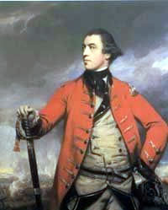
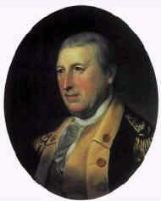
Saratoga
General John “Gentlemen Johnny” Burgoyne
General Horatio Gates

Slide 48
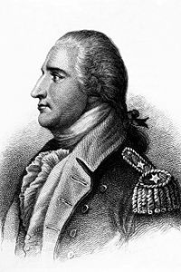
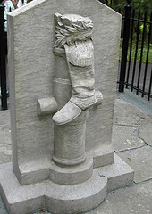
The Unsung Hero of Saratoga→ Benedict Arnold
Memorial to Arnold’s Leg
America’s First Serious Victory

Slide 49
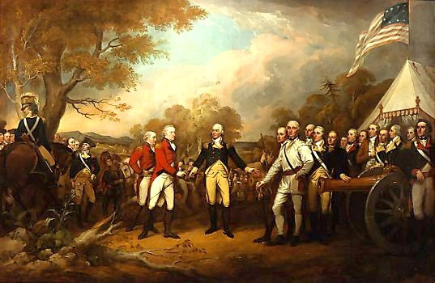
Burgoyne Surrenders

Slide 50
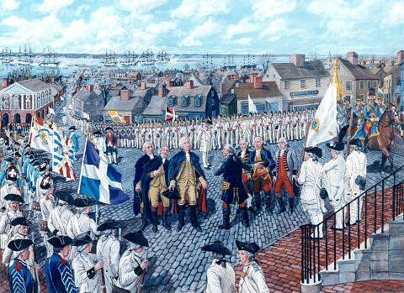
The French Enter the War on America’s Side

Slide 51
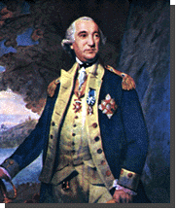
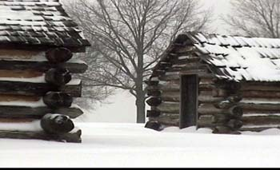
Winter Quarters
In the 18th century armies did not fight in the winter. With no paved roads, transporting men and supplies on muddy roads was impossible. In addition, armies relied on crops growing in the fields to feed their hungry men.
Washington planned to use this time to train his troops and found a great teacher in a former German officer named Baron von Steuben. Steuben used the winter at Valley Forge to turn the American army into a formidable fighting force.
Most people have heard about the American army wintering in Valley Forge, PA, for the winter of 1777-1778, but they do not know about the other winter quarters at Morristown, NJ.
In fact, the winters at Morristown were considerably worse than the one Washington’s army faced at Valley Forge. After one snowstorm lasting several days, there were snow drifts reported to have been eight feet high!
Baron Frederick von Steuben
Winter Cabin at Morristown
Twelve men to a cabin
Cicero © 2007

Slide 52
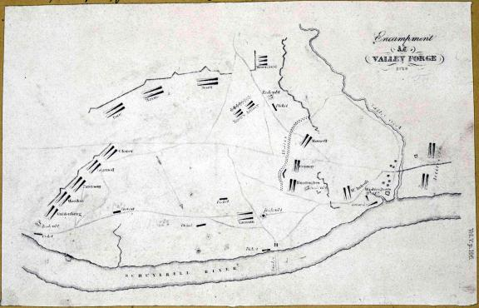
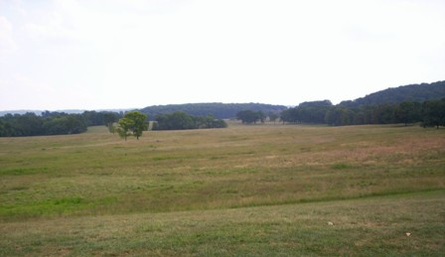
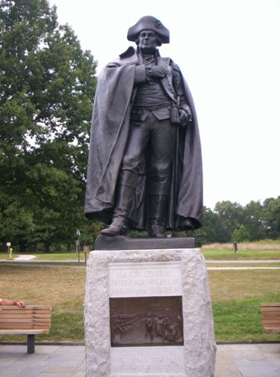

Slide 53


Monmouth
June 28, 1778
New Jersey
When the British began their withdrawal from Philadelphia to New York, Washington decided to take his newly trained army out to attack the British rear.
The Americans caught up with the British on a very hot day in late June.
The American attack was initially led by General Lee who did not bother to plan a strategy for the battle. Shortly after the Americans engaged the British, Lee ordered a retreat that angered Washington.
Washington personally took command of the army and turned them back into the battle.
Both sides lost around 300 men, many due to heatstroke. The battle is seen as a draw.
Mary Ludwig Hays a.k.a. Molly Pitcher
Washington confronts General Lee
(Washington is said to have cursed at Lee)
Cicero © 2007

Slide 54


The War at Sea
While the British fleet greatly outnumbered the Americans, there were a few engagements on the high seas.
The British naval strategy throughout the war was to blockade the colonies and cut them off from supplies from France.
One of the most famous sea battles occurred on September 23, 1779 off the coast of England.
American captain John Paul Jones, using a converted slave ship, attacked the British warship Serapis.
After a tough three-hour battle, and with many of their guns out of commission, the Americans were able to board the Serapis and capture the ship.
When the British called for Jones’ surrender early in the battle, he replied “I have not yet begun to fight.”
Commodore John Barry
Father of the American Navy
HMS Serapis vs. the Bonhomme Richard
Cicero © 2007

Slide 55

War Moves to the South

Slide 56

General Sir Charles Cornwallis

Slide 57

Southern Disasters
Horatio Gates
Charleston
Waxhaws
Camden
Guilford Courthouse
  (empty Pyrrhic British victory)

Slide 58

3 Major Boosts
The French Arrive in Newport under Comte de Rochambeau
Loyalists’ rapine re-ignite Patriots in the South
Bowing to George Washington, Congress replaces Gates with Greene
Nathaniel Greene

Slide 59


Kings Mountain
October 7, 1780
South Carolina
This battle was fought primarily between local militias from the South. The Americans were called Whigs or Patriots while the British supporters were called Tories or Loyalists.
The Patriots were able to surround a large force of loyalists on Kings Mountain and a very violent battle began.
The Americans were angered by the British tactics of burning homes and killing Patriot soldiers who surrendered in the South.
The Revolutionaries attacked the Tories on Kings Mountain with the battle cry of “Tarleton quarter” (No prisoners).
The Americans wiped out the Loyalist forces killing or capturing 1,000 compared with the Patriot losses of 90.
American sharpshooters picked off British and Loyalist targets throughout the day.
American militia in the South were excellent shots.

Slide 60


Cowpens
January 17, 1781
South Carolina
The British Colonel Banastre Tarleton, was pursuing Daniel Morgan and his combined force of Continentals and militia.
Morgan used a brilliant strategy in this battle when he ordered his militia to fire two shots and then run. The British, who had come to expect this, ordered their army to pursue the Americans and finish them.
Morgan had split his force and as the British chased the American militia, Morgan’s Continental soldiers slammed into the British left.
This maneuver stunned the British, forcing them to retreat.
Banastre Tarleton was well known for the vicious tactics he employed.
Much of the battlefield included dense forests.

Slide 61


Slide 62


Yorktown
September 28-October 19, 1781
Virginia
This was the last major battle of the Revolutionary War in which Washington’s forces were able to march from New York to Virginia undetected. Along with French forces, both on land and sea, they trapped the British under Cornwallis on the Yorktown peninsula.
After 21 days of constant bombardment, the British were forced to surrender.
As the British marched out of Yorktown, the band played The World Turned Upside Down.
This defeat convinced the British that continuing the war for the colonies was a lost cause.
Storming of the British redoubts on October 14, 1781
Surrender of Cornwallis

Slide 63


Slide 64

The Surrender at Yorktown, October 19, 1781

Slide 65

The Peace of Paris, 1783

