Slide 1
Multiple Perspectives in History: The Whiskey Rebellion
The BLaST IU 17 Liberty Fellowship
June 27, 2011
Fran Macko, Ph.D.
fmacko@aihe.info

Slide 2
Framing the Session
What are the qualities of expert readers of history?
How does our understanding of history evolve?
What strategies can teachers use to support historical thinking in their students?

Slide 3
Novice vs. Expert Readers of History
The expert reader:
Seeks to discover context and know content
Sees any text as a construction of a vision of the world
Sees texts as made by persons with a view of events
Considers textbooks less trustworthy than other kinds of documents
The novice reader:
Seeks only to know content
Sees text as a description of the world
Sees texts as accounts of what really happened
Considers textbooks very trustworthy sources

Slide 4
Compares texts to judge different accounts of the same event or topic
Assumes bias in texts
Gets interested in contradictions and ambiguities
Checks sources of documents
Acknowledges uncertainty and complexity
Learns the “right answer”
Assumes neutrality, objectivity in texts
Resolves or ignores contradictions and ambiguities
Reads the documents only
Communicates “the truth”, sounding as certain as possible

Slide 5
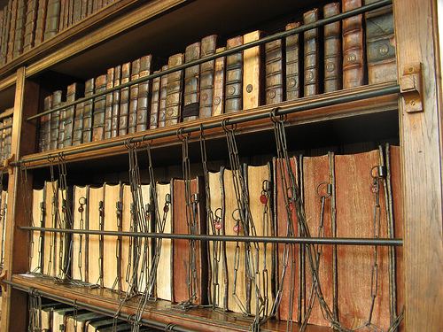
How does our understanding of history evolve?
History is not a stagnant or closed-end subject; it is always “in progress”.
As new documents are analyzed and evaluated by historians, the interpretation of an event evolves.
Facts may not change; what they mean often does.

Slide 6
Reinterpretations often challenge old assumptions and stereotypes.
This interpretation is influenced by the historian’s purpose, intentions and goals, as well as his/her assumptions, beliefs and world view.

Slide 7
“True historians comprehend a subtext on the literal, inferred and critical levels. These subtexts include what the writer is saying literally but also any possible biases and unconscious assumptions the writer had about the world. Historians try to reconstruct authors’ purposes, intentions, and goals, as well as understand authors’ assumptions, world view and beliefs”.
Sam Wineburg

Slide 8
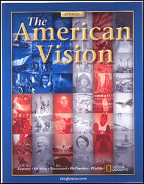
The textbook as source of historical understanding
Textbooks serve a crucial function as a “starting point” for the study of history.
Textbooks:
are age-appropriate in vocabulary and complexity
are screened for moral and ethical appropriateness
strive to create a master narrative – a single, coherent story or big picture of history

Slide 9
However, textbooks:
present history as an end-product – a closed and consensus-based narrative
are written to appeal to a wide audience
encourage the memorization of dates, places, facts and events
often do not reflect all the “voices”

Slide 10
Multiple perspectives and historical thinking
Historians don’t settle for one perspective on an historical issue; they piece together many, sometimes competing, versions of events to construct an accurate interpretation.
Multiple perspectives are usual and have to be tested against evidence, and accounted for in judgments and conclusions.
The writing of history is based on a critical analysis, evaluation, and selection of authentic source materials and composition of these materials into a narrative subject to scholarly methods of criticism.
The result is a body of historical literature on any event or individual in history that reflects the process of historical thinking.

Slide 11
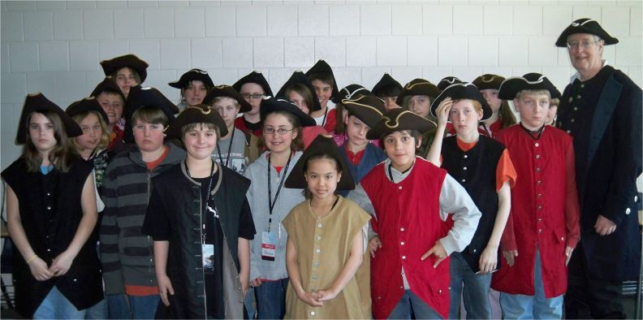
What are some strategies for teaching multiple perspectives?
Students take on the perspective of different participants in an historical event through:
role playing
journal writing
letter writing
debate
The goal of these activities is to develop empathy and affinity for individual perspectives.

Slide 12
What is the Multiple Sources/ Multiple Perspectives Strategy?
The Multiple Sources/Multiple Perspectives strategy supports students to:
compare how historians interpret the same event
to distinguish fact from opinion
analyze information within an historical viewpoint
construct historical arguments
The strategy uses a graphic organizer.

Slide 13
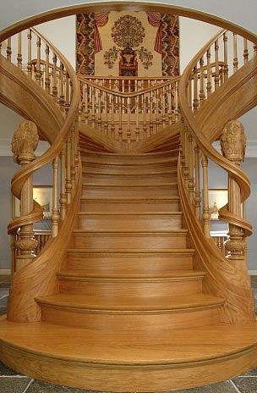
What are the steps in the process?
Select the sources for the activity.
Ask:
What point of view do the resources I use reflect?
Are there other important viewpoints (well accepted by historians and documented with historical evidence)?
What resources will provide other points of view

Slide 14
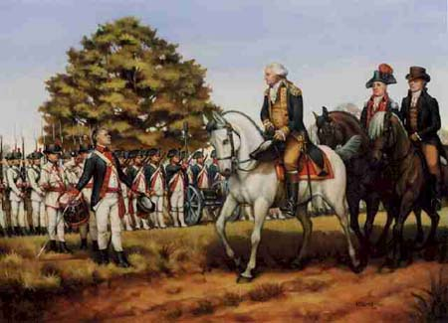
What types of sources work for MS/MP?
Primary Sources
Non-Fiction
Fiction
Interviews
Videos
Periodicals
Poetry
Music
Art

Slide 15
What is the MS/MP graphic organizer?

Slide 16
Build or access prior knowledge of the event.
What do we know about this event?
What are the “undisputed” facts?
Use the textbook interpretation of the event as a starting point.
List the “undisputed facts” in the center box of the graphic organizer

Slide 17
Introduce the first source and have students list the author and date.
What do we know about the author of the source?
What is the significance of the date of the source?
What is the historical context of the source?
Have students read/view and discuss the source in small groups.
Have students complete the graphic organizer with:
What information has been added to our understanding of the event?
What information might have been omitted? Why?
What are the author’s opinions on the event?
What are the author’s conclusions or interpretations of the event?
Have students cite the page references where applicable.

Slide 18
Repeat the process with the second source.
Then have students discuss their findings and draw conclusions based on the new information.
Debrief the activity with the class.
Guiding questions include:
What did we know about this event?
What do we now know?
How did our analysis of different perspectives on the event add to our understanding?
What influences how a person “sees” an event in history?

Slide 19
Modeling the Strategy

Slide 20
Prior Knowledge and Perspective
What do our students know about The Whiskey Rebellion?
How do they know?
What are the sources of their prior knowledge?

Slide 21
Modeling the Strategy: Identifying the “Undisputed Facts”
Working in small groups, make a list of 5-7 “undisputed facts” about The Whiskey Rebellion that your students would glean from their textbooks and other sources. (Use Source #1 if necessary)
List them on the graphic organizer.

Slide 22
Modeling the Strategy: Perspective #1
Read “Reaction to the Tax”.
Discuss the text and the image and list:
Information added
Information omitted
Author’s opinions
Author’s conclusions or interpretations

Slide 23
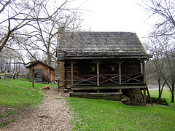
Modeling the Strategy: Perspective #2
Read The “Murder “of Oliver Miller
Discuss the text and the image and list:
Information added
Information omitted
Author’s opinions
Author’s conclusions or interpretations

Slide 24
Other Sources for Multiple Perspectives

Slide 26
Additional Resources
Primary Sources:
“Washington’s Proclamation on the Whiskey Rebellion”
http://www2.cicerohistory.com/Cicero/subscriber/content/Books/Book-5/L06-PrimarySources/LandmarkDocuments/11WhiskeyRebellion_1794.pdf
Song:
“Copper Kettle”
http://www.leoslyrics.com/listlyrics.php?hid=ZstNb%2BtifkM%3D
Video:
American Experience: “The Presidents”
http://www.pbs.org/wgbh/amex/presidents/01_washington/
Whiskey Rebellion Guided Reading:
http://www2.cicerohistory.com/Cicero/navigate/UnitContents.do?action=display&bookid=5&chapterid=11

Slide 27
Modeling the Strategy: Drawing Conclusions
What conclusions can you draw?
What did you know about this event?
What do you now know?
How did your analysis of different perspectives on the event add to my understanding?
What influences how a person “sees” an event in history?

Slide 28
Factors to Consider in Selecting Sources for MS/MP
The selection of sources for Multiple Sources/Multiple Perspectives depends upon a number of factors:
The content introduced
The grade level
The need to differentiate based on student strengths and areas of weakness
However, each source should provide a different perspective on the topic or event.

Slide 29
Adapting MS/MP to Your Classroom
How might you use MS/MP in your social studies classroom?
What adaptations would you make?

Slide 30
Adapting MS/MP to Your Classroom
Adaptations include those:
To the selection of texts/sources
To the template
To the method of use
To the length of the texts/sources
To the level of vocabulary
To the timeframe
To the method of presentation
What other adaptations can you think of?

Slide 31
Next Steps for MS/MP
Once students have analyzed different interpretations of a topic, event or individual, they can:
Debate a particular viewpoint or interpretation
Write a position paper in which they construct an historical argument
Research other perspectives on the topic and add to the graphic organizer
Select a point of view and role play, write a journal entry or letter from that perspective
Research the author of the source
What other next steps can you think of?

