Slide 1
Making Permanent North American Settlements
Virginia, New England and the Middle Colonies –
Was there anything uniquely “American” about them?

Slide 2
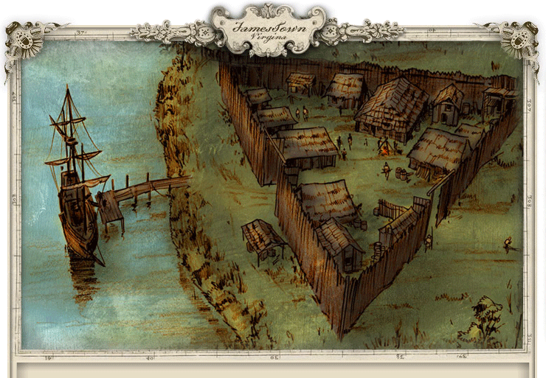
Jamestown: How did it succeed?
Purpose of the colony: Profit
  Learning from Roanoke – a joint-stock corporate enterprise
  Intended settlers:
    stockholders (aristocracy and gentry)
    and unemployed laborers

Slide 3
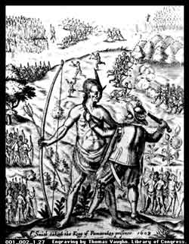
How does it work out? Not well!
Focus on defense
Powhatan attack in response
Settlers search for treasure, and steal supplies from Powhatan
Why bully Amerindians? Remind themselves of their superiority!
(Meanwhile, they’re starving)

Slide 4
How does Jamestown achieve stability?
LAND GRANTS
1614: land grants reward former servants
1618 new charter formalizes these as “headrights” for all who pay for new arrivals

Slide 5
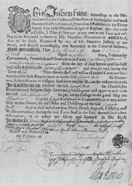
How does Jamestown achieve stability?
TOBACCO
1619 John Rolfe introduces crop; boom follows immediately
Indentured servants grow it
  Legally unfree for contract duration:
    Have to obey masters (can be physically disciplined)
    Can’t move freely without permission
    Can’t marry
    Can’t own property
Opportunity for future economic independence and socio-economic mobility for potential servants

Slide 6
Changes in Virginia after 1660
Declining opportunities for freedmen
Boils over in Bacon’s Rebellion, 1676
  In defense of their “English liberties”
Lessons learned . . .

Slide 7
Social Change in Virginia after 1660 . . .
Growing importation of African slaves
St. Mary’s County, MD
1660: 4 servants/slave
1710: 1 servant/5 slaves
Legal differentiation of African American slaves from whites
Elites begin to embrace idea of “The People” having voice in governance

Slide 8
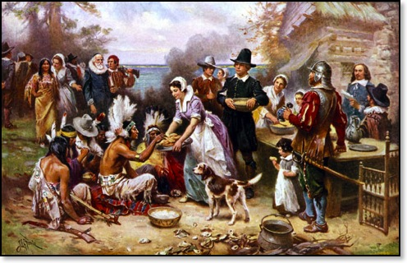
What about New England’s colonies? What’s different?
Myths about Puritan New England
  Critical: a cold, repressive place
  Celebratory: heroes searching for religious freedom
What WAS Puritanism about? How did it shape settlement?

Slide 9
Puritan beliefs:
Providential universe: God intervenes in world
God is omniscient and people’s fates are predestined
God is merciful – some chosen for salvation
The chosen “saints” can do great things in this world

Slide 10
How does Puritanism influence settlement?
Gives purpose and direction to government
  Town meetings – all heads of household vote
  Church government – by the “saints”
Different group of settlers
  The Great Migration: 20-25,000 emigrants, 1630-1642
  Families: 70%
    Seeking pure spiritual community for families
  A community of Saints, with sense of communal responsibility

Slide 11
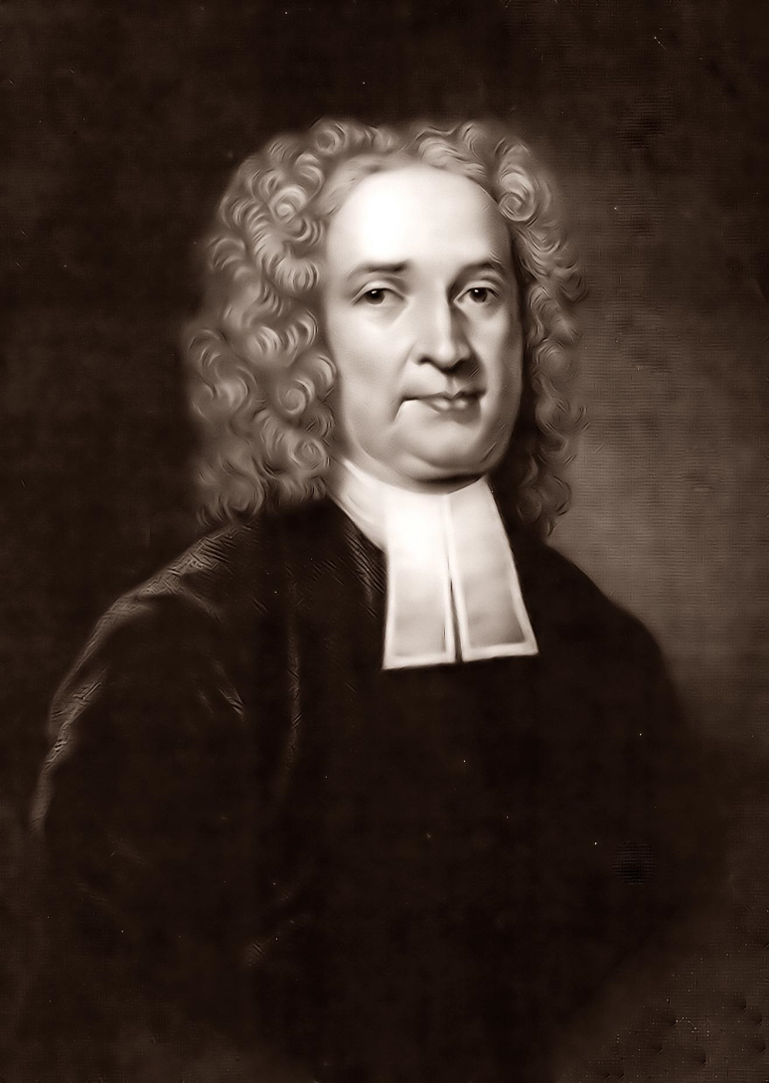
The paradox of Puritan Christian community: handling dissent
Case study: The Antinomian Controversy, 1636
  Criticism of conversion “tests”
  John Cotton and Anne Hutchinson
Resolution: community harmony must prevail over individual truth
Dissenters must leave!

Slide 12
John Winthrop, 1645
Concerning liberty, I observe a great mistake in the country about that. There is a twofold liberty, natural (I mean as our nature is now corrupt) and civil or federal. The first is common to man with beasts and other creatures. By this, man, as he stands in relation to man simply, hath liberty to do what he lists; it is a liberty to evil as well as to good. This liberty is incompatible and inconsistent with authority . . . The exercise and maintaining of this liberty makes men grow more evil, and in time to be worse than brute beasts. . . The other kind of liberty I call civil or federal, it may be termed moral . . . It is a liberty to that only which is food, just and honest. This liberty is maintained and exercised in a way of subjection to authority.

Slide 13
Diversity in the Middle Colonies
Pennsylvania Charter of Privileges, 1701
That for the further Well-being and good Government of the said Province, and Territories; and in Pursuance of the Rights and Powers before-mentioned, I the said William Penn do declare, grant and confirm, unto all the Freemen, Planters and Adventurers, and other Inhabitants of this Province and Territories, these following Liberties, Franchises and Privileges:
FIRST
BECAUSE no People can be truly happy, though under the greatest Enjoyment of Civil Liberties, if abridged of the Freedom of their Consciences, as to their Religious Profession and Worship: I do hereby grant and declare, That no Person or Persons, inhabiting in this Province or Territories, who shall confess and acknowledge One almighty God, the Creator, Upholder and Ruler of the World; and profess him or themselves obliged to live quietly under the Civil Government, shall be in any Case molested or prejudiced.

Slide 14
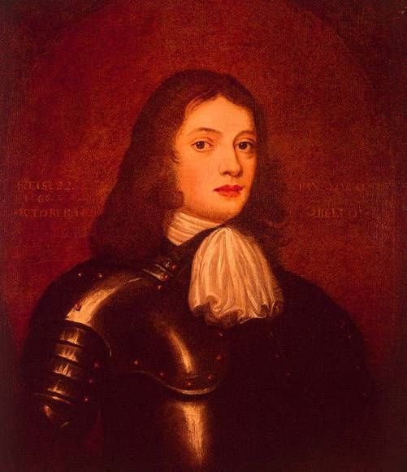
How well did the ideal of tolerance match with the reality of life in the Middle Colonies?
Who was William Penn? What inspired this new ideal?
Political context – The Restoration, 1660
The proprietary colonies, captured from Netherlands during Anglo-Dutch War
James Duke of York – New York
Berkeley and Carteret- New Jersey
William Penn – Pennsylvania
Penn , the Quaker faith and persecution
The search for the “inner light” – a challenge to hierarchy and social deference
ANYONE can have inner light (women, servants, etc.)
Pacifism . . .

Slide 15
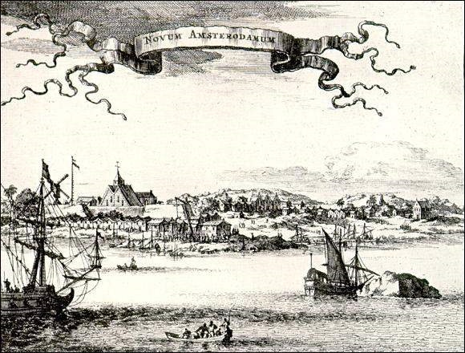
What does he find in the Middle Atlantic?
Not a firstcomer: diverse pre-existing settlements
New Amsterdam; Fort Orange (Albany) – about 900 people by 1660s
Pennsylvania – population about 4000 in 1682
(Dutch, Swedes, Finns, plus Welsh and English Quakers)

Slide 16
Toleration in practice
The problem of who will govern – no specific qualifications for voting, officeholding (Beyond property and accepting Christianity)
Quakers don’t like it: fear persecution
Anglicans don’t like it: see Quakers as unfit to govern
  The issue of oaths
Anglicans protest, obstructing legal system and petitioning for revocation of proprietorship

Slide 17
But where is everyone else???
They keep to themselves.
Sometimes have to cooperate – broad similarities become more important, given small numbers

Slide 18
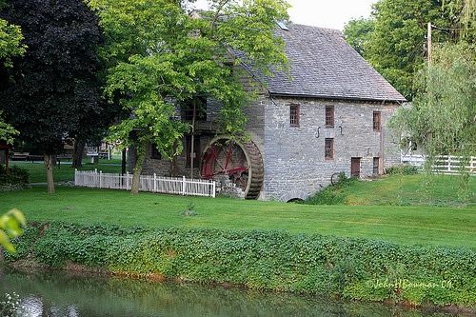
Middle Colonies: Key conclusion about conflicts:
Economics underlies it all –
Economy booming because of immigration
Becoming breadbasket of Americas
Becoming the “best poor man’s country”, so everything else is secondary

Slide 19
Continuities and Contrasts:
Tension: Between Desire for Order and Individual desire for freedom
Resolved differently because of nature of local population

