Slide 1
Teaching The French and Indian War
Using Tier One Historical Thinking Skills
This power point presentation is for educational purposes. It may contain copyrighted material. Please do not post, redistribute or copy without the permission of the author or Dr. Kevin Brady at the American Institute for History Education.
© 2010 AIHE

Slide 2
Goals and Sequence
To demonstrate an introduction to Historical Thinking and use those principles to teach the French and Indian War. There will be multiple sources, visuals, timelines, and critical thinking.
Quick look at the foundations of historical thinking
Begin with some classical narrative history of a family in the war
Establish the timeline of the war, including scope and sequence
Analyze the geography of the war
Discuss the causes of the war
Analyze some pertinent images
Allow participants in the war to tell their story
Discuss the results of the war
© 2010 AIHE

Slide 3
Where does the Piece Fit?
© 2010 AIHE

Slide 4
Seeing the BIG Picture of History
Determining the main idea
Establishing time, scope, and sequence
Eliminating things that are not essential
© 2010 AIHE

Slide 5
Building a Personal Connection to the Past
Seeking personal or local connections to history
Seeing history as the story of people and their voice
© 2010 AIHE

Slide 6
Avoiding Historical Presentism
Establishing the values and beliefs of the time
Using the values of the time to analyze historical meaning
Comparison and contrast with 21st century values
© 2010 AIHE

Slide 7
Analyzing and Utilizing Multiple Historical Sources
Analysis of primary sources
Determination of bias and unique point of view
Establishing reliability
Utilizing primary and secondary sources as companion material
© 2010 AIHE

Slide 8
Let’s go do it!
© 2010 AIHE

Slide 9
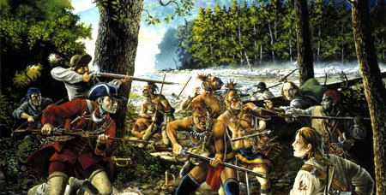
The War that Made America
and began the dissolution of the British American Empire

Slide 10
The Jemison Family
In 1758, a party of six Shawnee Indians and four Frenchmen attacked the homestead of the Jemison family on Marsh Creek, near modern-day Chambersburg. The Jemisons had emigrated from Ireland sixteen years earlier and settled on the Pennsylvania frontier. Like many of their Scots-Irish countrymen, they were drawn to Pennsylvania by its reputation as "the best poor man's country:" the land was cheap and plentiful, taxes were low, and no state church hounded religious dissenters.
Story of People and their Voice
© 2010 AIHE

Slide 11
Emigrants such as the Jemisons faced a hardscrabble life on the frontier. Pennsylvania had a thriving commercial economy, but settlers would be hard pressed to find evidence of that prosperity once they crossed the Susquehanna. New arrivals like the Jemisons lived in log homes far removed from centers of trade and survived on the corn and livestock they raised. Some Pennsylvanians half-jokingly suggested that the Scots-Irish had more in common with their Indian neighbors than other colonists.
Story of People and their Voice
© 2010 AIHE

Slide 12
The Jemison family discovered just how badly relations had deteriorated with the local Indians on that fateful morning in 1758. The French and Indian raiders spared sixteen-year old Mary, but they killed and scalped her mother, father, and three of her siblings. So began an odyssey for Mary that would take her even deeper into the Pennsylvania wilderness. Her captors carried her to Fort Duquesne, the French post at "the Forks," where the Allegheny and Monongahela rivers join to form the Ohio. There, two sisters of the Seneca nation who had lost a brother in the war adopted Mary as his replacement.
Story of People and their Voice
© 2010 AIHE

Slide 13
Establishing time, scope, and sequence
1603
1750
1755
1758
1776
1607
1754
1763
British begin to turn the tide with Pitt’s policies
England and France dispute land claims in Canada and Ohio Valley
Declaration of Independence
French settle in Quebec
English troops under Colonel George Washington march on Fort Duquesne: French victory
English and French sign Treaty of Paris
English settle in Jamestown
English troops under General Edward Braddock march on Fort Duquesne: French victory.
© 2010 AIHE

Slide 14
The Three Phases
Phase 1 | Phase 2 | Phase 3
Local actions in North America Begins with Ft Necessity Both sides are non-committal at this point Most action is about trying to capture forts | Begins with a for-real declaration of war Touches off a true world war (Seven Years War) Both sides commit more men and material | Britain decides to concentrate on North America Britain invests HUGE amounts of money Ends with British victory
Establish Sequence
© 2010 AIHE

Slide 15
America pre-1763
A Land of Competing Empires
Use of multiple sources

Slide 16
Causes of the War
© 2010 AIHE

Slide 17
Causes of the War
Fur traders from Pennsylvania and Virginia were eager to trade with Indians in the Ohio River Valley. Leading Virginia planters, who were interested in developing the region, had formed the Ohio Company, and with support of London merchants, had received a royal grant of 200,000 acres in the Ohio River valley in 1749.
Determining the Main Idea
From http://www.digitalhistory.uh.edu/database/article_display.cfm?HHID=688
© 2010 AIHE

Slide 18
Causes of the war
The French, determined to secure the territory against encroaching British and American traders and land speculators, built a chain of forts along Pennsylvania's Allegheny River. The British ministry ordered colonial governors to repel the French advance, "by force" if necessary.
Determining the Main Idea
From http://www.digitalhistory.uh.edu/database/article_display.cfm?HHID=688
© 2010 AIHE

Slide 19
Causes of the War
In 1753, Virginia's Governor Robert Dinwiddie, an investor in the Ohio Company, sent George Washington, a 21-year old major in the Virginia militia, to Pennsylvania to demand a French withdrawal from the forts. The French refused. In the spring of 1754, Washington returned to Pennsylvania with about 160 men. The French defeated Washington at Fort Necessity, the first battle of the French and Indian War.
Determining the Main Idea
From http://www.digitalhistory.uh.edu/database/article_display.cfm?HHID=688
© 2010 AIHE

Slide 20
Now What?

Slide 21
Attempts at colonial unity
Meanwhile, representatives of seven colonies met in Albany, New York, with representatives of the Iroquois Confederacy. The goal of the Albany Congress was to solidify friendship with the Iroquois in light of the approaching war with France and to discuss the possibility of an inter-colonial union. Benjamin Franklin presented a "plan of union" at the conference which would establish a Grand Council which would be able to levy taxes, raise troops, and regulate trade with the Indians. The delegates at the congress approved the plan, but the colonies refused to ratify it, since it threatened their power of taxation.
Attempts at colonial unification are floated but unsuccessful
=
Eliminate the non-essential
From http://www.digitalhistory.uh.edu/documents/documents_p2.cfm?doc=411
© 2010 AIHE

Slide 22
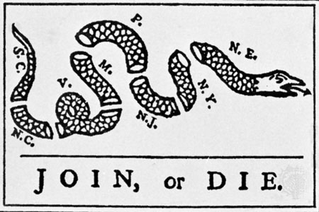
The Famous Snake
Using the values of the time
Use of multiple sources

Slide 23
The Early War Years
Following the surrender of Fort Necessity, Britain ordered 60-year-old Major General Edward Braddock and a combined force of 3,000 redcoats and colonial militia to attack the French stronghold of Fort Duquesne at the site of present-day Pittsburgh. French and Indian forces ambushed the expedition eight miles from the fort, killing Braddock and leaving two-thirds of his soldiers dead or wounded.
British Army is not invincible
=
Eliminate the non-essential
From http://www.digitalhistory.uh.edu/documents/documents_p2.cfm?doc=411
© 2010 AIHE

Slide 24
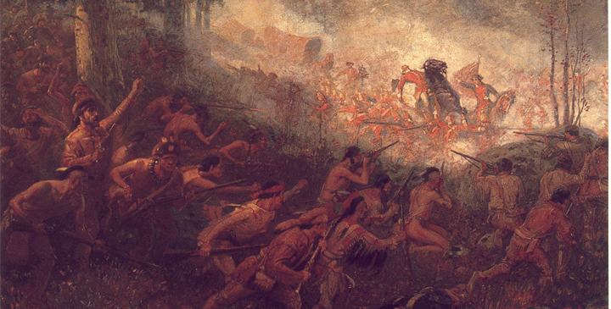
Braddock
Death at Ft. Duquesne
Use of Multiple Sources

Slide 25
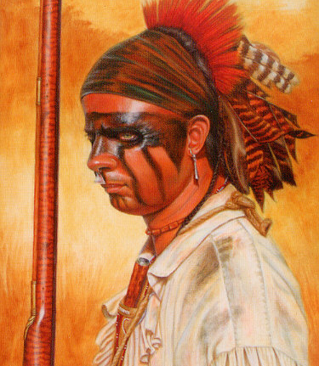
The Next Phase
The next few years witnessed French successes on the battlefield against the English. The major reason for the French victories was their Native American allies. Ohio Country natives enjoyed trading with both the English and the French. However, most tribes feared the large number of British colonists in North America. Natives west of the Appalachian Mountains feared that the number of English colonists would continue to grow. As the English population increased, the Indians believed that white settlers would seek their fortunes in the west, driving the natives from their land.
http://www.ohiohistorycentral.org/entry.php?rec=498
Use of Multiple Sources

Slide 26
Robert Moses’ Diary
... a number of Indians... took the man's heart and cut it in two and laid it on his neck...
Cutlasses and hatchets playing on every quarter with much effusion of blood...
Story of People and their Voice
Use of Multiple Sources
© 2010 AIHE

Slide 27
William Trent’s Journal
two women and a child were Merdered by Wolfe and some other Delaware Indians... The women that were killed... were treated in such a brutal manner that Decency forbids the Mentioning.
... there was with him there a White Man named Hicks and an Indian names Recois who would have burnt the Fort had he not persuaded them from it, that Hicks told him that an Indian War was broke out and that he would kill the white People wherever he found them, and went with Intention to murder Madcalfs People...
Out of our regard to them we gave them (Indians) two Blankets and a Handkerchief out of the Small Pox Hospital. I hope it will have the desired effect.
Story of People and their Voice
Use of Multiple Sources

Slide 28
John Wollman’s Journal
Soon after I entered this province a deep and painful exercise came upon me... As the people in this and the Southern Provinces live much on the labor of slaves, many of whom are used hardly, my concern was that I might attend with singleness of heart to the voice of the true Shepherd and be so supported as to remain unmoved at the faces of men.
After some further conversation I said, that men having power too often misapplied it; that though we made slaves of the negroes, and the Turks made slaves of the Christians, I believed that liberty was the natural right of all men equally.
And as they are human creatures, whose souls are as precious as ours, and who may receive the same help and comfort from the Holy Scriptures as we do
Story of People and their Voice
Eliminate the non-essential
Use of Multiple Sources

Slide 29
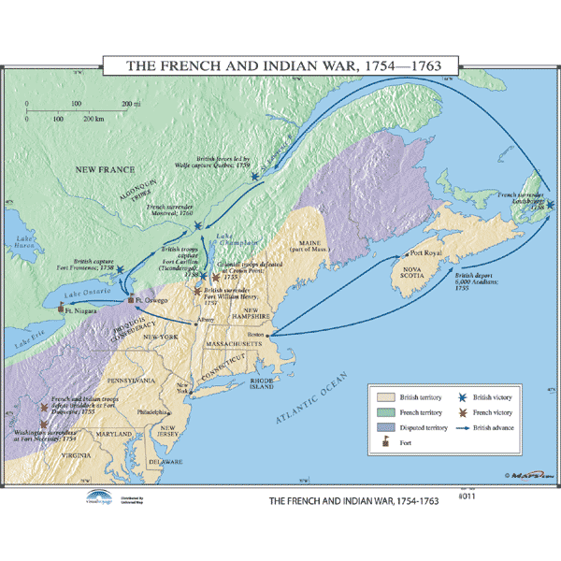
Map of the War
Analyzing history through the values of the Past

Slide 30
The Tide Turns
In 1757 the tide turned in favor of the English. William Pitt, the English Prime Minister, determined that the best way that England could defeat the French in Europe was first to conquer the French in the New World. In 1758, sizable numbers of British soldiers arrived to carry out Pitt's plan. With colonial assistance, British soldiers captured Fort Duquesne that year. In 1759, the English captured both Fort Niagara and Quebec, France's major city in the New World. Montreal fell the following year, leaving England in control of France's possessions in North America.
Determining the Main Idea
http://www.ohiohistorycentral.org/entry.php?rec=498
Use of Multiple Sources

Slide 31
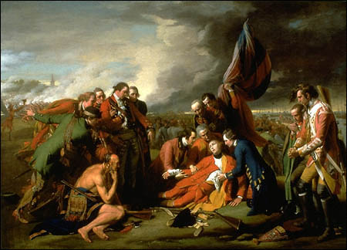
Imagery from the War
© 2010 AIHE

Slide 32
Results of the War
This encroaches on my second presentation but would be part of any lesson on the French and Indian War.
© 2010 AIHE

Slide 33
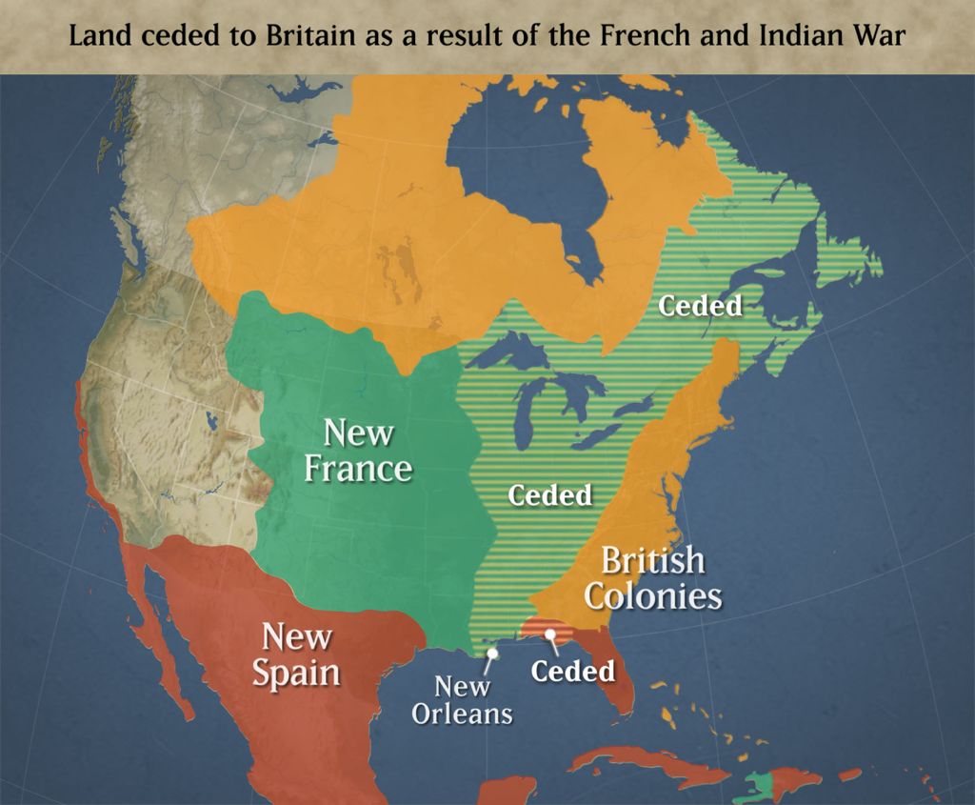
Changes in the Map
What did “we” get?

Slide 34
Debt!
War cost the British Empire
The debt created a cash-crunch for Britain
Colonists were expected to pay
Began to create and enforce laws designed to raise revenue
Colonists saw this as decidedly unfriendly
BIG picture?

Slide 35
American Loyalty?
Many Americans were disloyal during the war
Some New England states traded with the French
Americans were typically not inclined to join the fight
Some American units performed poorly in the field
Many American troops and officers were openly critical of their British Army counterparts and superiors
Establish values and beliefs

Slide 36
American Ideas
Americans felt that they had been a key cog in the British victory
Since they had suffered (well somewhat), they should be allowed to share in the spoils
Americans had always been somewhat self-governing and wanted that to continue
The idea of Parliament levying taxes was foreign and patently immoral as Englishmen if they had no representation
Establish values and beliefs

Slide 37
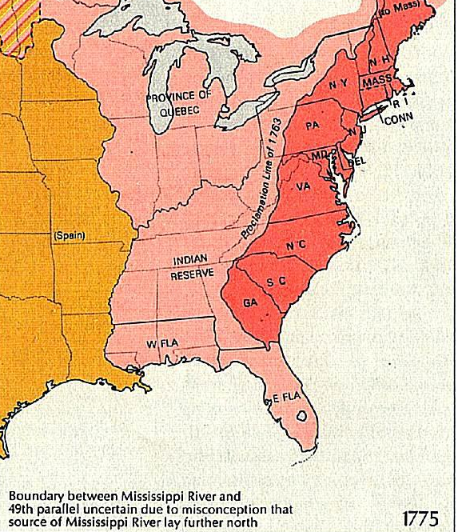
Pontiac’s Rebellion
Designed by Pontiac to oust the English, or at least retard their movement
In the end Britain had to send troops and incur more costs
King issued the Proclamation
Big Picture?

Slide 38
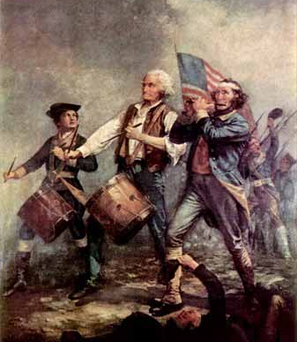
Where does it end?
The logical conclusion takes us through the series of “acts” and into the American Revolution
Ultimately it is a cyclical struggle where the questions of governmental power and taxation are still being fought and discussed
© 2010 AIHE

Slide 39
Many Thanks to...
Digital History Online Textbook at U. of Houston
Social Studies for Kids Online
U-S-History.com
Explore PA History
Philaprintshop.com
Ohiohistorycentral.org
A&E Channel
The Boisterous Sea of Liberty

