Slide 1
The 8 Ates of Immigration
Irish and Jewish Immigration
Presentation by Dr. Kevin T. Brady, AIHE

Slide 2
The BLaST IU17 Liberty Fellowship/ Williamsport, PA
Monday, June 21st, 2012

Slide 3
Pennsylvania Social Studies Standards: Immigration
8.3.D. Identify and describe conflict and
cooperation among social groups and
organizations in United States history.
8.3.12. Immigration and Migration
(e.g., anti-immigrant attitudes,
quota laws, westward and
southward migration)

Slide 4
8 Ates as a Project
Students can research any ethnic immigrant group that has moved to the United States.
They can use the “8 Ates” as a framework to discover what forced them to leave their homelands and settle in the United States.
This will also give them a background into the introduction of the market “cash” economy in subsistence economies and how that changed the lives of millions and millions of people.
They can further use the “8 Ates” as a framework to discover how that same market economy led many immigrants to stay in America.
As members of ethnic groups moved into American society, the came to appreciate themselves as Americans.
Later generations celebrate their particular ethnic heritage, as part of the American culture.

Slide 5
The 8 Ates
1. Alienate The economy or culture changes
2. Deliberate Discuss alternatives and plan
3. Emigrate They leave their homeland
4. Separate They associate with themselves
5. Eliminate Shed parts of culture to survive
6. Appreciate They come to appreciate the new land
7. Assimilate Become American
8. Celebrate Nostalgia; look back with pride

Slide 6
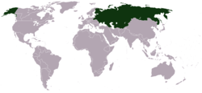
Background
Irish Catholics
Russian Jews

Slide 7
Irish Emigration from Ireland
Jewish Emigration from Russia

Slide 8
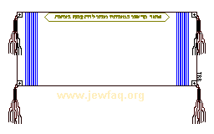
Why were Jews able to become the richest and most educated ethnic group in the U.S

Slide 9
And the Irish Catholics
The 2nd Highest Income
The 2nd Highest Level of Education
With the 2nd Highest Occupational Prestige

Slide 10
Jewish Immigrants to the USA
Came from severe oppression:
To a nation that really did not
welcome them.
How did they become so
successful?

Slide 11
Irish Catholic Immigration to the USA
The Irish Catholics came from a much more primitive environment and are now a close second in each category.
How did this happen?

Slide 12
Through Strategies?
By Chance?
By the Luck OF THE IRISH?

Slide 13
How? Why?

Slide 14
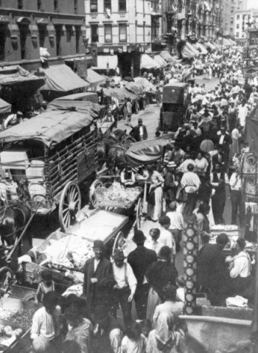
Both Were EXILES

Slide 15
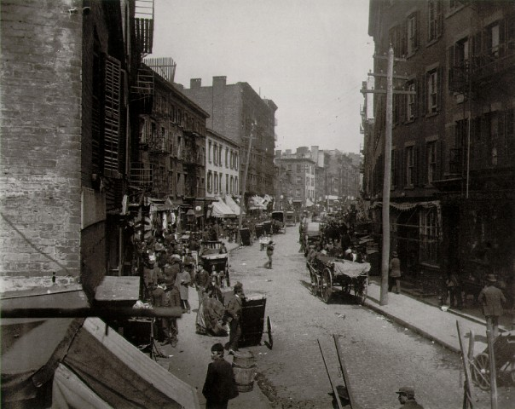
The Irish Catholics were the First Major Minority Group:
All of the urban pathologies we now associate with the urban poor

Slide 16
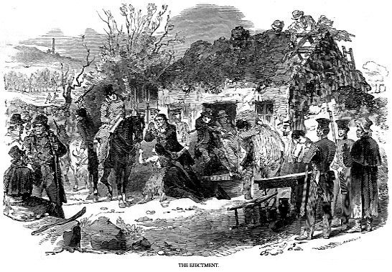
1. Alienate
From their own
moral economy
From their traditional way of life!

Slide 17
S.P.E.E.C.H.
Social
Political
Economic
Environmental
Cultural
Aspects of History

Slide 18
S.P.E.E.C.H.
Social Peasantry
Political Disenfranchised
Economic Subsistence to Market
Environmental Agrarian — Potato Blight
Cultural Gaelic Catholics under English Protestant rule
Aspects of History

Slide 19
The Irish Catholics
MOVED FROM:

Slide 20
Ireland to the USA From To
A Subsistence economy
A Rural environment
A Gaelic-Irish Speaking Nation
to a Market economy
to an Urban environment
to an English-Speaking Nation
They remained in an atmosphere extremely hostile to Roman Catholicism

Slide 21
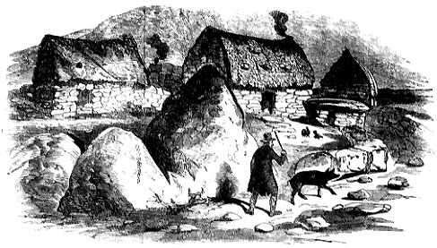
Earlier
during the 18th century

Slide 22
The British Market economy moved into Ireland
Anglo-Irish Landlords enclosed pastoral lands and changed them to grazing lands
Irish agrarians were thrown off the land

Slide 23
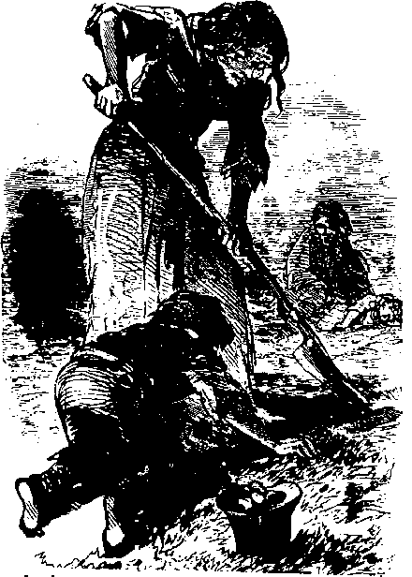
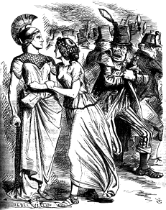
The Majority is Second Class
The 85% Irish Catholic majority is already alienated from the Anglo-Irish Protestant minority, along with the British and Anglo-Irish governments and hegemonies

Slide 24
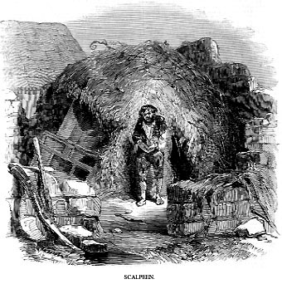
Because of:
18th Century PENAL LAWS
No rights for Irish Catholics
e.g., No land ownership, no education, no gun ownership, no suffrage, etc.
Catholic Emancipation of 1829 Provides only Limited Rights for the Richer, Catholic Middle Class

Slide 25
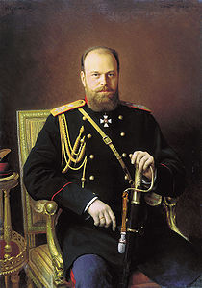
Jews in Late 19th Century Russia
Autocracy
Orthodoxy
Russification

Slide 26
Late 19th Century Russian Jewish S.P.E.E.C.H
Social Landless Tradesmen and Merchants
Political No Franchise
Economic Petty Bourgeois
Environmental Urban — Village
Cultural Jewish under Russian
Orthodox rule
Aspects of History

Slide 27
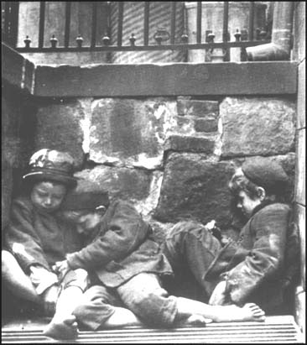
98% of all 19th Century Jews in the Russian Empire
lived in Poverty, Persecution, and Overcrowded Conditions

Slide 28
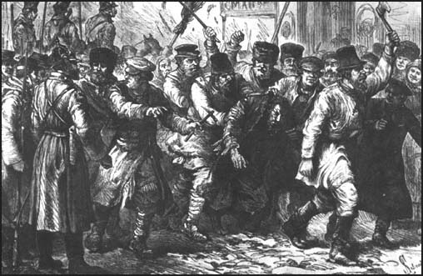
Jews could not own land in the Russian Empire

Slide 29
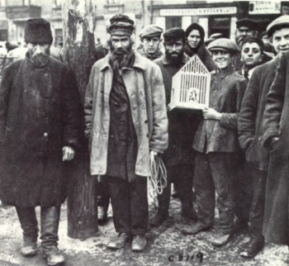
Jews concentrated on urban skills and trades

Slide 30
2.
With the advent of the market economy, they Deliberate

Slide 31
2. Irish peasants deliberate on ways to bring in money
Migrant Workers
They explore ways to raise cash – major transformation

Slide 32
For the First Time,
They Moved off their Ancestral Lands, Temporarily or for Good
→ Some become landless laborers
Some become migrant workers
→ Some move to cities

Slide 33
As the Market (Cash) economy encroaches, Russian Jews look for alternative ways to survive

Slide 34
Common Story of Emigration
Peasants need cash to pay rent for land.
They go to labor markets/migrant farm workers.
Then, migrant factory workers.
Then, urban factory workers.
Finally, emigrants!

Slide 35
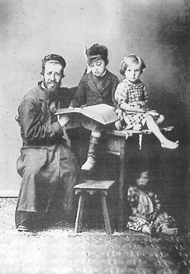
The Market Economy
.
Factories pushed many Jews out of the trades.
Russian peasants moved into cities and took factory jobs.

Slide 36
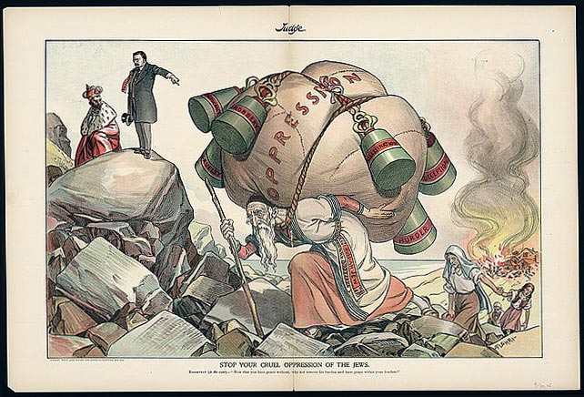
Late 19th Russian Pogroms
Jews are already alienated from the dominate Russian Orthodox culture.
Persecution leaves them alienated from their status as second-class subjects of the Tsar.
Pogroms change the moral economy.
Jews decide what they must do!

Slide 37
3.
Emigrate

Slide 38
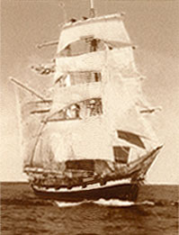
EVENTUALLY, they
Choose to (3) Emigrate
The Irish moved to England, Scotland, Canada, Australia, or the United States

Slide 39
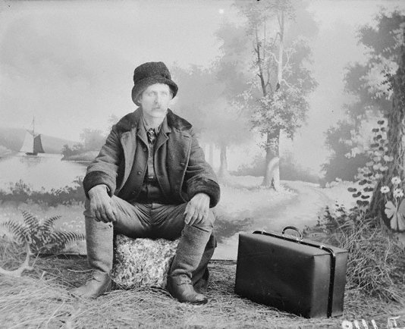
Once in America

Slide 40
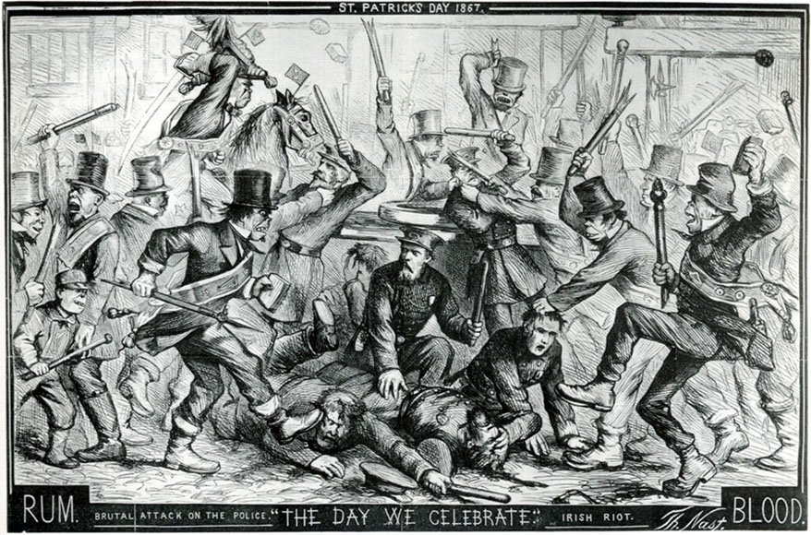
The Irish (4) Separate

Slide 41
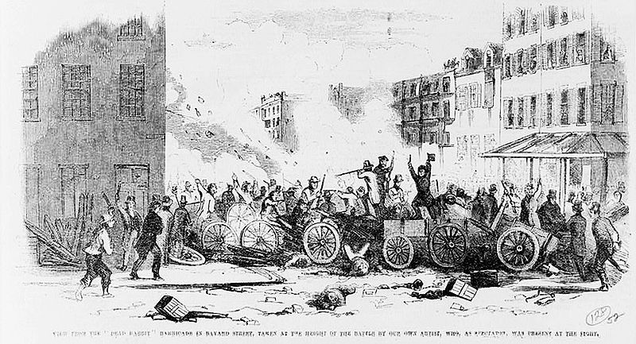
From an antagonistic American Culture
Irish Catholics retreat into the
Catholic Church and into benevolent
societies

Slide 42
They also Formed Nationalist Societies to Keep Connected to the Homeland.
→ Some Radical
→ Some More Moderate

Slide 43
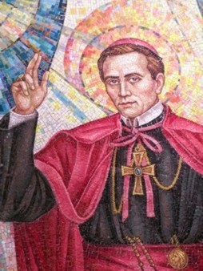
They Retreated into CATHOLIC SCHOOLS
Because Americans:
Used Protestant Bibles
Proselytized Catholics
Harassed Their Children

Slide 45
NATIVISTS RIOTS
BIBLE CONTROVERSY
HARASSMENT OF CATHOLIC CHLDREN

Slide 50
The Un-assimilatable!
The Irish!

Slide 52
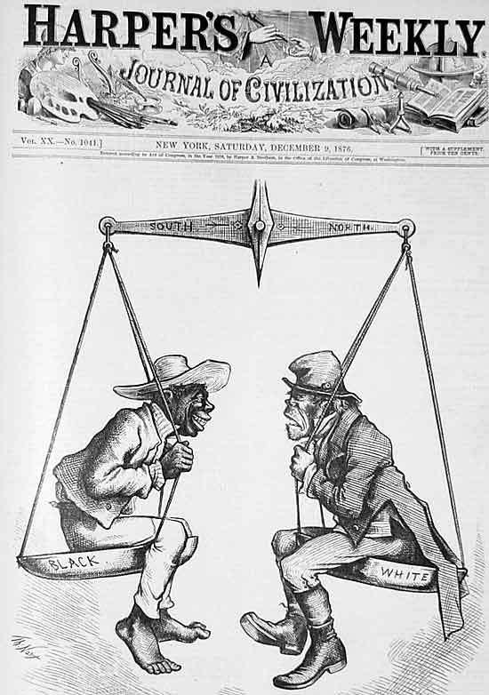

Slide 53
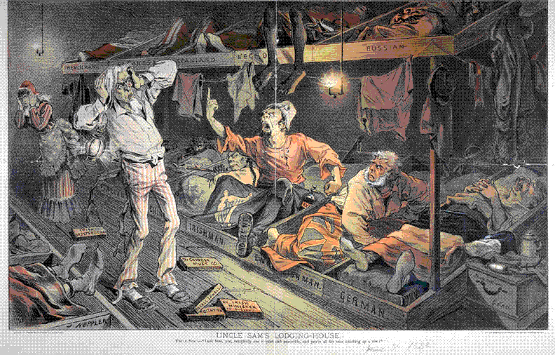

Slide 54
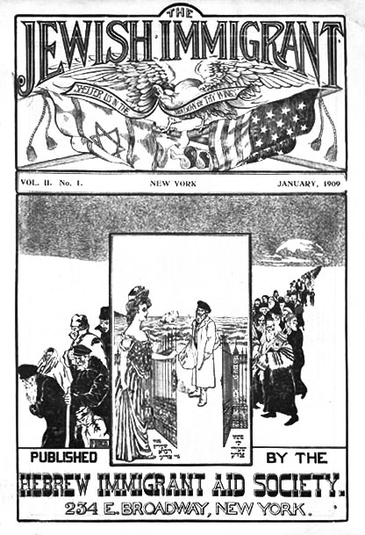
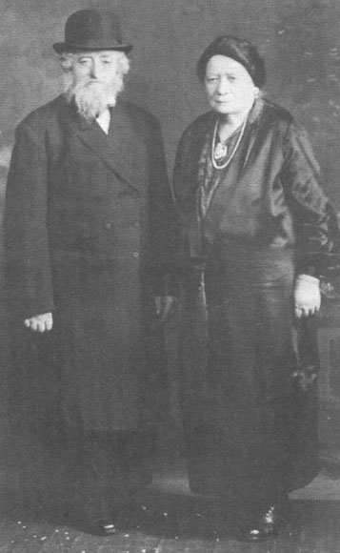
JEWS in USA

Slide 55
They Separate
Older German Jews had been accepted by the WASPs
Newer Eastern European Jews were rejected by the WASPs

Slide 56
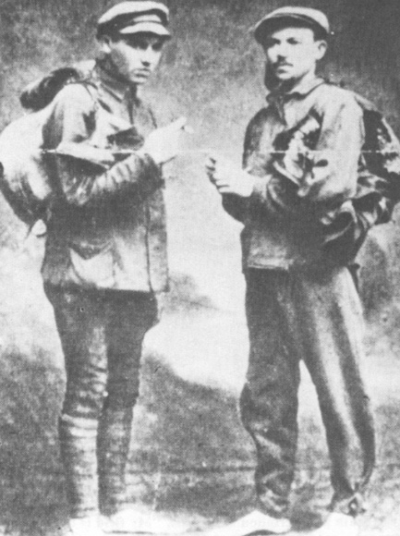
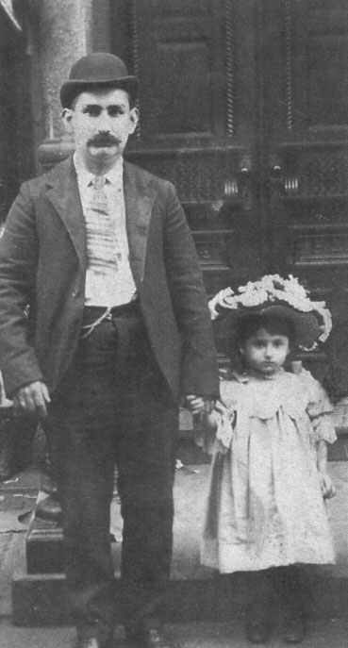
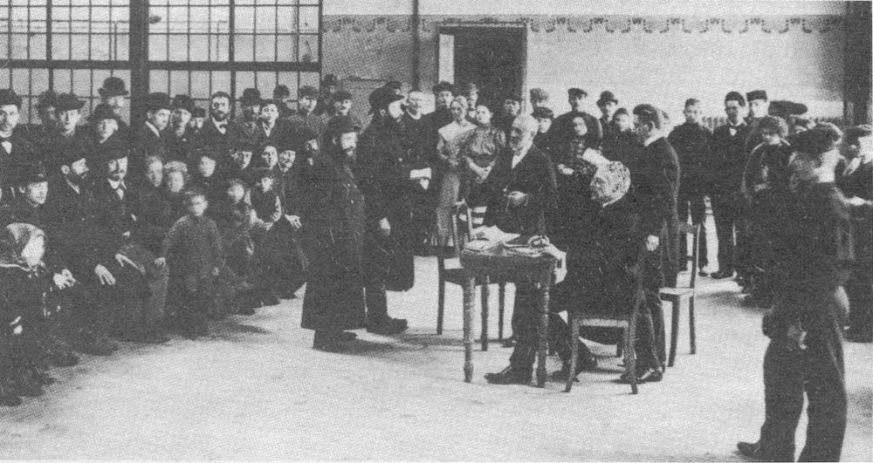
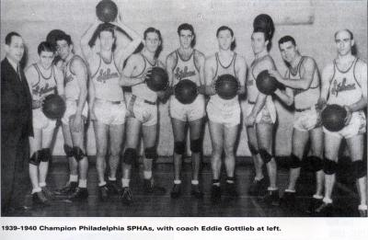
YIDDISH

Slide 57
The Irish eliminated all parts of the Gaelic culture not needed for survival. They maintain parts of the culture they need to survive. They had coalesce in the Catholic Church, in politics, in nationalist organizations, and in labor movements.
5. ELIMINATE

Slide 58
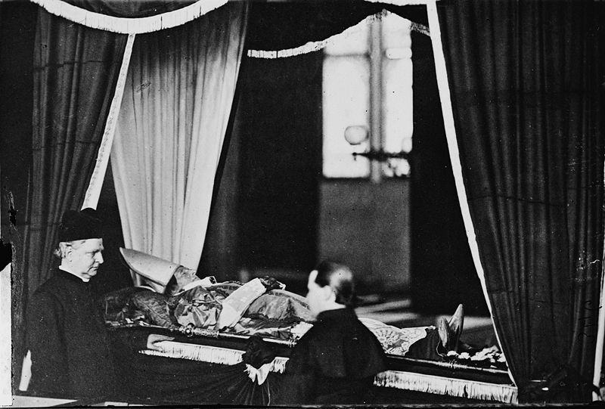
The Irish Developed an
Americanized
Catholic Culture,
not a
Celtic or Gaelic Catholic
Culture

Slide 59
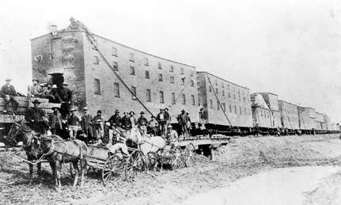
Many Irish initially worked as UNSKILLED WORKERS
No longer agrarians, they worked on canals such as: Erie, Delaware & Chesapeake, Delaware & Raritan, New Orleans, etc.
They laid the railroads and worked in factories and foundries.

Slide 60
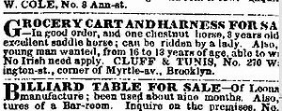
COMPETITION WITH BLACK LABORS
IRISH MOVE INTO CITIES EN MASSE
$3 paid forwarding agents for fictitious RR jobs.
They could work 12 hours for 87.5 cents a day.
Much lower than African Americans
See Want-ads in Boston, New York, and Philly papers
NINA “No Irish Need Apply”
1854 NY Times

Slide 61
In Catholic Schools
Irish children were taught by Irish and Irish American nuns to be Americans.
They learned an Anglo-American Catholicism, not a Gaelic-Celtic Catholicism.
They learned Anglo-American and Western history, not a Gaelic Irish-Celtic history.
From American Irish to Irish Americans
From American Catholics to Catholic Americans

Slide 62
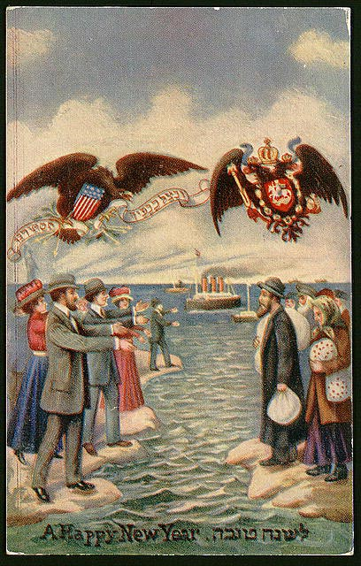
5. ELIMINATE
Eastern European Jews move from a Yiddish World to an American Jewish World

Slide 63
Americanization
For the newer Jewish immigrants, German Jews set up education programs
Middle Class Values
WASP Middle Class Values

Slide 64
German Jews forced Eastern European Jews to change their names to Germanic names
Goldberg, Greenberg
The more German sounding, the more American

Slide 65
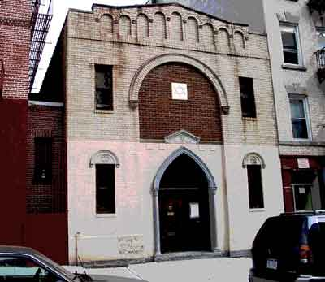
From the Slums to Harlem: 2nd Stage Settlement
Overcomes the divisions between German and East European Jews

Slide 66
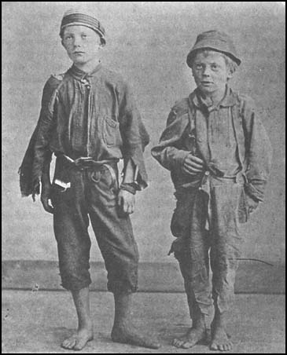
Institutions:
promoted acculturation which allowed retention of Jewish religious heritage

Slide 67
Jewish Immigration Societies
Taught English
Found Jobs for Immigrants
Taught the Talmud and Torah
Intense Instruction of Rabbinic Text
An American Orthodoxy

Slide 68
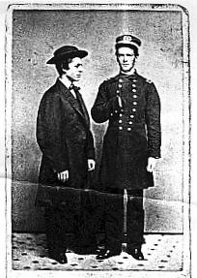
Institutions
Promoted Americanization
Middle Class Models for Ghetto Youth

Slide 69
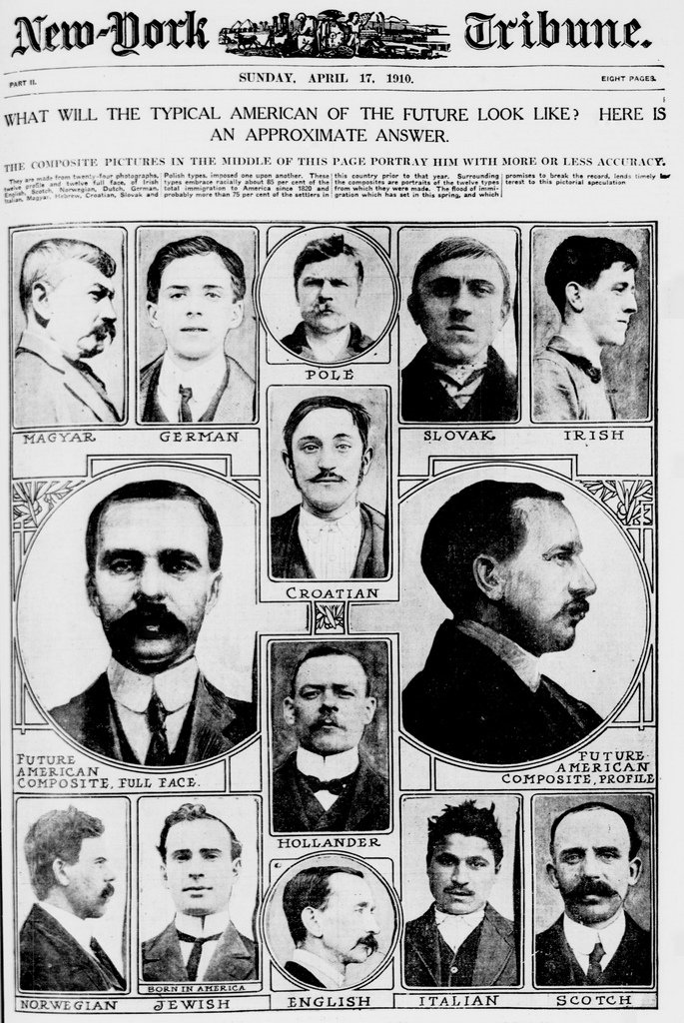

Slide 70
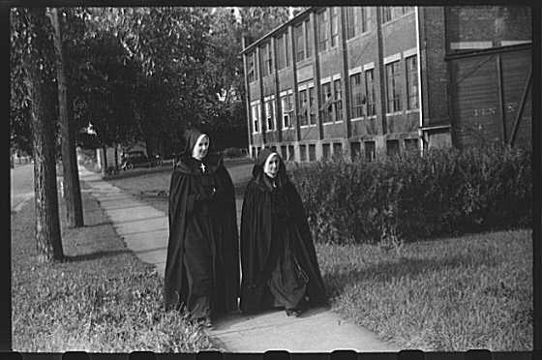
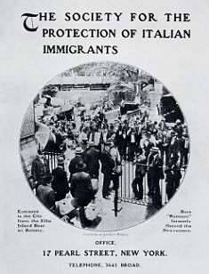
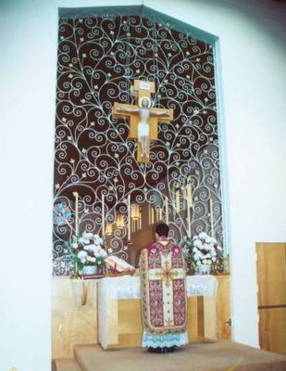
Catholic Schools did the Same for Catholic Immigrants

Slide 71
The Irish came to (6) Appreciate the new American environment and the opportunities for upward mobility
They took advantage of opportunities and created opportunities in a free market, liberal democracy.

Slide 72
ENTREPRENEURS
Entrepreneurs raise the Irish to New Levels
1850 48% of Irish were unskilled laborers.
This has NO parallel with any other immigrant group.
But only 33% of Philly’s Irish were unskilled laborers.

Slide 73
1850 Only 1% of Boston grocers were Irish
1857
20% of Philly’s grocers were Irish
12% of Philly’s Dry Goods Merchants were Irish
SEVEN YEARS CANNOT MAKE THAT MUCH OF A DIFFERENCE!

Slide 74
The Philadelphia Irish
The Irish in Philadelphia had a much easier time of upward mobility than Irish in other eastern cities because the abundant land allowed cheaper housing. In 1851:
New York’s population was 515,000,
but had only 37,730 houses.
Philadelphia’s population was 490,000, but had 61,200 houses.

Slide 75
Catholic Schools Boom in Philly
Prior to 1860:
Boston has only four.
Because the Irish had more money and quicker upward mobility, Philadelphia had 19 Catholic schools.

Slide 76
Irish Construction Companies Build Catholic Churches, Catholic Schools & Homes
Irish Catholic construction workers earn money at Irish companies.
They formed Building and Loans
Workers can afford homes

Slide 77
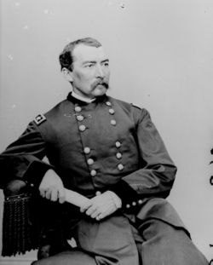
Upward Mobility
Priesthood and Religious Life
Politics
Police
Firemen
Labor Unions
Nationalism

Slide 78
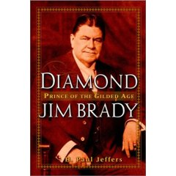
Key to Success:
Entrepreneurism

Slide 79
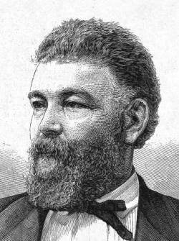
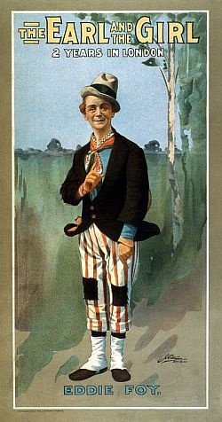
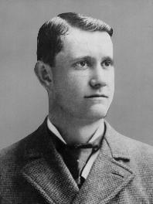
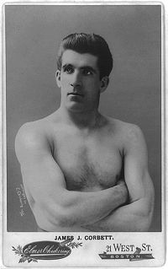
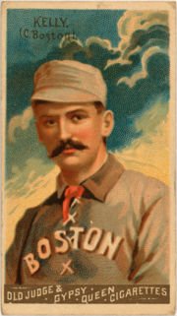
Fields Dominated by the Irish in the 19th & early 20th centuries
Boxers
Sportsmen
Singers
Actors
Paddy Irish
Musicians
Organized Crime

Slide 80
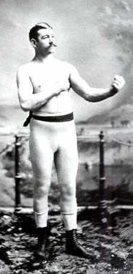
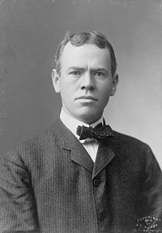
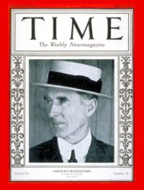
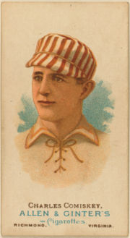
BUT,
These fields did not lead
to upward mobility
Except for a
select few
individuals

Slide 81
Jewish Immigrants Appreciated the Opportunities
Still,
1905 -- 54% of Jewish
households were headed by
Manual Laborers
Less than 3% were professionals

Slide 82
Many Jews Began to Move into he Middle Class through
Unions, Union Leadership
and
as Entrepreneurs

Slide 83
Education
At first, Jews did not go to school
Education in European Jewish Style
– Shtel, very Ritualistic
Conservative – not Modern

Slide 84
Previously, in Europe. Mercantile and Banking Experience Served Jews Well

Slide 85
In the Jewish Community,
Economic Success Proceeded
Commitment to Education

Slide 86
Most German Jewish sons stayed in father’s business.
Many discouraged sons from education, especially from Classics and Economics.

Slide 87
Russian Jews did quit school later than non-Jews
But
on a “Retarded” Test (that was very biased against immigrants) they scored
two or more grades behind their peers
64% Italians
42% Jews
16% Swedes

Slide 88
High Profile Irishmen, however,
Helped the Irish to
(7) Assimilate
Into American Society

Slide 89
As the Irish moved into the Middle Class
They begin to
ASSIMILATE

Slide 91
Even the gangsters moved from ethnic gangs, to gangs, then out from crime, as ethnics
Legs Diamond, NYC
Vannie Higgins. BKLYN
Bugs Moran, CHI
Owney Madden, NYC
Fight between the Dead Rabbits and
the Bowery Boys, 1857, NYC
Mickey Duffy, PHL
Dean O’Banion, CHI

Slide 92
(7) ASSIMILATE
Jewish entrepreneurship led to upward mobility
Tradition of non-land-owning people
They had to deal with money – buying and selling.
They established a Middle Class.
The children or grandchildren sent to college and enter professions.
education, academics, law, medicine, politics
Jewish tradesmen in the unions sent children to college.
Opportunities were available within the Jewish community.
They too became professionals

Slide 93
Even the gangsters moved from ethnic gangs, to gangs, then out from crime, as ethnics
,
Myer Lansky, NYC
Boo Boo Hoff, PHL
Monk Eastman, NYC
Jacob Orgen, NYC
Bugsy Siegel, LV
Arnold Rothstein, NYC
Dutch Schultz, NYC

Slide 94
Similar story for other “exiles.”
Real Upward Mobility came through the entrepreneurs:
grocers, saloonkeepers, construction companies
They became professionals
by 1920s, there was a
greater percentage of
Irish Catholics in college
than there were WASPs

Slide 95
After Assimilation and Success, the 3rd generation American ethnic group begins
to:

Slide 96
8.
Celebrate
The 8 Ates

Slide 97
8. CELEBRATE

Slide 98
8. CELEBRATE

Slide 104
.

Slide 106
.

Slide 107
Bibliography for Further Reading
Bottigheimer, Karl S. Ireland and the Irish: A Short History. New York: Columbia University Press, 1982.
Brown, Thomas N. Irish-American Nationalism, 1870-1890. Philadelphia and New York: J. B Lippincott Company, 1966.
Clark, Dennis. Erin's Heirs: Irish Bonds of Community. Lexington: The University of Kentucky Press, 1991.
__________. Irish Relations: Trials of an Immigrant Tradition. Rutherford, N.J.: Fairleigh Dickinson University Press, 1982.
__________. The Irish in Philadelphia: Ten Generations of Urban Experience. Philadelphia: Temple University Press, 1973.
Daly, Thomas A. The Friendly Sons of St. Patrick. Philadelphia: F. McManus, Jr. & Co. Publishers and Printers, 1920.
Hershberg, Theodore, editor. Philadelphia: Work, Space, Family and Group Experience in the 19th Century. New York: Oxford University Press, 1981.
McCaffrey, Lawrence J. The Irish in Diaspora. Bloomington, Indiana: Indiana University Press, 1976.
Nolan, Hugh. The Most Reverend Francis Patrick Kenrick: Third Bishop of Philadelphia, 1830-1851. Philadelphia: American Catholic Historical Society, 1948.
O'Grada, Cormac. Ireland Before and After the Famine. Manchester: Manchester University Press, 1988.
O'Grady, Joseph. How the Irish Became Americans. New York: Twayne Publishers, Inc., 1973.
Silcox, Harry C. Philadelphia Politics from the Bottom Up: The Life of Irishman William McMullen, 1824-1901. Philadelphia: The Balch Institute Press, London and Toronto: Associated University Presses, 1989.
Wittke, Carl. The American Irish. Louisiana State University Press, 1956.

Slide 108
Bibliography for Further Reading
Bodnar, John. The Transplanted: A History of Immigrants in Urban America. Bloomington: Indiana University Press, 1985.
Glazer, Nathan. American Judaism. Chicago: University of Chicago Press, 1972.
Hertzberg, Arthur. The Jews In America: Four Centuries of an Uneasy Encounter. New York: Simon and Schuster, 1989.
Rischin, Moses. The Jews of North America. Detroit: Wayne State University Press, 1987.
Sacher, Howard M. A History of the Jews in America. New York: Knopf, 1992.

