Slide 1
America and the British Empire
A Matter of Perspective
This power point presentation is for educational purposes. It may contain copyrighted material. Please do not post, redistribute or copy without the permission of the author or Dr. Kevin Brady at the American Institute for History Education.

Slide 2
Why Perspective?
“Good history” does not rely on one perspective
“Good history” pieces together information from many sources and points of view
In today’s case the British and the Colonists
Multiple perspectives provide a more complete view and understanding of the past.

Slide 3
A View from the Cheap Seats
Colonists
British
Amer-Indian
Overlap Between Two Perspectives
How do these Perspectives Differ?

Slide 4
Americans in the early-mid 1700’s

Slide 5
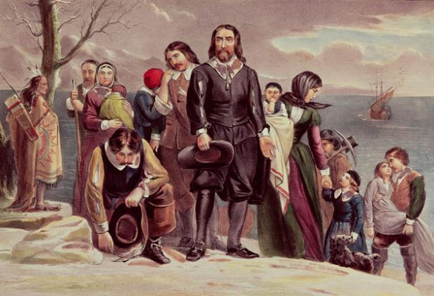
Similarities with British
Descendants of those who left England
Thought of themselves as English
Spoke English as official language
Legal system was based on English common law
Political system mimicked England
Similar diet and dress
Same holidays and pastimes

Slide 6
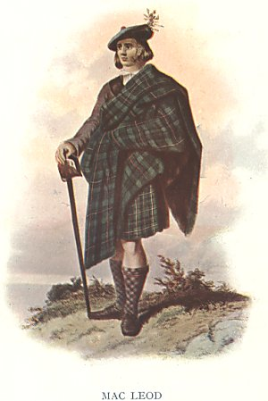
Differences with British
Many nationalities and ethnicities mixed in
Enjoyed better social status than in England
Could rise higher in America
Status rested on wealth rather than lineage
Had more suffrage
More opportunities

Slide 7
The Relationship
Historically Britain was who the colonies looked for to provide them protection
Britain wanted to end the individuality of the colonies
For ease of defense and governing
“march to the same drummer” – John Ferling
In 1721 wanted to consolidate the colonies as a unit
Planned to build forts all along the frontier
Maintain a garrison of 8 regiments of Regulars

Slide 8
American Whig Ideology
A Tradition of Opposition

Slide 9
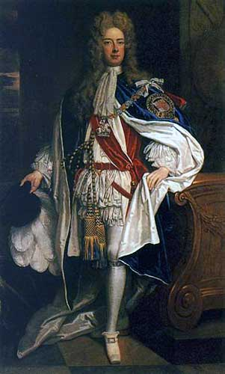
Power and Liberty
Whigs believed there was an ongoing struggle between power and liberty
People lust after power
Stop at nothing to achieve power

Slide 10
Bernard Bailyn
America inherited England’s radical Whig tradition of opposition
Power was “brutal, ceaselessly active”
Liberty was “delicate, passive, and sensitive”

Slide 11
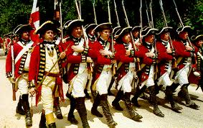
Standing Armies
Were an affront to liberty
Militaries wipe out liberty
They become tools of the powerful or become autonomous
Standing armies were an indicator and agent of corruption
The larger the army the more corrupt the power

Slide 12
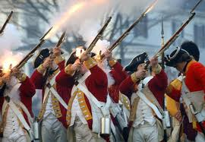
Standing Armies as Corruption
Cost money to maintain
Money = Taxes
Taxes were a threat to property
Threats to property meant political slavery

Slide 13
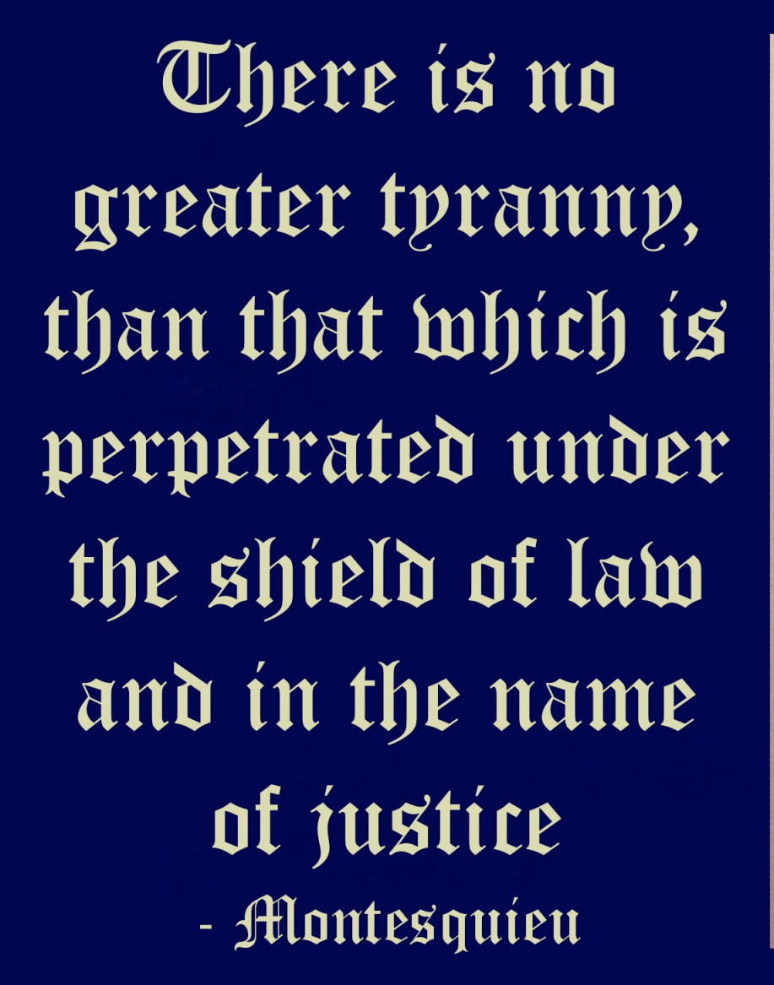
What this all means…
The story of America vs. the British has a new element
Not just about “rights as Englishmen” and “no taxation without representation”
It is not simply an economic or monetary machination
Terms like “liberty” and “tyranny” actually had meaning to the Americans of the day

Slide 14
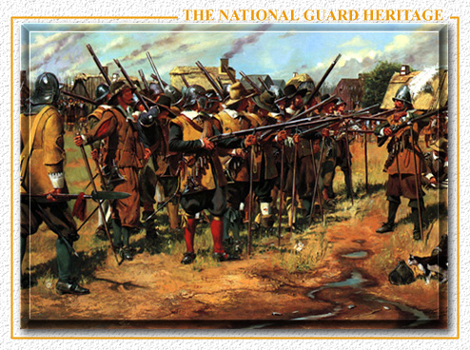
Militia
Property holding citizens organized as militia were the appropriate army and could counter tyranny
The Prince (1513)
Calls standing armies nothing more than mercenaries

Slide 15
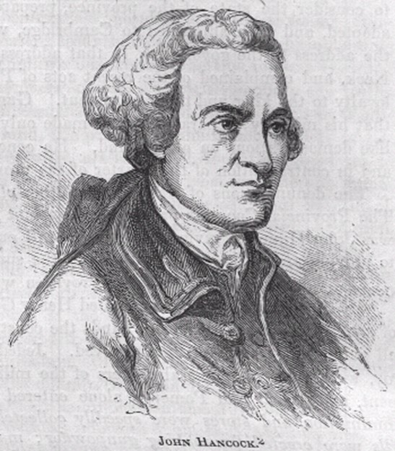
Long Term Stability
Political and Social
Depended on :
The propertied to protect liberty
Militia and not standing armies

Slide 16
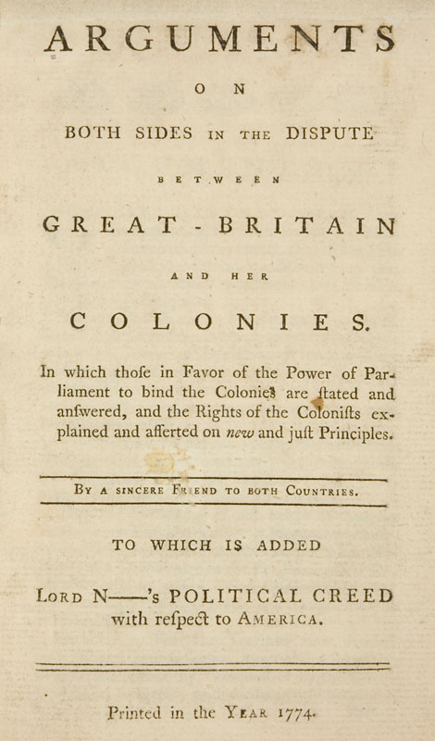
Transmission of Ideas
America was a literate society
Political pamphlets were very popular
Radical English Whigs wrote and influenced the American pamphlet authors
Pressed the necessity of defending liberty at all hazard

Slide 17
Why the French and Indian War?
A.K.A. the Seven Years War

Slide 18
Why this War?
French and Indian War was the most important struggle of the 18th century
Dramatically rearranged the balance of power
Decisive defeat of one of the belligerents
It is more effective to study the history of the American Revolution from 1754 than from 1763
No one knew the Revolution was coming
Can study from an imperial as well as a Revolutionary perspective

Slide 19
Why this War?
Violent imperial competition was followed a troubled attempt to construct an empire
Britain’s efforts to specify and clarify the imperial relationship began a new chapter
Early years of the war convinced the British that only way to deal with colonists was to exert imperial control
The French and Indian War was about control of territory that leads to questions of governance

Slide 20
Impact of The French and Indian War

Slide 21
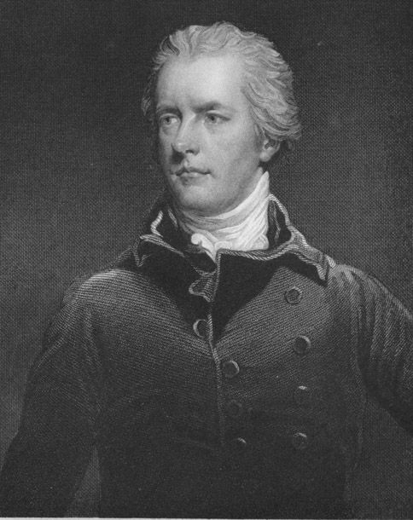
Winning the War
Two major causes for British victory
Military
Supplies, logistics, controlling the sea lanes
Cultural
Pitt concedes to treat Americans as allies rather than subjects
Begin to reimburse and pay rather than impress

Slide 22
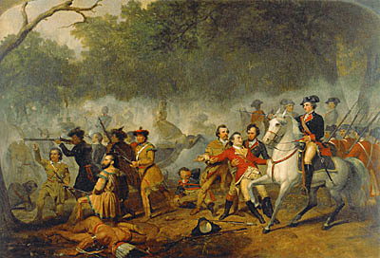
Winning the War
Anglo-America was victorious
There were many joint operations btw colonists and Regulars
Colonists erected monuments to the Regulars
Colonists saw themselves as crucial to the victory
The victory created a distinct sense of pride

Slide 23
Economic Impact of the War
Created a decade long period of American prosperity
Many colonists were getting wealthy
Mainly due to the $ that Pitt infused to pay for supplies, soldiers, and other aspects of the war
In essence the colonies profited handsomely from the war itself

Slide 24
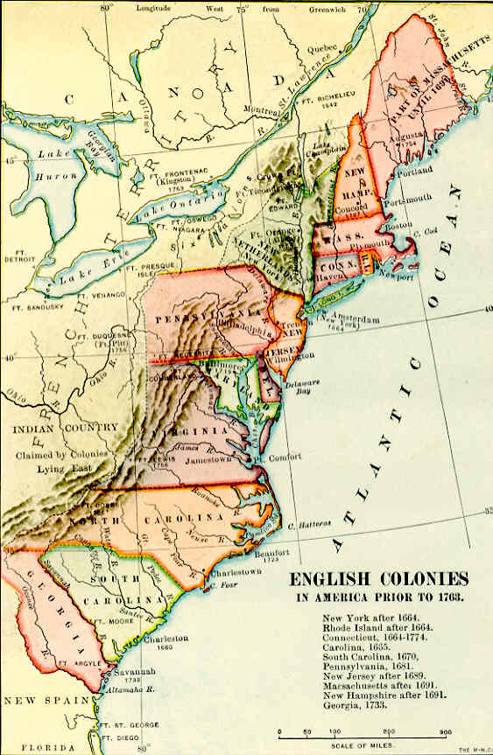
Post-War American Ideas
Foremost wanted to get on with their lives
Getting new lands won in the war
Assuming that the British government would return to the benign state that had been in place for decades

Slide 25
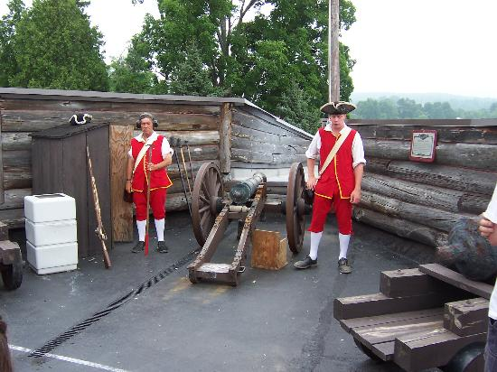
Post-War British Ideas
Protect the newly won territory
Leave a garrison
Attempt to alleviate conflict with natives
Organize the new territory
Stanch the flood of settlers into the interior of the continent

Slide 26
Sovereignty and Fear
Great Britain and the American colonies

Slide 27
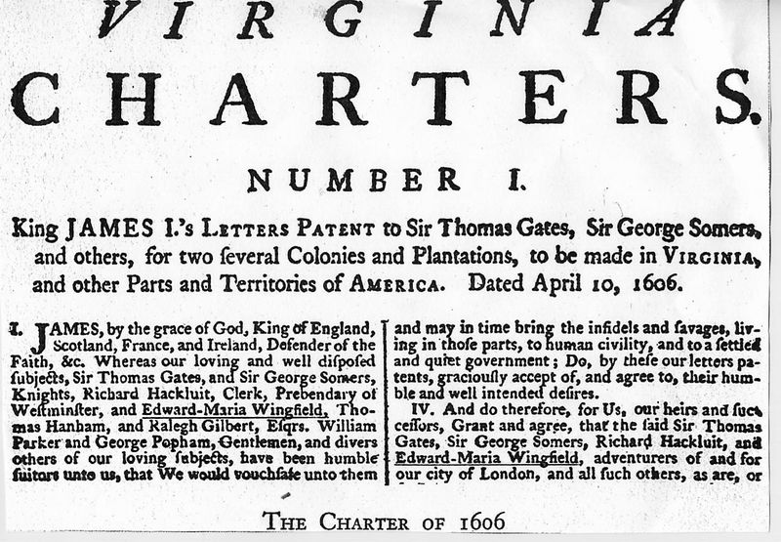
Sovereignty
Each colony had a long history as a separate entity
Charters, institutions, laws, history, and identity
Each colony was independent of the others

Slide 28
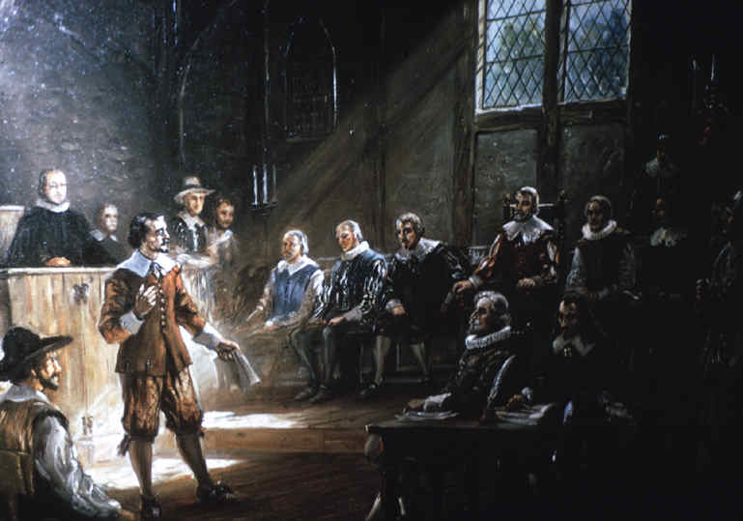
Sovereignty
Small colonies feared any attempts at unification
Would be dominated by the larger colonies
Influential men feared losing their position and power
Taxpayers wanted no additional taxes and wanted a say in where their taxes went

Slide 29
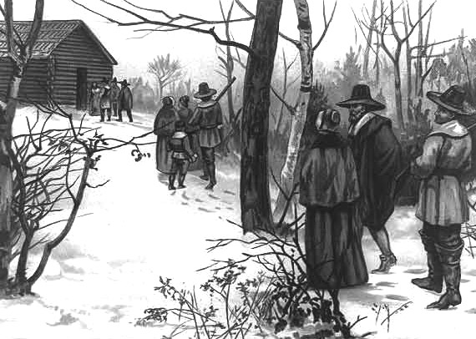
Immigration / Emigration
People of America had fled Europe to escape something (tyranny, religion, etc)
Autonomy was important to maintaining the type of life they wanted to establish here
Any consolidation or increased scrutiny was moving in the wrong direction

Slide 30
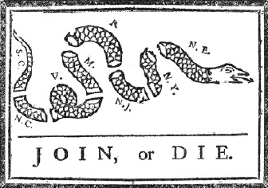
British Fears
Began with the Albany Plan
Would make America unified and hard to handle
Could lead to “an independency”
Could make the colonies as formidable as the French

Slide 31
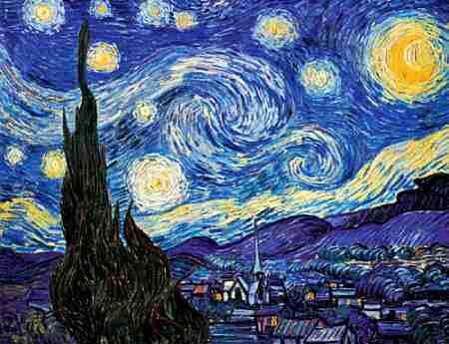
A.R.T.I.S.T. + R&B
Author
Reason
To Whom
Immediate Effects
Subsequent Effects
Time Period
© 2010 AIHE

Slide 32
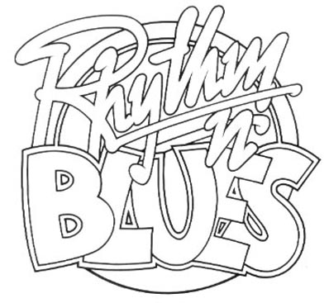
What is R&B?
R&B is the logical extension of the ARTIST analysis.
R&B stand for Reliability and Big picture ideas respectively.
It is absolutely imperative that students have a grasp of the reliability of historical documents as well as the big picture ideas contained in them.
© 2010 AIHE

Slide 33
The Albany Plan of Union

Slide 34
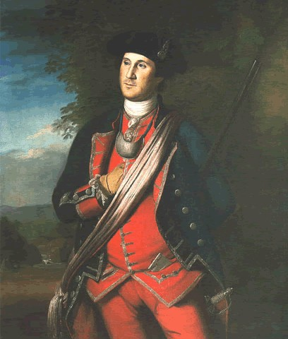
More British Issues
American dialect and words
America seeming to drift apart from Britain
Immigration of Scotts-Irish and Germans
American behavior in the war
Poor manpower support
Trading with enemy
Profiteering

Slide 35
The British Solution
Not a great solution but…

Slide 36
Setting the Stage
Before the war many in London thought that they should exert more control over the colonies
Since 1680’s a series of wars had thwarted this
The wars were part of the greater issue
Cost lots of money and created debt
Colonists ought to help pay that debt

Slide 37
Two Components of Revolution
Attempts to End Sovereignty
Establish a Standing Army in America
But they did not just happen at the end of the French and Indian War, they were in process in the early 1700’s

Slide 38
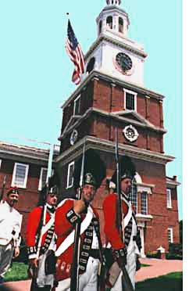
Leaving Regulars in America
Keep an eye on the French colonists
Keep an eye on the Indians
Keep officers employed in the Army
Cost money
Colonists should pay for them being here

Slide 39
Why the Colonists Should Pay
The colonies had benefitted from the war more than anyone
Colonies paid low taxes
Only taxes to the crown that the colonies paid was customs duties
Oh, and the Regulars were sent to protect THEM

Slide 40
British Post-War Goals
These were set by the King himself
Create a secure and financially stable empire
Institute political order in the conquests
Restore peace with the Indians
Use the prosperity of the older colonies to strengthen the empire
These had the potential for serious friction because the come from the point of view of the empire and that of America

Slide 41
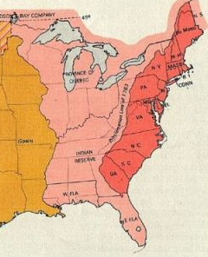
Proclamation of 1763
Was designed to be temporary
Try to stem the flood of settlement in the west and make it orderly
Designed to save money
No wars with the Indians

Slide 43
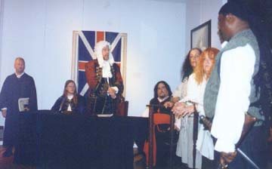
Admiralty Courts
Designed to make sure that money flowed to Britain
Limit graft at the customs houses
Limit smuggling
Reduce influence of local juries and mobs

Slide 44
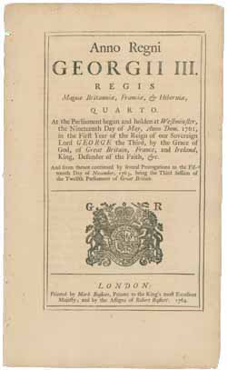
Currency Act (1764)
Colonies could not issue inflated paper money
Designed to protect English creditors
Debts paid in gold or silver or money backed by it
Colonial money to have same value as that in Britain

Slide 45
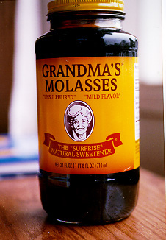
Sugar Act
Explicitly designed to raise revenue
Actually REDUCED taxes on sugar and molasses to help stem smuggling and bribery

Slide 46
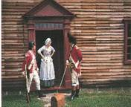
Mutiny Act (Quartering Act)
Designed to save money by economizing the housing of soldiers in America
Barracks cost money
This would lessen the debt which would result in lower taxes

Slide 47
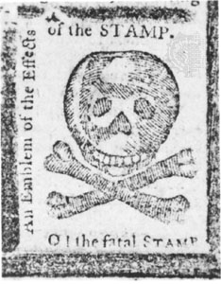
Stamp Act
The most hated of all
Came at the wrong time
War saw colonial internal taxes go up sharply
This type of tax was very new to America
Americans wondered where the bounds of Parliament were

Slide 48
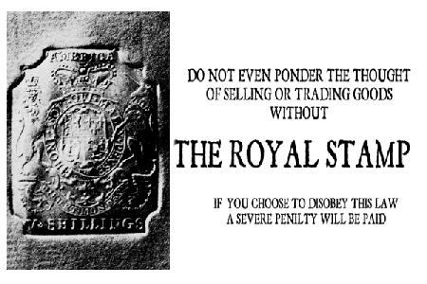
The Stamp Act Congress

Slide 49
Where this leaves things
In a bad way

Slide 50
Tyranny vs. Freedom
Big question is who has the power to tax?
Whig ideology states that property is the bulwark of freedom and taxation is a threat to property
Only local taxation is appropriate since it is responsive and controllable
Parliament believes emphatically that it has the power to tax as it sees fit

Slide 51
Whig Ideology Expressed
Stamp Act reduced people to a form of slavery
Violent protests erupted
Town meetings were held to establish “rights as Englishmen”
Colonial leaders began to analyze the colonies’ role in the empire
Determined that Parliament’s rights over the colonies was limited
Parliament had no power to tax the colonies
Taxation without representation was tyrannical

Slide 52
Now comes the Road to Revolution!

Slide 53
Bibliography
Ferling, John. A Leap in the Dark: The Struggle to Create the American Republic. New York: Oxford University Press, 2003.
Martin, James. A Respectable Army: The Military Origins of the Republic. Wheeling: Harlan Davidson, 2006.
Anderson, Fred. The Crucible of War: The Seven Years War and the Fate of the British Empire in North America. New York: Vintage Books, 2000.
Bailyn, Bernard. The Ideological Origins of the American Revolution. Cambridge: Harvard University Press, 1967.
Grenier, John. The First Way of War: American War Making on the Frontier. New York: Cambridge University Press, 2005.

