Slide 1
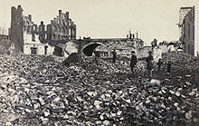
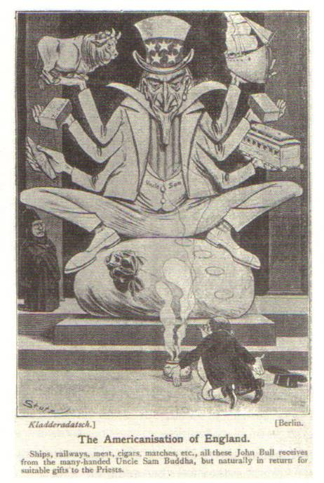
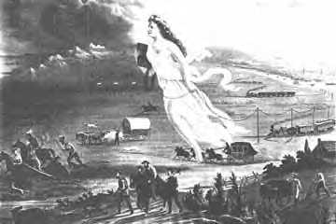
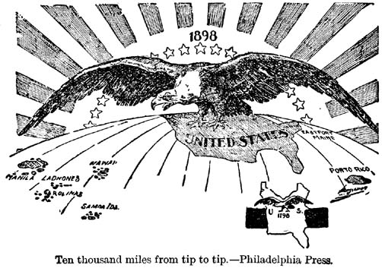
American Institute for History Education
June 21-22, 2012
Paul C. Rosier, Ph.D.
Associate Professor of History
Villanova University
Pedagogy: Product, Process, and Passion
Intersectional/Analytical Lenses of
Race, Class, Ethnicity, and Gender
America in the World
Transnational, International, Internationalist
Reconstruction America
Frontier Expansion/Imperialism
The Incorporation of the West
Gender Relations in the North and South
Apartheid and Economy in the South
Capital-Labor relations in the North

Slide 2
Courses Taught
Native American History
American Environmental History
Global Environmental History
American Women’s History
History of American Capitalism
History of American Sports
U.S. Since 1865 (grad/undergrad)
The American West (grad)
Themes in Modern World History

Slide 3
8.1. Historical Analysis and Skills Development
8.1.3. GRADE 3 | 8.1.6. GRADE 6 | 8.1.9. GRADE 9 | 8.1.12. GRADE 12
Pennsylvania’s public schools shall teach, challenge and support every student to realize his or her maximum potential and to acquire the knowledge and skills needed to . . .
A. Understand chronological thinking and distinguish between past, present and future time. • Calendar time • Time lines • Continuity and change • Events (time and place) | A. Understand chronological thinking and distinguish between past, present and future time. • Calendar time • Time lines • People and events in time • Patterns of continuity and change • Sequential order • Context for events | A. Analyze chronological thinking. • Difference between past, present and future • Sequential order of historical narrative • Data presented in time lines • Continuity and change • Context for events | A. Evaluate chronological thinking. • Sequential order of historical narrative • Continuity and change • Context for events knowledge and skills needed to . . .
B. Develop an understanding of historical sources. • Data in historical maps • Visual data from maps and tables • Mathematical data from graphs and tables • Author or historical source | B. Explain and analyze historical sources. • Literal meaning of a historical passage • Data in historical and contemporary maps, graphs and tables • Author or historical source • Multiple historical perspectives • Visual evidence • Mathematical data from graphs and tables | B. Analyze and interpret historical sources. • Literal meaning of historical passages • Data in historical and contemporary maps, graphs, and tables • Different historical perspectives • Data from maps, graphs and tables • Visual data presented in historical evidence | B. Synthesize and evaluate historical sources. • Literal meaning of historical passages • Data in historical and contemporary maps, graphs and tables • Different historical perspectives • Data presented in maps, graphs and tables • Visual data presented in historical evidence

Slide 4
8.1. Historical Analysis and Skills Development
8.1.3. GRADE 3 | 8.1.6. GRADE 6 | 8.1.9. GRADE 9 | 8.1.12. GRADE 12
Pennsylvania’s public schools shall teach, challenge and support every student to realize his or her maximum potential and to acquire the knowledge and skills needed to . . .
C. Understand fundamentals of historical interpretation. • Difference between fact and opinion • The existence of multiple points of view • Illustrations in historical stories • Causes and results | C. Explain the fundamentals of historical interpretation. • Difference between fact and opinion • Multiple points of view • Illustrations in historical stories • Causes and results • Author or source of historical narratives | C. Analyze the fundamentals of historical interpretation. • Fact versus opinion • Reasons/causes for multiple points of view • Illustrations in historical documents and stories • Causes and results • Author or source used to develop historical narratives • Central issue | C. Evaluate historical interpretation of events. • Impact of opinions on the perception of facts • Issues and problems in the past • Multiple points of view • Illustrations in historical stories and sources • Connections between causes and results • Author or source of historical narratives’ points of view • Central issue
D. Understand historical research. • Event (time and place) • Facts, folklore and fiction • Formation of historical question • Primary sources • Secondary sources • Conclusions (e.g., storytelling, role playing, diorama) | D. Describe and explain historical research. • Historical events (time and place) • Facts, folklore and fiction • Historical questions • Primary sources • Secondary sources • Conclusions (e.g., simulations, group projects, skits and plays) | D. Analyze and interpret historical research. • Historical event (time and place) • Facts, folklore and fiction • Historical questions • Primary sources • Secondary sources • Conclusions (e.g., History Day projects, mock trials, speeches) • Credibility of evidence | D. Synthesize historical research. • Historical event (time and place) • Facts, folklore and fiction • Historical questions • Primary sources • Secondary sources • Conclusions (e.g., Senior Projects, research papers, debates) • Credibility of evidence Pennsylvania History, 8.3. United States History and 8.4. World History.

Slide 5
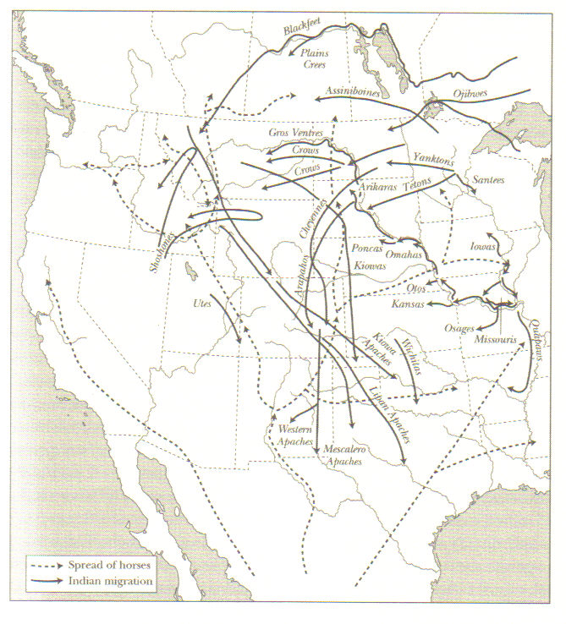
Construction of the American West and Nation
With a brief review of the Pre-Civil War Era (including Removal era)

Slide 6
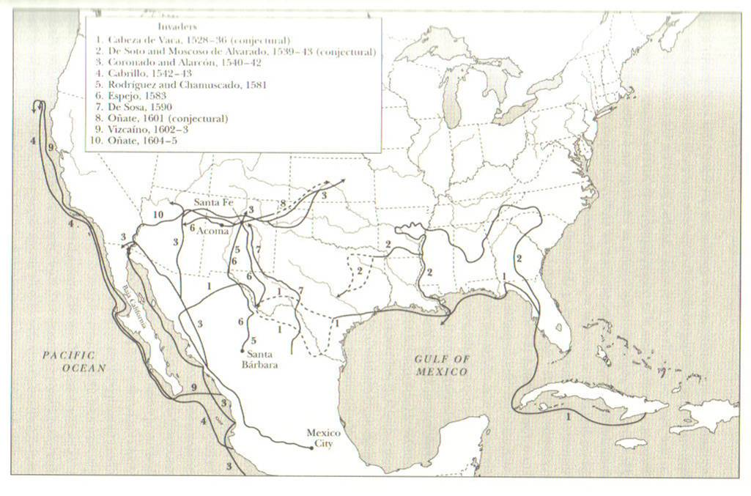
Early Western Frontiers

Slide 7
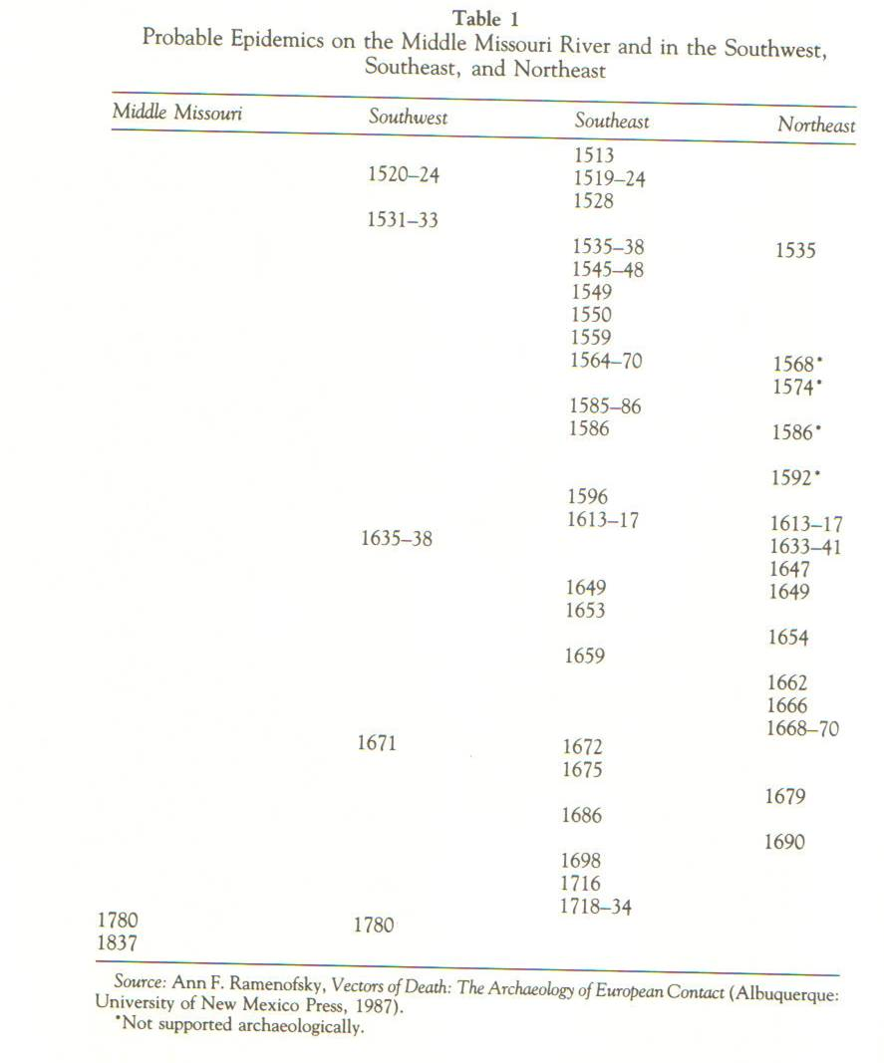

Slide 8
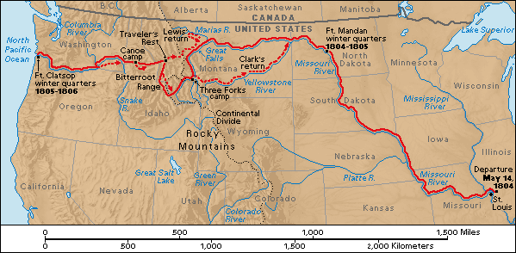

Slide 9
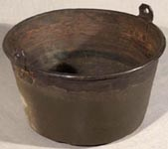
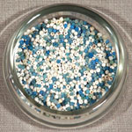
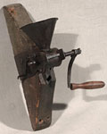
Jefferson’s Civilization Program and Real Estate Acquisition Program

Slide 10
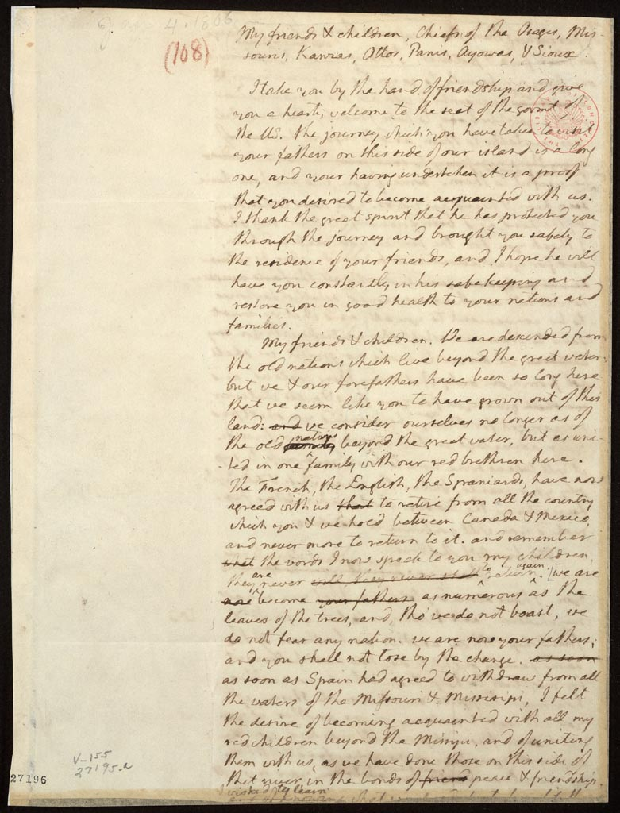
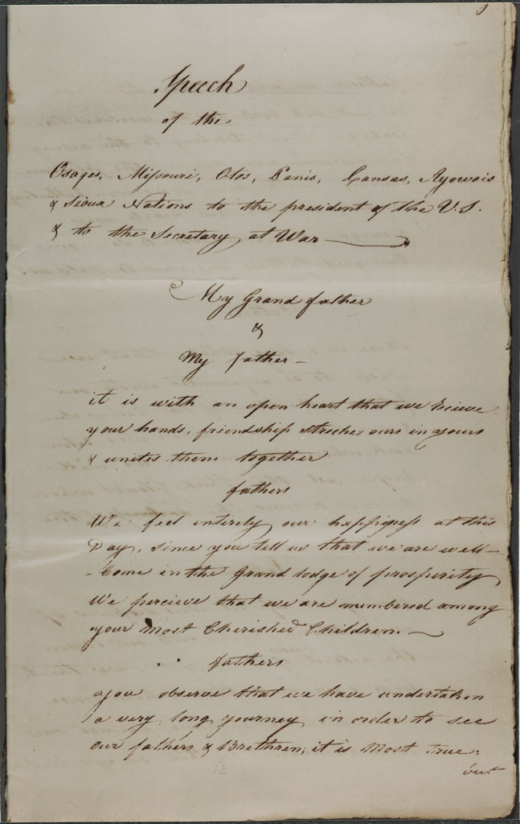
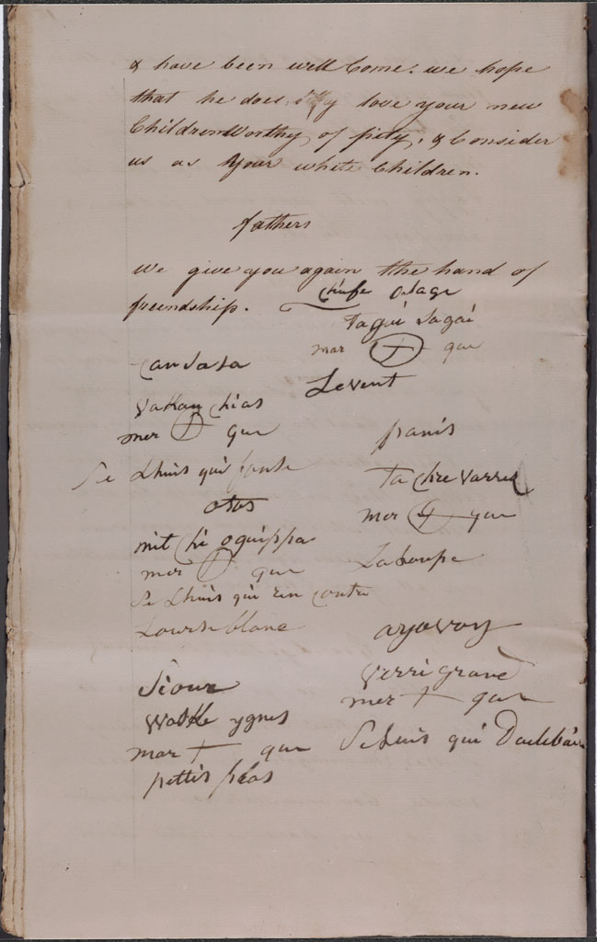
Jefferson and Chiefs, 1806
Jefferson: “We Are Now Your fathers; and you shall not lose by the change…..My children, we are strong, we are numerous as the stars in the heavens & we are all gunmen…..”
Chiefs: “We wish to live like you & to be Men like you; we hope you will protect us from the wicked, you will punish them who wont hear your word.”

Slide 11
“Act of May 25, 1824” to make “treaties of trade and friendship with Indian tribes beyond the Mississippi”
Treaty example: Crow, 1825
“It is admitted by the Crow tribe of Indians, that they reside within the territorial limits of the United States, acknowledge their supremacy, and claim their protection.—The said tribe also admit the right of the United States to regulate all trade and intercourse with them… The United States agree to receive the Crow tribe of Indians into their friendship, and under their protection, and to extend to them, from time to time, such benefits and acts of kindness as may be convenient, and seem just and proper to the President of the United States.”

Slide 12
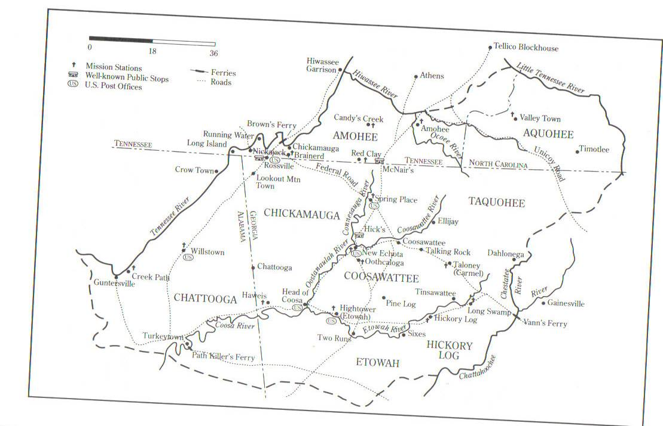

Slide 17
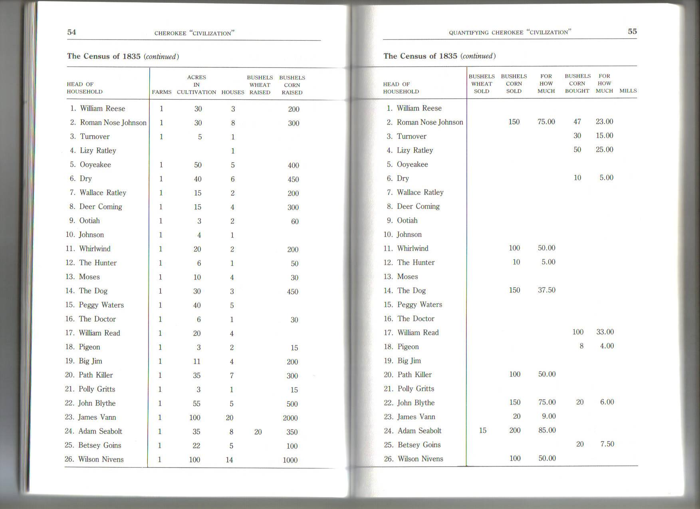

Slide 18
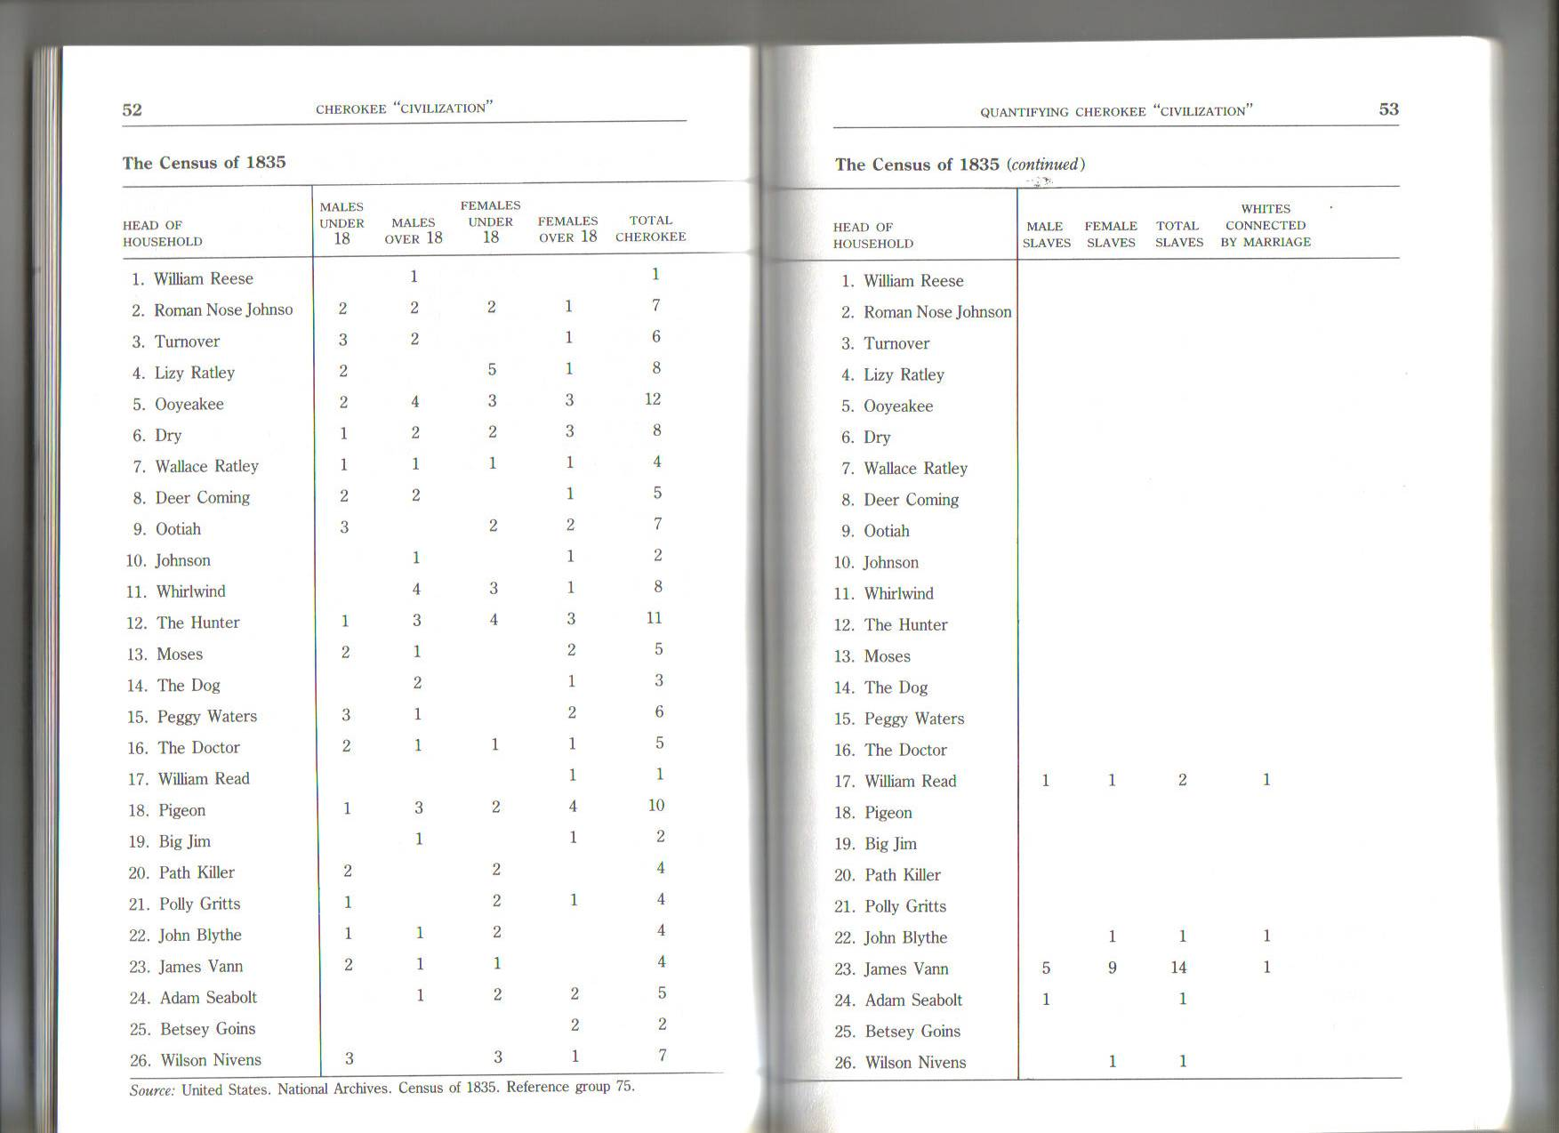

Slide 19
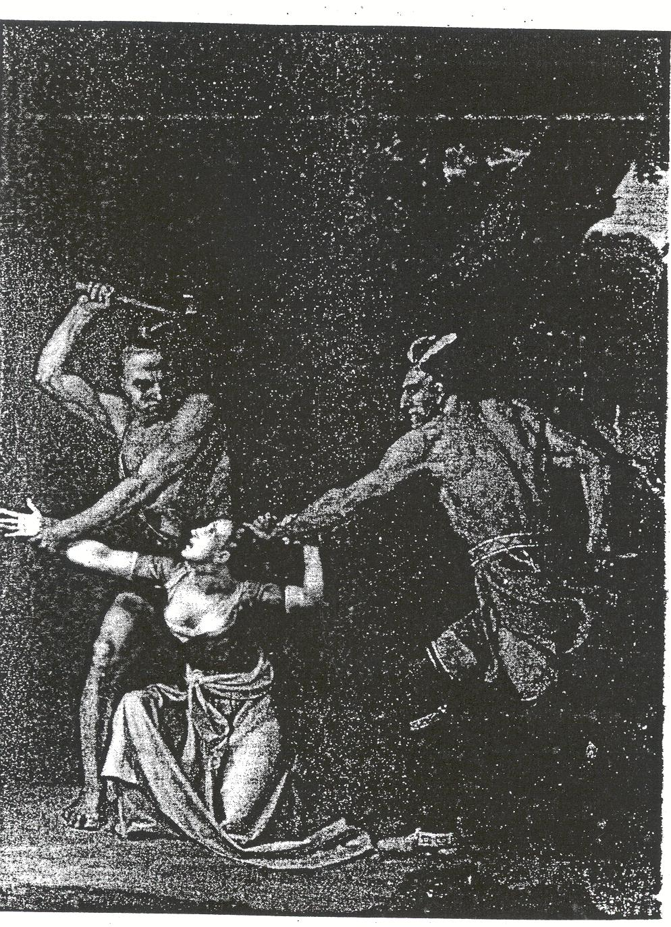
“the merciless Indian Savages, whose known rule of warfare, is an undistinguished destruction of all ages, sexes and conditions.”
Declaration of Independence
Andrew Jackson: “What good man would prefer a country covered with forests and ranged by a few thousand savages to our extensive Republic, studded with cities, towns, and prosperous farms, embellished with all the improvements which art can devise or industry execute, occupied by more than 12,000,000 happy people, and filled with all the blessings of liberty, civilization, and religion?” 1830

Slide 20
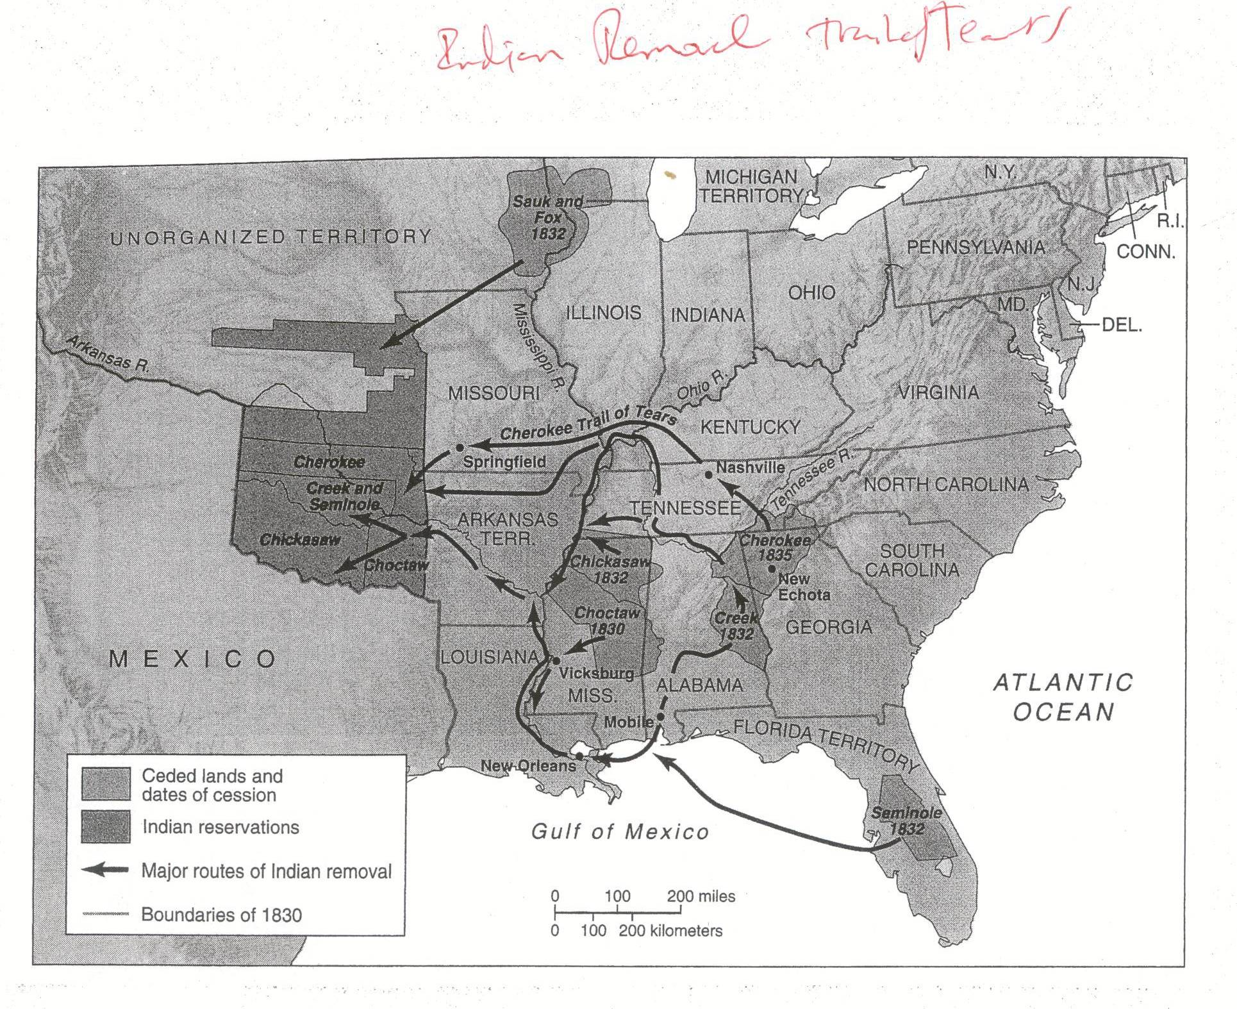
Notes:
Cherokee girl and Choctaw boy – both removed

Slide 21
Persico, “Discovery of America” 1837/1844

Slide 22
Greenough, “The Rescue,” 1837/1853

Slide 23
James Buchanan’s Inauguration, 1857

Slide 24
Thomas Crawford, The Indian: Dying Chief Contemplating the Progress of Civilization” 1856.
Notes:
Thomas Crawford, The Indian: Dying Chief Contemplating the Progress of Civilization” 1856.

Slide 25
Narratives in National Architecture Thomas Crawford, Progress of Civilization, 1855-1863
Notes:
Thomas Crawford’s Progress of Civilization, 1855-1863. Note far right.
See p. 116.

Slide 26
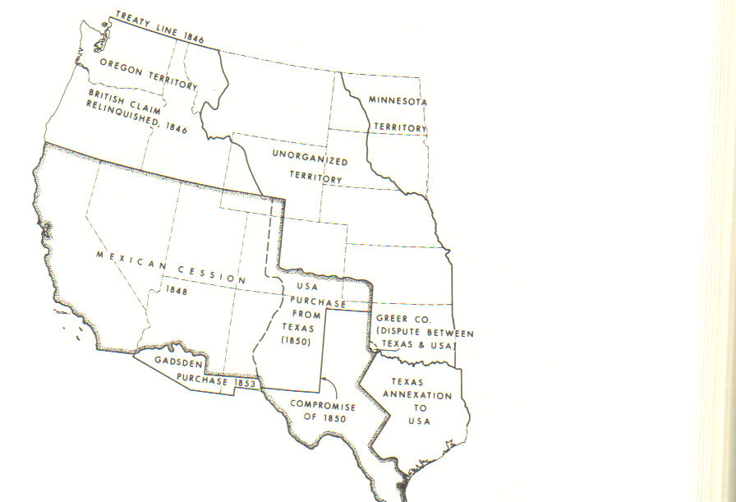
Manifest Destiny revisited, 1840s

Slide 27
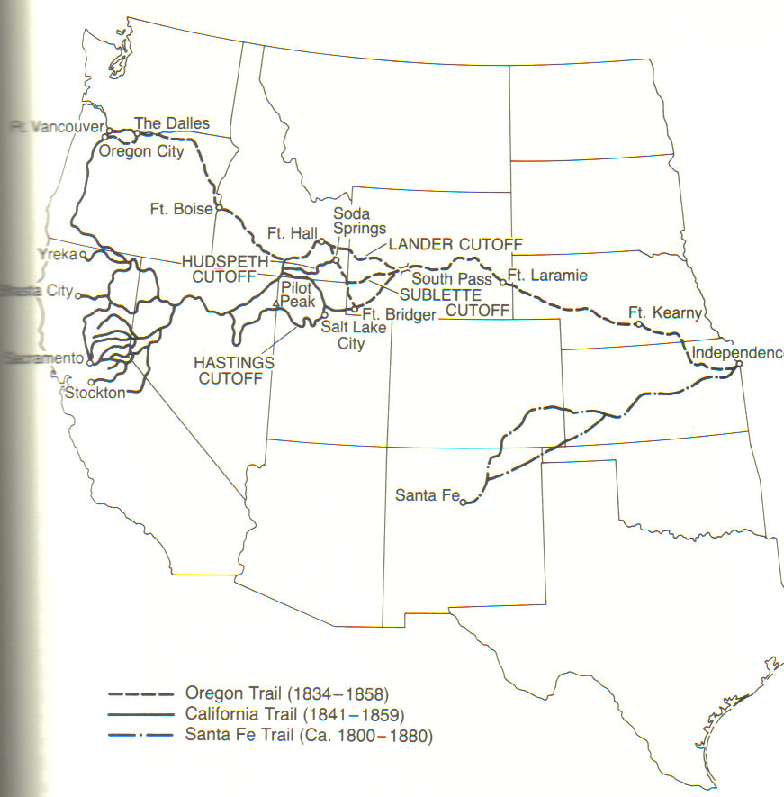
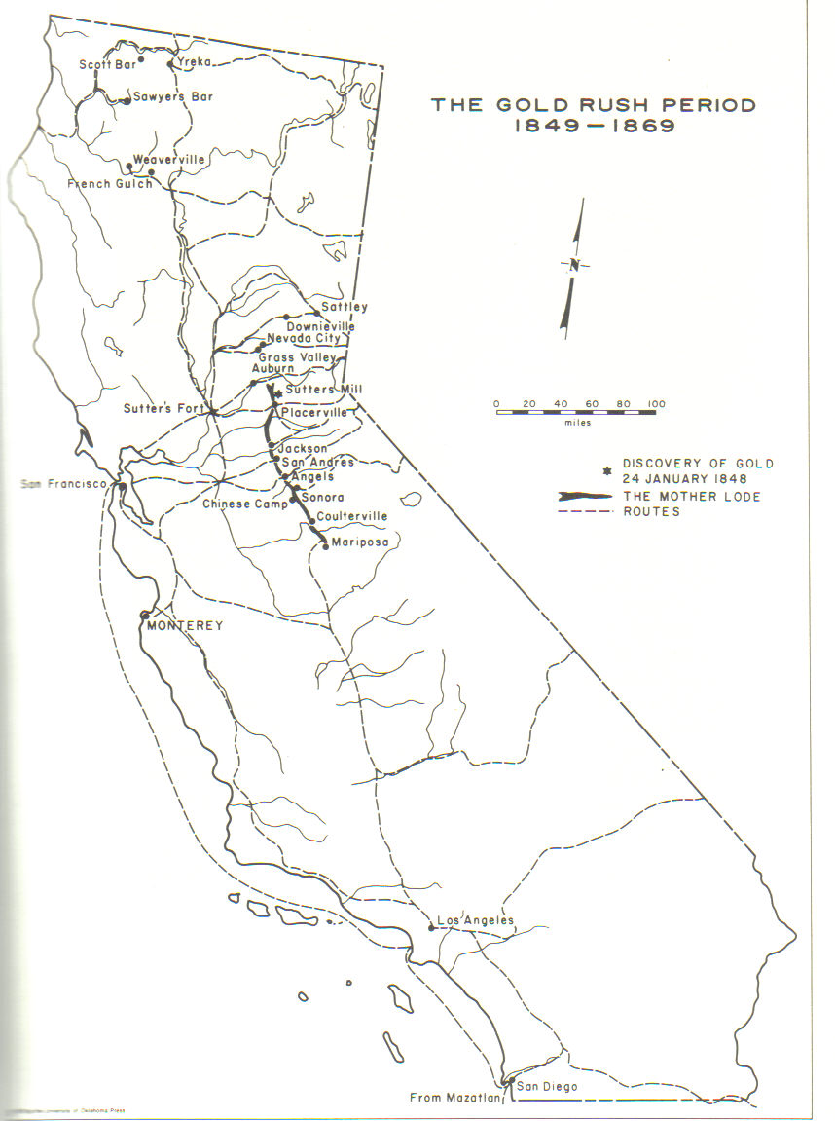
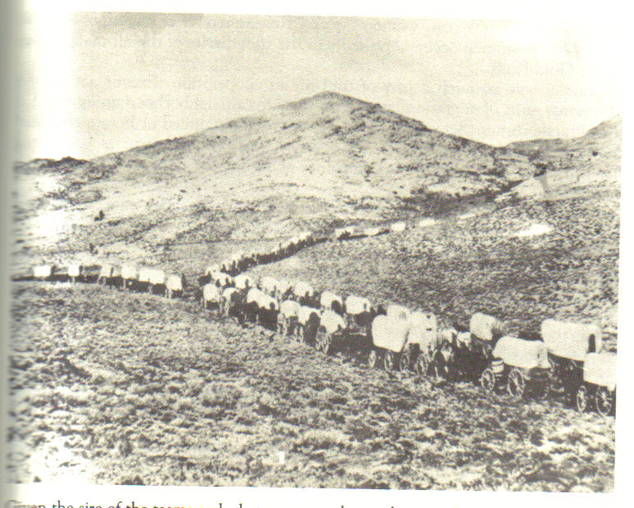
Luke Lea, 1851
“Concentration, domestication, incorporation”

Slide 28
California Frontier – Look Eastward?
Two Recent Books:
American Genocide: The California Indian Catastrophe 1846-1873
California Genocide
Genocide? Ethnic Cleansing?
Sacramento River Massacre April 1846 --150-800 Wintu/Yana men, women, and children John Fremont (operating in Mexican territory) Kit Carson: “It was a perfect butchery.”
California Economy pre and post Gold Rush
Dependent up on Indian serfs, slaves (including sex slaves), and domestics. Indians “tilled our soil, sheared our sheep, cut our lumber, built our houses, paddled our boats, took care of our children, made our meals…” Owner of 30k acre estate. Indians also fought in battles against Mexico.
Sutter’s Mill: Sutter – “It was common in those days to seize Indian women and children and sell them.”
After the Gold Rush
“a war of extermination against the Aborigines.” A common refrain.
The dynamics of Indians and Gold Mining. 2 owners of Big Valley Ranch killed for rape/abuse/torture (“they murdered the Indians without limits or mercy”; 4 died from “sever whipping.”
--Bloody Island Massacre, May 15, 1850 – 120-800 Pomo men, women and children
--Cokadjal Massacre, May 19, 1850 75-150 Cokadjal killed (“the soldiers boasted that the tribe was exterminated.”
Results: General Persifor Smith, by way of Philadelphia and Princeton (awarded 1856 command of the Department of the West; Brigadier General); Captain Nathaniel Lyon (Ft. Lyon)
1850s-1860s
“killing them like Coyotes”
Supported by congressional appropriations to pay for militias. Attack on feudal system of pre-Gold Rush California. Attack on Indian gold miners.
Lynchings, burnings, removals.
“We must kill them, big and little, as nits will be lice.” Sept. 1864.
Domesticated Indians: Eliza: “Don’t kill me; when you were here I cooked for you, I washed for you; I was kind to you.” 11 bullets in Eliza’s chest and head.
100+ men, women, and children killed
Round Valley/Humboldt Bay/Horse Canyon/Bridge Gulch

Slide 29
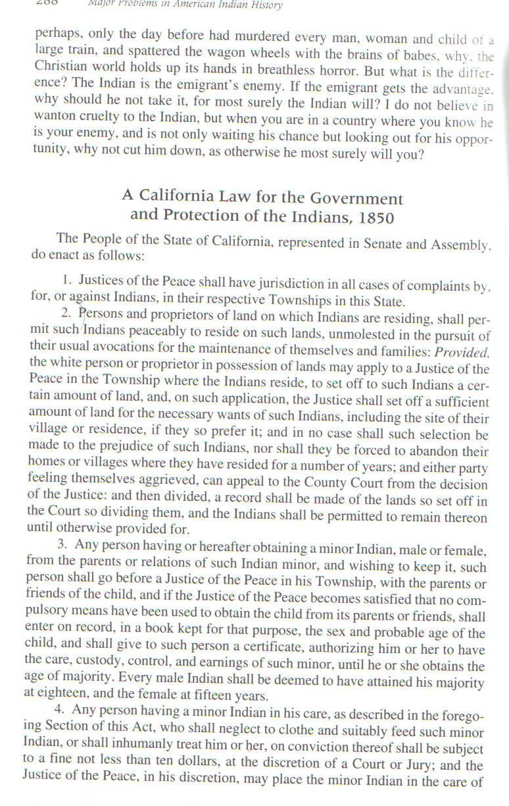

Slide 30
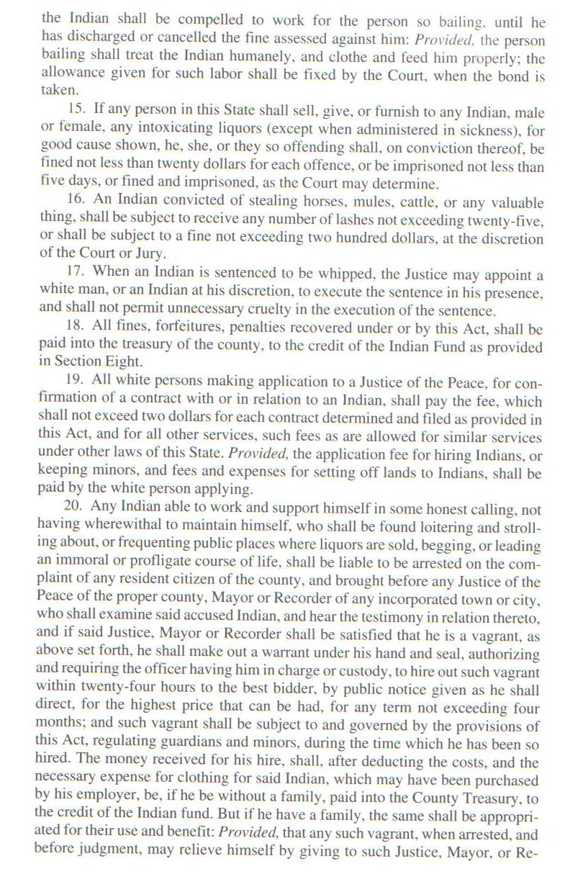

Slide 31
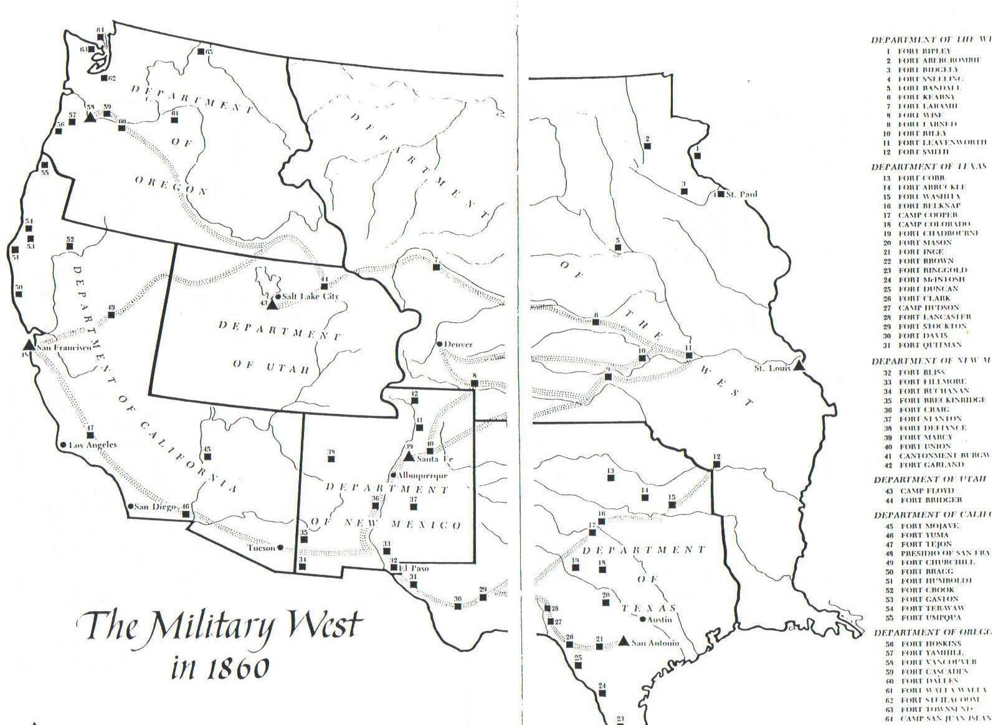
Commissioner Luke Lea, 1851 – “the final solution to the Indian problem”
“concentration,” “domestication,” “incorporation”
Between 1840 and 1860, 362 white settlers/emigrants
were killed in the West

Slide 32
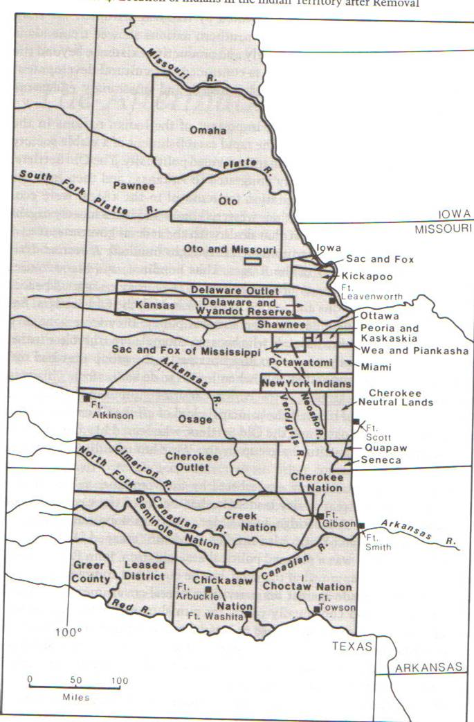
Indian Country during the Civil War
Ongoing battles over territory: concentration of Indians onto reservations.
American Indian nations in post-removal Indian Territory have to decide whether to support the Confederacy or the Union.

Slide 33
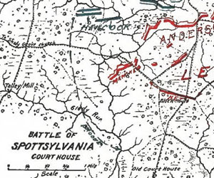
“One of the most unknown aspects of the Civil War,” according to historian Arnold Schofield, “is the participation of American Indians as soldiers in the Union and Confederate armies.” 28,693 Native Americans served in the Union and Confederate armies, participating in battles such as Second Manassas, Spotsylvania, and Antietam.
Ojibwe Warriors Join the Battle of Spotsylvania
On May 9, 1864, Ojibwe Indians from the 7th Wisconsin Infantry help Colonel Rufus Dawes and his regiment, the 6th Wisconsin Infantry, drive back enemy skirmishers with American Indian war tactics in Spotsylvania, Virginia.

Slide 34
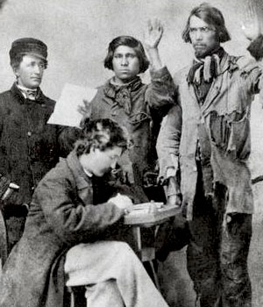
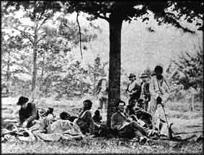
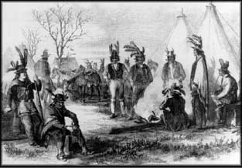
Why would American Indians serve in the Union Army? Or in the Confederate Army?

Slide 35
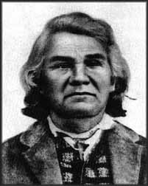
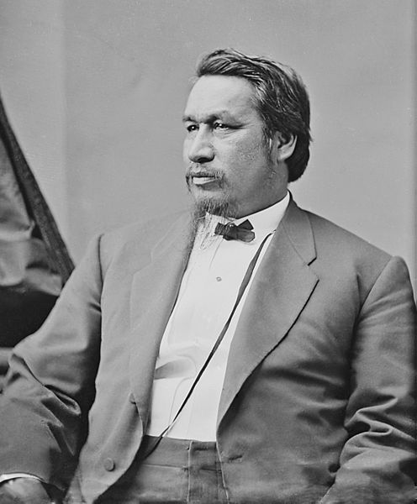
Indian Territory and the Civil War
Eli Parker (Seneca), one of two Native Americans who served as Brigadier General (Union). Parker wrote the peace terms between the Union and the Confederacy; and he later became the first Native American Commissioner of Indian Affairs.
Stand Watie (Cherokee) was the other. He was the last Confederate General to surrender.

Slide 36
Outcomes and Legacies
Those who served the Confederacy paid a stiff price – especially the Cherokee.
Cherokee, Choctaw, and Chickasaw “freedmen.”
Ongoing battle over “citizenship.”

Slide 37
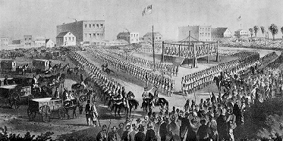
Treaties and their Provisions: Ration Day – Dependency, Despair and Desperation Minnesota – “Great Sioux Uprising”, 1862

Slide 39
Massacres and Battles

Slide 40
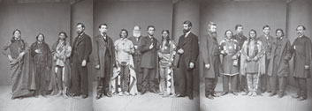
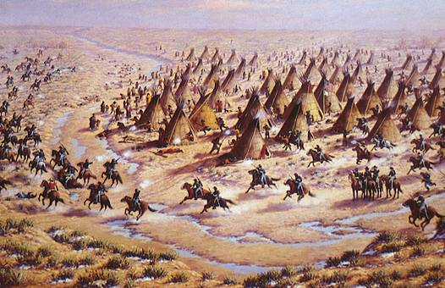
Key Treaties/Key Battles
The Treaty of Medicine Lodge, 1867 (docs)
Ft. Laramie Treaty, 1868
Ute Delegation to Washington, DC 1868
Little Big Horn/Battle of Greasy Grass, 1876
Centennial Celebration

Slide 41
Concentration:"We are not going to let a few thieving, ragged Indians check and stop the progress of the railroads.... I regard the railroad as the most important element now in progress to facilitate the military interests of our Frontier…. All Indians who are not on reservations are hostile and will remain so until killed off.“ -- General William T. Sherman
“Across the Continent: Westward the Course of Empire Takes it Way”, Currier and Ives, 1869

Slide 42
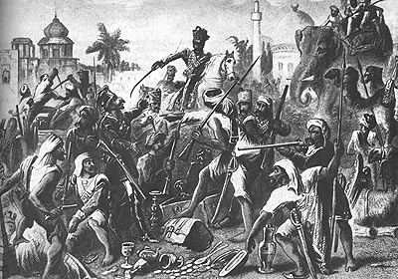
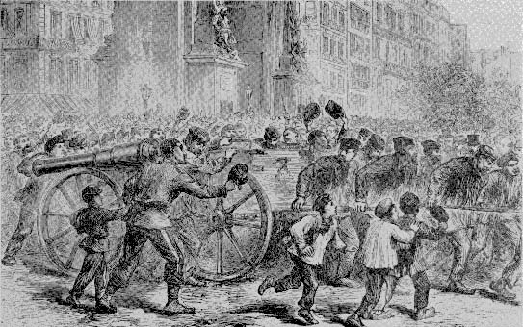
The Paris Commune (1871) in Native America? Indian reds as communists. Tribalism as Communism
Keeping in Mind International Linkages
The Sepoy Rebellion (1857)
Indian-Afghan War
British “civilizing mission”

Slide 43
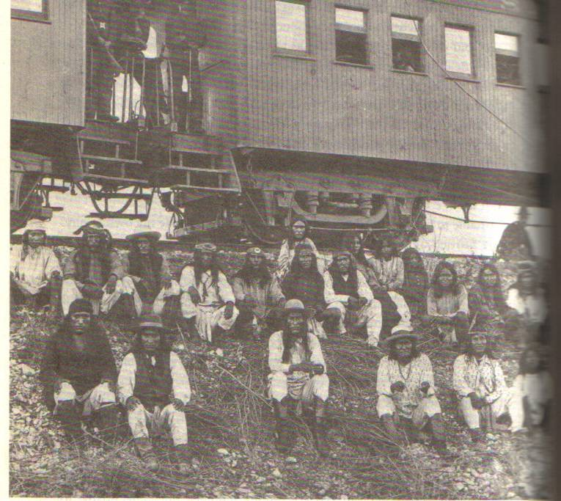
Geronimo and Apache prisoners on their way to Florida prison, 1886
Osama Bin Laden as “Geronimo,” 2011
Notes:
Geronimo and Apache prisoners in 1886. Near their prison train going to Florida.

Slide 44
Remaking the Frontier/The American Nation: New Species – human, flora, fauna
General Philip T. Sheridan -- Commander of the Armies of the West
"These men (the buffalo hunters) have done more to settle the vexed Indian question than the entire regular army has done in the last thirty years…. let them kill, skin and sell until the buffalo are exterminated. Then your prairies can be covered with speckled cattle and the festive cowboy who follows the hunter as the second forerunner of an advanced civilization."
“The only good Indian is dead.”

Slide 45
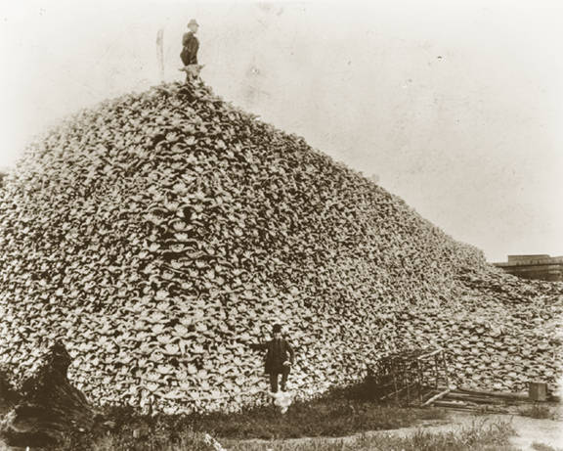
Transforming the West Buffalo and Cattle
North American Bison – 27 million to 75 million
“The country was one robe.”
Threats to Bison – wolves (1 million in early 19th century); Native Americans; white hunters, U.S. Army
Commodities – “tribal department store,” robes, leather for industry, bones for fertilizer
Virtually extinct by 1882

Slide 46
Further pest control – prairie dogs

Slide 47
THEMES American Cattle: cattle-capital (“stock of life”) Investment syndicates – Britain, Europe (“America for Americans”) Public Domain; Free Range; Free grass Simultaneous growth of Cattle industry – 90k to 500k in Wyoming from 1874-1880; 5 million by 1884 in West. Technologies: Barbed wire, 1873 Refrigeration, 1875
Remaking the Frontier
Climate vs. Capital/Cattle
1884-1885 90% death rates
1886 below-zero in Austin TX
‘walking 400 miles on carcasses’

Slide 48
Avenging Custer: Wounded Knee, Dec.1890

Slide 49
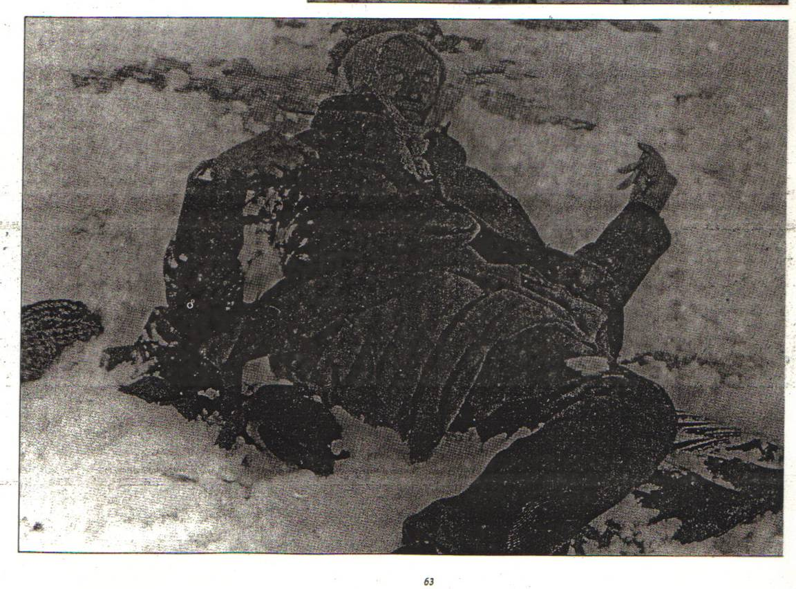
Commodifying Death: Mass Graves and Mass Production: “there are a number of beauties among them, and are just the thing to send to your friends back east.”

Slide 51
Change or Continuity in the Philippines, 1900

Slide 52
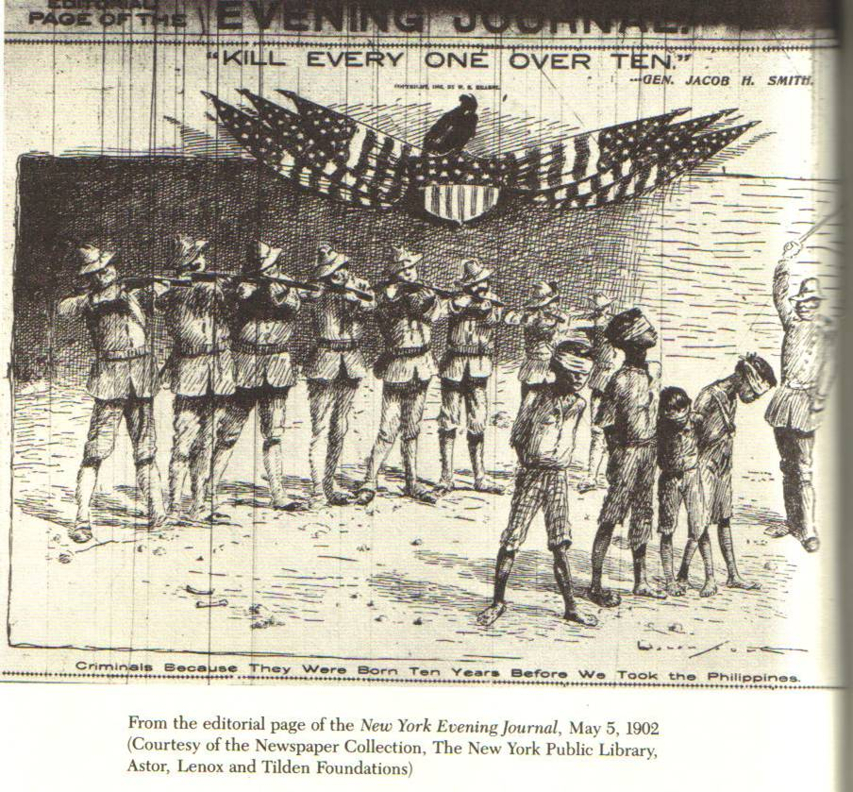

Slide 53
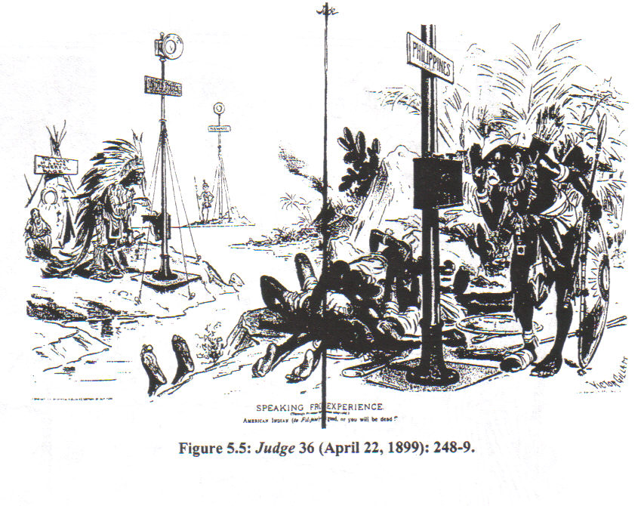
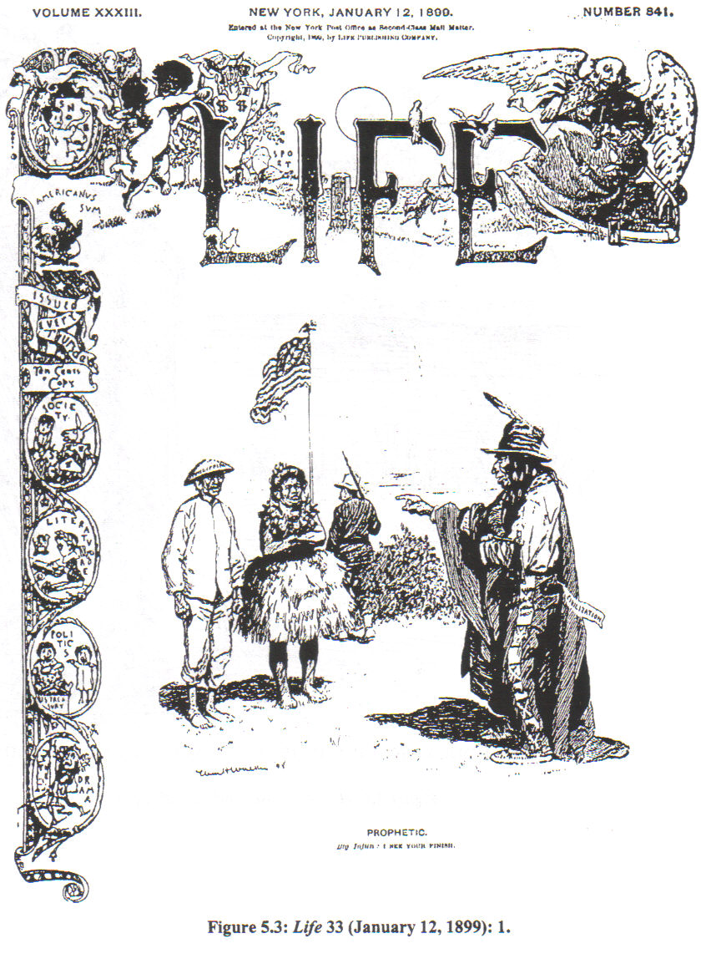
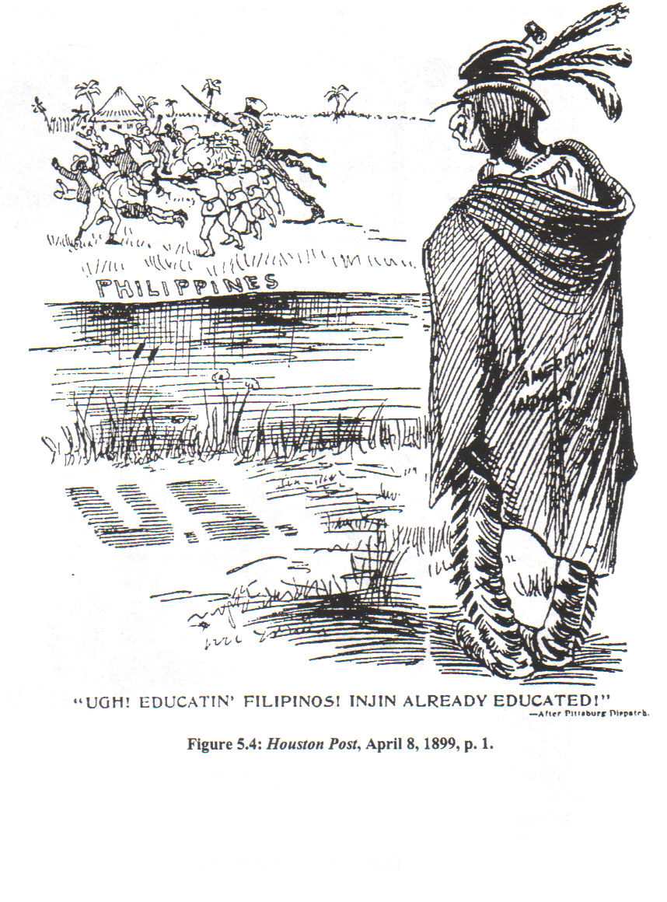

Slide 54
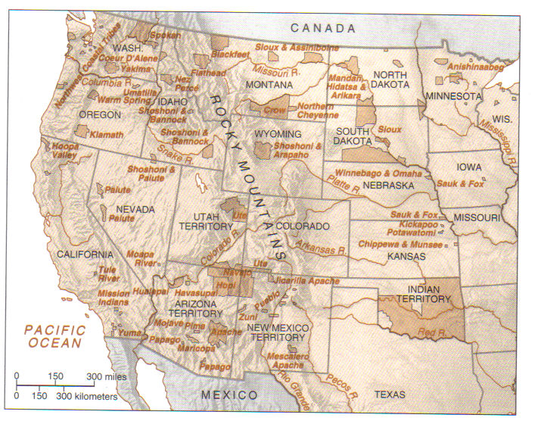
Phase 1 Concentration Complete
Notes:
1880

Slide 55
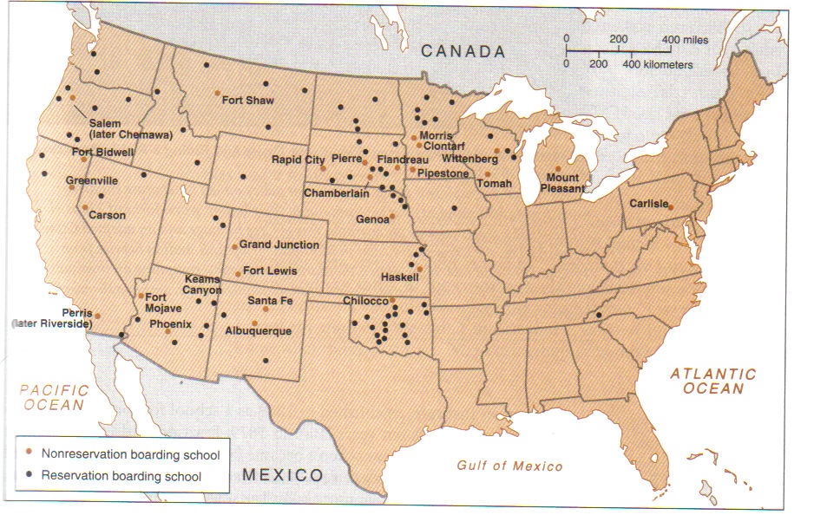
Phase 2: Domestication: Civilization Program
Education, Allotment, Yeoman Farmer Model
Intersections with British and European Civilizing Mission in Africa, Asia, and Australia

Slide 56
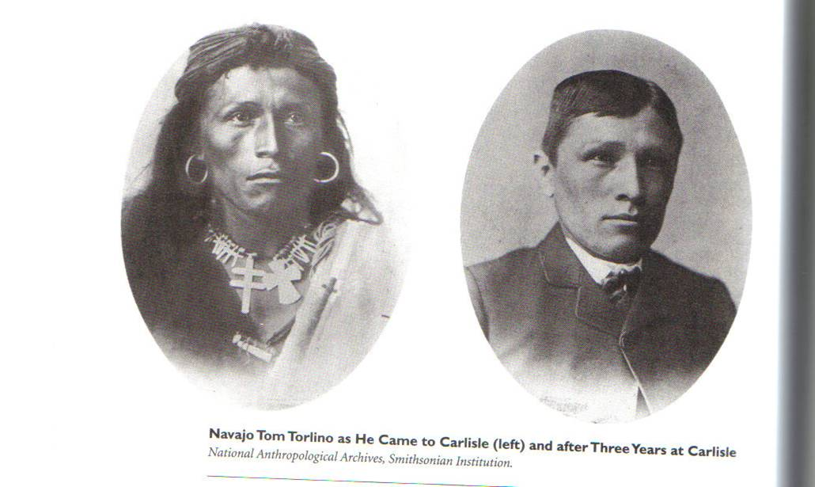
The Makeover

Slide 57
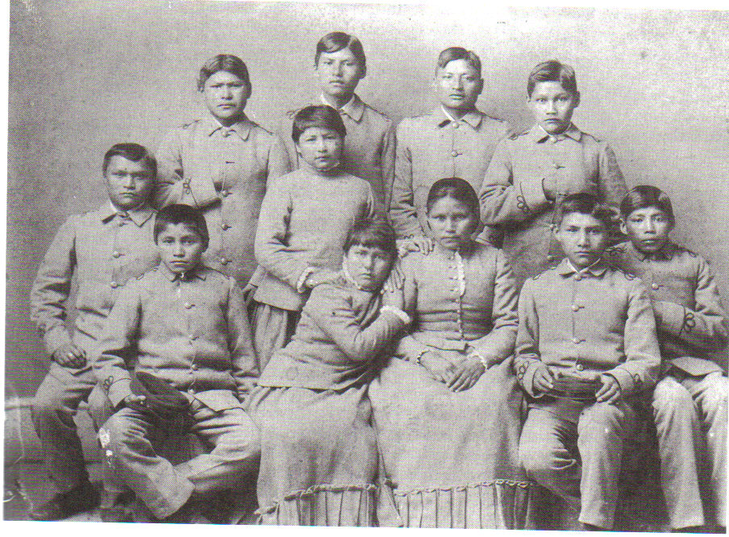
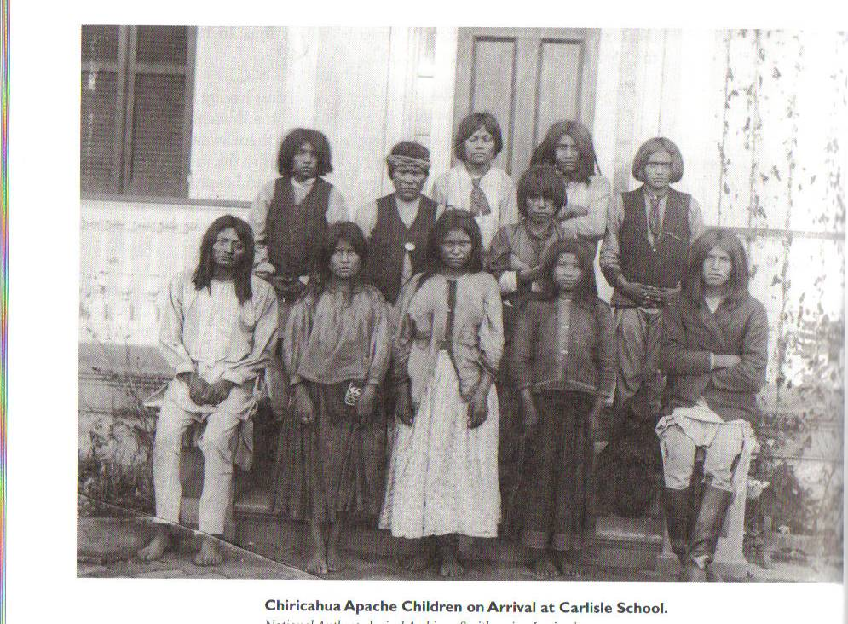
Chiricahua Apache Before Photo

Slide 58
Settlement in the West
Homestead Act 1862
160 acres
Railroad lands
Desert Land Act 1877
640 acres @ $1.25; irrigable
John Wesley Powell, Report on the Arid Lands of the United States, 1878
Allotment Act of 1887
Reclamation Act of 1902
1880 1 million acres of irrigable land in the West
1890 3.36 million acres
1919 19 million acres

Slide 59
Allotment Essentials
General Allotment Act 1887 (Dawes Severalty Act)
Law of Congress 1891/1894
Lone Wolf v. Hitchcock, 1903

Slide 60
Notes:
1893 Settlers racing to stake a claim on former Cherokee lands

Slide 62
Albert Bierstadt and the West

Slide 63
Surveying Yellowstone in 1871

Slide 64
Conserving America
Scientific Forestry (Gifford Pinchot)
“the use of natural resources for the greatest good of the greatest number for the longest time.” TR
TR: 5 new national parks, 16 national monuments, 53 wildlife reserves. Public Lands Commission.

Slide 65
America The Beautiful (written 1895, originally “Pike’s Peak”) by Katharine Lee Bates O beautiful for spacious skies, For amber waves of grain, For purple mountain majesties Above the fruited plain! America! America! God shed his grace on thee And crown thy good with brotherhood From sea to shining sea! O beautiful for pilgrim feet Whose stern impassioned stress A thoroughfare for freedom beat Across the wilderness! America! America! God mend thine every flaw, Confirm thy soul in self-control, Thy liberty in law! O beautiful for heroes proved In liberating strife. Who more than self the country loved And mercy more than life! America! America! May God thy gold refine Till all success be nobleness And every gain divine! O beautiful for patriot dream That sees beyond the years Thine alabaster cities gleam Undimmed by human tears! America! America! God shed his grace on thee And crown thy good with brotherhood From sea to shining sea! O beautiful for halcyon skies, For amber waves of grain, For purple mountain majesties Above the enameled plain! America! America! God shed his grace on thee Till souls wax fair as earth and air And music-hearted sea! O beautiful for pilgrims feet, Whose stem impassioned stress A thoroughfare for freedom beat Across the wilderness! America! America! God shed his grace on thee Till paths be wrought through wilds of thought By pilgrim foot and knee! O beautiful for glory-tale Of liberating strife When once and twice, for man's avail Men lavished precious life! America! America! God shed his grace on thee Till selfish gain no longer stain The banner of the free! O beautiful for patriot dream That sees beyond the years Thine alabaster cities gleam Undimmed by human tears! America! America! God shed his grace on thee Till nobler men keep once again Thy whiter jubilee!

Slide 66
Questions

Slide 67
Notes:
NOTE THE CONTRAST WITH THE LOWER LEFT MAP

Slide 68
New Frontiers

Slide 69
It is claimed by many observers that a two-horse wagon has never gone where the Bible did not go first. It is certainly a significant fact that international commerce has everywhere followed in the wake of the gospel. The intrepid missionary invaded the wilds of China, India, Madagascar and the islands of the southern sea long before the trading ships of the merchants dared to enter their ports. Everywhere the foul and ravenous beasts of tyranny, ignorance and superstition have retired at the introduction of the glorious light of the cross. Christianity has blazed the pathway and civilization has followed. Now the rainbow arch of the gospel spans the continents and seas, from Greenland's icy mountains to India's coral strands, and we seem to hear the glad should of ten million ransomed souls who sing with the ancient Psalmist, "The entrance of thy word giveth Eight."
The people that walked in darkness have seen a great light; they that dwell in the land of the shadow of death, upon them hath the light shined. Isaiah 4:2
Scanned from Fifty Great Cartoons (Chicago: The Ram's Horn Press, 1899) unpaginated This cartoon is part of the collections of the The Cartoon Research Library of Ohio State University.

Slide 70
Notes:
Rosebud

Slide 74
waterboarding

