Slide 1
The Lesson Plan Process
The BLaST IU17 Liberty Fellowship
September 21. 2012

Slide 2
What is the purpose of the lesson plan?
The lesson plan:
Provides a format for teachers to demonstrate the integration of the content and strategies into their classroom practice (application objective).
Provides classroom resources for non-participating teachers to access the content and resources of the grant (dissemination and replication objective).
Fulfils the requirements for graduate credit from either Ashland (education) or Southern Oregon (history).

Slide 3
What are the steps in lesson plan process?
Teachers work in teams of two to select a content focus from the timeframe for the year.
Using the CICERO website and other research materials, teams write an historical narrative or background essay on the selected time period.

Slide 4
Teams develop a grade level appropriate lesson plan that focuses on an aspect of the content.
Teams submit the lesson plan to the Project Director for review.
Each member of the team teaches the lesson.

Slide 5
Teams review and discuss the lesson.
Teams complete the lesson reflection form.
Teams review and discuss the feedback and make adjustments to the lesson.
Teams share their research and lesson with their colleagues on the school or district level.

Slide 6
Teams share their experience with their colleagues at the next TAH colloquium for feedback.
Teams make revisions to the narrative and lesson using the templates on their grant website and publish the lesson on that website.
The following year teams revisit the lesson and make additional refinements.

Slide 7
What is the lesson format?
All lesson plans should include the following components:
An Essential Question
The Pennsylvania State Standards addressed in the lesson
Lesson Objectives
Vocabulary/ Key Terms
Historical Background
Procedures and Activities
Strategies for Differentiation
Assessment (Formative and Summative)
Materials and Resources

Slide 8
What is the Historical Content Narrative?
The historical content narrative or background essay reflects your research on the content focus of your choice.
The narrative or essay provides the context for your lesson and the background for colleagues who might use the lesson in their classrooms.
The research should reflect multiple sources and different interpretations of the historical period.

Slide 9
This background is essential so that teachers
have a clear and detailed understanding of the topic
can teach it effectively, and
respond to student questions.
The narrative or essay must include the Binary Paideia for the time period.

Slide 10
What are the steps in developing the lesson plan?
“Begin with the end in mind” or the Understanding by Design model
Identify desired results (the objectives)
Determine acceptable evidence (the assessment)
Plan learning experiences and instruction (the activities)

Slide 11
Identify the lesson objectives
Develop the objectives or outcomes for the lesson.
Ask: What will students know (the content) and be able to do (the skills) as a result of this lesson?
Objectives should be measurable or observable and reflect both content and skill.
For example, it’s hard to assess whether students “appreciate” something, but you can assess how well a student can explain, describe, etc.
Objectives are not a description of the methods and activities that will be used in the lesson.

Slide 12
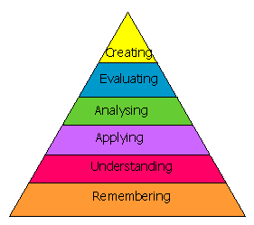
Bloom’s Taxonomy
Content and skill acquisition objectives should utilize the language of one or more of the six levels of Bloom’s Taxonomy.

Slide 13
Remembering (define, describe, identify)
Understanding (discuss, explain, interpret)
Applying (demonstrate, determine, chart)
Analyzing (analyze, compare/contrast, differentiate)
Evaluating (defend, interpret, argue)
Creating (synthesize, organize, create)

Slide 14
Determine the Assessment
Assessment is connected to the objectives of the lesson.
The objectives are what students will know and be able to do, the assessment is how they will show or demonstrate what they know and are able to do.
Planning the assessment after the objectives and before the activities:
creates a direct connection between the lesson objectives and how they will be assessed.
helps to identify the activities that will support students in meeting the lesson objectives.
keeps the lesson focused.

Slide 15
Plan the Activities
The activities should:
move students toward meeting the lesson objectives.
scaffold or build upon each other.
be differentiated to meet the diverse needs/learning styles of the students.
All of the activities should all relate to the objectives of the lesson.
If an activity doesn’t tie into an objective, ask why are we doing it?
If there’s a good reason, add an objective that the activity supports.
If there is no reason, drop the activity.

Slide 16
Let’s look at the documents you will need to complete:
Historical Narrative or Background Essay
Lesson Plan Template
Lesson Reflection Form
Let’s look at the timeline for the process.

Slide 17
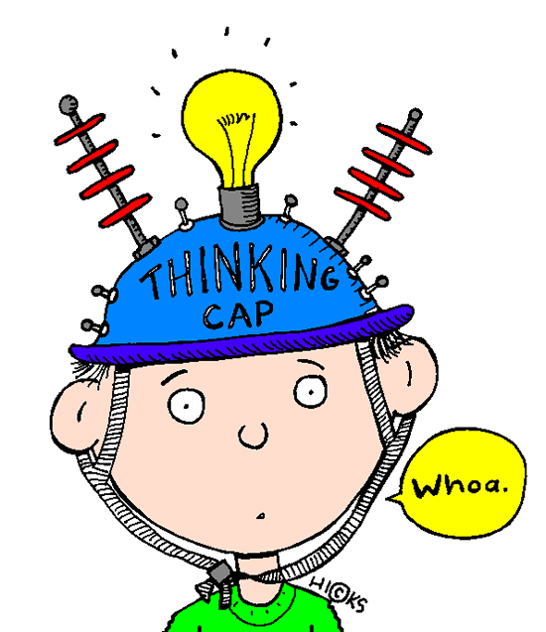
Please share your:
-Thoughts
-Questions
-Concerns

