Slide 1
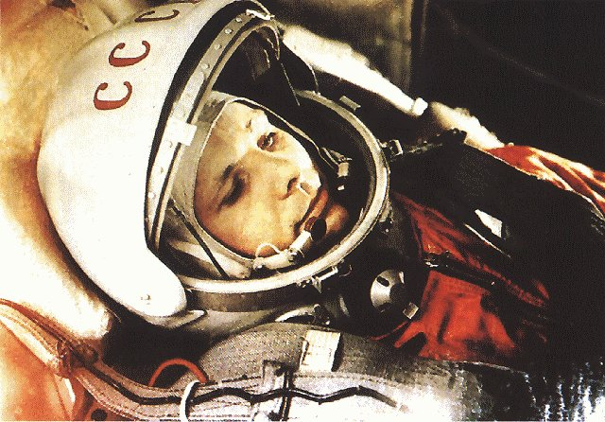
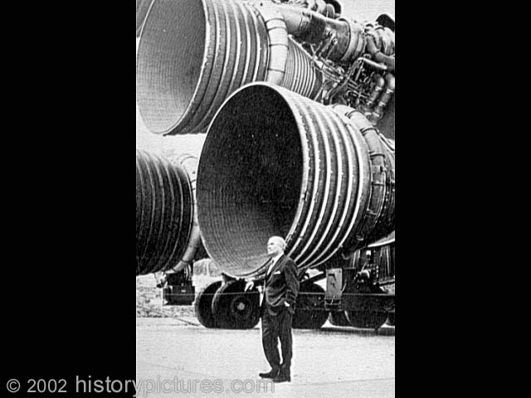
Space Race
Yuri Gagarin (1961)
Wernher von Braun

Slide 2
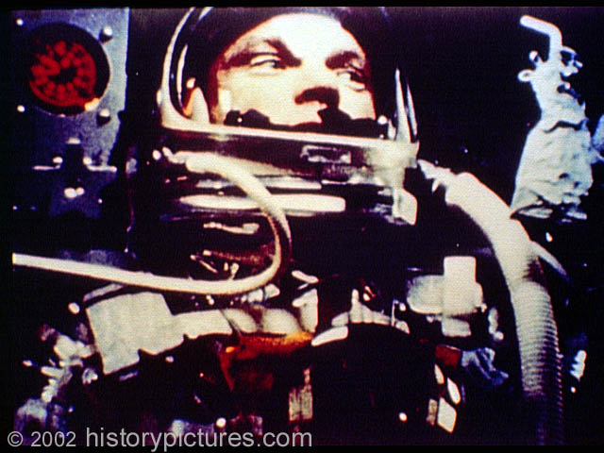
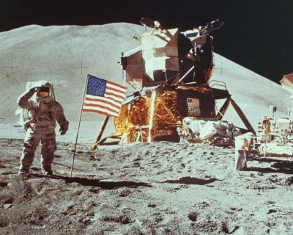
John Glenn (1962)
Moon Landing (1969)
U.S. wins the race
Cost: $21.35 billion

Slide 3
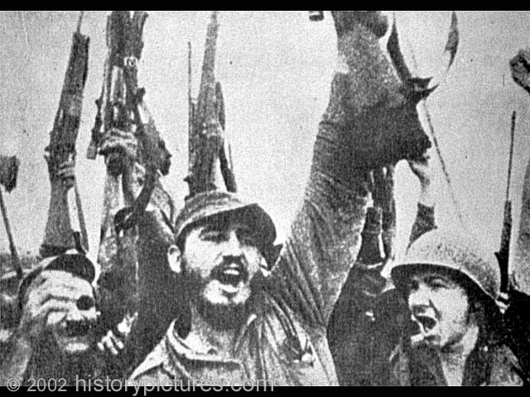
COLD WAR
Berlin Wall (1961)
Bay of Pigs
Fidel Castro (1959)

Slide 4
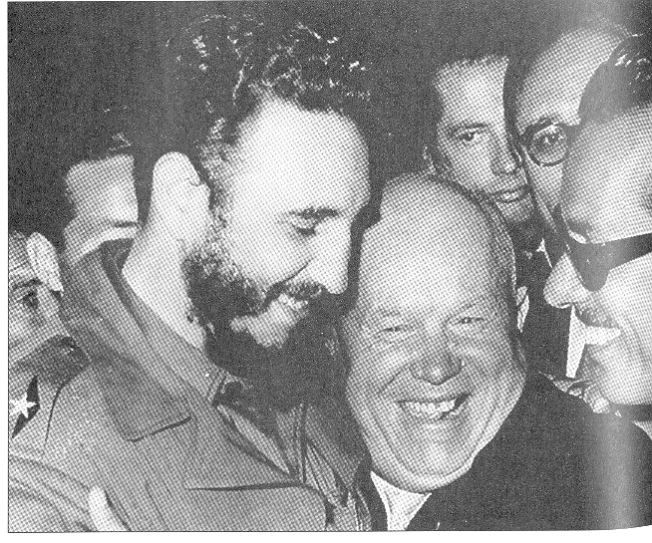

Slide 5
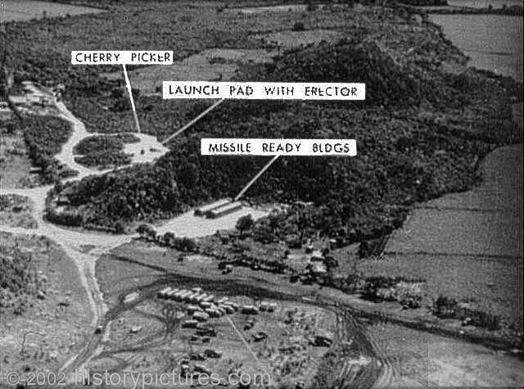
Cuban Missile Crisis (1962)

Slide 6
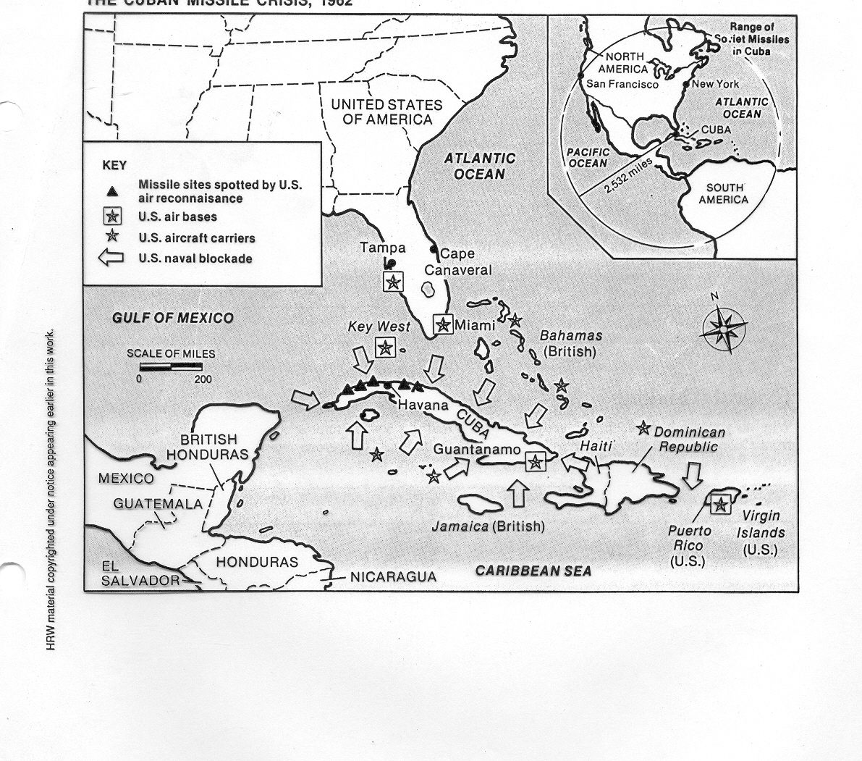

Slide 7
Cuban Missile Crisis – JFK Speech, October 22, 1962

Slide 8
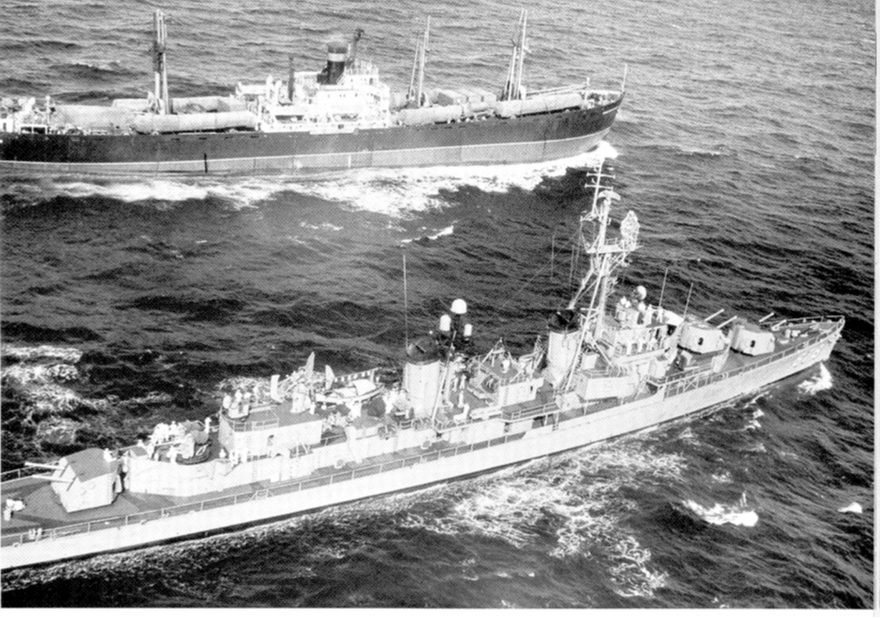

Slide 9
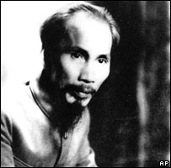
COLD WAR
Vietnam
Ho Chi Minh and Vietnamese Revolution
French-Vietnamese War (financed largely by US)
The domino theory
Division of Vietnam (1954)

Slide 10
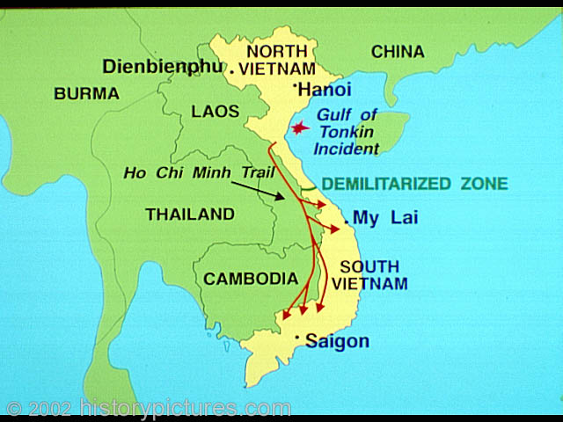

Slide 11
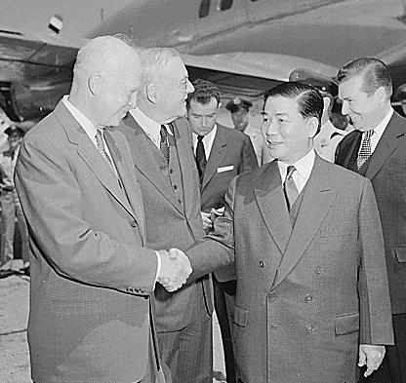
COLD WAR
The United States and the Republic of Vietnam (South Vietnam)
Ngo Dinh Diem
Blocks national elections
Unpopular policies
Rural uprisings (1959)
NLF (Vietcong)
Overthrow of Diem (1963)

Slide 12
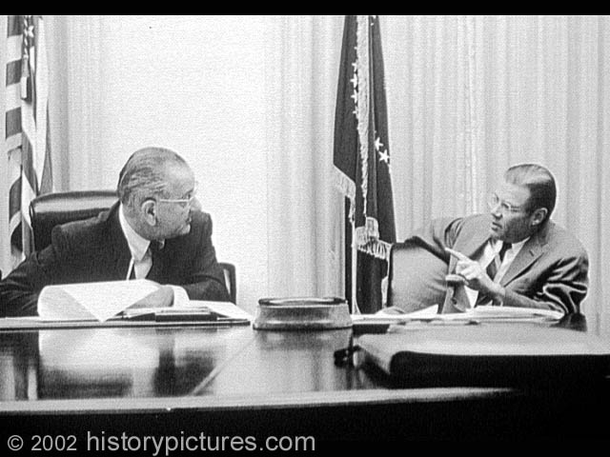
COLD WAR
Tonkin Gulf
American Escalation

Slide 13
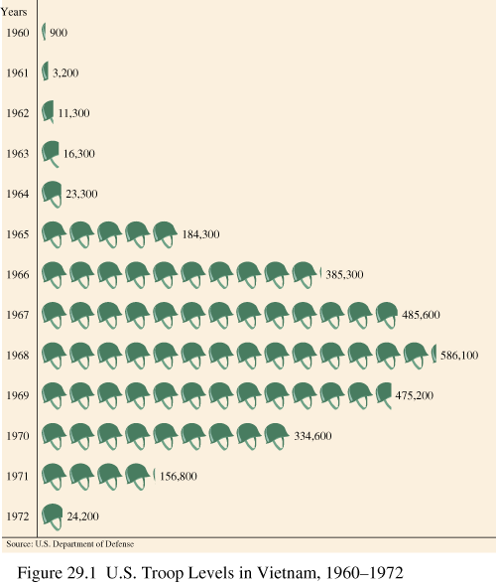

Slide 14
COLD WAR
Cold War concerns shaped U.S. military strategy
U.S. bombing campaign fails to halt North Vietnam supply routes into South Vietnam
U.S. ground forces fail to root the Vietcong out of South Vietnam

Slide 15
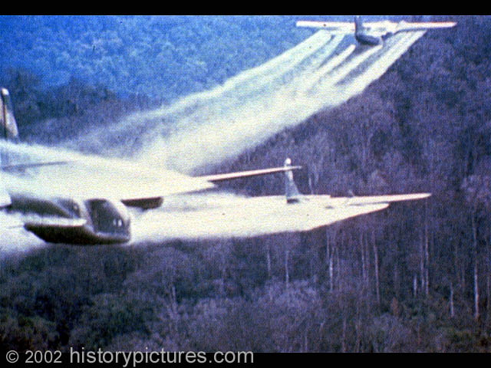

Slide 16
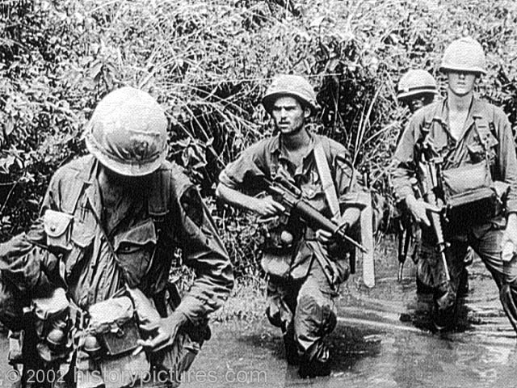
Free Fire Zone
Search and Destroy
My Lai

Slide 17
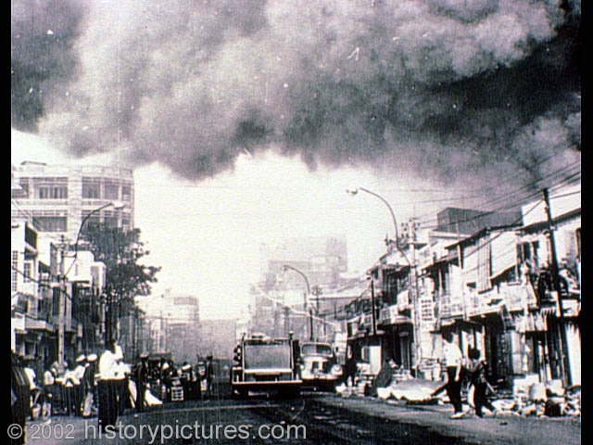
Tet Offensive (1968)

Slide 18
COLD WAR
Richard Nixon
Vietnamization
The “madman” strategy
Invasions of Cambodia and Laos
American Withdrawal

