Slide 1
The Solid South
BLaST TAH
June, 2013

Slide 2
I. LBJ: the big picture
A. Democratic Party
B. Domestic policies
C. Foreign policies
II. Civil Rights and the Divided Democratic Party
A. LBJ v. George Wallace
B. Inspiration
C. The Johnson Treatment
D. Civil Rights
E. Optimism of 1964.
F. George Wallace.
III. Domestic policies
A. War on poverty
B. Medicare/Medicaid.
C. Liabilities
IV. Vietnam.
A. Ike/Kennedy’s legacy
B. Why increase America’s commitment?
C. War in Vietnam
D. Tet Offensive and the end of LBJ
E. LBJ’s legacy

Slide 3
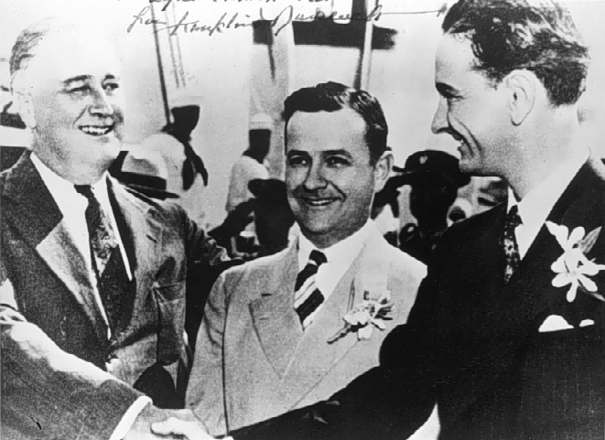
FDR and LBJ

Slide 4
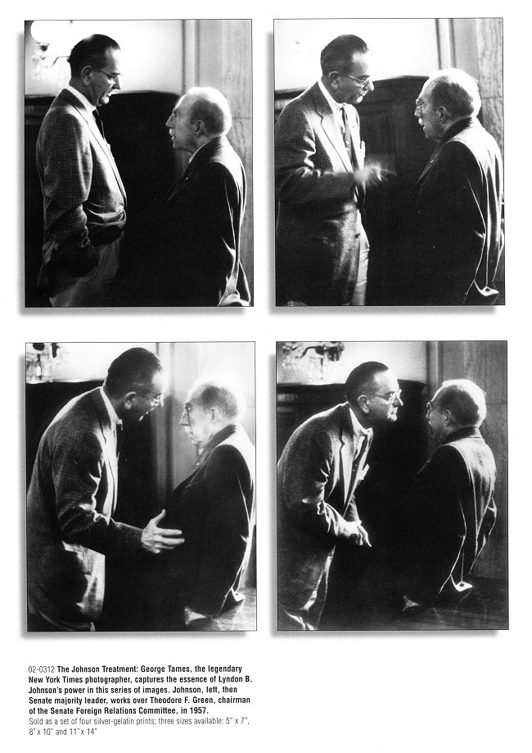
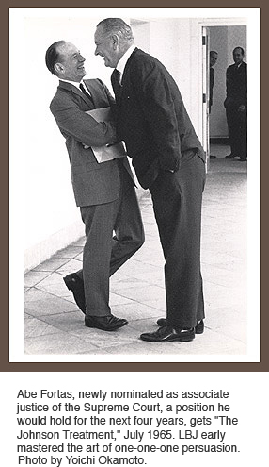

Slide 5
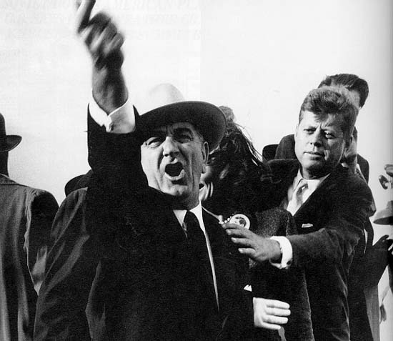

Slide 6
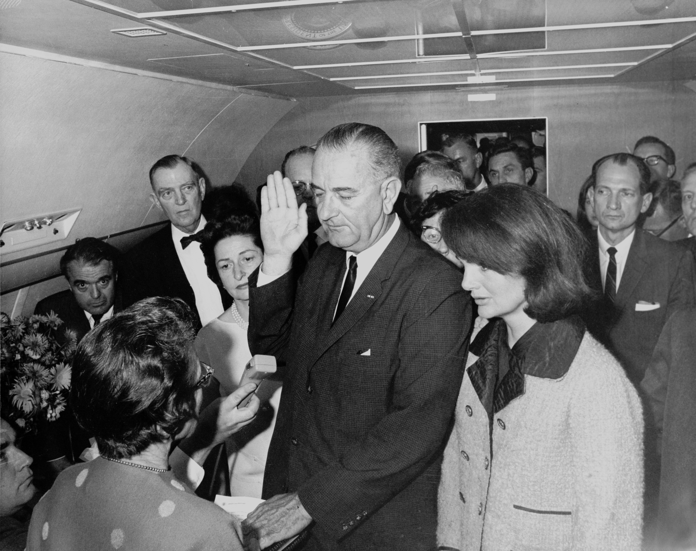

Slide 7
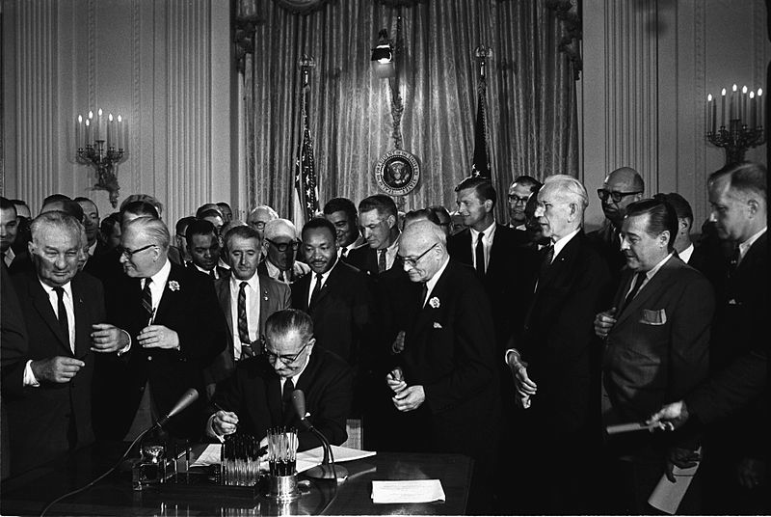

Slide 8
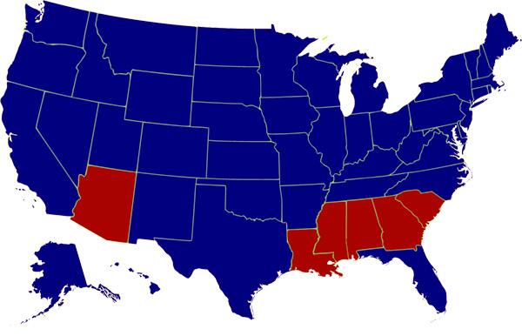
1964 Presidential Election

Slide 9
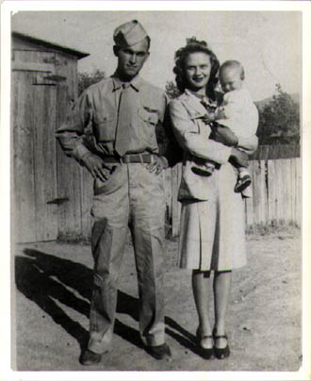
Young George Wallace

Slide 10
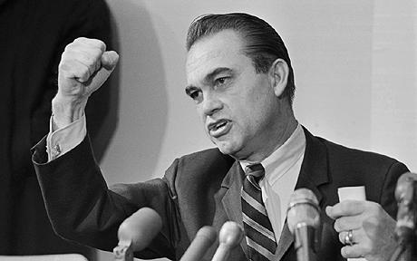
“I draw the line in the dust and toss the gauntlet before the feet of tyranny … and I say … segregation now … segregation tomorrow … segregation forever.”
-George C. Wallace, Inaugural Address, 1962

Slide 11
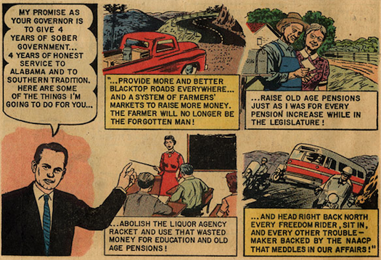

Slide 12
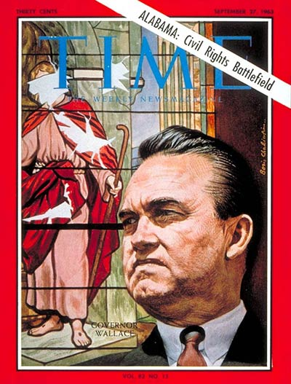
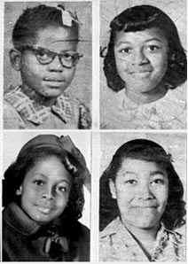

Slide 13
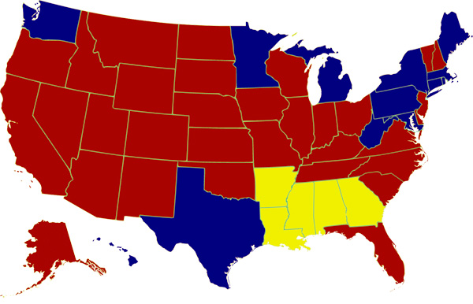
1968 Presidential Election

Slide 14
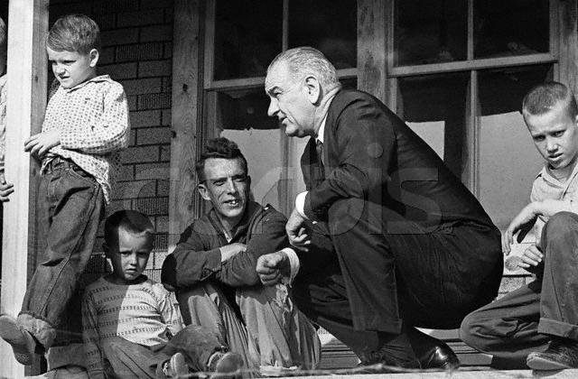
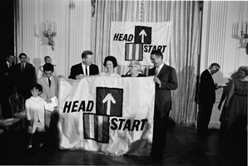
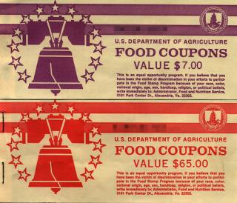

Slide 15
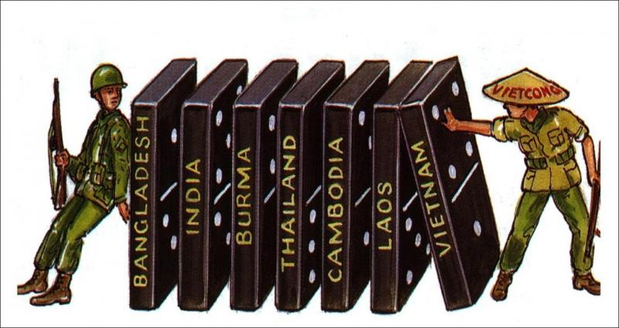

Slide 16
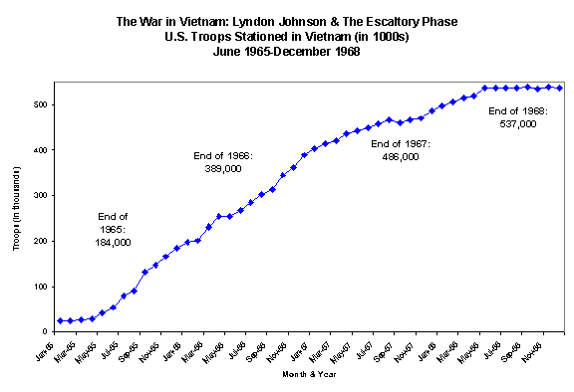

Slide 17
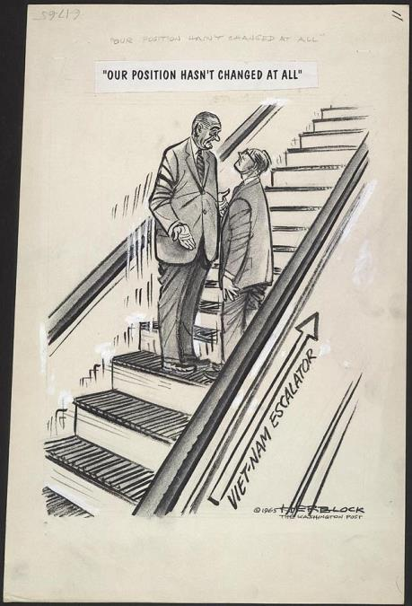
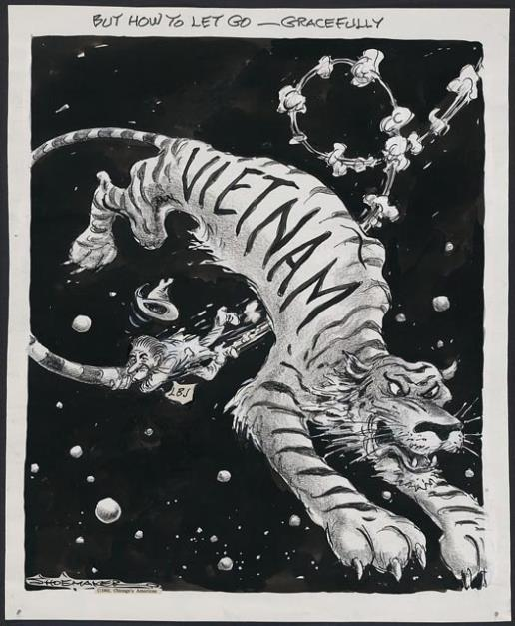

Slide 18
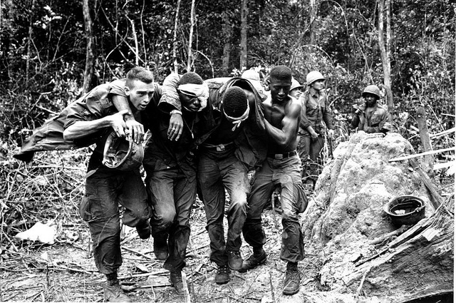

Slide 19
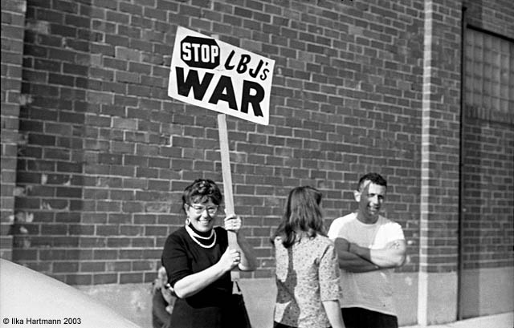

Slide 20
