Slide 1
The Long Civil Rights Movement
BLaST TAH
June 2013

Slide 2
I. Race in the South
A. Actors
1. NAACP
2. Federal government
3. Black grass roots
4. Southern white liberals
5. Southern white moderates
6. Southern white conservatives
B. Context
1. Cold War
2. Economically robust US and South
3. Shifting political coalitions
II. National context
A. Politics
B. Challenges to the order
C. An American Dilemma
D. Truman
III. NAACP led legal campaigns before 1954.
A. Educational inequalities.
B. Weak spots – graduate education
C. Due process (Scottsboro Boys)
D. White primary. Smith v. Allwright (1944)
IV. Brown v. Topeka Board of Ed.
A. Evidence of segregation’s effect?
B. Earl Warren
C. Implementation
D. “Black Monday”

Slide 3
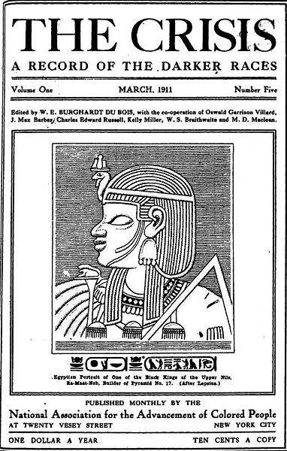

Slide 4
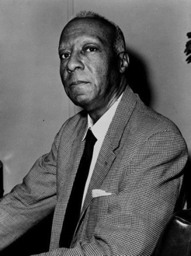
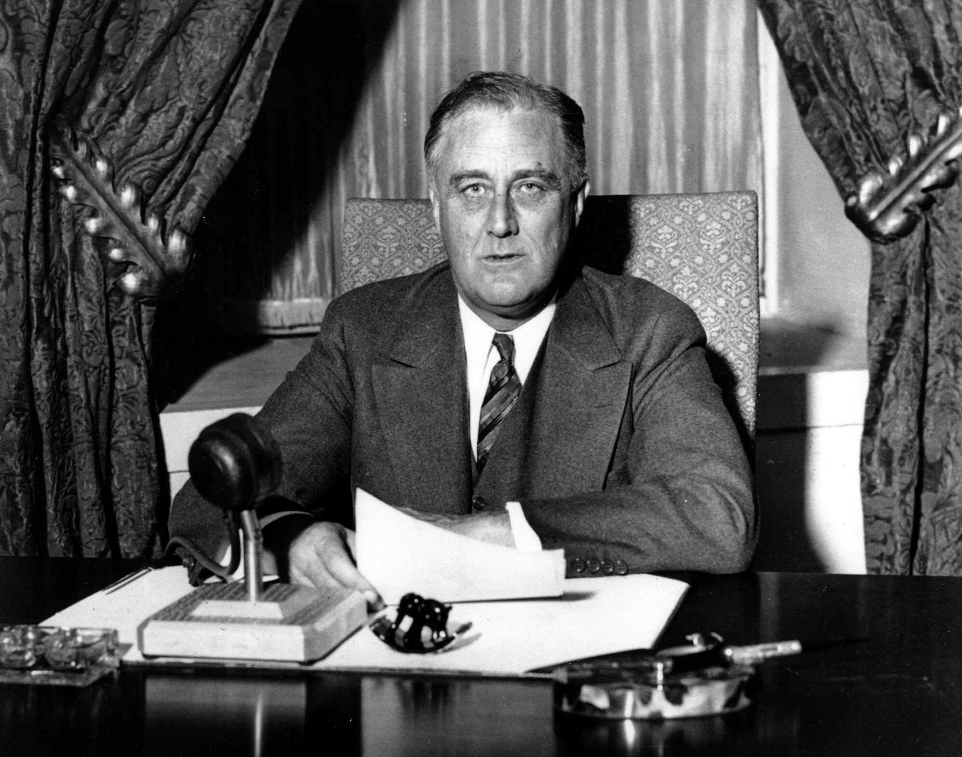
FDR
A. Philip Randolph

Slide 5
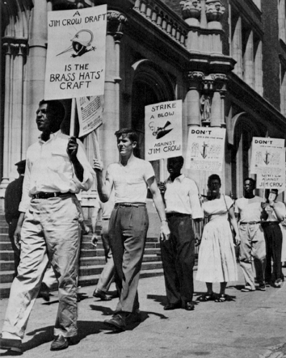

Slide 6
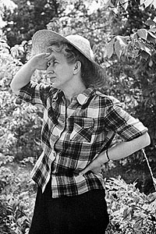

Slide 7
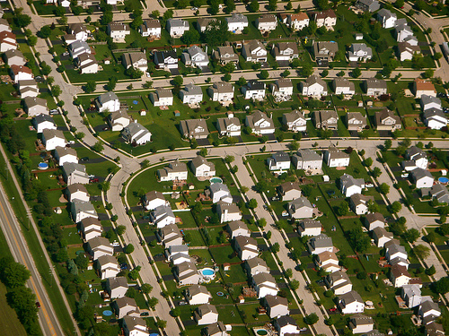
Southern Moderates

Slide 8
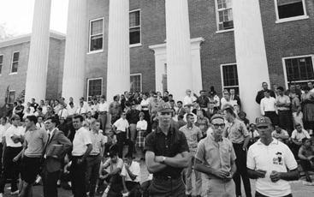
Southern Conservatives
(at integration of Ole Miss, 1963

Slide 9
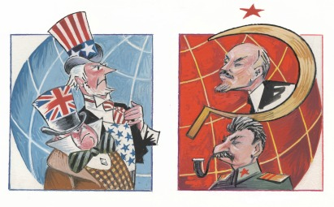
The Cold War

Slide 10
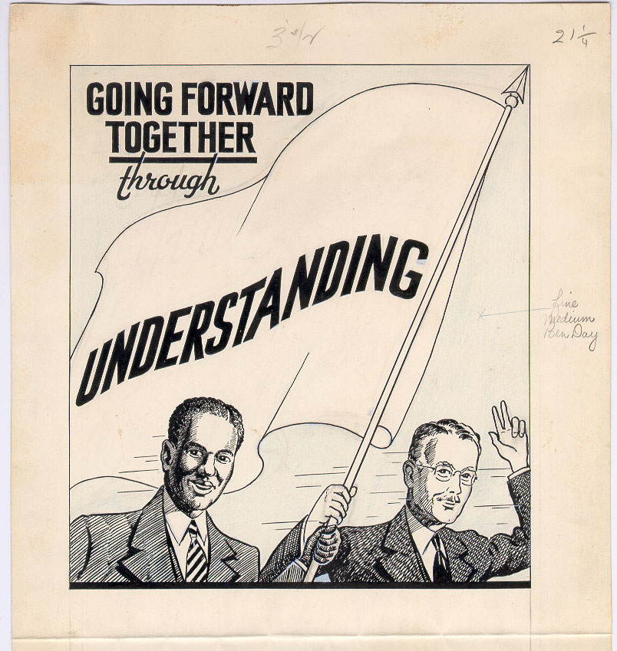
Commission on
Interracial Cooperation

Slide 11
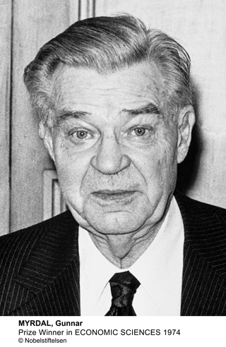
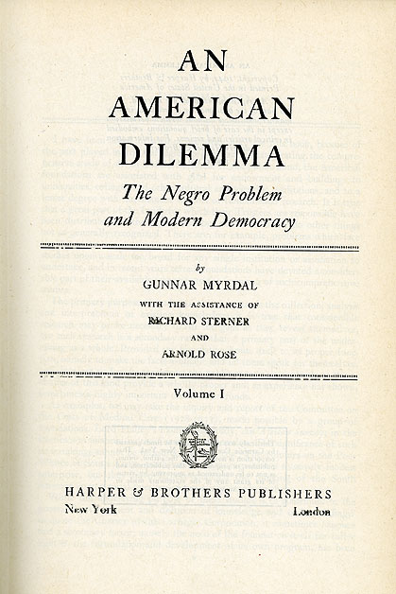

Slide 12
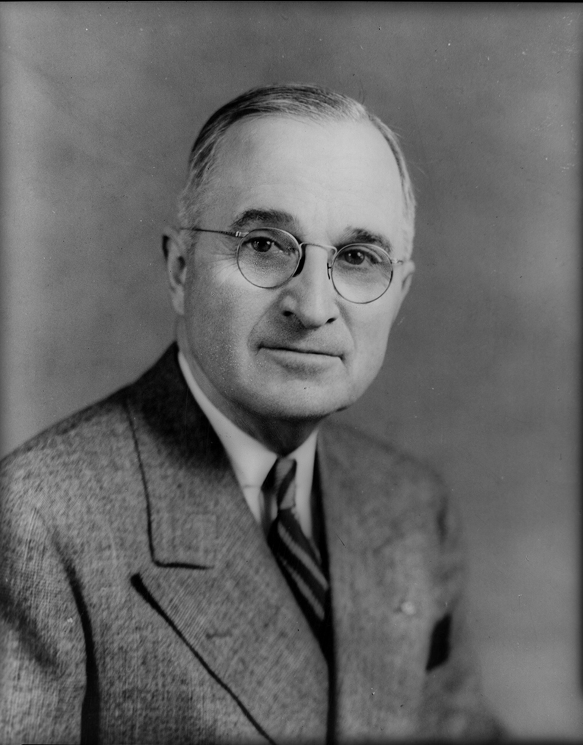
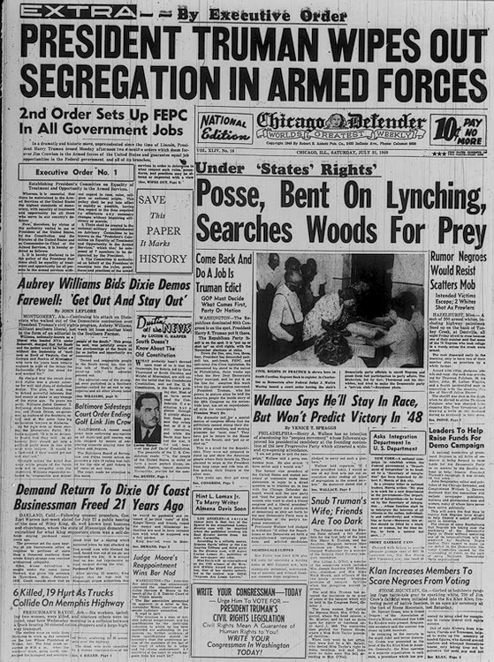

Slide 13
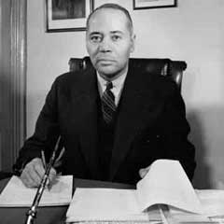
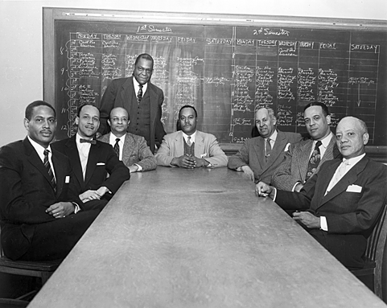
Charles Hamilton Houston
Howard University Law School Faculty

Slide 14
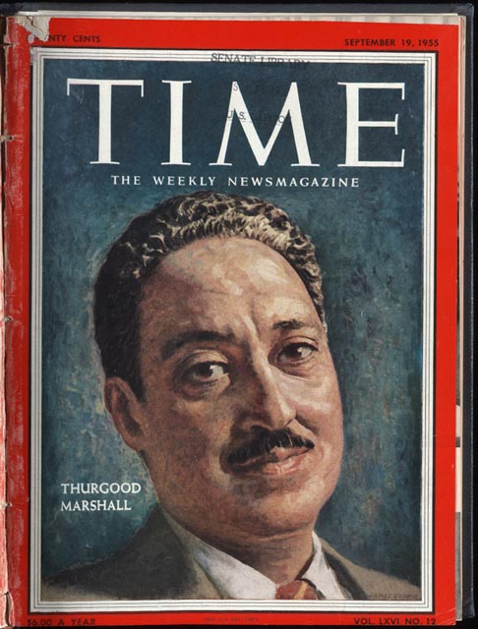
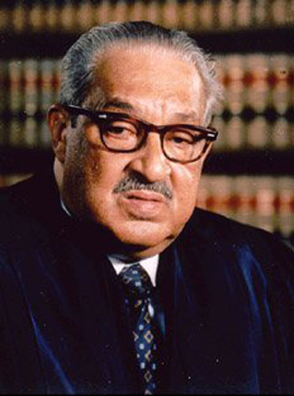

Slide 15
Per Student Spending, 1935-36

Slide 16
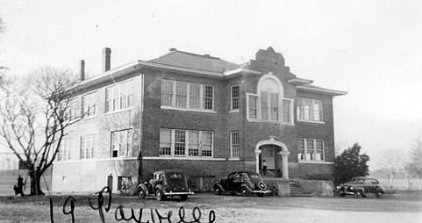
Paxville, South Carolina White School

Slide 17
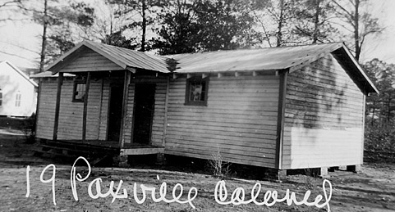
Paxville, South Carolina Black School

Slide 18
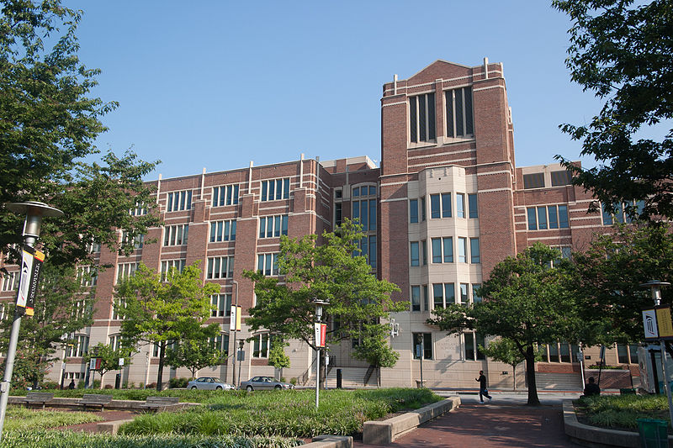
University of Maryland Law School

Slide 19
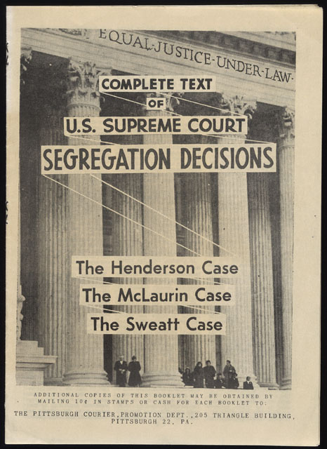

Slide 20
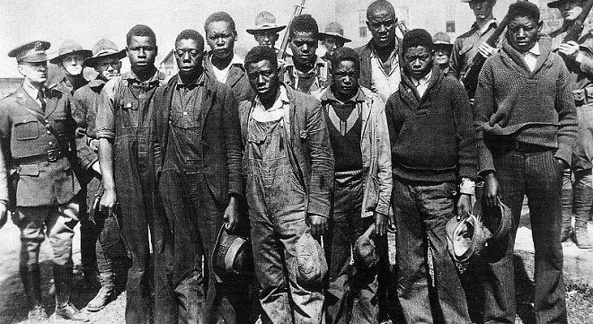
The “Scottsboro Boys”

Slide 21
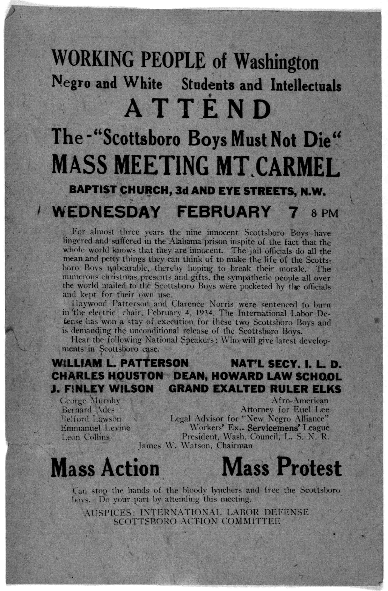
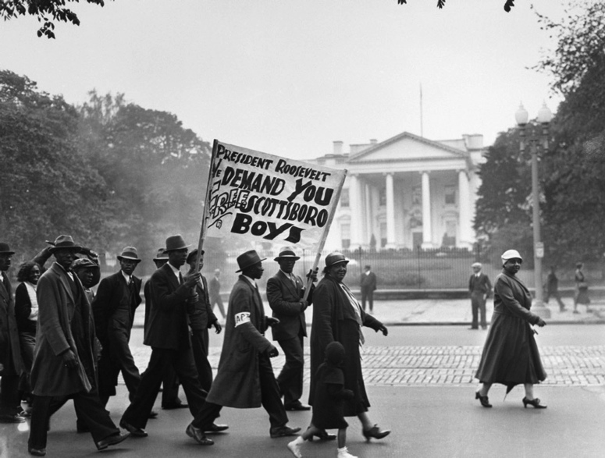

Slide 22
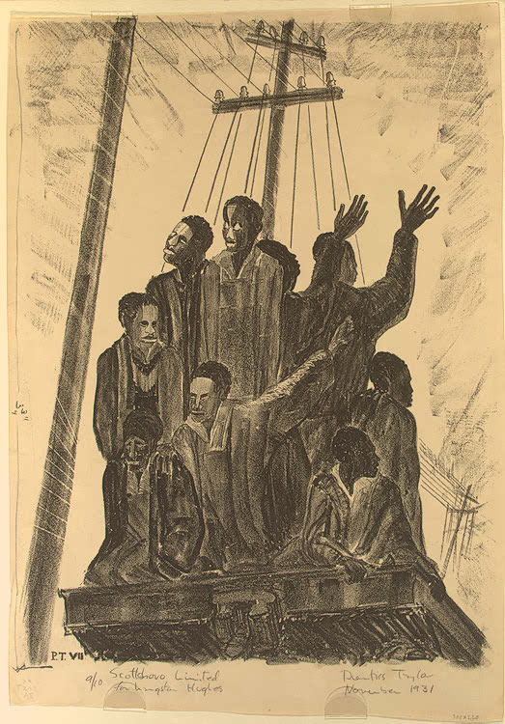

Slide 23
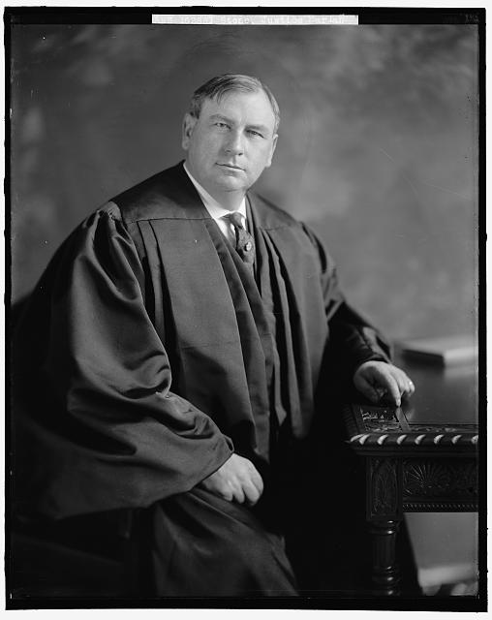
Chief Justice
Harlan Fisk Stone
"The United States is a constitutional democracy. Its organic law grants to all citizens a right to participate in the choice of elected officials without restriction by any state because of race. This grant to the people of the opportunity for choice is not to be nullified by a state through casting its electoral process in a form which permits a private organization to practice racial discrimination in the election."

Slide 24
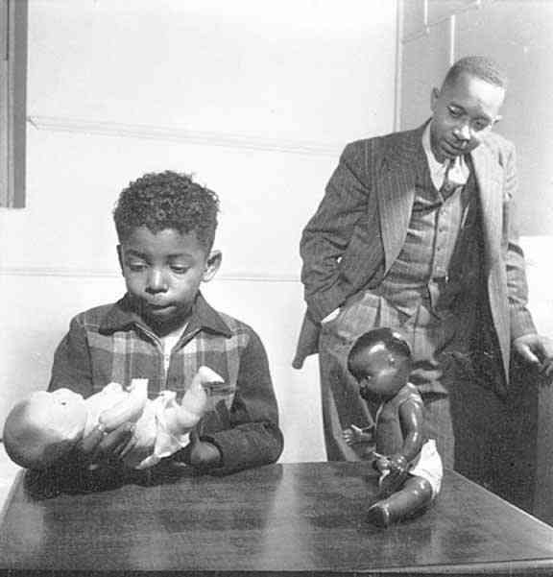
Kenneth Clark

Slide 25
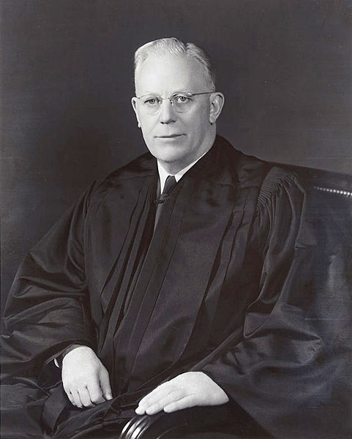
“We conclude, unanimously, that in the field of public education the doctrine of ‘separate but equal’ has no place. Separate educational facilities are inherently unequal.”
Chief Justice Earl Warren

Slide 26
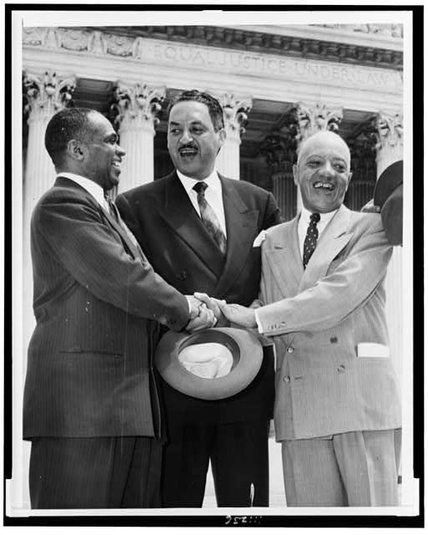

Slide 27
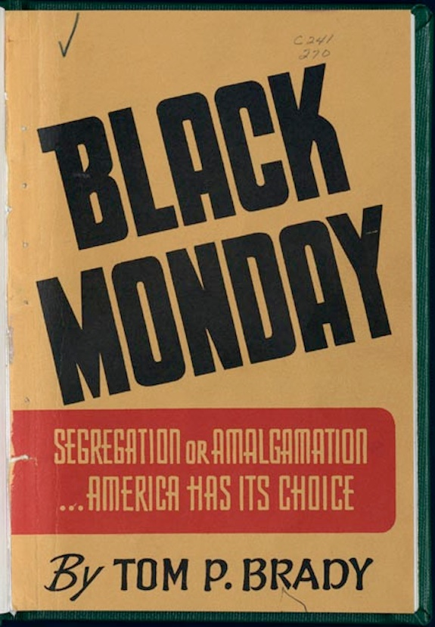
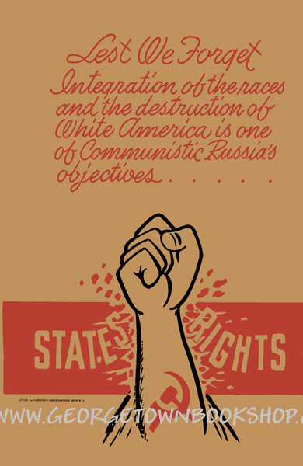

Slide 28
The unwarranted decision of the Supreme Court in the public school cases is now
bearing the fruit always produced when men substitute naked power for established law…
We regard the decision of the Supreme Court in the school cases as clear abuse of
judicial power. It climaxes a trend in the Federal judiciary undertaking to legislate, in derogation
of the authority of Congress, and to encroach upon the reserved rights of the states and the
people… This interpretation [Plessy v. Ferugson], restated time and again, became a part of
the life of the people of many of the states and confirmed their habits, customs, traditions and
way of life. It is founded on elemental humanity and common sense, for parents should not be
deprived by Government of the right to direct the lives and education of their own children… This unwarranted exercise of power by the court, contrary to the Constitution, is
creating chaos and confusion in the states principally affected. It is destroying the amicable
relations between the white and Negro races that have been created through ninety years of
patient effort by the good people of both races. It has planted hatred and suspicion where there
has been heretofore friendship and understanding. Without regard to the consent of the governed, outside agitators are threatening
immediate and revolutionary changes in our public school systems. If done, this is certain to
destroy the system of public education in some of the states…
We pledge ourselves to use all lawful means to bring about a reversal of this decision
which is contrary to the Constitution and to prevent the use of force in its implementation. In this trying period, as we all seek to right this wrong, we appeal to our people not
to be provoked by the agitators and troublemakers invading our states and to scrupulously
refrain from disorder and lawless acts.

Slide 29
Southern Manifesto
What is the message of the Congressmen who signed the manifesto?
What is their attitude? Fearful? Confident?
How do they use history in their argument?
What is to be done with outside meddlers?

