Slide 1
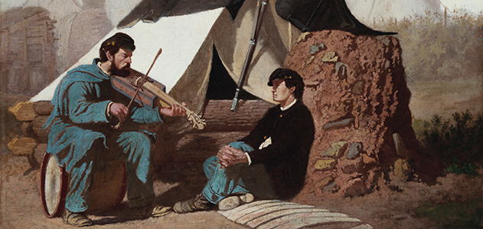
Civil War Music Songs and Lyrics
Nancy Taylor
American Institute for History Education Blast, Pennsylvania June, 2012
http://www.smithsonianmag.com/history-archaeology/The-Sentimental-Ballad-of-the-Civil-War.html

Slide 3
Pennsylvania Standard
8.1.8.B.
Compare and contrast a historical event, using multiple points of view from primary and secondary sources.

Slide 4
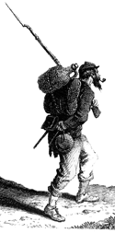
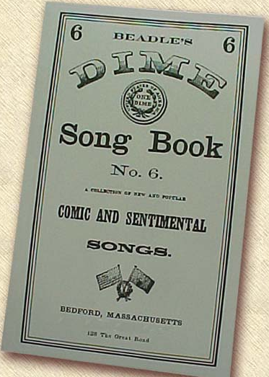
NO MP3 Players!
Songs were shared in print but also passed down orally and sang from memory.
Soldiers carried pocket-sized song books.
The Soldier Boys Songster
Beadle’s Dime Songs of War
Next to the bible songsters were the most common form of printed material carried by soldiers in the field.
The Civil War Music Collector’s Edition, Time-Life Music, Alexandria, Virginia, 1991, p.14.
njsekela.com
http://www.nativeground.com/articles/207-sivil-war-music.html

Slide 5
1861
Over 2,000 pieces written and published throughout the North and South
1865
By the end of the war 10,000 pieces were published
http://www.nativeground.com/articles/207-civil-war-music.html
http://www.nps.gov/history/history/online_books/civil_war_series/3/sec2.htm

Slide 6
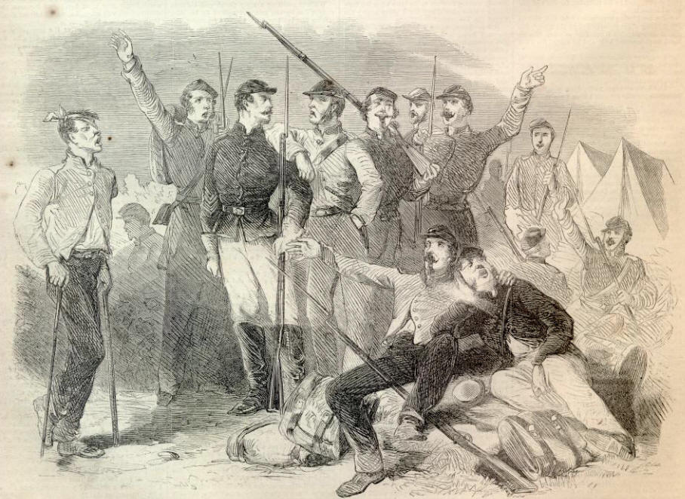
Although soldiers enjoyed instrumental music mmusic, by far the most common musical outlet was singing.
Soldiers sang, whistled and hummed on marches, behind earthworks, while waiting for orders, in camp, and even on the eve of a battle, with their muskets primed and ready. They sang solo, in duets, trios, and they often formed glee clubs. Sometimes entire regiments, Generals and all, sang on marches.
http://www.nativeground.com/articles/207-civil-war-music.html
http://www.sonofthesouth.net/leefoundation/civil-war/1862/august/california-joe.htm
McCLELLAN IS OUR MAN"—FAVORITE SONG OF THE ARMY OF THE POTOMAC

Slide 7
“I don’t believe we can have an army without music.”
Robert E. Lee 1864
http://www.nativeground.com/articles/207-civil-war-music.html
http://www.sonofthesouth.net/leefoundation/robert-e-lee-pictures/robert-e-lee-picture.htm

Slide 8
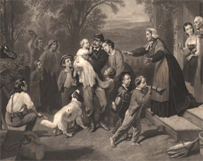
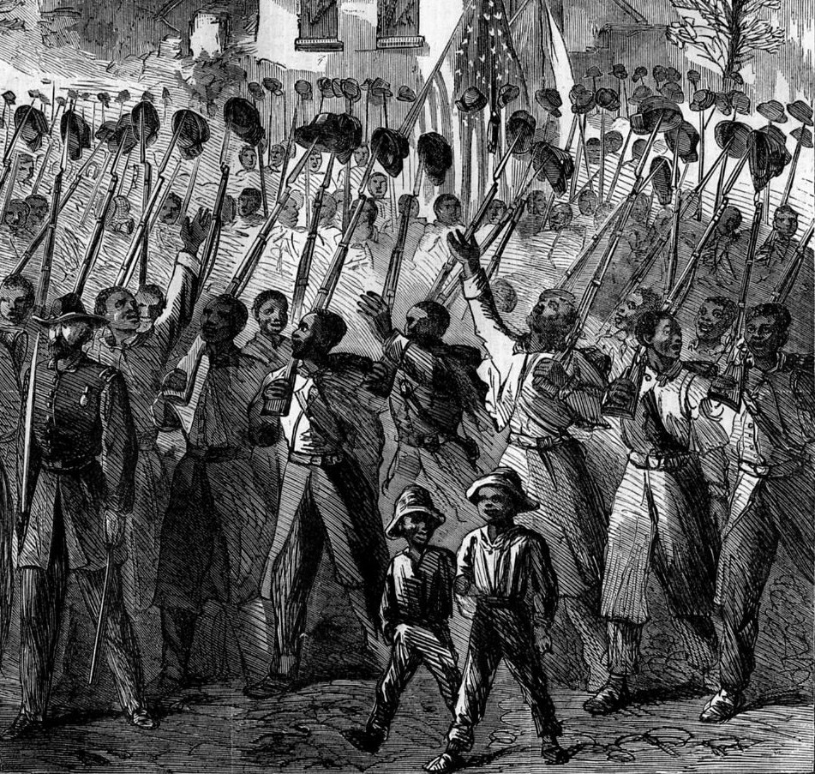
Emotional Impact
On the home front music reminded
loved ones of their family members
and friends engaged in the war
and
it offered hope that they would
return home safe and of sound body.
In camp it offered comfort,
inspiration, relaxation, reflection.
On the march it rallied troops
together.
On the battlefield for the nervous
and homesick with rifles primed
– it lifted morale.
http://www.nativeground.com/articles/207-civil-war-music.html
http://www.hartwick.edu/news-and-events/news-archive-new/civil-war-songs-02-14-11
http://www.sonofthesouth.net/leefoundation/civil-war/1865/march/colored-regiment.htm

Slide 9
Types of Songs
Patriotic
Sentimental
Comic
Vicious satire
Protest
Marching
Genteel parlor
Rowdy drinking

Slide 10
Directions
1. Listen to your assigned song on the CD before working with the lyrics.
2. Read through the background for the song.
3. Together work through The Civil War Song Analysis Sheet (this will focus on the lyrics and music.)
Prepare to share the song and your analysis for a presentation to the class. (3 to 5 minutes)
Divide the presentation so that every member in the group takes part in some way.
-OR-

Slide 11
If time is available your small group will prepare a skit using the song.
This could be a reader's theater style presentation that uses material from your analysis, the background and the song.
It could be a presentation of the song with a narrator to do an opening and group members putting action to the words in mime.
It could be an acted out scene of soldiers in camp, men marching into battle, a family on the home front or other possible setting from the time period.
In each of these cases the singers can sing along with the recording or without the recording. If the song is only sung by one singer on the CD it can be presented with many voices in the skit. If appropriate for your skit, one member pretend to sing the song and the others in character react to the song. But it is important for you to bring the song to life. Make sure from your actions and words we learn something about the song that you discovered in your analysis.

Slide 12
“Music is as indispensable to warfare as money. Money is the sinew of war – music is its soul.”
1862 Editorial New York Herald
http://www.nativeground.com/articles/207-civil-war-music.html
http://library.duke.edu/digitalcollections/hasm_b1051/

