Slide 1
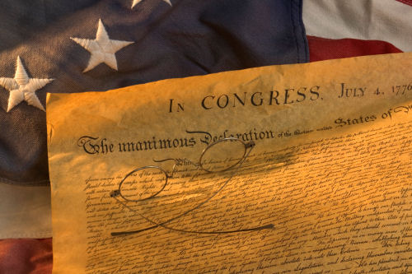
Concept-Based Instruction
Teaching History Beyond the Facts
This power point presentation is for educational purposes. It may contain copyrighted material. Please do not post, redistribute or copy without the permission of the author or the American Institute for History Education.

Slide 2
Some BIG Issues
Unless teachers consciously identify the essential understandings related to a topic, they focus on fact-based content as the endpoint in instruction, and the conceptual level of understanding usually is not addressed.
When students arrive at content classes reading below grade level, teachers are challenged to deliver complex content. In many classes, students often study facts without reaching larger concepts.
Source: McCoy, J.D., & Ketterlin-Geller, L.R. (2004). Rethinking Instructional Delivery for Diverse Student Populations: Serving All Learners with Concept-Based Instruction. Intervention in School and Clinic, 40(2).

Slide 3
Other Issues
In the absence of grade-to-grade coherence, the social studies curriculum is needlessly splintered and needlessly repetitive at the beginning levels of understanding.
Conceptual understanding requires a higher-level, integrative thinking ability that needs to be taught systematically through all levels of schooling.
Source: Erickson, H.L. (2002). Concept-Based Curriculum and Instruction: Teaching Beyond the Facts. p. 8.

Slide 4
What is a concept and why should we use them?
A concept is an idea that is timeless, abstract, broad and can be shown through a variety of examples.
Well… why should we use them?
Two jobs that concepts have are to focus the study of topics and integrate the overall curriculum. Looking at a topic through a concept gives the study a focus. Without the focus of a concept, only factual learning takes place.

Slide 5



Role of a Concept

Slide 6
Problem and Possible Solution
Many ideas are introduced but few are elaborated and deepened. (1)
Conceptual understanding requires a higher-level, integrative thinking ability that needs to be taught systematically through all levels of schooling. (2)
Source: Parker, W.C. (1991). Renewing The Social Studies Curriculum.
Source: Erickson, H.L. (2002). Concept-Based Curriculum and Instruction: Teaching Beyond the Facts. p. 8.

Slide 7
Impact of Concept-Based Instruction

Slide 8
Conceptual Flow
Students take Concept Down
Students draw on prior knowledge
Students add new learning
We cannot confuse amassing information with learning.

Slide 9
The Conceptual Relationship
Concept
Fact
Fact
Fact
Fact
The conceptual relationship is based on using facts to define, explain, and build the overall concept.

Slide 10
Macro and Micro Concepts
These are BIG concepts that can be traced across scope of US History no matter the time or era.
Macro
Micro
These are smaller concepts generally found in one area or era of US History.

Slide 11
Intra-Conceptual Relationship
Macro Concept
Micro Concept
Micro Concept
Micro Concept
Micro Concept
Micro Concept
Micro Concept
Each Macro Concept can be “built” through the use of multiple Micro Concepts.
Micro Concepts are “built” through the use of inter-related facts and information.
In essence we are trying to build a personal historical framework.

Slide 12
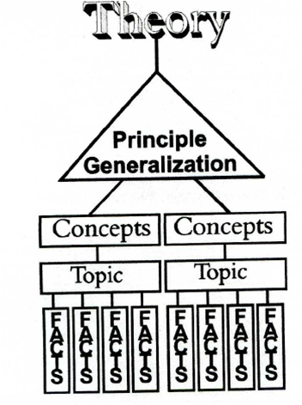
Concept-Based Instruction in Action
ESSENTIAL QUESTION
TOPIC
CONCEPT
CONCEPT
F
A
C
T
F
A
C
T
F
A
C
T
F
A
C
T
F
A
C
T
FACT

Slide 13
Let’s go see if we can put this in action …

