Slide 1
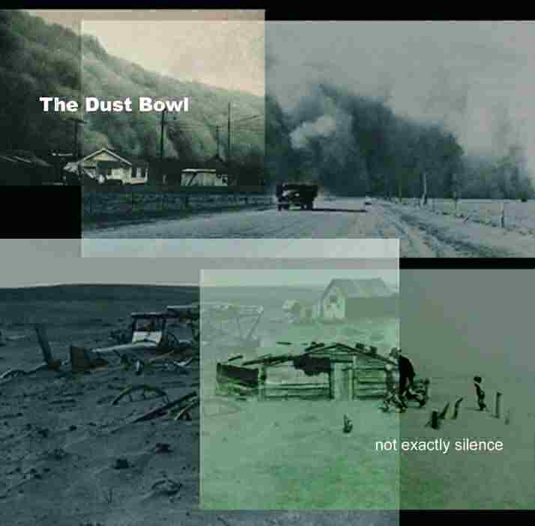
DUST TO DUST ASHES TO ASHES? OR
WHY IN THE WORLD DID THEY STAY?

Slide 2
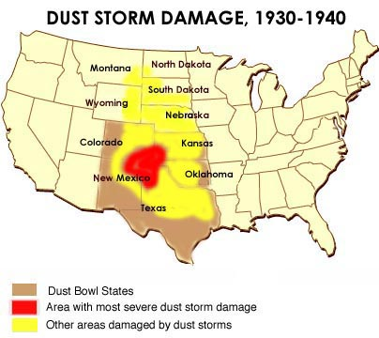
Mapping the Dust Bowl
RELIEF AND LOAN SERVICES: KERC, JULY 25, 1934
Agricultural Adjustment Act
Regional Production Corporation
Farm Credit Administration
Emergency Crop and Feed Loans

Slide 3
Direct Relief
“For those person or families who are unable to provide the necessities of life for themselves and dependents…”
Applications made through County Poor Commissioner
1
Notes:
“The thing that impressed me the most was probably not the dust storms but the devastation on the land…There would just not be any vegetation at all on the land for maybe half a mile in any direction… I don’t know how anyone survived.”
“The thing that impressed me the most was probably not the dust storms but the devastation on the land…There would just not be any vegetation at all on the land for maybe half a mile in any direction… I don’t know how anyone survived.”
Note Card #1

Slide 4
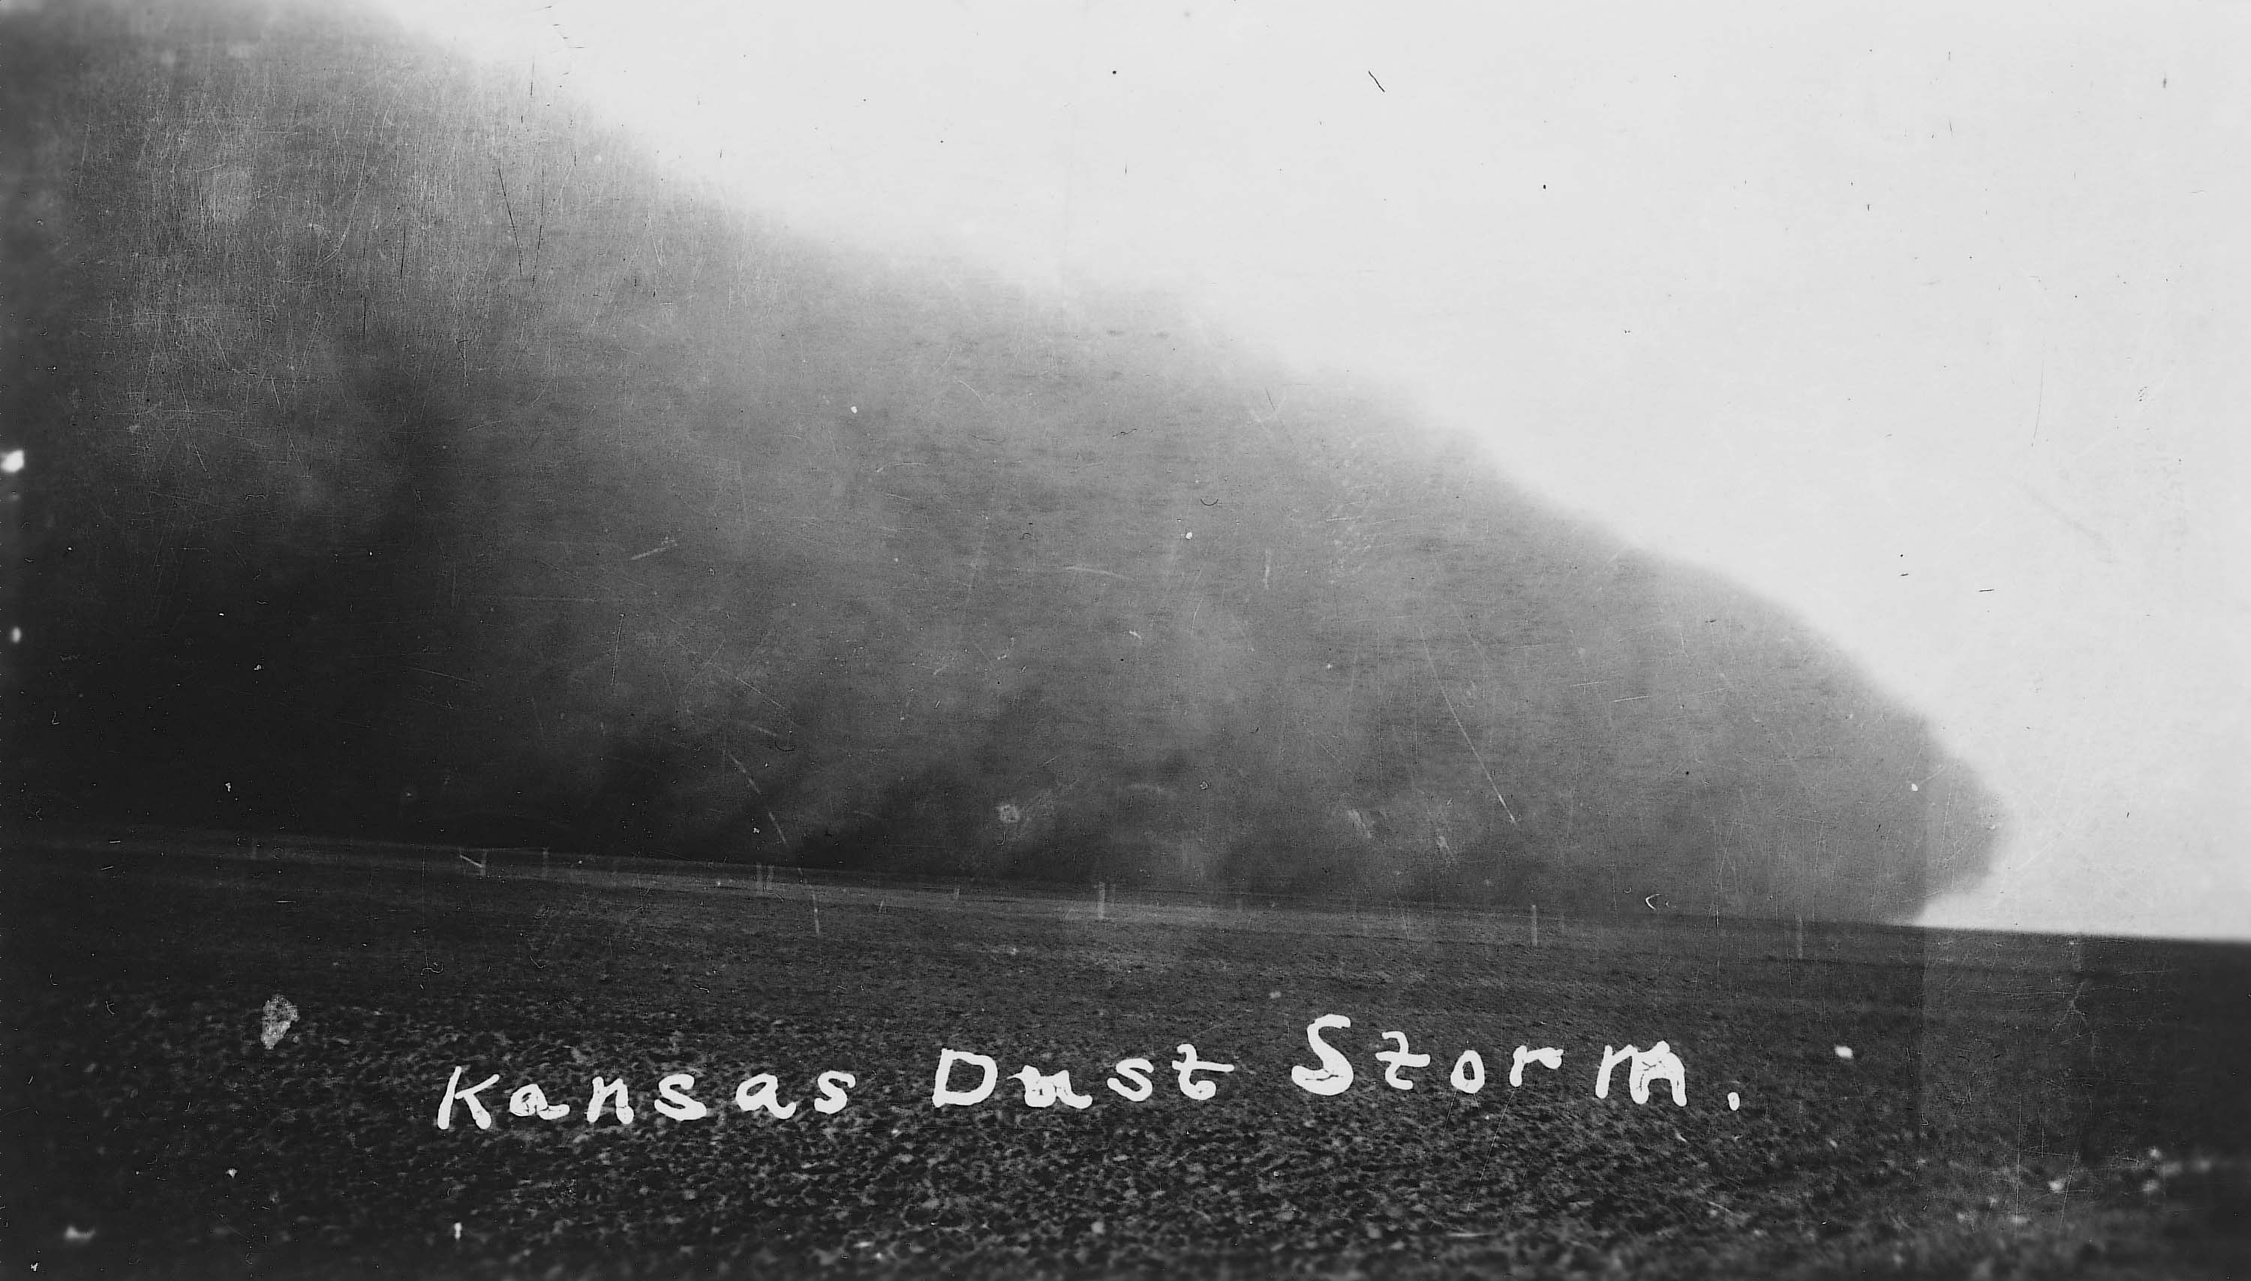
Federal Emergency Relief Act
“Person or families not residents of Kansas…unable to provide the necessities of life…”
Applications made through County Poor commissioner
5
Notes:
Note Card #5

Slide 5
Work Relief
“For Persons Who Are Able to Work” Apply to the County Poor Commissioner
6
Notes:
Note Card #6

Slide 6
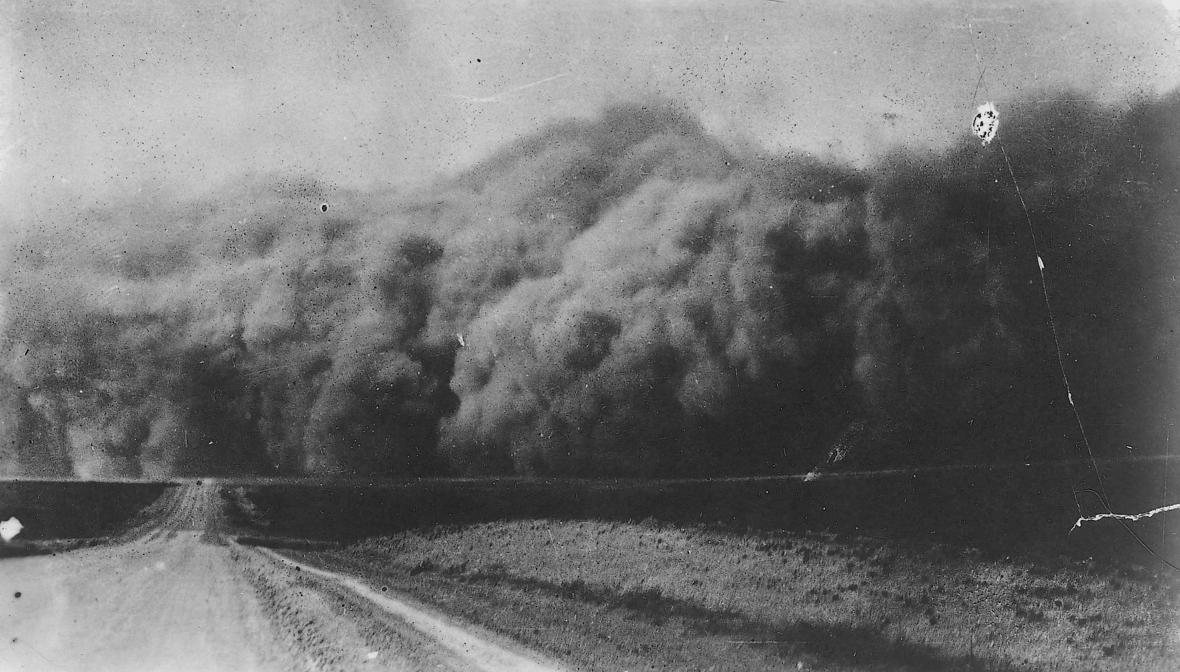
Water Shortages
“Where an acute water shortage in farm(s)..exists for humans or livestock needs, aid in locating underground water supplies by geologists may be furnished”
3
Notes:
Note Card #3

Slide 7
Work Relief
(For)…members of the family who are able to work. Make application through the County Poor Commissioner.”
12
Notes:
Note Card #12

Slide 8
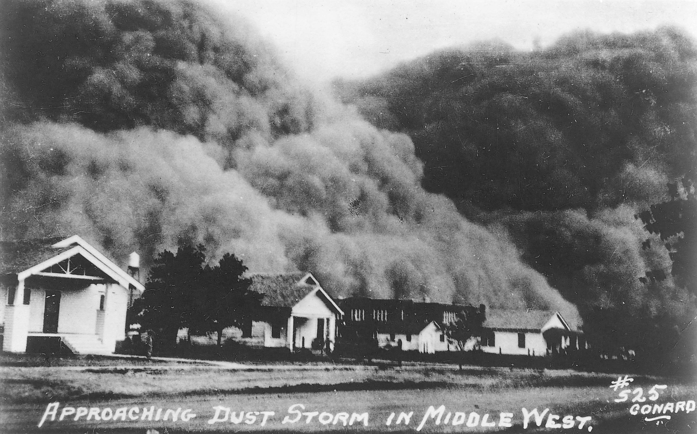
Homestead Rehabilitation
“For persons or families who own or have rented a suitable place to live and have a family enterprise…”
2
Notes:
Note Card #2

Slide 9
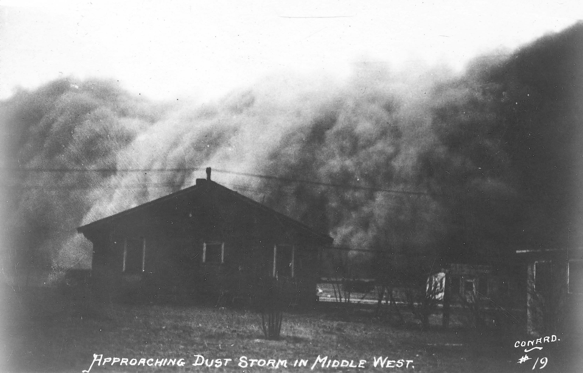
“…of farming, gardening or suitable trade... Make application through the County Poor Commissioner”
11
Notes:
Note Card #11

Slide 10
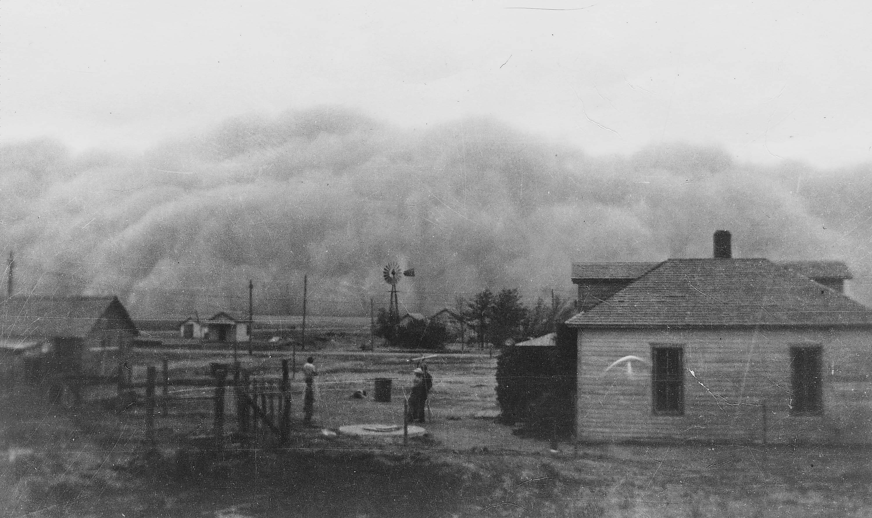
Production Credit Association Loans
“To be eligible for a loan, an applicant must be a farmer.”
13
Notes:
Note Card #13

Slide 11
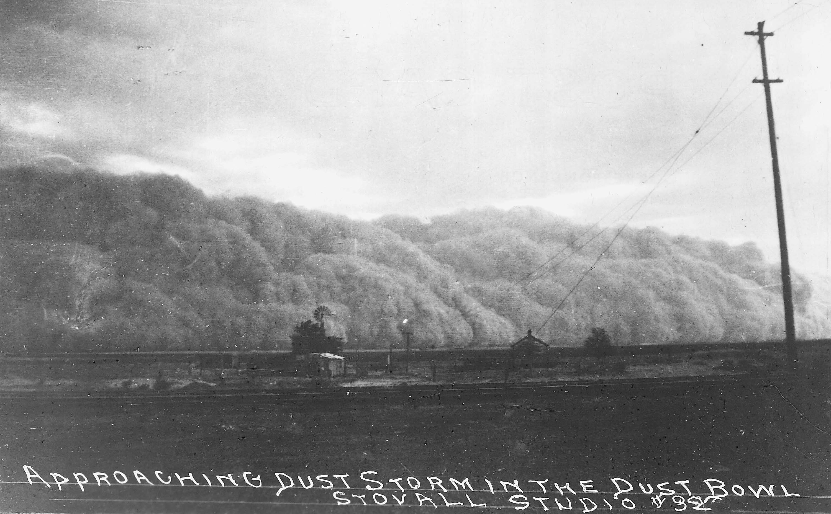
“To be an eligible applicant, an individual must devote certain time and energy to the active management of farming or livestock operations.”
8
Notes:
Note Card #8

Slide 12
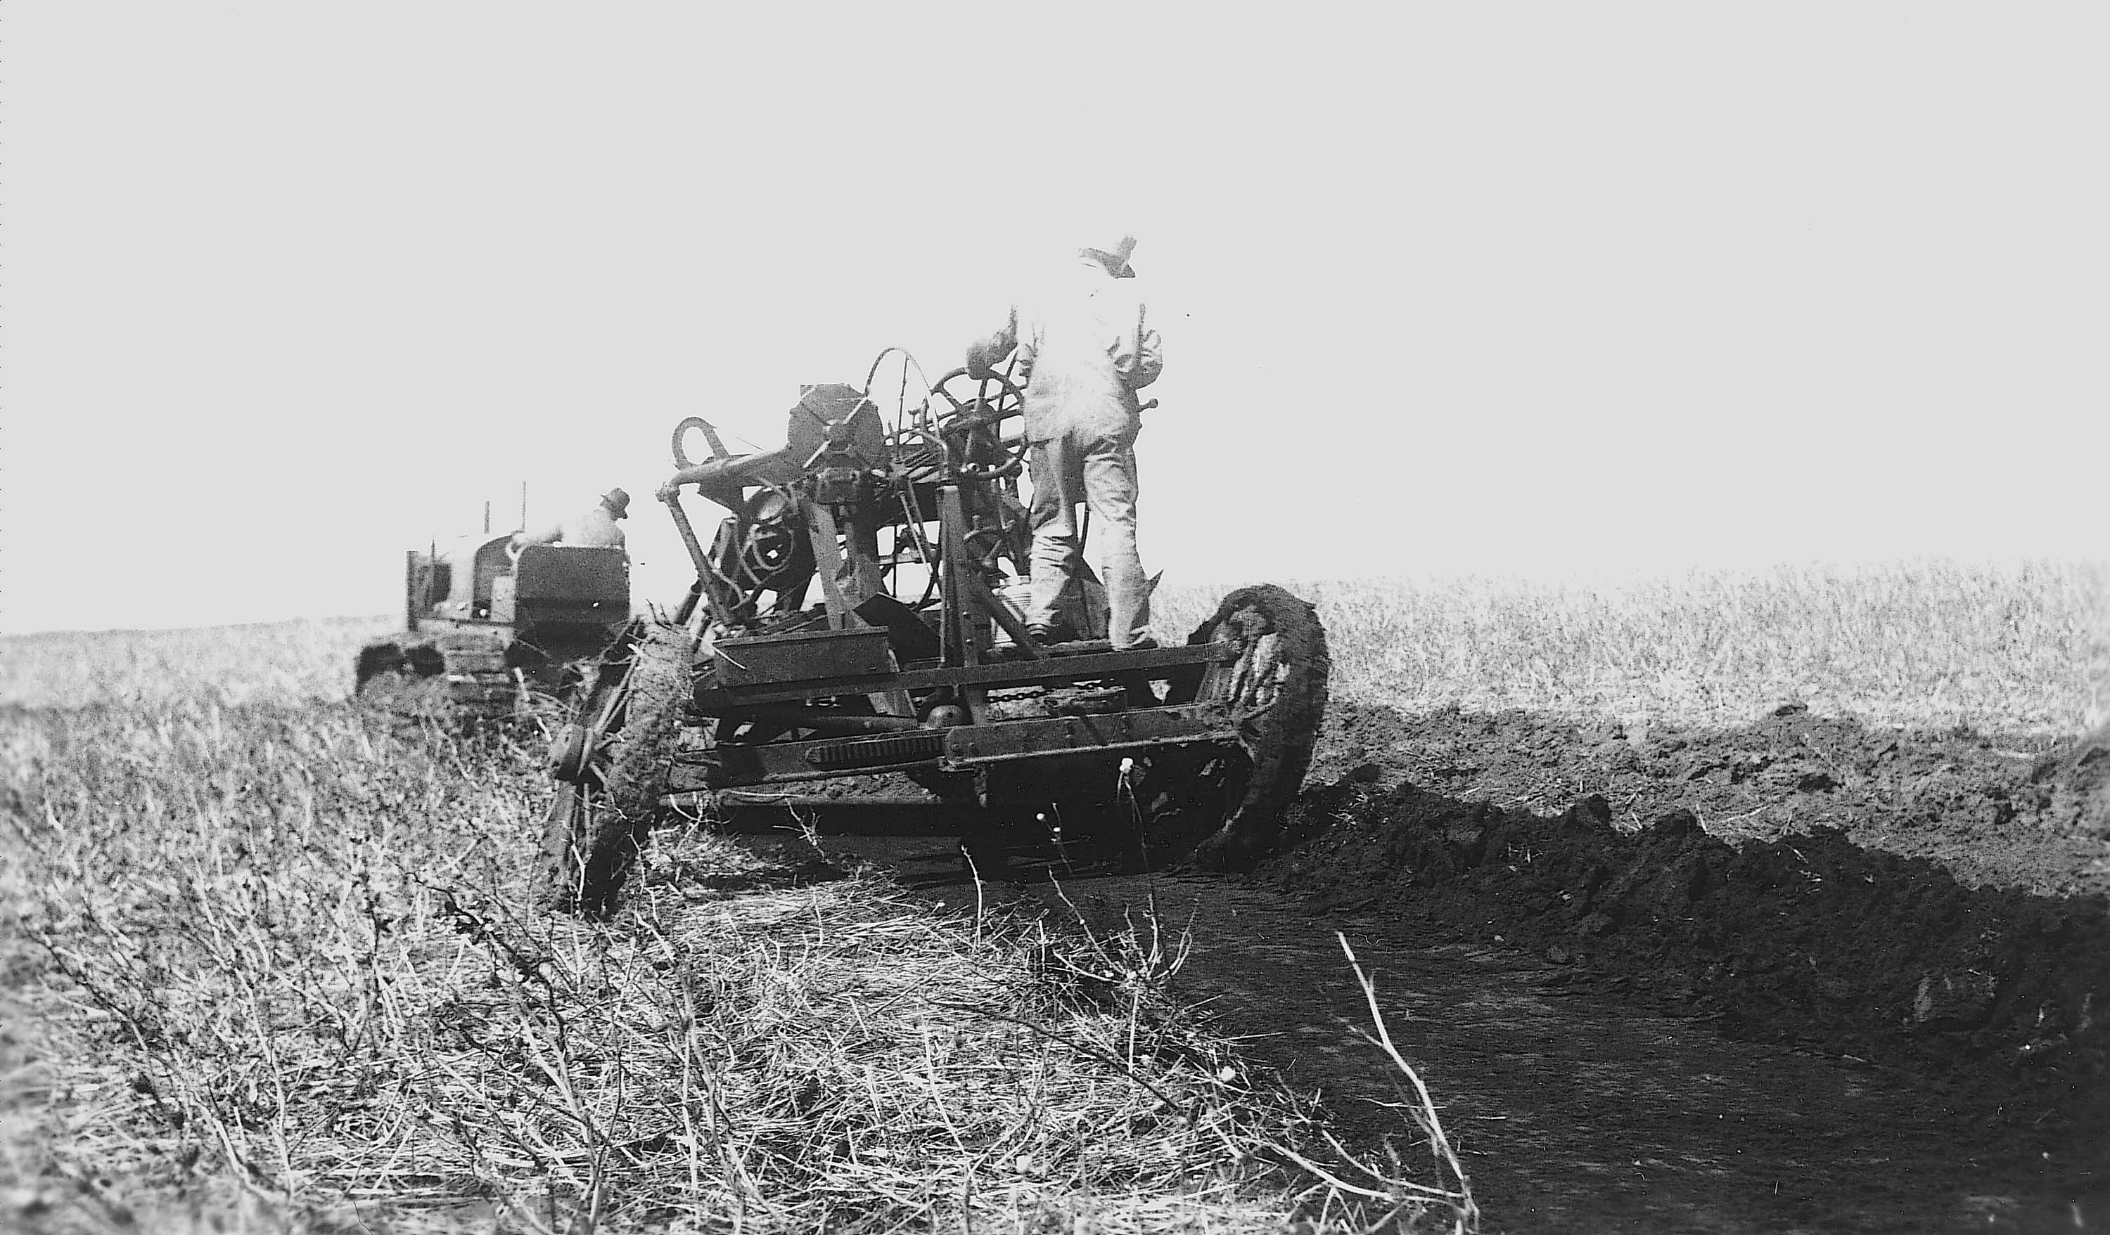
“The enterprise must be conducted so that he reaps the benefit of the operation if it is successful, and suffers the loss if it is a failure.”
10
Notes:
Note Card #10

Slide 13
“The majority f the loans are made for a period not exceeding 12 months. No loans are made for less than $50.00”
9
Notes:
Note Card #9

Slide 14
“Primary security must consist of first liens on crops or livestock…”
7
Notes:
Note Card #7

Slide 15
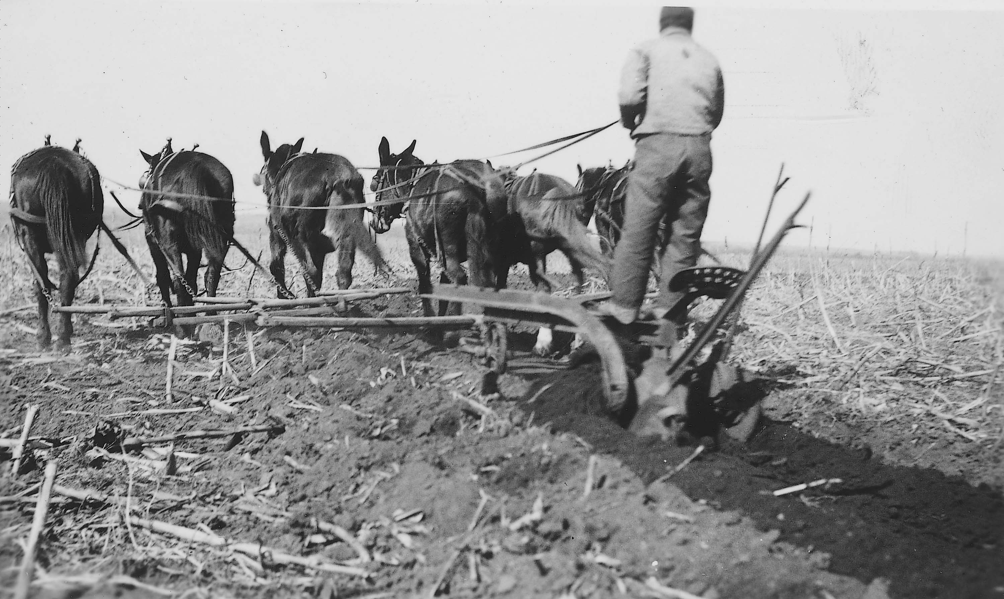
Value of Livestock:
Horse or Mules..$4.00
Cattle…$3.00
Hogs…$1.00
Sheep and Goats…$.75
4
Notes:
Note Card #4

Slide 16
Available Only in Primary Drought Counties
“Cattle will be purchased by the Agricultural Adjustment Administration.”
14
Notes:
Note Card #14

Slide 17
“Edible cattle will be turned over to the Kansas Emergency Relief Committee to be processed and distributed among needy families…”
16
Notes:
Note Card #16

Slide 18
17
“Condemned animals will be killed and disposed of on the farm, preferably by burying”
Notes:
Note Card #17

Slide 19
Cimarron, Kansas
15
Notes:
Note Card #15

Slide 20
KU Campus, Lawrence March 1935

Slide 21
Black Sunday April 14, 1935

Slide 22
Black Sunday April 14, 1935 Dodge City

Slide 23
Black Sunday, Oklahoma

Slide 24
Can It Happen Again?

Slide 25
1935 Dust Storm Colby, Kansas

Slide 26
2004 Dust Storm Colby, Kansas

Slide 27
Focus Questions
Did the soil conservation methods of the 1930s end the Dust Bowl or did it just rain?
Why did the farmers stay?
Was the government’s role powerful enough to keep the farmers on the farm?
18
Notes:
Note Card #18

Slide 28
Soil Conservation Can Save The Land
Conservation Methods
Irrigation
Shelter Belts
Terracing
Stubble Mulch
Crop Rotation

Slide 29
Government Agencies Providing Assistance
Agricultural Adjustment Administration
Federal Emergency Relief Association
Production Credit Corporation
Federal Intermediate Credit Bank
Farm Credit Administration
Drought Relief Committee
County Poor Commissioner

Slide 30
IRRIGATION
Notes:
Watering the land through with the use of reservoirs. (Western Kansas is watered by the Oglalla Aquifer)

Slide 31
SHELTER BELTS
Notes:
One or more belts of trees are planted on the farm facing the prevailing winds. Often another belt is planted at a right angle to the first.

Slide 32
TERRACING
Notes:
A ridge thrown up along the side of a slope with a channel for water on its upper side. A drop of 4 to 5 inches every 100 feet.

Slide 33
STUBBLE MULCH
Notes:
Turning the top soil once and leaving crop remnants to help bind the soil to the land.

Slide 34
CROP ROTATION
Notes:
Rotating the crops around from year to year keeping four to five years between clean tilled crops like corn and wheat. One of the crops should be a legume because they take notrigen from the air and fix it in the soil.

