Slide 1
COLD WAR
Definition
Origins in World War II
Atlantic Charter (1941)
The second front in Europe
U.S. economic aid to the Soviet Union
Dealing with occupied territories: Yalta (1945)
Future of Germany
Atomic Bomb: Manhattan Project

Slide 2
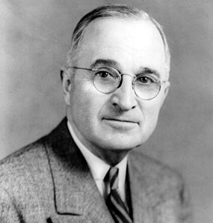
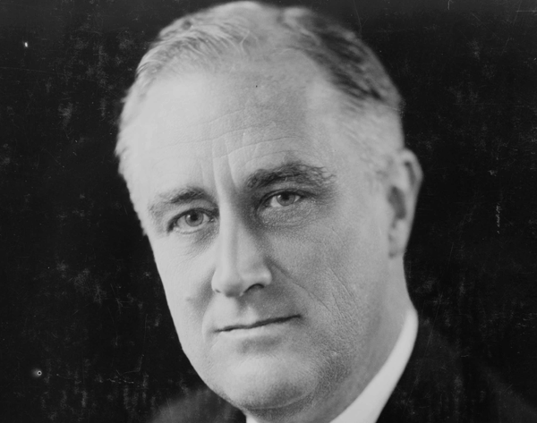
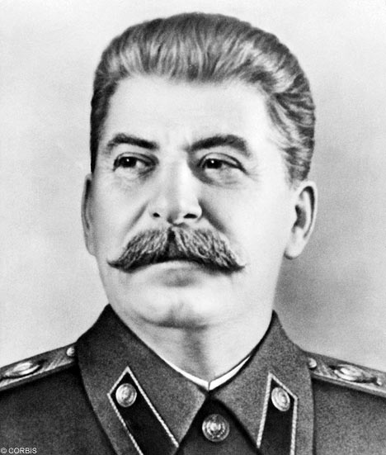
COLD WAR
Personalities

Slide 3
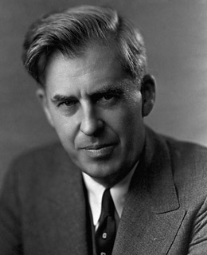
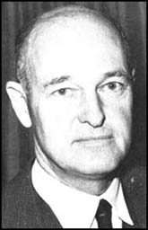
COLD WAR
Continuing disputes between U.S. and Soviet Union in the immediate postwar period
Development of American containment policy
Henry Wallace
George F.
Kennan

Slide 4
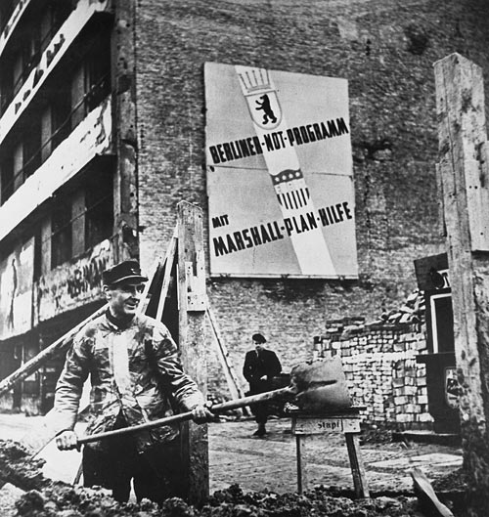
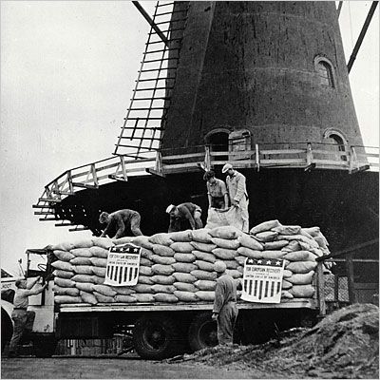
COLD WAR
Truman Doctrine
Marshall Plan
NATO (Warsaw Pact)

Slide 5
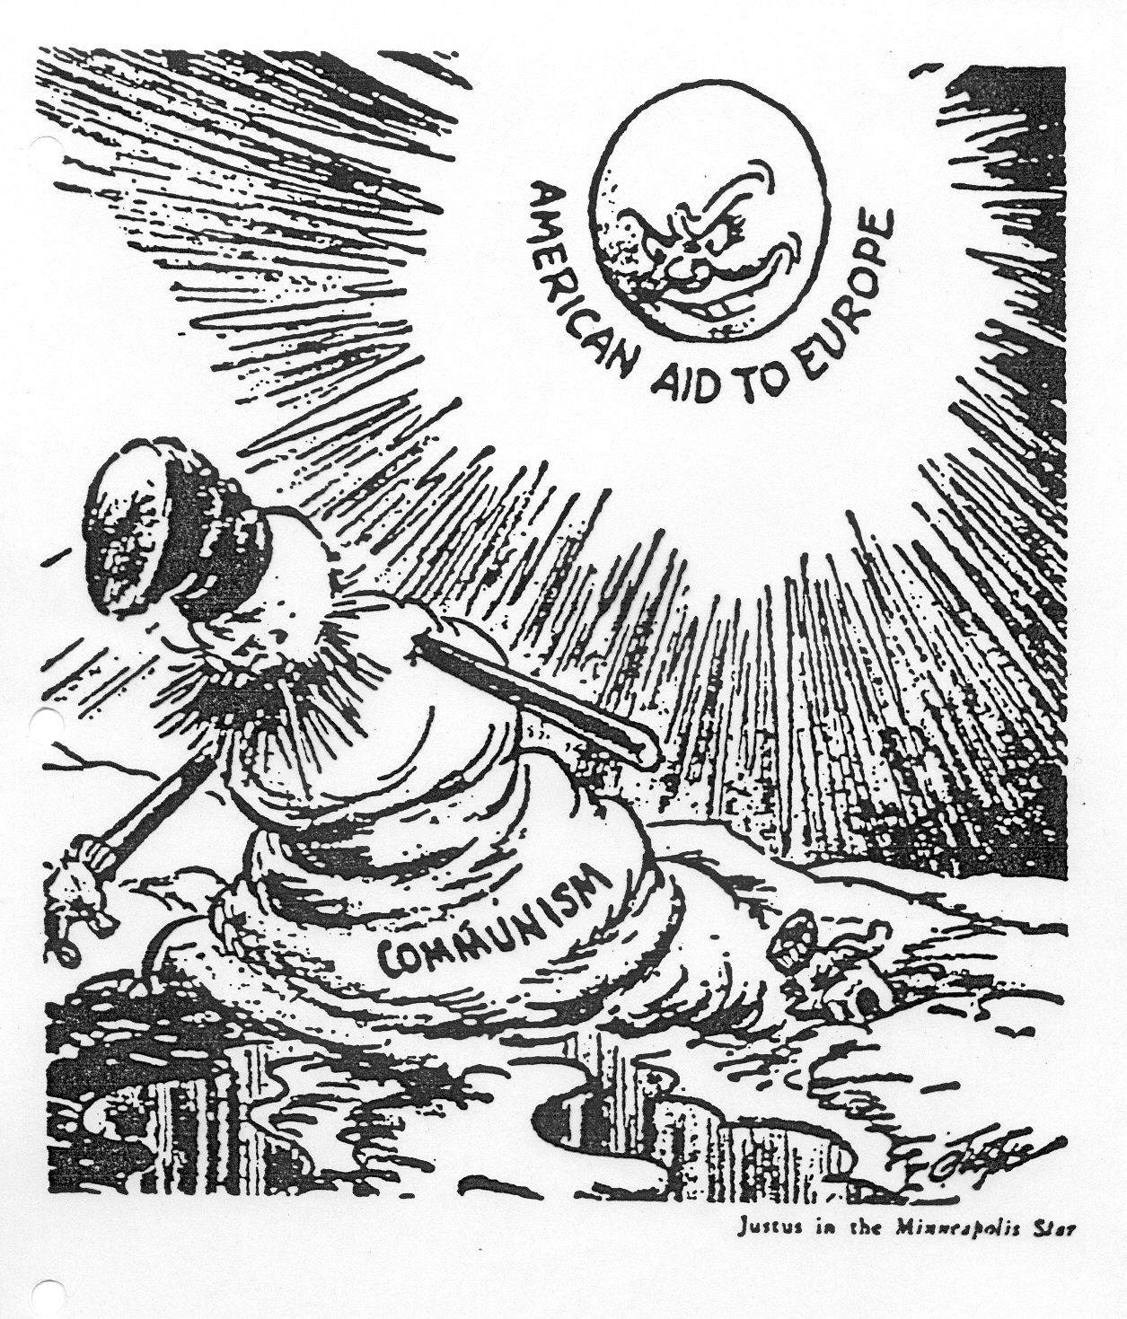

Slide 6
COLD WAR
National Security Act of 1947
Central Intelligence Agency (CIA)
National Security Council (NSC)
NSC-68

Slide 7
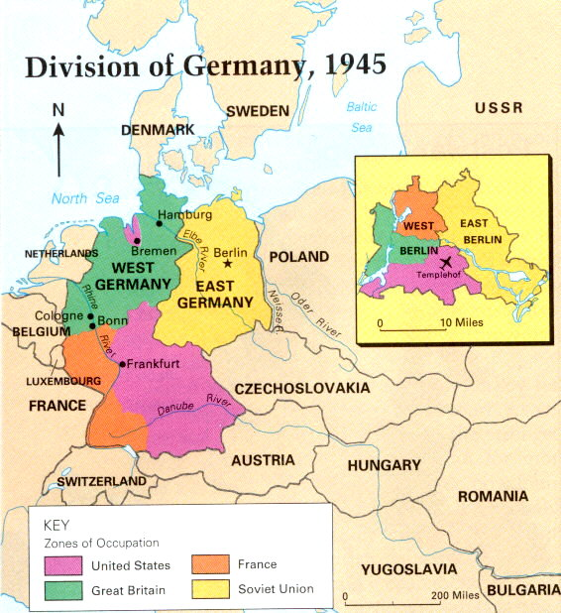
COLD WAR
Berlin Blockade (1948)

Slide 8
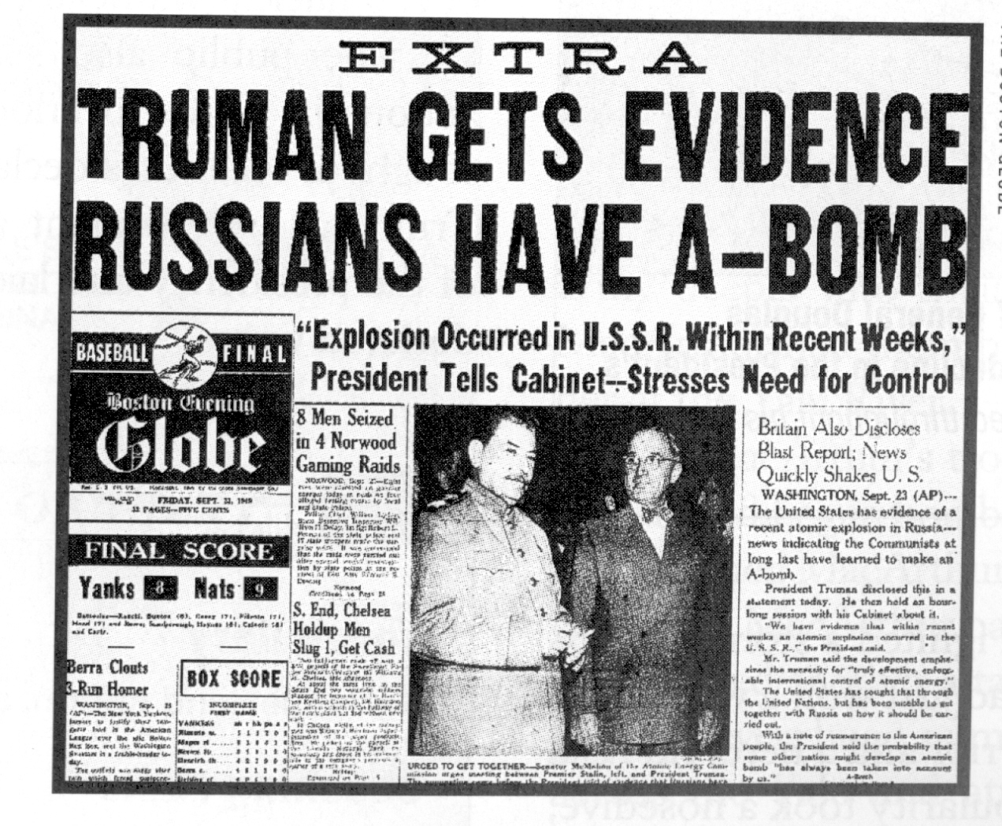
Arms Race

Slide 9
COLD WAR
Hydrogen Bomb
Edward Teller
1,000 X more powerful than atomic bombs dropped on Japan in 1945.

Slide 10
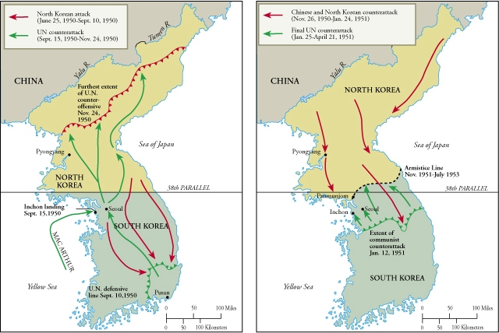
The Korean War (1950-1953)

Slide 11
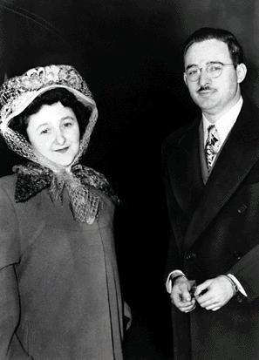
COLD WAR
Second Red Scare
Reasons
World events
Soviets explode a nuclear bomb and China goes Communist (1949)
Korean War
Existence of some American communists
Alger Hiss case (1948)
Ethel and Julius Rosenberg (1950)
Truman’s policies: government loyalty program

Slide 12
Rise and Fall of Senator Joseph McCarthy

Slide 13
Edward R. Morrow – See It Now (March 9, 1954)

Slide 14
COLD WAR
New Leaders: Dwight Eisenhower and Nikita Khrushchev (“Peaceful Coexistence”)
Sputnik (1957)
ICBM-Intercontinental Ballistic Missile (1957)
A Missile Gap?
U-2 Reconnaissance Planes

Slide 15
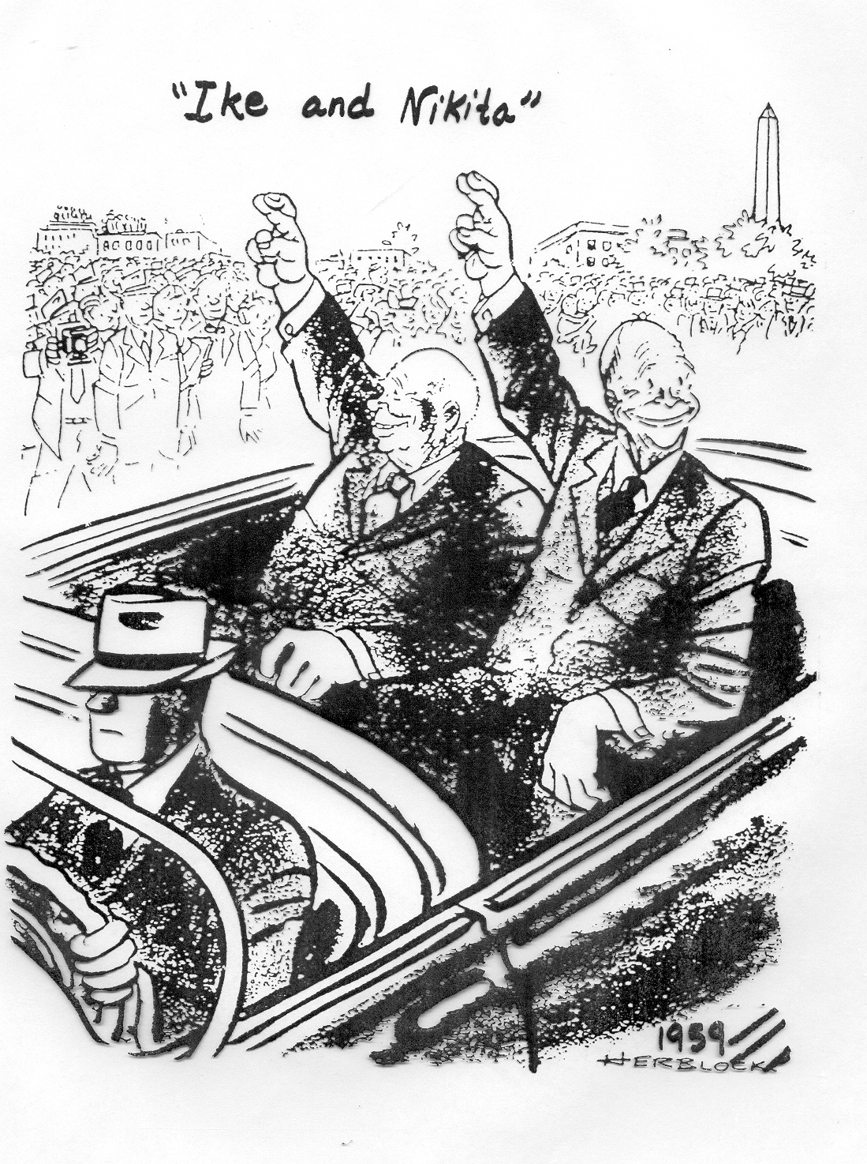

Slide 16
Dwight D. Eisenhower’s Warning about the Military-Industrial
Complex – January 1961

