Slide 1
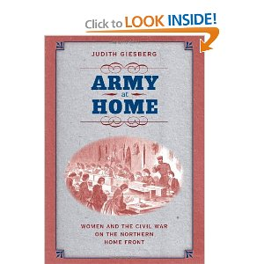
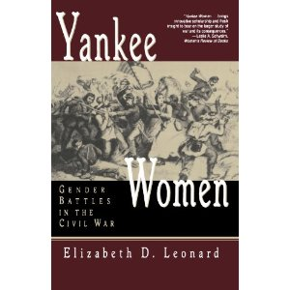
AIHE Summer Institute June 21, 2012 Gender in Reconstruction America
Gender Matters: Civil War, Reconstruction, and the Making of the New South
Leeann whites
Battle Scars: Gender and Sexuality in the American Civil War
Catherine Clinton, Nina Silber, eds.
Divided Houses: Gender and the Civil War
Catherine Clinton, Nina Silber
Yankee Women: Gender Battles in the Civil War
Elizabeth Leonard

Slide 2
Documents
Letters from South Carolina women
The Women’s Centennial Agenda 1876
Sex in Education; or, A Fair Chance for Girls 1875
Elizabeth Cady Stanton, “Solitude of Self” 1892
Recommended: U.S. v. Susan B. Anthony trial transcript
Three Parts:
Suffrage campaigns
Backlash to suffrage campaigns
Gender and American Politics in Gilded Age America

Slide 3
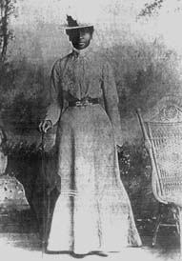
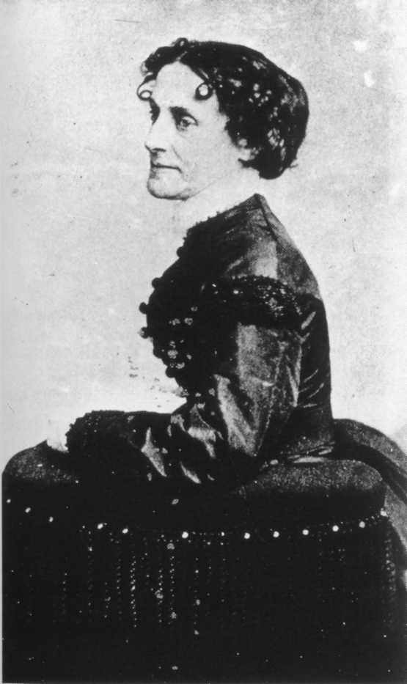
In 1995, the U.S. government honored Mary Elizabeth Bowser for her efforts by inducting her in the U.S. Army Military Intelligence Corps Hall of Fame in Fort Huachuca, Arizona. During the ceremony, her contribution was described thus:
"Ms. Bowser certainly succeeded in a highly dangerous mission to the great benefit of the Union effort. She was one of the highest placed and most productive espionage agents of the Civil War. ... [Her information] greatly enhanced the Union's conduct of the war. ... Jefferson Davis never discovered the leak in his household staff, although he knew the Union somehow kept discovering Confederate plans."
Elizabeth Van Lew
Notes:
Mary Elizabeth Bowser Photo provided by James A. Chambers U.S. Army Deputy, Office of the Chief, Military Intelligence NAME: Mary Elizabeth Bowser
DATE OF BIRTH: 1839?
PLACE OF BIRTH: Richmond, Virginia
FAMILY BACKGROUND: Mary Elizabeth Bowser was born as a slave to owner John Van Lew, a wealthy hardware merchant. His daughter, Elizabeth, and her mother freed her father's slaves after his death in 1843 or 1851 (sources differ). Accounts record the Van Lew women buying members of their slaves' families from other owners, when they found out they were going to be sold, and then freeing them. Another former slave named Nelson went North with Mary after the Civil War; some sources believe this was her father.
EDUCATION: Mary remained with the Van Lew family after she was freed and worked as a paid servant. Elizabeth sent Mary to the Quaker School for Negroes in Philadelphia in the late 1850s.
ACCOMPLISHMENTS: After graduating, Mary returned to Richmond and married William or Wilson Bowser, a free Black man, on April 16, 1861 -- just days before the Civil War began. The ceremony was highly unusual because the church parishioners were primarily white. They settled down just outside Richmond, and Mary continued to work in the Van Lew house.
After the war began, Elizabeth Van Lew asked Mary to help her in the elaborate spying system she had established in the Confederate capitol. Despite Elizabeth being a staunch abolitionist and loyal to the Union, she was a prominent member of Richmond because of her father's wealth and status. But her views and actions (attending to Union soldiers at Libby Prison with food and medicine, in particular) earned her the enmity of her community. Elizabeth used this to her advantage -- taking on a slightly crazy, muttering, slovenly personae that earned her the nickname "Crazy Bet" -- to cover up her serious efforts to help the Union. In addition to the industrious spying and aiding Union prisoners (while also gleaning information from the captives), Elizabeth also helped escaped prisoners by hiding them in a secret room in her mansion. She wrote her information in cipher code, hid the messages in the soles of servants' shoes or hollowed egg shells, then had the notes relayed to Union officers through several helpers and agents.
Mary had considerable intelligence, as well as some acting skills. In order to get access to top-secret information, Mary became "Ellen Bond," a dim-witted, also slightly crazy, but able servant. Elizabeth had a friend take Mary along to help at functions held by Varina Davis, the wife of Confederate President Jefferson Davis. Mary proved herself well and was eventually taken on full-time, working in the Confederate White House until just before the end of the war. Of course, they assumed she was a slave.
With the racial prejudice of the day, the assumption that slaves were illiterate and not intelligent, and the way slave servants were trained to seem invisible, Mary was able to glean considerable information simply by doing her job. While serving meals and cleaning up after, she overhead conversations about troop strategy and movement between the president and his advisors and military officers. Being literate, she was able to read letters and documents that were left out in the president's private study. She memorized everything word for word. Apparently President Davis came to realize there was a leak in the house, but did not suspect Mary until late in the war.
Mary passed her information to either Elizabeth, whom she met occasionally at night near the Van Lew farm just outside Richmond, or Thomas McNiven, a reputable Richmond baker. With his business, both at the bakery itself and while making deliveries, he was able to receive and pass on secrets without suspicion. In his stops at the Davis household, Mary would greet him at the wagon and talk briefly. Just before he died in 1904, Thomas told his daughter Jeannette about these activities, and she in turn told her nephew, Robert Waitt Jr., who recorded them in 1952. According to Thomas, Mary was the source of the most crucial information available:
"...as she was working right in the Davis home and had a photographic mind. Everything she saw on the Rebel president's desk, she could repeat word for word. Unlike most colored, she could read and write. She made a point of always coming out to my wagon when I made deliveries at the Davis' home to drop information."
Toward the end of the war, suspicion finally did fall on Mary, although it is not known how or why. She fled in January 1865, but she attempted one last act as a Union spy and sympathizer. She tried to burn down the Confederate Capitol, but was unsuccessful.
After the war, the federal government destroyed the records of Southern spy activities, to protect their lives -- including Mary, Elizabeth and Thomas. This is why details are missing in their stories. Several sources state that Mary recorded her spying activities in a diary, but family members inadvertently discarded it in 1952. Other sources say the family destroyed them on purpose because they were afraid they might fall into the wrong hands. And still other sources say the diary still exists, in the possession of a Black family that refuses to release it. Apparently, the Bowser family rarely discussed her work -- even among family members -- fearing retaliation from lingering Confederate sympathists, and given the political and social climate in the South. There is no record of Mary's life after the war, or her death. It is thought that she returned to the North (Philadelphia?).
In 1995, the U.S. government honored Mary Elizabeth Bowser for her efforts by inducting her in the U.S. Army Military Intelligence Corps Hall of Fame in Fort Huachuca, Arizona. During the ceremony, her contribution was described thus:
"Ms. Bowser certainly succeeded in a highly dangerous mission to the great benefit of the Union effort. She was one of the highest placed and most productive espionage agents of the Civil War. ... [Her information] greatly enhanced the Union's conduct of the war. ... Jefferson Davis never discovered the leak in his household staff, although he knew the Union somehow kept discovering Confederate plans."
DATE OF DEATH: unknown

Slide 4
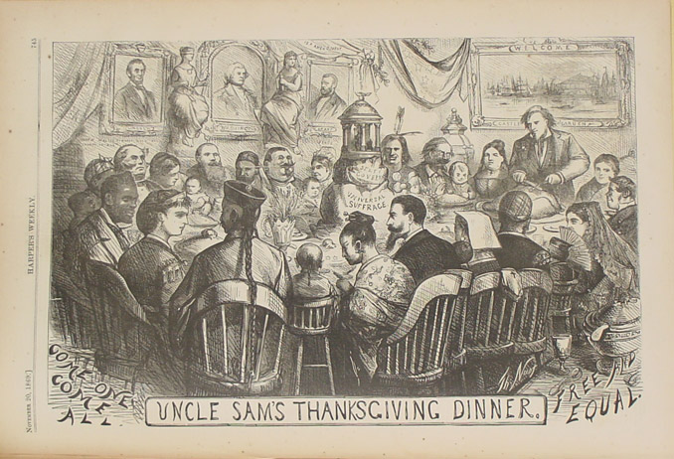
Thomas Nast, “Uncle Sam’s Thanksgiving Dinner,” Harper’s Weekly, November 20, 1869. Nashian idealism of one happy family across lines of race and gender
Notes:
“Uncle Sam’s Thanksgiving Dinner” marks the highpoint of Nast’s Reconstruction-era idealism. By November 1869 the Fourteenth Amendment, which secures equal rights and citizenship to all Americans, was ratified. Congress had sent the Fifteenth Amendment, which forbade racial discrimination in voting rights, to the states and its ratification appeared certain. Although the Republican Party had absorbed a strong nativist element in the 1850s, its commitment to equality seemed to overshadow lingering nativism, a policy of protecting the interests of indigenous residents against immigrants. Two national symbols, Uncle Sam and Columbia, host all the peoples of the world who have been attracted to the United States by its promise of self-government and democracy. Germans, African Americans, Chinese, Native Americans, Germans, French, Spaniards: “Come one, come all,” Nast cheers at the lower left corner.

Slide 5
Antebellum influences on women’s suffrage movement
British writers: Mary Wollstonecraft, Vindication of the Rights of Women
Indian Removal petitions drives
Industrial strikes by Lowell Mill girls
Abolitionist movement
European revolutions of 1848
Seneca Falls Declaration/Dec. of Independence
Civil War and its constitutional outcomes

Slide 6
Seneca Falls Convention 1848 Declaration of Sentiments (1851 image in Punch)

Slide 7
Ninth National Women’s Rights Convention, May 12, 1859 Uppity women as a sociological type Anthony asked "Where, under our Declaration of Independence does the Saxon man get his power to deprive all women and Negroes of their inalienable rights?"

Slide 8
Anthony and Stanton, 1860s-1870s
Notes:
Susan B. Anthony and Elizabeth Cady Stanton, ca. 1870s

Slide 9
New Departure 1868-1875
Anthony: “As the slaves got their freedom must take it over or under, or through the unjust forms of law…now must women, to get their voice in this government must take it”
the contested nature of citizenship
balance of power between states/feds, and
whether the vote was an inherent right of citizenship

Slide 10
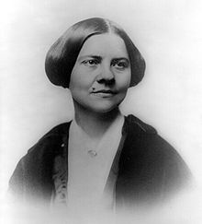
The Schism (1869)
NAWSA
AWSA

Slide 11
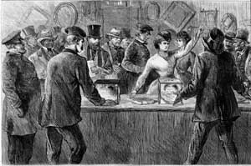
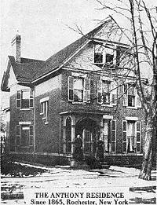
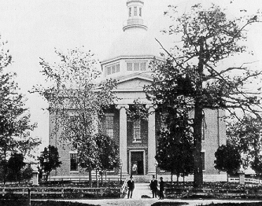
Susan B. Anthony votes in 1872 presidential election

Slide 12
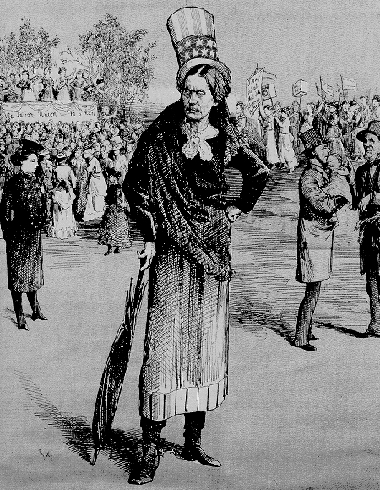
Pre-trial tour: "Is it a Crime for a Citizen of the United States to Vote?"

Slide 13
U.S. v. Susan B. Anthony June 1873
14th amendment prohibited states from denying ”the privileges and immunities of citizens of the United States”
15th Amendment recognized and protected “right of citizens of the United States to vote”

Slide 14
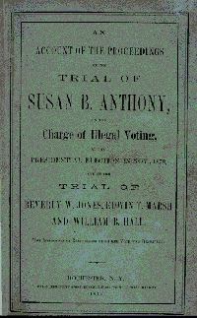
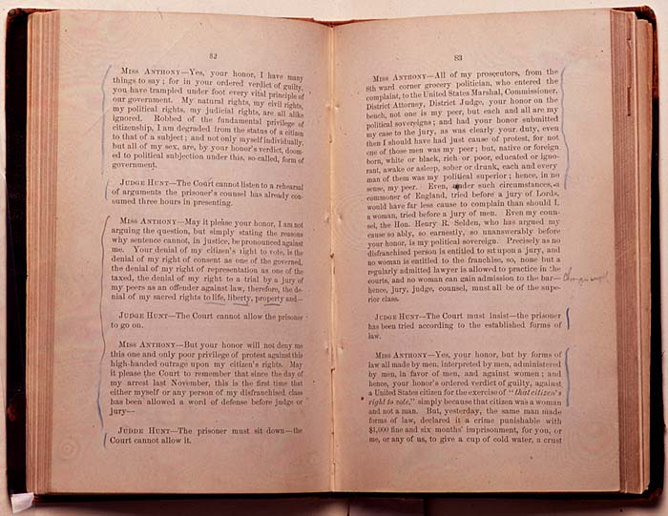
Trial Reenactment Exercise
Trial transcript
Sentencing

Slide 15
Post-trial Statement
Your guilty verdict has “robbed me of the fundamental privilege of citizenship, I am degraded from the status of a citizen to that of a subject…my sex are …doomed to political subjection under this so-called form of government.”

Slide 16
Minor v. Happersett (1875)
women are citizens of the United States
the right to vote is not a "necessary privilege and immunity" to which all citizens are entitled
the Fourteenth Amendment did not add the right of suffrage to citizenship privileges

Slide 17
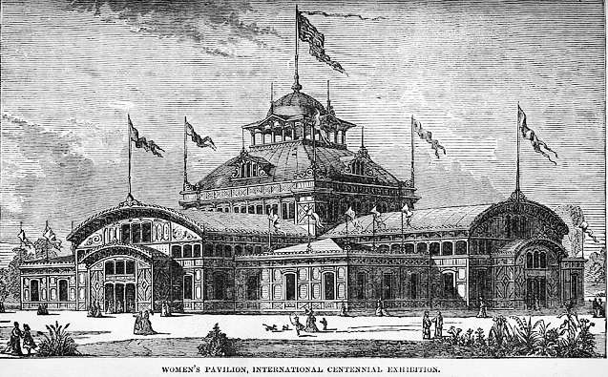
Centennial Celebration, 1876, Philadelphia The Women’s Centennial Agenda, EC Stanton; Susan B. Anthony

Slide 18
History of Woman Suffrage, Stanton, Anthony, and Matilda Gage, 1881-
Multivolume history places Stanton, Anthony, and suffrage at the center of story of women’s rights
Only Sojourner Truth gets a reference

Slide 19
Women of color and the collective nature of the vote

Slide 20
Not mentioned in History:
Mary Ann Shadd Cary
Teacher by day and law student by night (first woman to attend Howard Univ. Law School
Veteran suffrage activist
1871 led (alongside Douglass) an interracial group of women voters
Testified before House Judiciary Committee on behalf of black women – all women’s – right to vote

Slide 21
Not mentioned in History:
Margaretta Forten, Sarah Forten, and Harriet Forten Purvis (sisters)
Organized 1854 Women’s Rights Convention in Philadelphia
Founding members of Philadelphia Female Anti-Slavery Society (PFASS)
Leaders in American Equal Rights Association (1866)
Organized and led the Philadelphia Suffrage Association (1866)

Slide 22
Not mentioned in History:
Charlotte Forten and Harriet Forten Purvis, Jr. (nieces)
Charlotte taught in freedmen’s schools
Harriet (Hattie) never married, and worked for most of her life alongside of Anthony for the woman’s movement

Slide 23
Not mentioned in History:
Frances Ellen Watkins Harper
Well-known poet and activist
“I do not believe that giving the woman the ballot is immediately going to cure all the ills of life. I do not believe that white women are dew-drops just exhaled from the skies.
“I think that like men they may be divided into three classes, the good, the bad, and the indifferent. The good would vote according to their convictions and principles; the bad, as dictated by prejudice or malice; and the indifferent will vote on the strongest side of the question, with the winning party. “

Slide 24
Why Truth chosen as representative?”
Women left out were intellectual equals
Some had been critical of ECS and SBA’s racism
ECS and SBA concluded that “Black men were opposed to woman suffrage”
F. Douglass, R. Purvis, and C. Langston remained loyal to the movement

Slide 25
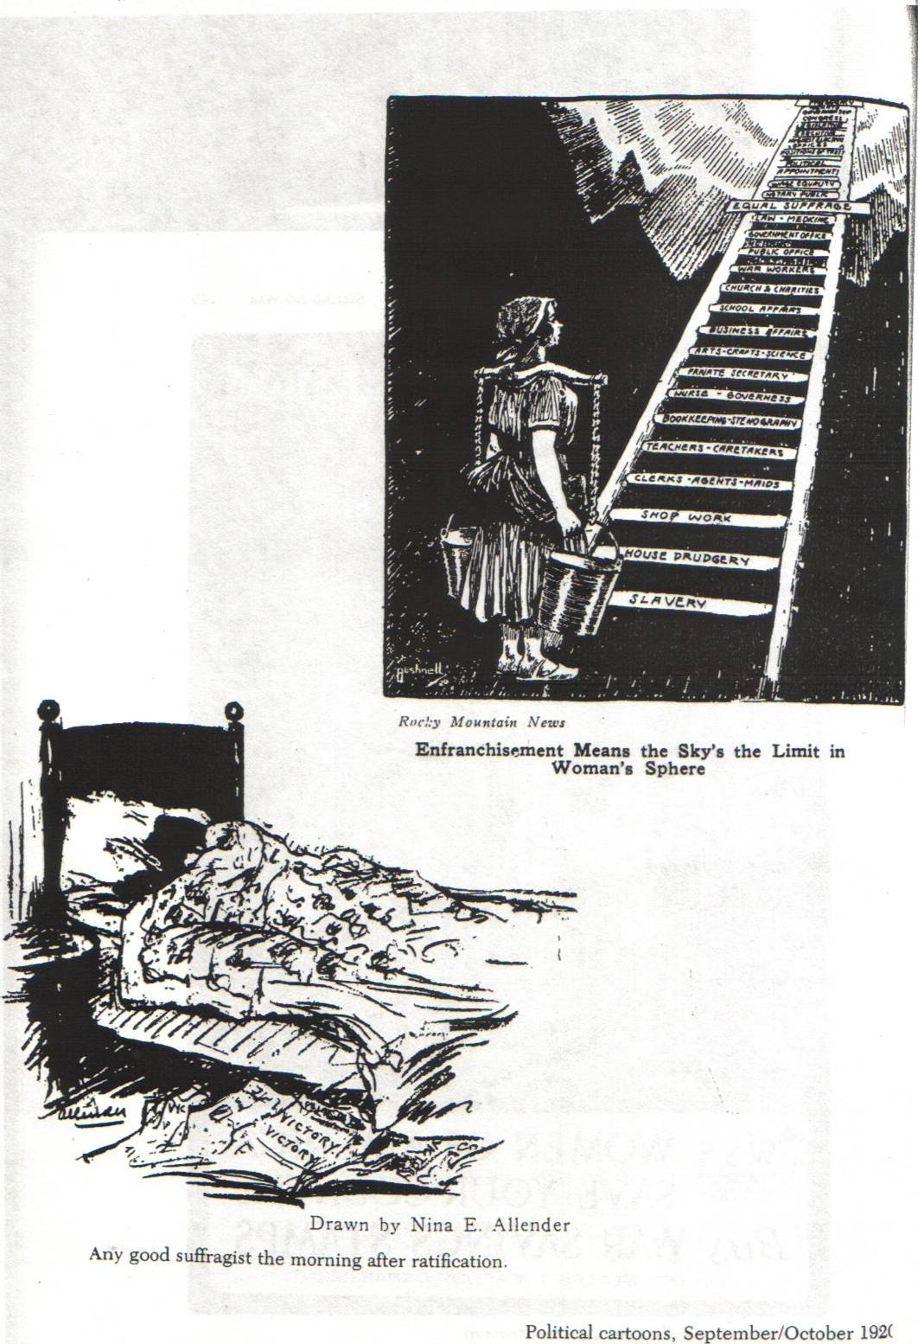
State by State

Slide 26
The progress of suffrage in the West
Suffrage for whom?

Slide 27
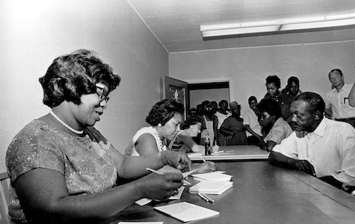
When did women get the vote?
1965 Voting Rights Act

Slide 28
Gender and the postwar backlash

Slide 29
1869 women’s right convention who are these women? And what is at stake?

Slide 30
Currier and Ives, 1869

Slide 31
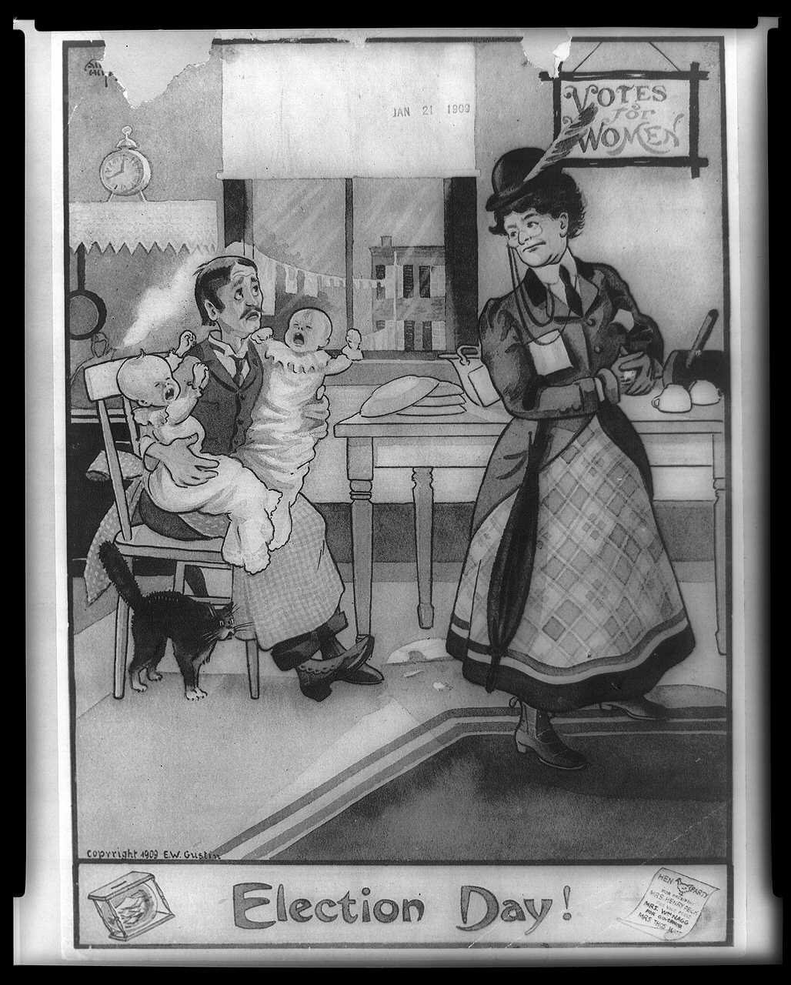

Slide 32
Edward H. Clarke, M.D. “Sex in Education; or, A Fair Chance for Girls” Social Darwinism: Nature and Gender
“Its solution must be obtained from physiology.”
“He should be master of the plough, and she mistress of the loom.”
“she furnished another text for the often-repeated sermon on the delicacy of American girls.”
“I was finally obliged to consign her to an asylum.”

Slide 33
Women and Sports in Victorian America
Margaret Coxe, Young Lady’s Companion
Elizabeth Cady Stanton, The Lily
Stanton and Bloomers (Amelia Bloomer)
Vassar College baseball games
Bryn Mawr Athletic Association
Women’s Basketball: Stanford vs. Univ. of California, 1896
Women and Country Clubs
Women’s Athletic Association, 1891
“Right to public outdoor exercise

Slide 34
The Frontier, Manhood, and War
“Closing of the American Frontier” (1890 census/1893 lecture)
Social Darwinism (11:30 discussion)
Great Depression of 1893-1897
Arbitrationists/Jingoists
– Britain vs. U.S. 1895
Conflict over Venezuela/Monroe Doctrine
Sen. Stewart: “I want American manhood asserted.”
Treaty w/ G.B. in 1897/Rejected by Senate
Spanish-American War, 1898
U.S.-Philippines War, 1898-1903
Imperialists/expansionists
Anti-imperialists/anti-expansionists

Slide 35
Wilderness, Frontier, and American Manhood
Fresh Air Relief – NY Times (188,742 individual outings in 1895)
Fresh Air Fund -- NY Tribune
Primitivism
The football field as a substitute “frontier” to toughen new generation:
Football displayed “those characteristics that have made the Anglo-Saxon race pre-eminent in history.” (President of University of Wisconsin)
“The child revels in savagery, and if its tribal, predatory, hunting, fishing, fighting, roving, idle, playing proclivities could be indulged in the country, they could conceivably be so organized and directed as to be far more truly humanistic and liberal than all that the best modern school can provide.” – G. Stanley Hall, Adolescence, 1904
Roosevelt, “The Strenuous Life” and the fear of “degeneracy” writ large
Boone and Crocket Club, 1885
Sons of Daniel Boone, 1905
Boy Scouts, 1907/Girl Scouts, 1912

Slide 36
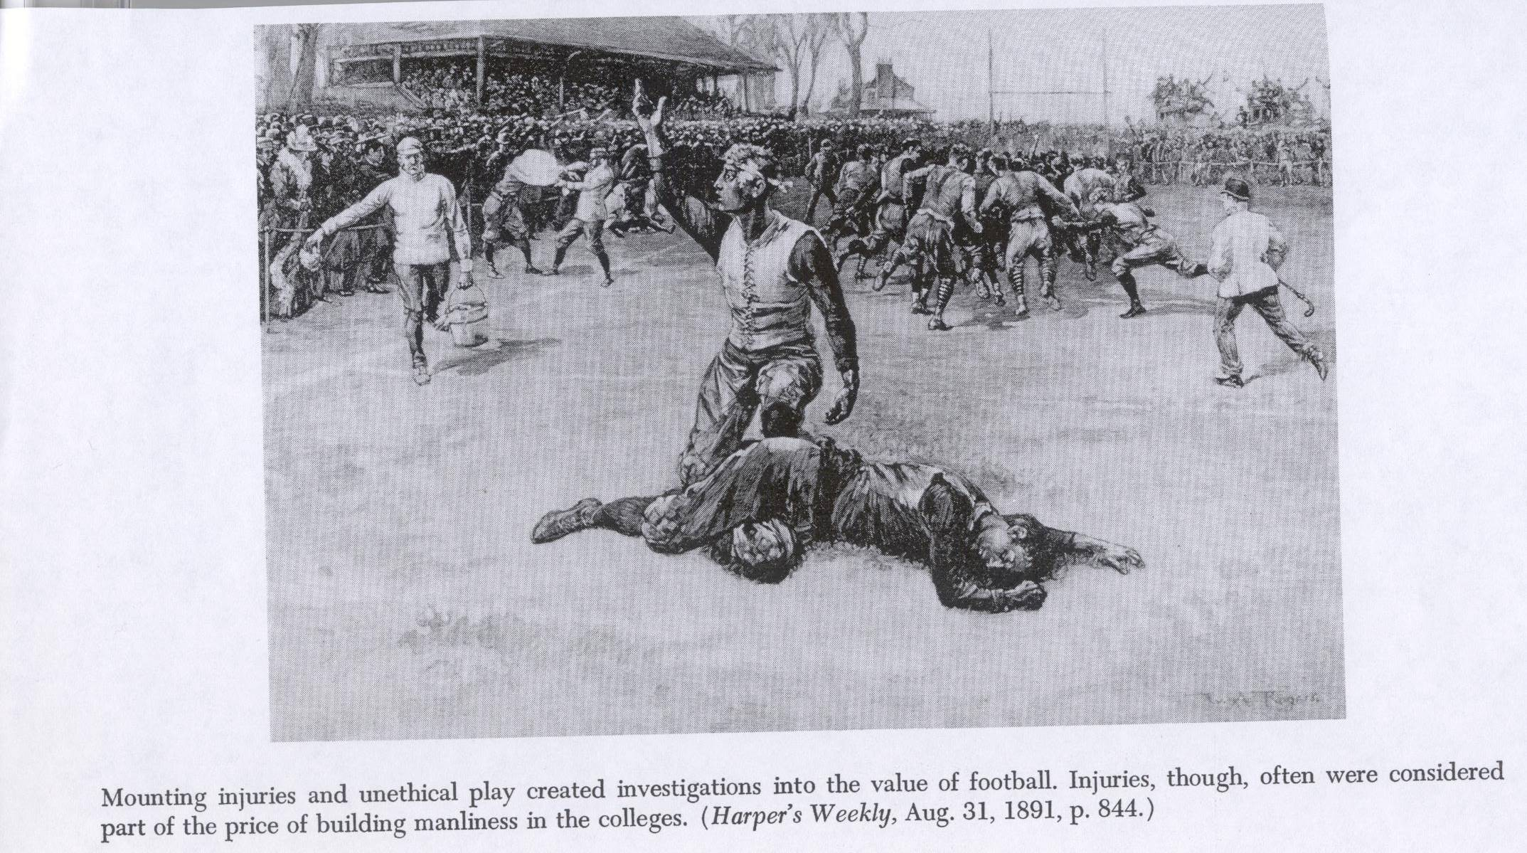
Processes to toughen “weak men”: Football field as frontier battlefield; Impetus for NCAA, 1907 (19 football deaths in 1905)
Products to toughen “weak men”

Slide 37
The “weak man” and the “new woman” invading male spheres

Slide 38
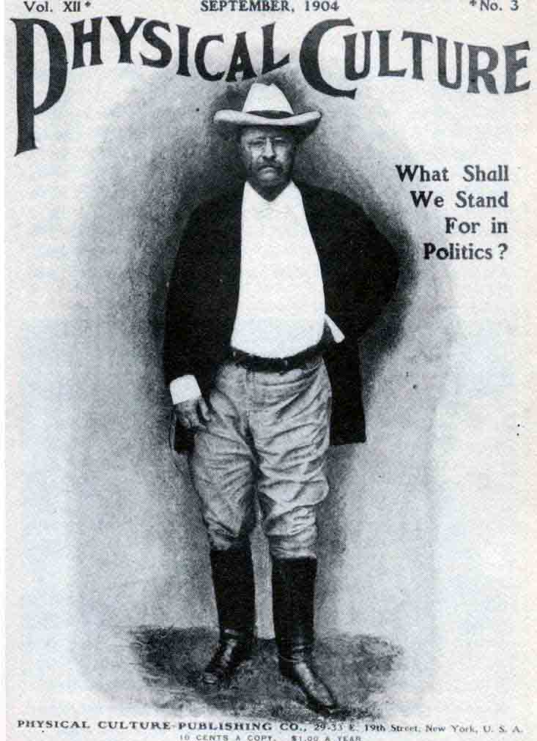
Politics and Gender

Slide 39
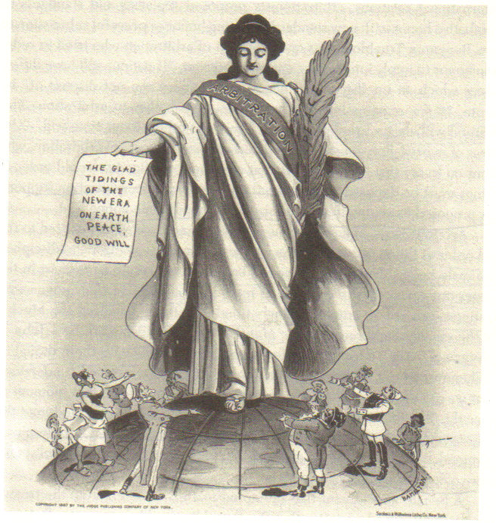
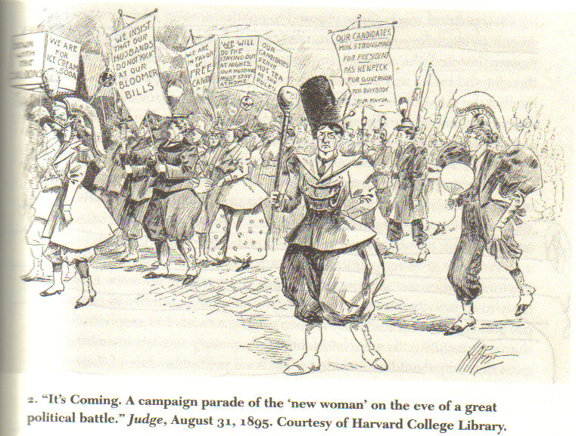
Arbitrationists – women as political actors

Slide 41
Kipling, The White Man’s Burden 1899 Take up the White Man’s Burden, done with Childish Days, Comes now, to search your manhood, through all the thankless years, Cold, edged with dear-bought wisdom, the judgment of your peers.”
Notes:
NOTE THE BOTTOM CAPTION: FROM JOHN BULL

Slide 43
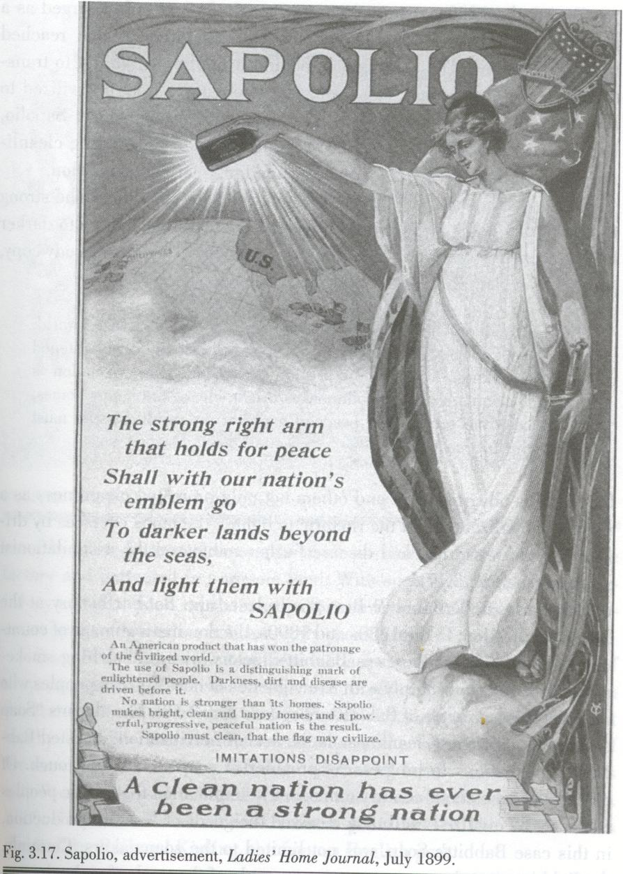
Imperial cleanliness Anti-expansionists

Slide 44
Gender and the Corporate welfare movement

Slide 45
Questions?

Slide 46
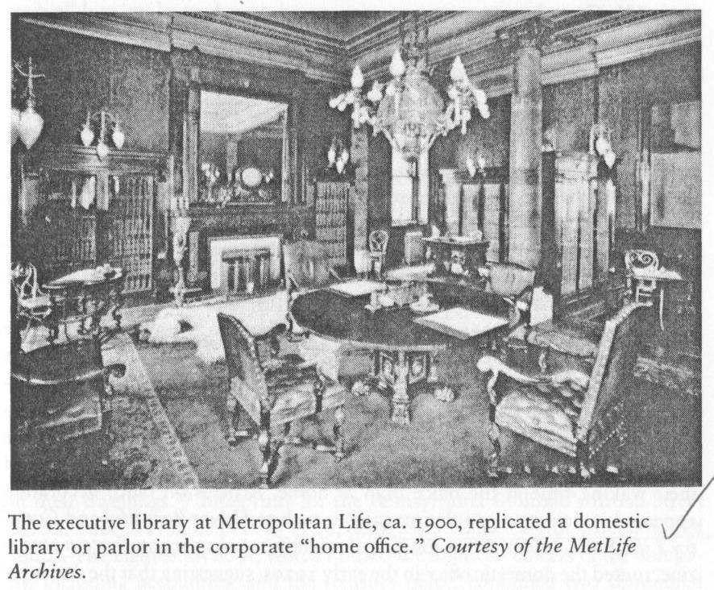

Slide 47
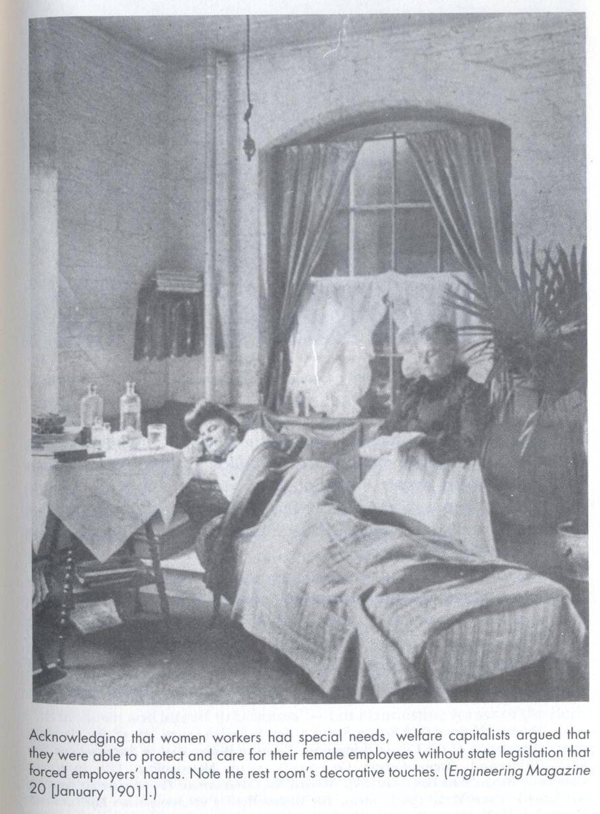
Notes:
Acknowledging that women workers had special needs, welfare capitalists argued that they were able to protect and care for their female employees without state legislation that forced employers’ hands. Note the rest room’s decorative touches. HOMEY.

Slide 48
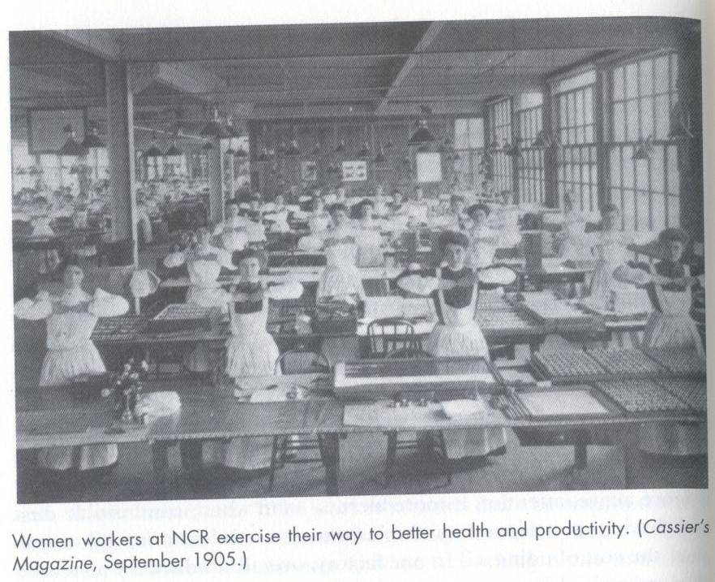

Slide 49
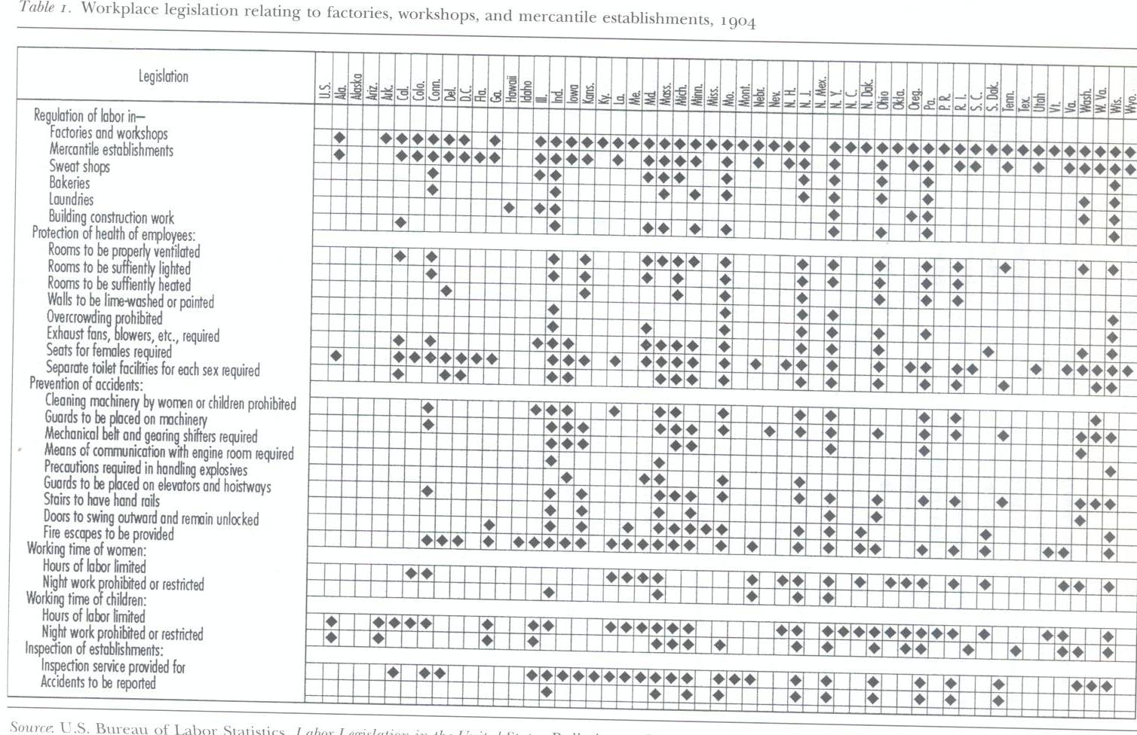
Corporate welfare movement

Slide 50
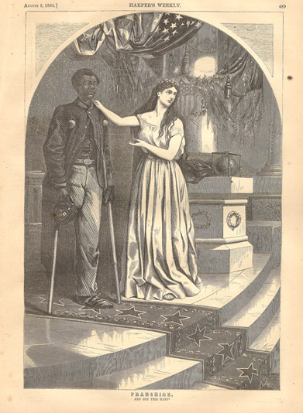
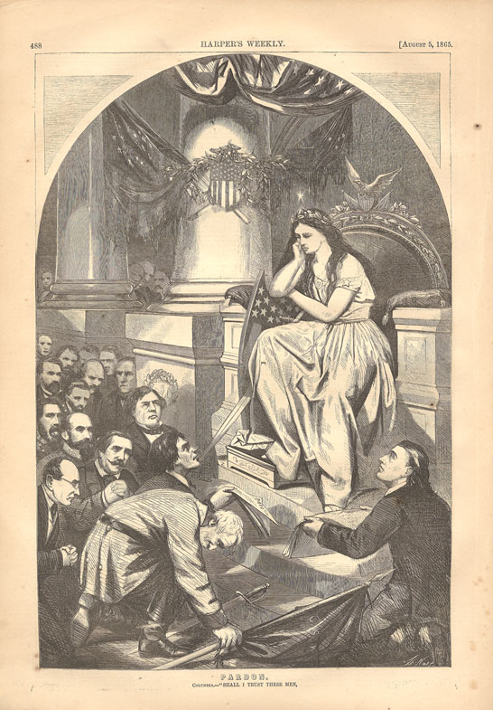
“Pardon/Franchise,” Harper’s Weekly, August 5, 1865, p.488-489. Wood engraving.
Harper’s Weekly and Nast favored what was seen as a radical policy of Reconstruction—both of the Union itself and of southern society—with the enfranchisement of African American men as a central element. But in the summer of 1865, radical Republicans faced strong public opinion in favor of lenient treatment of the South, speedy restoration of the Union, and good feelings, which would leave former slaves with little more than freedom. Columbia, symbolizing the nation, ponders the supplicating southerners, led by General Robert E. Lee, who hope to be restored to their rights and privileges as American citizens. How sincere is their repentance, she wonders? Shall I trust them with civil rights and the power of the vote, but not give the disabled African American Union veteran the same rights?

Slide 51
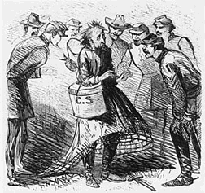

Slide 52
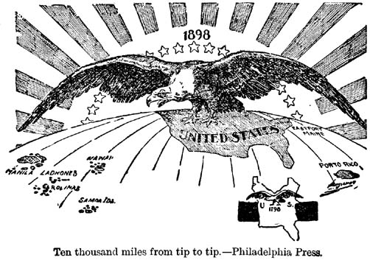
Jingoism

Slide 54
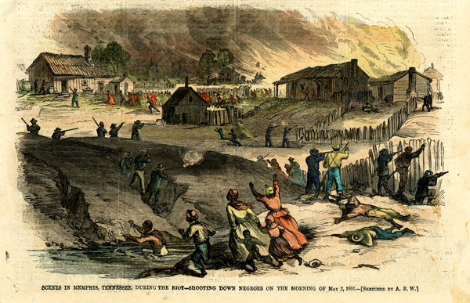
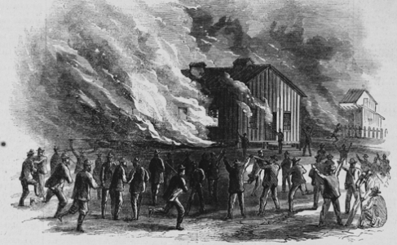
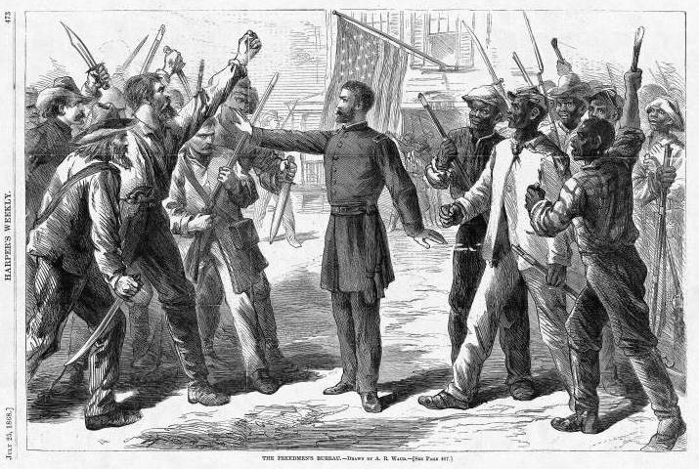
Memphis Riot of 1866
Below is an idealized image of the Freedmen's Bureau from Harper's Weekly from 1868. In it the stalwart officer of the Bureau, framed by the Stars and Stripes, separates angry whites and blacks. Left to themselves, a race war would break out. However exaggerated the portrait, the events in Memphis, New Orleans, and elsewhere throughout the South proclaimed the need for a federal presence.

Slide 55
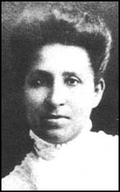
Mary Church Terrell
Father shot during Memphis riots
She became the co-founder of the Federation of Afro-American Women and in 1896 the first president of the National Association of Colored Women

Slide 56
Gender and the postwar backlash

Slide 57
Gender and the postwar backlash

