Slide 1
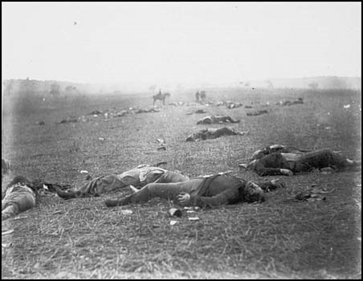
Ghosts of Gettysburg
Julie Quick, Social Studies Teacher, Montoursville Area High School
Kara Meyer and Cheyenne Hakes, Students
To use the navigation buttons, click on the one that points in the direction you want to go.
To go to the main menu, which is on the next slide, click on the HOME icon in the upper right corner.

Slide 2
Main Menu
Interesting Facts
Ghost Sightings in Gettysburg
Ghost Sightings in Gettysburg Cont…
Ghost Sightings in Gettysburg Cont…
Ghost Sightings in Gettysburg Cont…
Ghost Sightings in Gettysburg Cont…
Ghost Tours
Ghost Tours Cont…
Works Cited
Works Cited Cont…

Slide 3
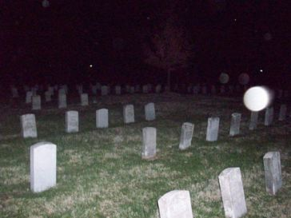
Interesting Facts
5,000 horses and 50,000 men were killed in the battle.
Many soldiers never received a proper burial.
Gettysburg was one of the bloodiest battles of the Civil War.
Rivers ran red after the battle.

Slide 4
Ghost Sightings in Gettysburg
Ghosts have haunted Gettysburg for 100 years.
In the Gettysburg Hotel
See women dancing in ballroom
Union Soldiers roam hotel

Slide 5
Ghost Sightings in Gettysburg Cont…
This picture shows an orb of light at Little Round Top. The man in the corner was not there at the time the picture was taken, and seems t be dressed in Civil War era clothing.

Slide 6
Ghost Sightings in Gettysburg Cont…
In the Baladerry Inn
Guest get a glimpse of their life after death
Confederate Soldier haunts the hotel
Cashtown Inn
In pictures taken there strange orbs and skeletons show up.
Lights turn on and off by themselves
Doors lock and unlock by themselves

Slide 7
Ghost Sightings in Gettysburg Cont…
During the 130th anniversary of the battle, 2 reenactors were sitting on the top of Little Round Top, when they saw what they thought was a fellow reenactor approaching them.
One of the sitting reenactors was a professor of Gettysburg college and he was quite impressed with the man's kit.
The man who came up approached using dialect of the Civil War era and said "Weren't Some fight we had today huh boys?"
"Well" said the man, "You might need these here tomorrow" The man reached in his kit and handed the boys some cartridges. The professor was deeply impressed, because the cartridges were tied the right way and sealed with the right amount of bees wax and he was going to say something when he felt the Minne ball inside.
BY FEDERAL LAW NO REENACTOR IS TO BRING LIVE ROUNDS ON THE FIELD
When the men looked up, the reenactor disappeared.
The relics were brought back to camp for us to see and they have been DNA tested to 1863.

Slide 8
Ghost Sightings in Gettysburg Cont…
A couple went to Gettysburg on vacation.
The wife kept seeing kids running around and figured the clothes they were wearing were just a new style.
A bunch of them gathered around a tree and asked her to take their picture.
After some other strange experiences, they returned home and had their pictures developed.
Under the tree there was nothing but bright green illuminations.

Slide 9
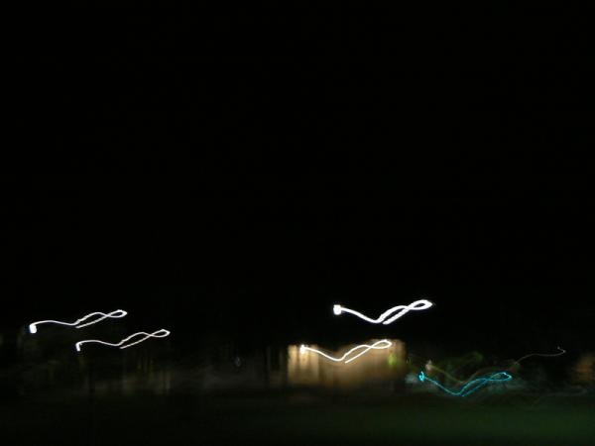
Ghost Tours
Ghost Train
90-minute tour
Goes across actual battlefield
People have reported ghost sightings.
Smells cigars but no one is smoking
See Soldiers roaming on train

Slide 10
Ghost Tours Cont…
Gettysburg Candlelit Ghost Walk
Participants have reported tugging on their clothes.
They’ve also reported the feeling of being choked and feeling sick, until leaving the area.
Some say they smell lavender, but are unable to find the source. During the battle, townspeople allegedly used lavender to cover up the stench of the bloodshed.

Slide 11
Works Cited
Mosby, Kwin. "Ghosts of Gettysburg." Travel Channel. 20 May 2009 <http://www.travelchannel.com/Travel_Ideas /Haunted_Travels/ci.Ghosts_of_Gettysburg.a rtTravelIdeasFmt?vgnextfmt=artTravelIdeasF mt>.
"Battle of Gettysburg." Travel Channel - Travel Shows and Guides. 22 May 2009 <http://www.travelchannel.com/Travel_Ideas /Great_American_Vacations/ci.Battle_of_Get tysburg.artTravelIdeasFmt?vgnextfmt=artTra velIdeasFmt>.

Slide 12
Works Cited Cont…
"Ghost Stories, The Ghosts of Gettysburg / GlobalPsychics.com." Global Psychics, Real Psychics, Real Answers / GlobalPsychics.com. 26 May 2009 <http://www.globalpsychics.com/amusing -you/ghost-stories/gettysburg- ghosts.shtml>.

