Slide 1
The Gilded Age
Always Challenge the Narrative
Kevin T. Brady, Ph.D.

Slide 2
Pennsylvania Social Studies Standards
Grade 9 – 8.3.9.C. Analyze how continuity and change has influenced United States history from 1787 to 1914.
Commerce and Industry (e.g., growth of manufacturing industries, economic nationalism)
Settlement Patterns and Expansion (e.g., Manifest Destiny, successive waves of immigrants)

Slide 3
Pennsylvania Social Studies Standards
Grade 9 – 8.3.9.C. continued . . .
Transportation and Trade (e.g., Pony Express, telegraph, Transcontinental Railroad)
Politics (e.g., election of 1860, impeachment of Andrew Johnson, Jim Crow laws)

Slide 4
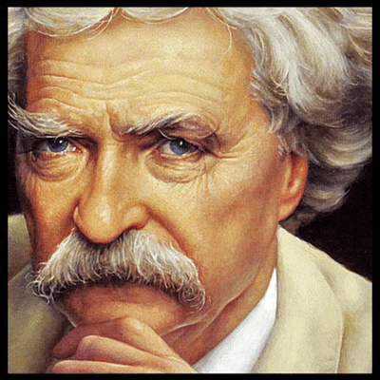
Where Did The Name Come From?
The Gilded Age: A Tales of Today, by Mark Twain & Charles Dudley Warner, 1873
Strong Sales– Weak Reviews
The plot could not hold together with two authors
Highlights American corruption
It complained about democracies’ inability to deliver Good Government.

Slide 5
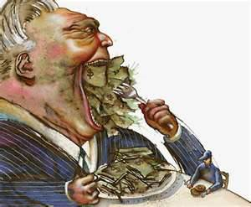
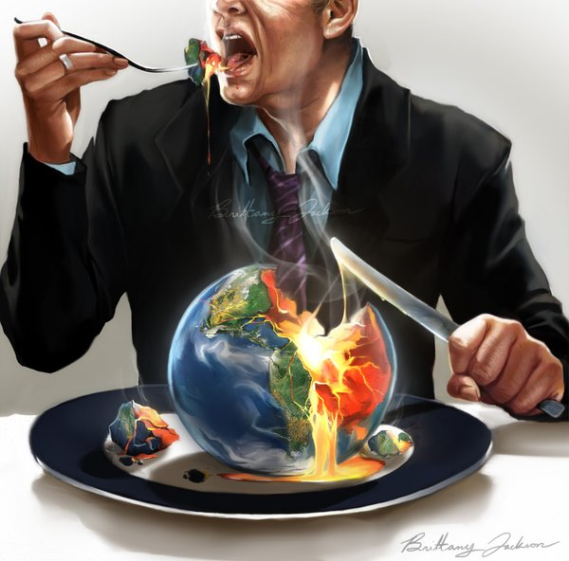
Greed appealed to capitalists & Couldn’t be put Aside when men entered politics
Title caught on:

Slide 6
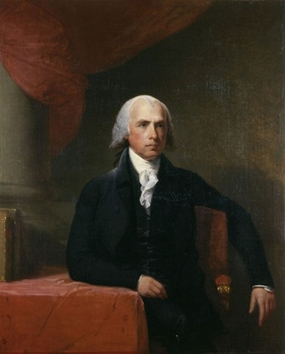
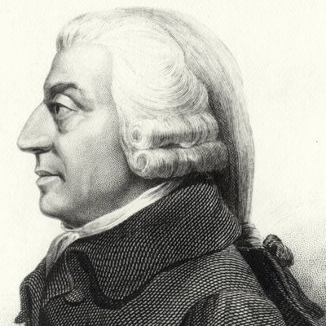
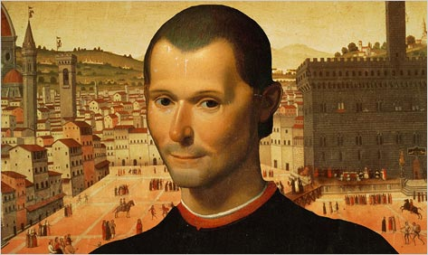
IRONICALLY
The Founders understood this; men will pursue glory, so they created a government with institutions to dilute power - Limited Government
Coeval Economists understood this; men should pursue self interests – the invisible hand will keep them in check
Who Me?

Slide 7
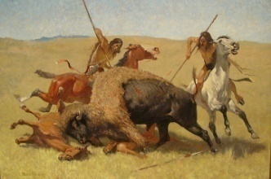
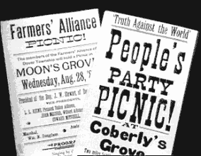
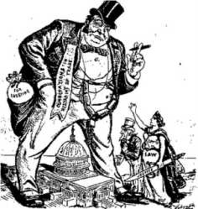
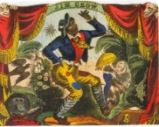
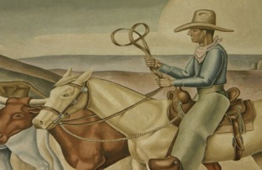
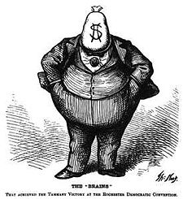
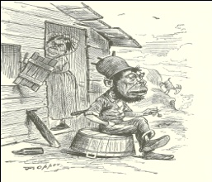
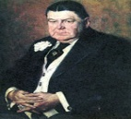
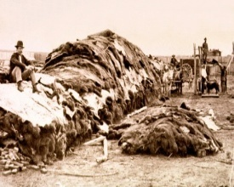
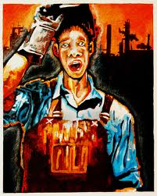
Late 19th Century America
Triumph of Capitalism
Industrial Revolution
Railroads
Increases in Standard of Living
Economics
Depressions
Immigration
Rise of Labor
Conquest of the South
Conquest of the West
Cattle & Capitalism
Farming a Desert
Populists
Rise of Cities
Political Machines
Politics
Imperial Aspirations

Slide 8
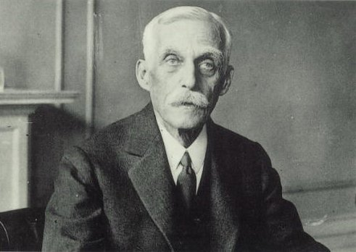
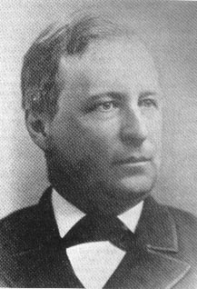
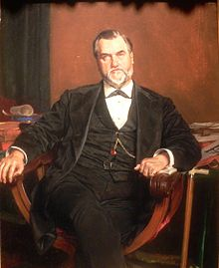
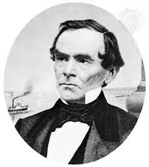
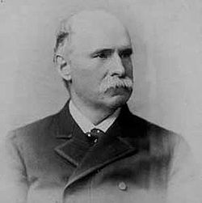
The Titans
Vanderbilt
Rockefeller
Carnegie
Morgan
Gould
Schwab
Mellon
Fisk
Drew
Gowen
Drake
Drexel
Stanford

Slide 9
Robber Barons or Captains of Industry?
Greedy
Exploited Workers
Tied Closely with Government
Destroyed Democracy
Unsafe Products
Polluters
Gouged Consumers
Increased the Standard of Living
Provided for the Masses
Produced Better Lives for All
Consumers could Leave
Philanthropists

Slide 10
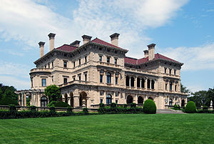
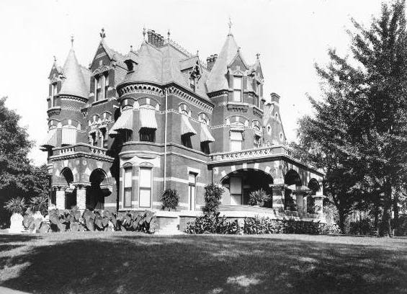
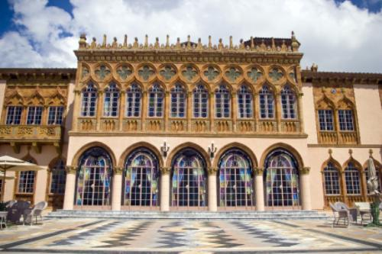
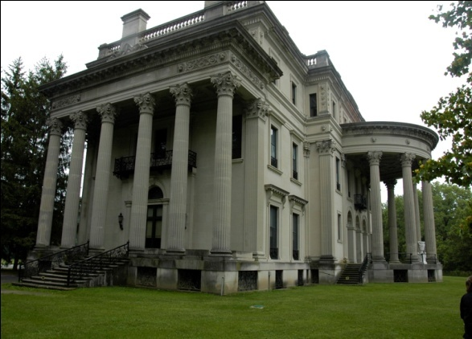
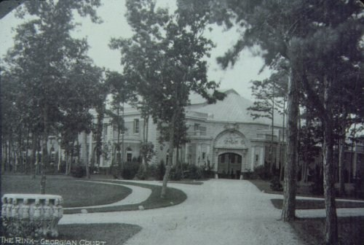
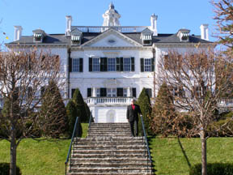
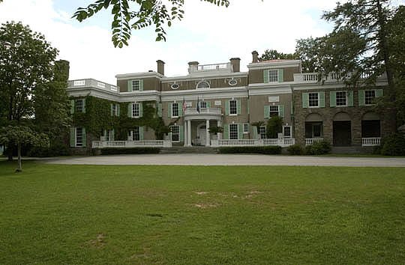
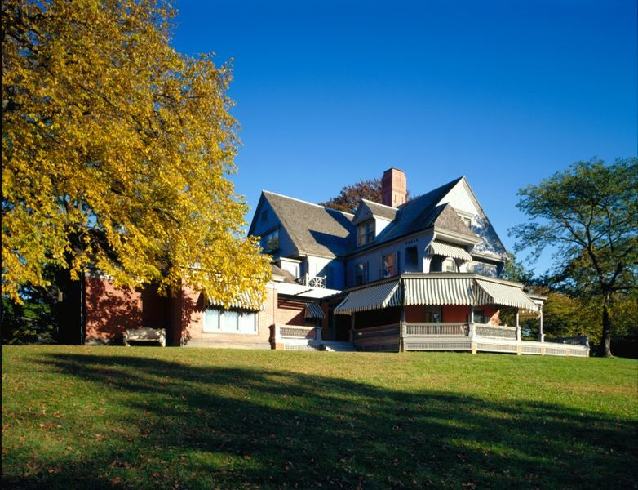
Conspicuous
Consumption
or, Commoners
with the Audacity
of Acting like
Aristocrats

Slide 11
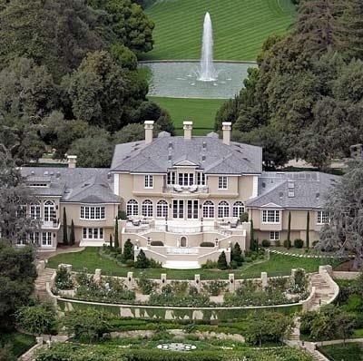
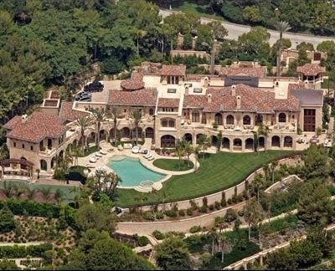
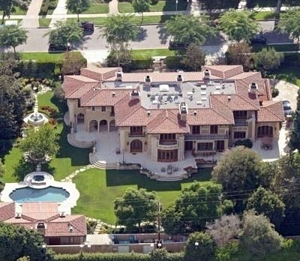
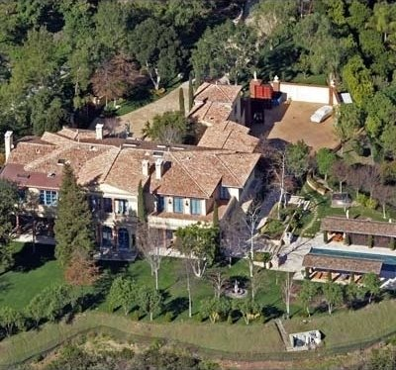
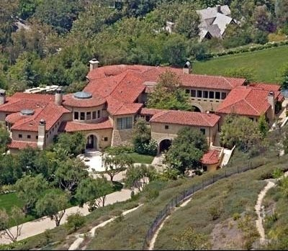
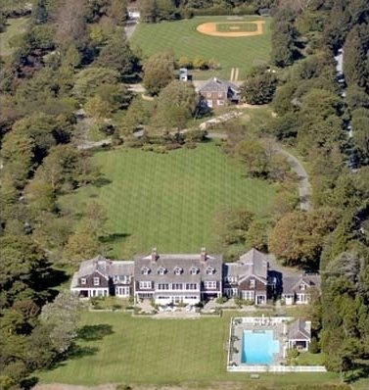
They had hovels
compared to our
Hollywood Stars

Slide 12
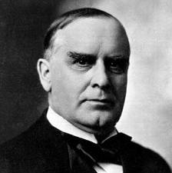
Government
Divided Government.
1868-1900: 7 (8) Presidents.
6 Republicans, but two had lost the the popular vote (1876 and 1888).
5 from Ohio; 2 from New York.
GOP only obtained the Presidency and both houses once: 1889-1891.
Democrats had all three only once: 1893-1895.
G.O.P. held 7 of the 10 Senates.
Democrats held 8 of the 10 Houses.

Slide 13
Even the G.O.P. was Divided
Radicals vs. Liberals.
Stalwarts vs. Half-breeds.
No real ideology.
Special interests – Patronage
(see Martin Van Buren in the 1820s)
Farmers got the Homestead Act.
Veterans got pensions.
Manufacturers got tariffs.

Slide 14
Democrats owned the “Solid” (White) South
They held the border (former slave) states.
The southern pathway to the west.
Northern cities, because of the Irish political machines. (Philadelphia had a strong Republican machine.)

Slide 15
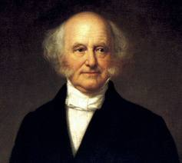
Machines
Party bosses ruled
Patronage and Power
E.g. Lincoln removed and replaced 1,639 workers; dismissed 1,457
We’re O.K. with
“Old Kinderhook” -
His legacy

Slide 16
The Free Market & Industrial Revolution
Steamships
Telephones
Light bulbs
Barbed Wire
Zipper
Bicycle
Automobile
Movies
Phonographs
Machine Gun
Typewriter
Sewing Machine
Created Jobs
Increased Longevity
Increased Standard of Living
Cheaper Clothes
Healthier Diets
Better Housing
Middle Class
Cheaper Food
Domesticity
Civil Manners
Railroads

Slide 17
Railroads
Changed the World.
Civil War matured this industry.
Transcontinental Railroad.
Primarily Irish workers on the Union Pacific.
Irish & Chinese Workers on the Central Pacific
Much Conflict
Some Deadly

Slide 18
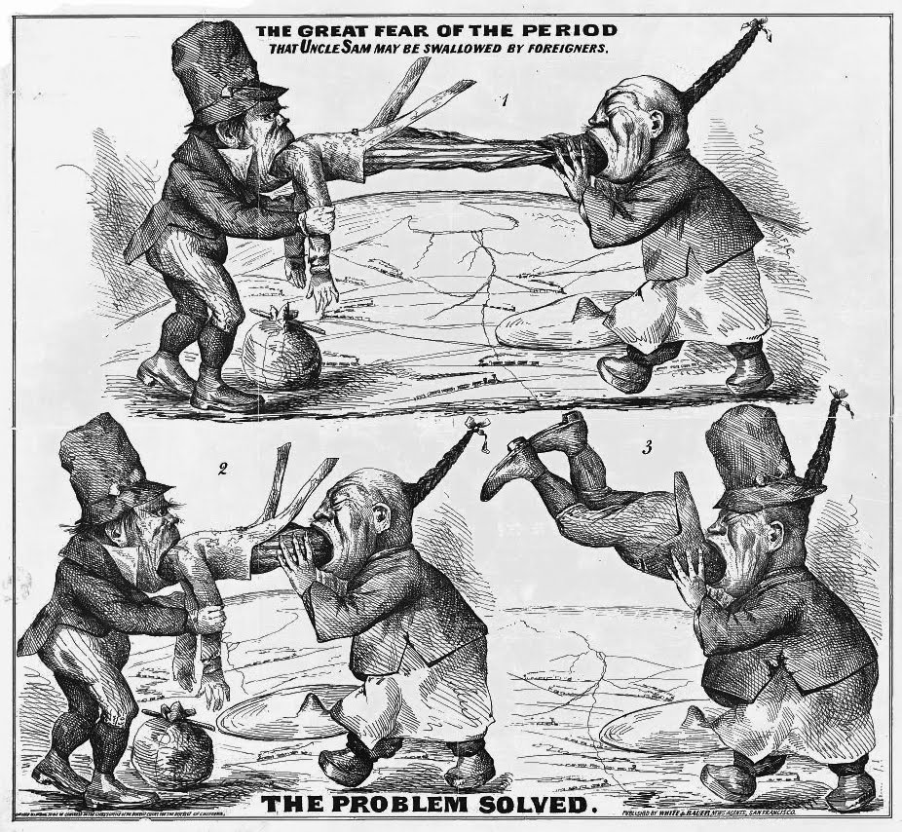
Railroad Workers!

Slide 19
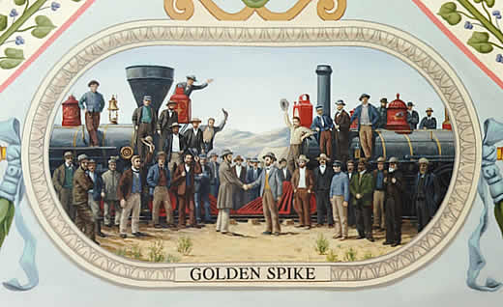
Political Entrepreneurs vs. Market Entrepreneurs
James J. Hill and the Northern Pacific
Vs.
The Central Pacific and Union Pacific Line

Slide 20
Gilded Age Economy
Growth rates of industrial production (1850s–1913)
 | 1850s–1873 | 1873–1890 | 1890–1913
Germany | 4.3 | 2.9 | 4.1
United Kingdom | 3.0 | 1.7 | 2.0
United States | 6.2 | 4.7 | 5.3
France | 1.7 | 1.3 | 2.5
Italy |  | 0.9 | 3.0
Sweden |  | 3.1 | 3.5

Slide 21
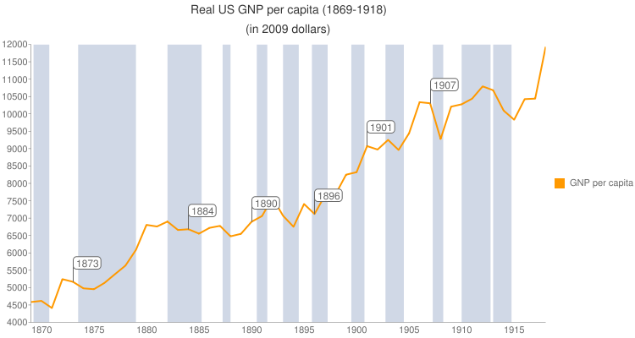

Slide 22
Estimates of Unemployment during the 1890s (Source: Romer, 1984)
Estimates of Unemployment during the 1890s (Source: Romer, 1984)
Year | Lebergott | Romer
1890 | 4.0 | 4.0
1891 | 5.4 | 4.8
1892 | 3.0 | 3.7
1893 | 11.7 | 8.1
1894 | 18.4 | 12.3
1895 | 13.7 | 11.1
1896 | 14.5 | 12.0
1897 | 14.5 | 12.4
1898 | 12.4 | 11.6
1899 | 6.5 | 8.7
1900 | 5.0 | 5.0

Slide 23
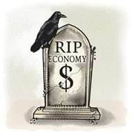
Crisis of 1873
1860s Europe.
Mortgage Backed Lending took place.
Vienna, Berlin, Paris building boom.
1873: Defaults began to restrict lending.
France had to pay a 200 million franc reparation to the new nation —
Germany.
Austrian stock market crash.

Slide 24
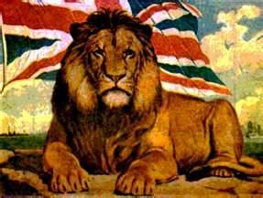
Chain Reaction
European banks started to recall loans from British banks.
Brits, in turn, started to recall loans from American entrepreneurs.
Biggest clients were American railroads.
Americans had built too much track, financed with debt.
Railroads start to default.

Slide 25
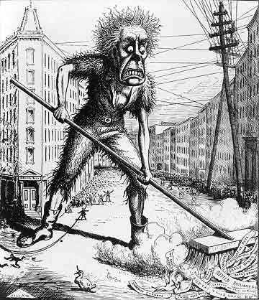
Jay Cooke in Philadelphia
Could not sell several million dollars of Northern Pacific Railroad bonds & it went into default.
Major collapse shocked the stock market.

Slide 26
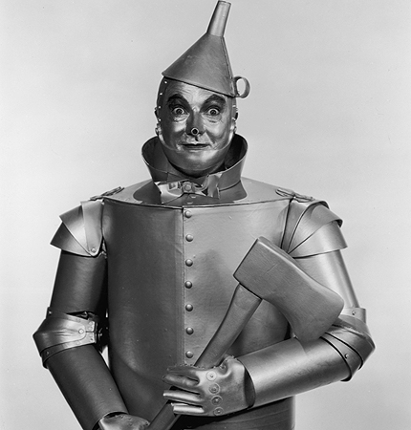
Stock market dominated by Railroads
Many go into default.
Individuals lost deposits.
Businesses lost liquidity.
Unemployment set in.
Rioting in the streets followed.
Four–six year depression.
U.S. exported its way out of it.
CANNED GOODS.

Slide 27
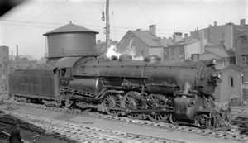
Crisis of 1893
1880s: Remarkable economic expansion.
Driven by railroad speculation.
Railroads over-built with expenses not meeting revenue.
New SILVER flooded the market.
Prices dropped – farmers suffered.
Bankruptcy of the Philadelphia –
Reading railroad.

Slide 28
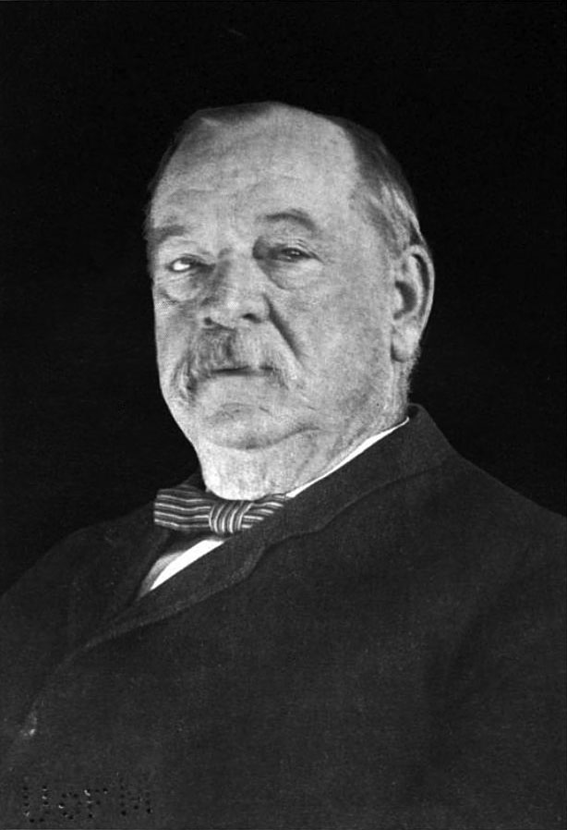
Grover Cleveland Repealed the Sherman Silver Act
It had required the U.S. to buy millions of ounces of silver.
People run on banks.
15,000 companies go under.
600 banks filed for bankruptcy.
Democrats are crushed in 1894.
Biggest GOP gains in history.

Slide 29
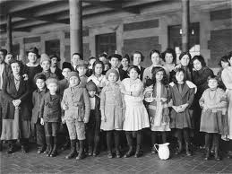
Immigration

Slide 30
Immigration

Slide 31
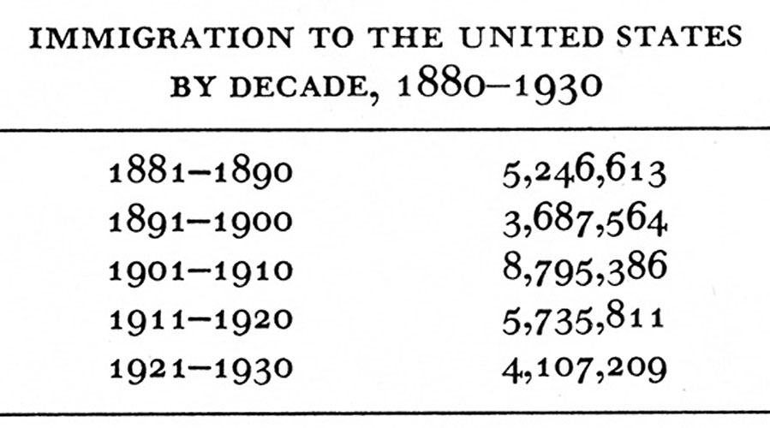

Slide 33
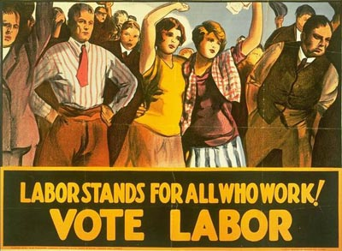
LABOR

Slide 34
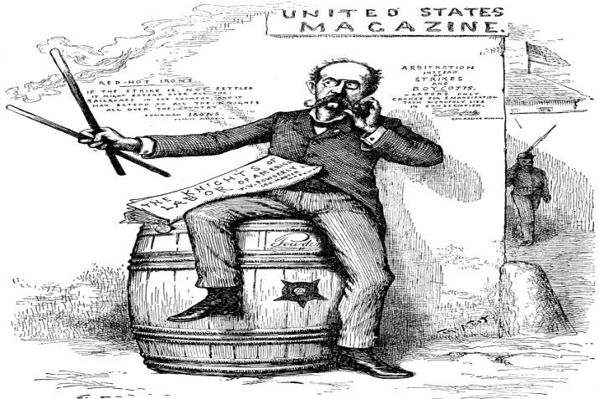
Knights of Labor
Teach workers middle class values and culture.
Looking for a social & cultural uplift.
NO socialism or radicalism.
Terence Powderly moves the Knights from a fraternal organization to a union.
Irish - Mayor of Scranton, member of Clan na Gael.

Slide 35
Knights of Labor
1880 28,000
1885 100,000
1886 700,000
1890 100,000
Declined after the Haymarket Massacre.
Outside, anarchists killed police with dynamite.

Slide 36
Homestead Works

Slide 37
Homestead
After the Haymarket Affair of 1886, labor retrenched.
Smaller Union groups.
At Carnegie’s Homestead Works outside of Pittsburgh, Carnegie modernizes the factory and introduces the “Open Hearth” method to make steel.
Better steel, made much more efficiently.

Slide 38
Workers React
New, efficient methods threaten wages & jobs.
Amalgamated Association of Iron & Steel Workers upset.
Carnegie could employ unskilled workers much more cheaply.
Carnegie proposed a 25% wage reduction. He had to peg wages on steel prices up to $25 per ton, for three years.

Slide 39
After Three Years
Carnegie had a good reputation with the workers.
In 1892, he asked the compensation and the minimum be lowered.
He gave authority to his partner Henry Clay Frick and left for Scotland.
Frick built a wall around
Homestead & hired
Pinkerton guards.

Slide 40
Violence!
The Union wanted more.
The Union represented 800 of the 3,800 workers.
Negotiations broke down and Frick locked them out.
When Pinkertons guards came down the river on barges, the workers opened fire on them.

Slide 41
Workers vs. Pinkertons!
Workers vs. Pinkertons!
2 workers killed, 11 wounded.
2 Pinkertons killed, 12 wounded.
Workers built scaffolds to fire down on the Pinkertons.
Hundreds of women came out screaming for the men to kill the stranded Pinkertons.
Workers sent oil-soaked, flaming barges and poured oil into the river to burn the Pinkertons; it burned itself out.

Slide 42
Pinkertons Surrender
Pinkertons come ashore to surrender and they were still attacked and beaten.
Pinkertons leave with
attorneys to Pittsburgh.
Jewish Lithuanian
anarchist, Alexander
Berkman, tried to kill Frick. (Berkman was Emma
Goldman’s lover)

Slide 43
Frick becomes The Man of Steel
Public look at Frick as a hero.
Berkman was a dangerous foreign anarchist.
PA Governor sends
in the militia.
Homestead hires
replacements.

Slide 44
American Railroad Union

Slide 45
Pullman Cars
George Pullman had built a company town for his workers.
He was very paternalistic.
They had trash collected.
The streets were clean.
Hedge trees and bushes were trimmed.
Lawn mowed, etc.
Libraries, schools, churches.

Slide 46
1893: Depression decreased the demand for luxury cars
Cut workforce by 3,000 men & women.
Cut piecework by 50%.
Pullman didn’t cut rent or prices in town.
5/11/94: The workers
walked out.
He did not evict
workers/tenants.

Slide 47
ARU Entered the Dispute
ARU not as inclusive as the Knights.
No Blacks, no unskilled workers.
President Eugene Debs.
ARU voted not to handle any Pullman cars.
Railroad managers wanted a fight with the ARU.
Railroads would not uncouple
Pullman cars.

Slide 48
Breaking Federal Law
ARU refused to deal with any trains that had Pullman cars.
But, the cars carried U.S. mail.
Richard Olney, U.S. Attorney General, got a federal judge to issue an injunction against the boycott and the ARU, under the Sherman Anti- Trust Act.
Vandals began to destroy cars.

Slide 49
Grover Cleveland sends in the U.S. troops
General Nelson A. Miles, of Wounded Knee Fame, crushed the strikers as he had the Ghost Dancers.
Debs believes this will start a new civil war.
The 90% against the 10%.
Mobs commit arson & vandalism.
Riots break out.
Troops are sent to American cities.
The public turns against the ARU.
Debs is arrested and the situation end.

Slide 50
POPULISTS
Agrarian Organizations
Pro-Silver
Anti-Wall Street
Anti-Railroad
Anti-Semitic
Xenophobic

Slide 51
End of the Frontier
The country had changed.
Industry was now becoming king.
Cities were the future.
Millions of Immigrants.
Powerful politicians.
Less and less farmers.
Farmers constantly in debt.
Food prices going down.

Slide 52
Anti-Capitalist
Workers who had reduced wages blamed bosses, not capitalism.
Farmers were their own bosses; they had to blame the system.
“Did they fail capitalism, or did capitalism fail them?”
Democracy would change capitalism.

Slide 53
Farmers looked to the Government
Democracy could control prices and interest rates.
Cleveland: “Though the people support the Government, the Government should not support the people.”
Lincoln: “In all that the people can individually do well for themselves, government ought not to interfere.”

Slide 54
Mary Elizabeth Lease
Charter member of the People’s Party.
Wall Street owns the country.
No longer a government by the people…Now a government by Wall Street, for . . .
“The common people of this country are slaves & monopoly is the master.”

Slide 55
What’s the Matter with Kansas?
William Allen White – Anti-Populist
Claims that Populism is class warfare against the rich.
Under Populism, Kansas’ population had stagnated. The U.S. population was growing around them. In five years, U.S. gained 5 million. Kansas loses over 10,000 a year.
Neighboring Missouri, Nebraska, Colorado and even the Indian Territory were growing.

Slide 56
The Rich
Monied people were leaving Kansas in droves.
The money went with them.
Very few banks were left to loan money to businesses and farmers.

Slide 57
Populist’s Quote
“If you legislate to make the masses prosperous, their prosperity will find its way up through every class which rest upon them.”

Slide 58
White
“Oh yes, Kansas is a great state. Here are people fleeing from it by the score everyday, capital going out of the state by the hundreds of dollars. . . . Let’s don’t stop this year. Let’s drive all the decent, self respecting men out of the state. Let’s keep all the old clodhoppers who know it all.”

Slide 59
The more things change, the more they stay the same!

