Slide 1
The Great Society
Presentation by
Kevin T. Brady, Ph.D.

Slide 2
The Great Society
In the Mold of:
Wilsonian Progressivism
The New Deal
FDR’s Four Freedoms
A Massive Expansion of Government
The Problem for President Lyndon Johnson was that he was also massively expanding the Vietnam War!
Could the United States afford Bullets & Butter?

Slide 3
A.R.T.I.S.T.
The American Institute for
History Education

Slide 4
BECOME AN
A
R
T
I
S
T

Slide 5
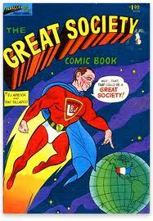
A
R
T
T
The Great Society
I
S
Notes:
http://www.dipity.com/sean1234/Poverty-Timeline/

Slide 6
R
T
I
S
T
A
AUTHOR:

Slide 7
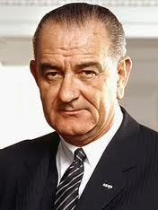
R
T
I
S
T
A
Lyndon B. Johnson
President of the U.S.
AUTHOR:

Slide 8
T
I
S
A
T
R
REASON:

Slide 9
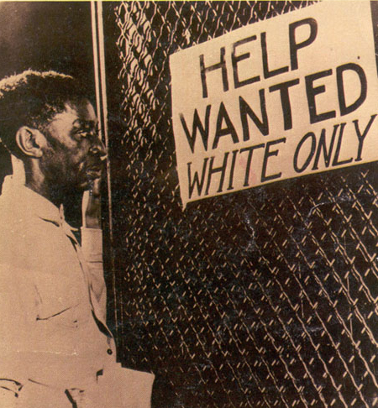
T
I
To End Poverty in America
S
A
T
R
REASON:
Notes:
www.dipity.com/sean1234/Poverty-Timeline/

Slide 10
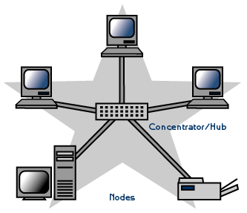
T
I
Have Experts Centrally Plan more & more of American Society
S
A
T
R
REASON:
Notes:
ankara-gtug.org

Slide 11
T
I
To Greatly Expand the Role of Government into the Economy and into Americans’ Personal Lives.
S
A
T
R
REASON:
Notes:
://www.openplacement.com/blog/2012/09/guide-to-medicare-plan-types-part-a-b-c-d

Slide 12
T
I
S
A
To Greatly Expand the Democratic Party voter base???
T
R
REASON:

Slide 13
I
S
T
R
A
T
TO WHOM:

Slide 14
I
S
The Students & Faculty of the University of Michigan
T
R
A
T
TO WHOM:
Notes:
http://web.eecs.umich.edu

Slide 15
I
S
African Americans,
The Poor,
The Elderly,
Students,
Parents,
Inter alia.
T
R
A
T
TO WHOM:

Slide 16
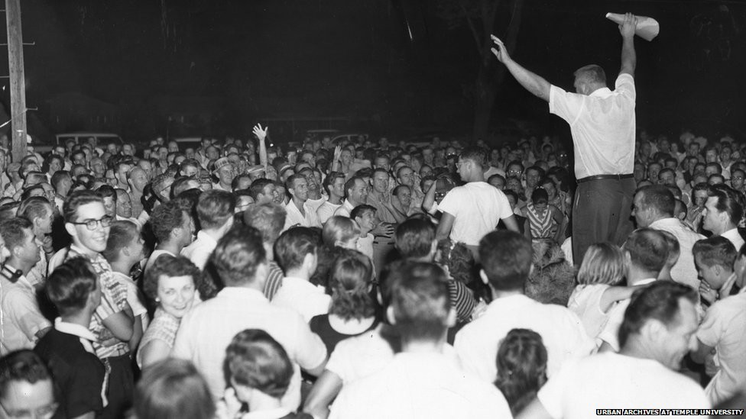
I
S
The People of the USA
T
R
A
T
TO WHOM:
Notes:
http://www.bbc.co.uk/news/magazine-18560866

Slide 17
I
S
The People of the World
T
R
A
T
TO WHOM:

Slide 18
S
T
T
A
R
I
IMMEDIATE
EFFECT:

Slide 19
S
T
T
Johnson Landside in the Presidential Election
Largest Liberal Congress since 1938
A
R
I
IMMEDIATE
EFFECT:

Slide 20
S
T
Medicare and Medicaid
ESEA Act of 1965
Head Start
Housing
PBS, NEH and NEA
Higher Education Act
Urban Transportation Act
Food Stamps
T
A
R
I
IMMEDIATE
EFFECT:

Slide 21
Some Great Society Programs
HIGHER EDUCATION FACILITIES ACT OF 1963 DEC. 16, 1963
PREVENTION & ABATEMENT OF AIR POLLUTION (THE CLEAN AIR ACT) DEC. 17, 1963
VOCATIONAL EDUCATION ACT OF 1963 DEC. 18, 1963
INTER-AMERICAN DEVELOPMENT BANK ACT JAN. 22,1964
CIVIL RIGHTS ACT OF 1964 JULY 2, 1964
URBAN MASS TRANSPORTATION ACT OF 1964 JULY 9, 1964
FEDERAL-AID HIGHWAY ACT OF 1964 AUG. 13, 1964
CRIMINAL JUSTICE ACT OF 1964 AUG. 20, 1964
FOOD STAMP ACT OF 1964 AUG. 31, 1964
WILDERNESS ACT SEPT. 3, 1964
NATIONAL ARTS CULTURAL DEVELOPMENT ACT OF 1964 SEPT. 3, 1964
MANPOWER ACT OF 1965 APRIL 26, 1965
OLDER AMERICANS ACT OF 1965 JULY 14, 1965
SOCIAL SECURITY AMENDMENTS OF 1965 JULY 30, 1965
VOTING RIGHTS ACT OF 1965 AUG. 6, 1965
HOUSING AND URBAN DEVELOPMENT ACT OF 1965 AUG. 10, 1965
PUBLIC WORKS AND ECONOMIC DEVELOPMENT ACT OF 1965 AUG. 26, 1965
DEPARTMENT OF HOUSING AND URBAN DEVELOPMENT ACT SEPT. 9, 1965
NATIONAL FOUNDATION ON THE ARTS & THE HUMANITIES ACTOF 1965 SEPT. 29, 1965
AMENDMENT OF FEDERAL WATER POLLUTION CONTROL ACT OCT. 2, 1965
AMENDMENT TO THE IMMIGRATION AND NATIONALITY ACT OCT. 3, 1965
HIGHER EDUCATION ACT OF 1965 NOV. 8, 1965
CHILD NUTRITION ACT OF 1966 OCT. 11, 1966
CHILD PROTECTION ACT OF 1966 NOV. 3, 1966
NATIONAL SCHOOL LUNCH ACT MAY 8, 1968

Slide 22
T
A
I
R
T
S
SUBSEQUENT
EFFECTS:

Slide 23
T
A
Opportunities for Critical Thinking:
Questions, Research, Projects, Projections, inter alia
I
R
T
S
SUBSEQUENT
EFFECTS:
Notes:
http://www.artsjournal.com/creatived/2010/04/10_little_questions.html

Slide 24
T
A
See
Below
I
R
T
S
SUBSEQUENT
EFFECTS:

Slide 25
A
R
T
S
I
T
TIME PERIOD:

Slide 26
A
R
May 22, 1964
T
S
I
T
TIME PERIOD:

Slide 27
Critical Thinking
Did the Great Society have more positive effects on American Society?
Was it a success?
Did the War on Poverty have more positive effects on American Society?
Was it a success?
Did the Great Society have more negative effects on American Society?
Was it a failure?
Did the War on Poverty have more negative effects on American Society?
Was it a failure?

Slide 28
$17,000,000,000,000.00
We have spent over $17 trillion dollars on the War on Poverty?
What is a Trillion?

Slide 29
What is a Trillion?
If you opened a Hoagie shop in Bethlehem on the day Jesus was born-- December 25, 0001 A.D. and lost $1 million a day ($365,250,000.00 per year) for 2013 years, on 12/25/2013 you still would have not lost $1 trillion.
You would have only lost:
$735,248,250,000.00
You’ll have lost $1,000,000,000,000.00 on
December 24, 2727- 724 years from 12/25/13

Slide 30
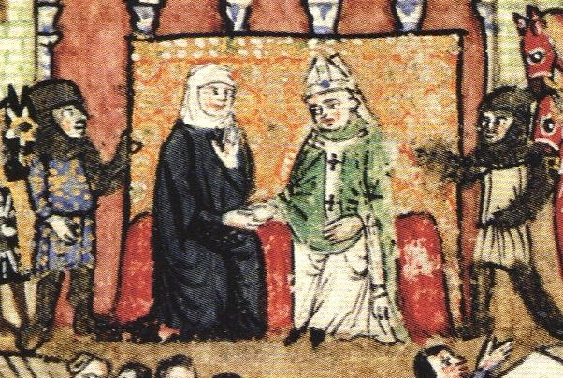
724 years ago was 1289
That same year, the Crusaders under Princess Lucia were driven from Tripoli, northern Lebanon by the Mameluks, after ruling for 180 years.
That was a LONG time ago!!!
Notes:
http://upload.wikimedia.org/wikipedia/commons/7/75/Lucia_of_Tripoli.jpg

Slide 31
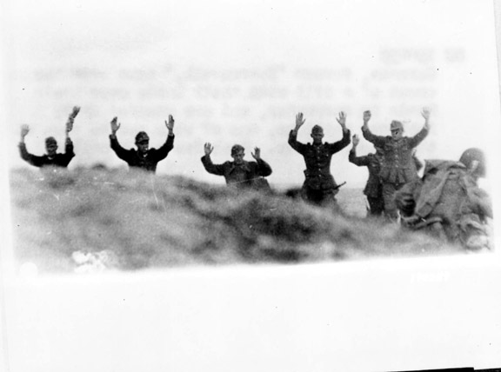
War on Poverty??
After spending $17 trillion
$17,000,000,000,000.00
Poverty rate:
1965: 14%
2012 16%
Notes:
http://thephilter.com/category/the-sporting-life/tour-de-france/

Slide 32
Effects on Inner-cities
Are cities better off?
The Johnson Administration treated urban poverty as a racial problem and as a justice problem
Compare:
Camden 1965 with Camden 2013
Detroit 1965 with Detroit 2013

Slide 33
Solution
Since housing discrimination and education discrimination had created ghettos, ending discrimination, along with affirmative action (Nixon) and massive infusion of money would solve the problems.
However, African Americans had already been moving into the middle class, as earlier and contemporary immigrants had. Blacks continued to move upward.

Slide 34
Housing
1968 Housing Act provided homes for 7 million families.
The Great Society created Ginnie Mae to provide over $1 billion to supply affordable mortgages.
1968 Fannie Mae separated from the FHA,
and became a Government Sponsored Enterprise (GSE). This allowed Johnson to cover budget deficits from his "Great Society" policies.
Notes:
He removed Fannie Mae from government balance sheets, while continuing to expose taxpayers to its risks.

Slide 35
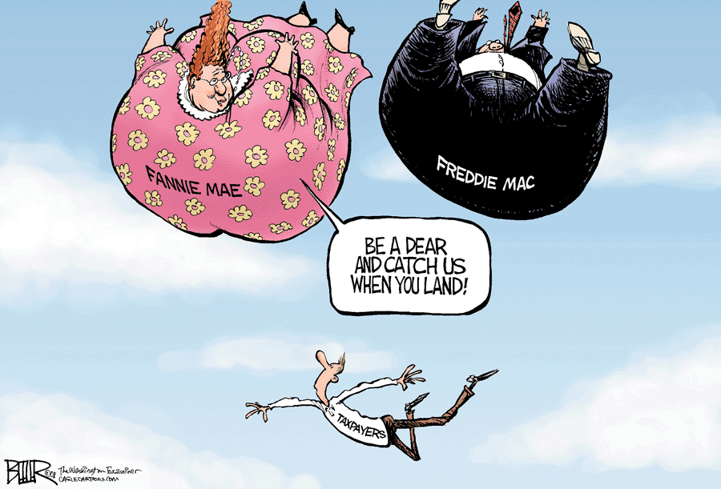
Housing
By 2011, the U.S. government had invested over $130 billion to bail out Freddie and Fannie.
U.S. taxpayers are on the hook for nearly $7 trillion worth of debt and guarantees?
Notes:
www.laprogressive.com/wp-content/uploads/2008/07/fannie-mae.gif
socalmultiunitrealestateblog.com
www.laprogressive.com/wp-content/uploads/2008/07/fannie-mae.gif
socalmultiunitrealestateblog.com

Slide 36
Inner-city life 2012
Much higher drug addictions
Family Breakdown
Social Breakdown
Much higher incarceration rate
Very high abortion rates
40% of all pregnancies in NYC
African-Americans have a 3X higher abortion rate than whites

Slide 37
What happened? Today!
60% of African American children grew up in fatherless homes.
Nearly 1 million African American men are in jail.
80% of all urban African American babies are born to unwed mothers.
360,000 African American babies are aborted each year. 3X the rate of white babies.
12% of the population 30% of all abortions.
50% of all new AIDs cases
50% of African American men are either not working or are in jail.

Slide 38
Whites (30-49 y. o.) on Assistance are Seeing Similar Results
1960- 94% married
2008- 83% married
1970-1% single mothers
2008- 6% single mothers
1968-3% out of workforce
2008-3% out of workforce
1960->1% Divorced
2010-> 5% Divorced
1970- 70% happy marriage
2010- 65% happy marriage
1960- 84% married
2008- 48% married
1970-6% single mothers
2008-44% single mothers
1968-3% out of workforce
2008-12% out of workforce
1960- 5% Divorced
2010- 35% Divorced
1970- 58% happy marriage
2010- 24% happy marriage
Upper middle class (top 20%)
Working Class (bottom 30%)
Notes:
There's also been a notable change in the rates of less-than-full-time work. Of the men in Fishtown who had jobs, 10% worked fewer than 40 hours a week in 1960, a figure that grew to 20% by 2008. In Belmont, the number rose from 9% in 1960 to 12% in 2008.

Slide 39
Religion & Crime
1976- 29% secular
1976- 71% practicing
2008- 40% secular
2008- 60% practicing
Crime rate remained the same from 1960 to 2010
1976- 38% secular
1976- 62% practicing
2008- 59% secular
2008- 41% practicing
Crime rate rose 6X from 1960 to 1995.
Even though overall crime rate diminished, it is still 4.7 higher than 1960
Belmont
Fishtown
Notes:
The surge in crime that began in the mid-1960s and continued through the 1980s left Belmont almost untouched and ravaged Fishtown. From 1960 to 1995, the violent crime rate in Fishtown more than sextupled while remaining nearly flat in Belmont. The reductions in crime since the mid-1990s that have benefited the nation as a whole have been smaller in Fishtown, leaving it today with a violent crime rate that is still 4.7 times the 1960 rate.

Slide 40
HEAD START?

Slide 41
Education: Head Start
$7.3 Billion per year
2010 Health & Human Service Study reported mild positive effects during the first year. It had 0 effects on students by first grade.
It costs more than the space program
$170 billion verses $145 billion for NASA.
Now unofficially called a “jobs” program.

Slide 42
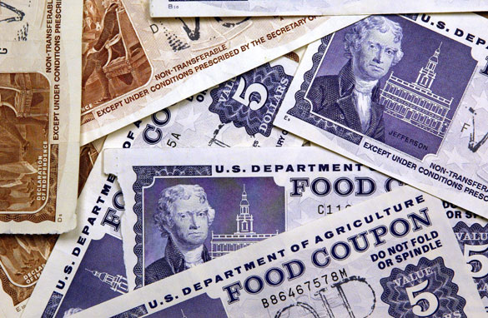
FOOD STAMPS
Notes:
http://www.breitbart.com/Big-Government/2012/06/21/USDA-Food-Stamps-Will-Help-You-Look-Your-Best

Slide 43
Food Stamps
Supplemental Nutrition Assistance Program
19.9 million (26.9%) of all Americans under 18 received aid from SNAP.
45% of all SNAP recipients are under 18.
From 2003 it rose from 26.5 million people to 47.5 million today.
Media campaign
WIC- calls to recruit
Drives up baby formula costs.

Slide 44
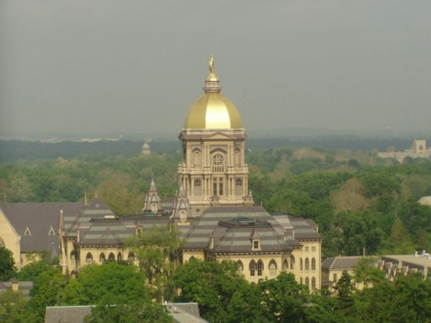
Higher Education

Slide 45
Higher Education-- Tuition
1973— $9, 876
1987— $12,800
2009— $25,143
College costs increased
439%
1973— $2,175
1987— $2,700
2009— $6,585
Inflation rose 147%
PRIVATE
PUBLIC

Slide 46
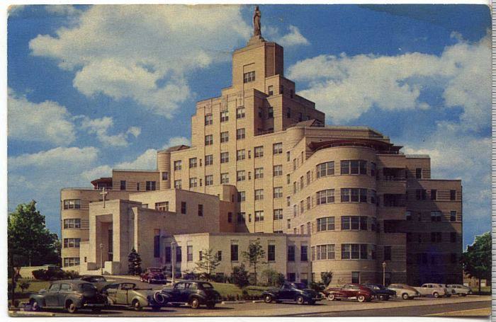
Medical Costs: Medicare & Medicaid

Slide 47
Unfunded Liabilities
We will owe:
$100 Trillion
$100,000,000,000,000.00
69% Medicaid
17% Drugs
12% Social Security

Slide 48
Patients are NOT Involved in Decisions & Costs
Government
Hospital
Doctors
Insurance Companies
WHO DECIDES
COSTS???
% of GNP
1950 4%
1965 6%
1990 12%
2010 17.3%
2012 18%

Slide 49
T
A
K
H
N
Y
O
U
Notes:
kibois.org

