Slide 1
Greek Philosophy and the Legacy in American Government

Slide 2
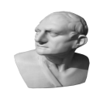
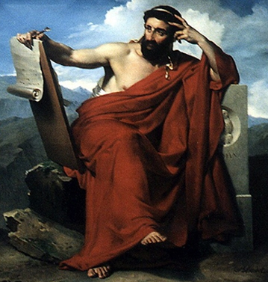
Greeks
Cicero
History Beyond The Textbook
The ancient Greeks laid the foundations for the idea of democracy in the western world. The Greeks believed that since all men participated in the life of the city, they would see self-rule as the most important good.
CICERO © 2007

Slide 3
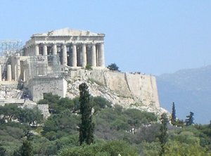
Demokratia
CICERO
History Beyond The Textbook
The term we most associate with our government is democracy. The term comes from the Greek words demos, “people,” and kratos, “rule.” The ancient Greeks practiced one of two forms of democracy. Direct democracy is a system in which the people vote on every issue or law proposed. The American government is an example of indirect democracy. In an indirect democracy the people elect representatives to make decisions on their behalf. The Greek form of democracy also differed from that in the United States because only free, male citizens of Greece were allowed to vote.
CICERO © 2007

Slide 4
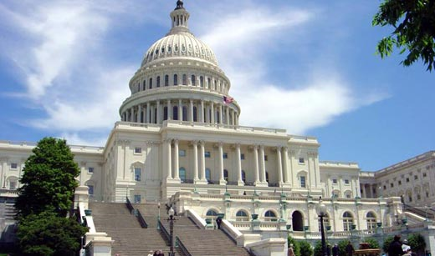
Interesting Comparison
V
The Acropolis, or high point in the city, served as the center of Greek culture for hundreds of years. Pericles began building most of the buildings visible today atop the Acropolis in the fifth century B.C.
The United States Capital Building.
Notice the distinct similarities in architecture as well as governing philosophy.

Slide 5
The Traits of Civic Virtue
Cicero
History Beyond The Textbook
What traits should one look for when
describing civic virtue?
CICERO © 2007

Slide 6
The Traits of Civic Virtue
Cicero
History Beyond The Textbook
What traits should one look for when
describing civic virtue?
putting the good of
one’s community before
oneself
CICERO © 2007

Slide 7
The Traits of Civic Virtue
Cicero
History Beyond The Textbook
What traits should one look for when
describing civic virtue?
putting the good of
one’s community before
oneself.
participating in
government by voting
or running for
public office
CICERO © 2007

Slide 8
The Traits of Civic Virtue
Cicero
History Beyond The Textbook
What traits should one look for when
describing civic virtue?
putting the good of
one’s community before
oneself.
participating in
government by voting
or running for
public office
giving one’s time to
help others in one’s
community, state, and
country
Diagrams
Main Menu
CICERO © 2007

Slide 9
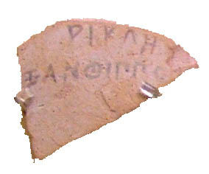
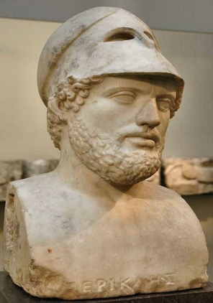
Pericles 495-429 B.C.
CICERO
History Beyond The Textbook
Pericles is known as the “First citizen of Athens” because of his many contributions to the people of that city-state. Pericles was a great supporter of the arts and sciences. He ruled Athens throughout much of its Golden Age. Pericles also was known as “the incorruptible” because of his reforms of Athenian government. By paying salaries to government officials and opening jobs to all Athenians, he believed corruption would be discouraged. Pericles also tried, but failed, to create a federation among the many Greek city-states forming what would later become Greece.
Ostracons, ancient Greek ballots, were made from pieces of pottery. (This ballot bears the name of Pericles)
Because of his many military campaigns, Pericles usually is depicted wearing a helmet.
CICERO © 2007

Slide 10
Cicero
Antecedent/Landmark Documents
History Beyond The Textbook
oldest example of
western law
Law Code of Gortyn
established democracy
Athenian Constitution

Slide 11
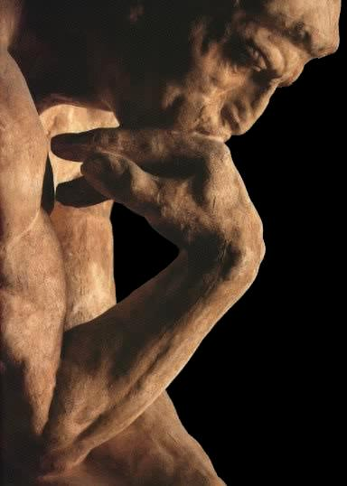
What is a Political Philosopher?
Cicero
History Beyond The Textbook
A political philosopher is a person who studies the government, laws, politics, and any other legal authority that may exist in a country or state. These philosophers often question the people’s relationship with their government. Political philosophy can be traced to ancient Greece nearly 2,500 years ago.
The Thinker Auguste Rodin
CICERO © 2007

Slide 12
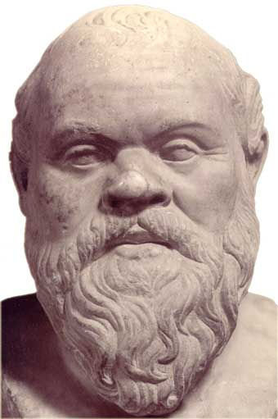
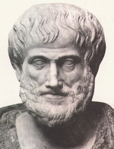
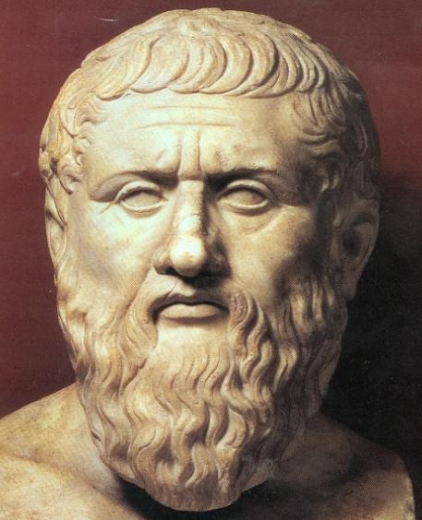
The Big Three Greeks
Cicero
History Beyond The Textbook
Socrates teaches Plato. Plato teaches Aristotle.
Plato helped to lay the foundation for philosophy, rhetoric and logic through his Socratic Dialogues.
Socrates left no writings of his own. It was his students, such as Plato who would write his words down for future generations.
Aristotle passed on what he had learned from Plato to his own students, including Alexander the Great. Alexander spread this knowledge through his conquests.
CICERO © 2007

Slide 13
Socrates
Greek philosopher noted for his unrelenting questions concerning the ideals of the world. He left no writings to detail these lessons, however the work of his student Plato allows for a view into his arena of thought. Unfortunately, Socrates life ended abruptly in 399 BCE after being convicted of multiple crimes due to his teachings with the punishment of death.
469 -399 BCE
Kemmerling, Garth. "Socrates." PhilospophyPages.com. N.p., 9 August 2006. Web. 22 Feb 2011. <http://www.philosophypages.com/ph/socr.htm>.

Slide 14
Plato
Cicero
History Beyond The Textbook
427-347 B.C.
Plato published his work, The Republic or Politeia, in 360 B.C. This is considered to be the first known philosophical writings about politics. In it, Plato compares the governments of various Greek city-states. He goes on to discuss the ideal state and how it might evolve. Plato was the second of the three great philosophers from ancient Greece. His teacher had been Socrates, and one of his students was Aristotle.
It is believed that Plato was related to the great Athenian leader Solon through his mother’s family.
CICERO © 2007

Slide 15
Aristotle
Cicero
History Beyond The Textbook
384-322 B.C.
Aristotle wrote that the state, or government, had its roots in the family. He also argued that the state’s role was to support the development of the people. Aristotle’s philosophy revolves around the relationships between people and the roles played in those relationships. One of the relationships Aristotle discusses is that of the ruler and ruled. He uses the roles of this relationship to justify slavery. Aristotle founded a famous school in Athens, the Lyceum.
Aristotle was the private teacher of Alexander the Great.
CICERO © 2007

