Slide 1
Introduction to CICERO
The BLaST IU17 Liberty Fellowship
September 20, 2011
Dr. Fran Macko
American Institute for History Education

Slide 2
What is CICERO? www.cicerohistory.com
CICERO is an online resource for teachers and students that provides a vast array of materials that support the teaching of American History.
Developed by AIHE, CICERO is an interactive resource that is constantly updated and expanded.
Resources on CICERO can be downloaded for classroom use; many of the documents can be modified to meet the needs of students.

Slide 3
How does CICERO support instruction?
The resources in CICERO:
  Provide multiple entry points into history.
  Are engaging for students.
  Address diverse learning styles and modalities (written, visual and aural).
  Support differentiated instruction (ELLs, special needs, gifted and talented).
  Are leveled (elementary, middle and high).
  Can be used as stand-alone resources or clustered to support an historical topic, theme, event or individual.

Slide 4
How is CICERO Organized?
CICERO is divided into 15 historical periods/unit from The Roots of America through The New Globalization.
Each CICERO unit is divided into two categories: Professional Development and The Classroom Toolkit.

Slide 5
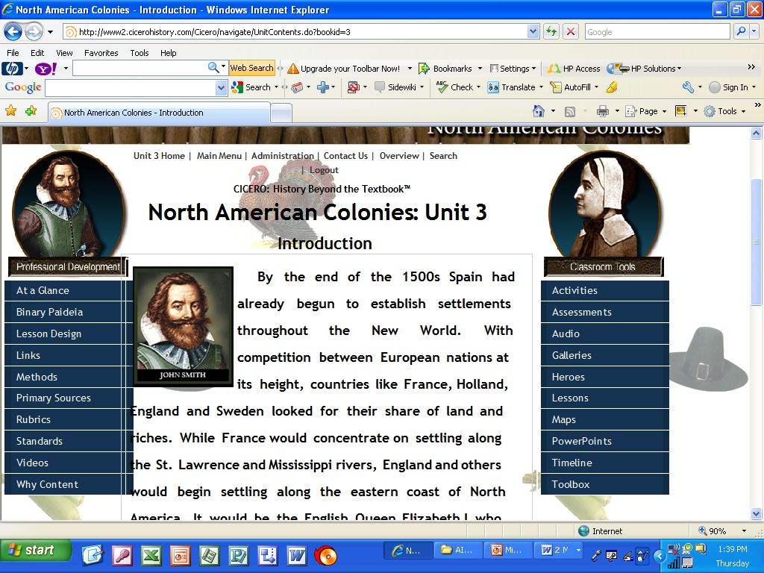
The Professional Development Component
The Professional Development Component offers extensive resources for teachers.

Slide 6
  At a Glance contains 5 separate overviews or talking points for the unit.
  Binary Paideia contains a PowerPoint presentation on this signature strategy, unit examples and blank templates.
  Lesson Design contains lesson templates with instructions and a PowerPoint on how to create an effective, substantive history lesson.

Slide 7
  Web Links contains 10-15 key websites and an additional 10 links to “Places to Visit” related to the unit.
  History Education Methods contains videos and Power Points that describe AIHE signature strategies. These strategies support the teaching of primary source documents, multiple perspectives, chronology, and a thematic (economic, social, political, cultural) approach to history.

Slide 8
Primary Sources contains 5-10 landmark documents, 10-15 speeches or correspondences, 3-7 journal/diary entries and 5-10 obituaries.
The Video section contains historians’ discussions, re-enactments, teacher videos and student videos on the web.
The section on Academic Background Knowledge examines the research of Robert Marzano and its application to teaching history.

Slide 9
The Classroom Toolbox Component
The Classroom Toolbox provides extensive resources for the classroom.

Slide 10
  Activities contains 4-5 historical maps, 4-5 guided readings by level, 3-5 literature connections, 3-5 dialogues and plays, all with critical thinking questions, and 3 web quests.
  Assessments contains rubrics and interactive quizzes with answer keys at all three levels.

Slide 11
  Audio contains period songs with background articles, sheet music and a modern piece on the historical period.
  Gallery contains 12-21 paintings or photographs from the period, 15-24 portraits of historical figures, and 15-24 political cartoons.
  Heroes features 12 heroes, each with an animated portrait and brief biography. This section includes videos of character actors bringing the heroes to life.

Slide 12
Lessons contains 12 elementary, 12 middle and 12 high school lessons on the unit that meet state and national standards.
The Map section contains historical maps for the unit.
The PowerPoint section provides an overview of the unit of study, two student tutorials, a Binary Paideia PowerPoint, and an interactive flash card and a Jeopardy game.
Interactive Timeline combines many of the resources presented in the context of other events of the period.

Slide 13
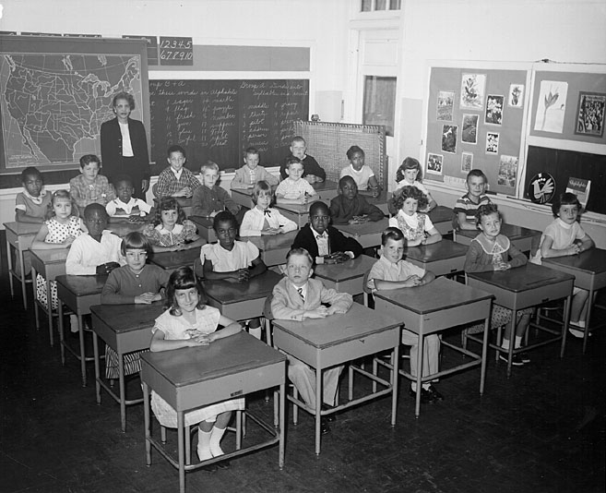
Using CICERO in Your Classroom
Let’s begin by creating a Cicero account.

