Slide 1
The Movement for Civil Rights
BLaST TAH
June 2013

Slide 2
I. Dark Decade:
A. Brown
B. White Citizen’s Councils
C. Emmett Till (August 1955)
II. Montgomery Bus Boycott. (December 1955) A. Parks.
B. Community leaders
C. NAACP
D. Grass roots
III. Little Rock. (1957)
A. Racially progressive city
B. Conflict
C. 101st Airborne
D. Outcome
IV. Sit-Ins (February 1960)
A. NC A&T.
B. Technique spreads quickly.
C. Consumers
D. SNCC.
E. Freedom Riders (1961)
V. Birmingham, AL (June 1963)
A. Shuttlesworth
B. Connor
C. 16th Stree Church Bombing
VI. March on Washington (August 1963)
A. National movement
B. Colorblind America
VII. Civil Rights Act of 1964
A. CRA stalled
B. Neshoba County, MS
C. Passage
D. CRA.
E. Pettus Bridge (March 1965)
F. Voting Rights Act

Slide 3
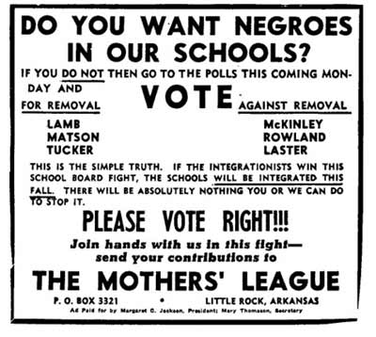

Slide 4


Slide 5
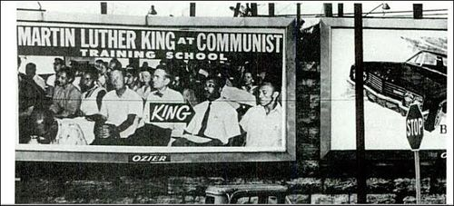
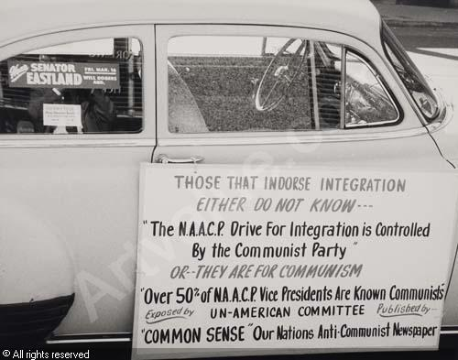

Slide 6
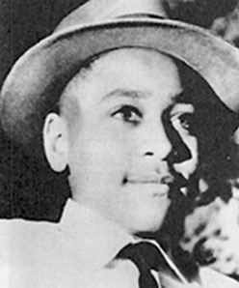
Emmett Till

Slide 7
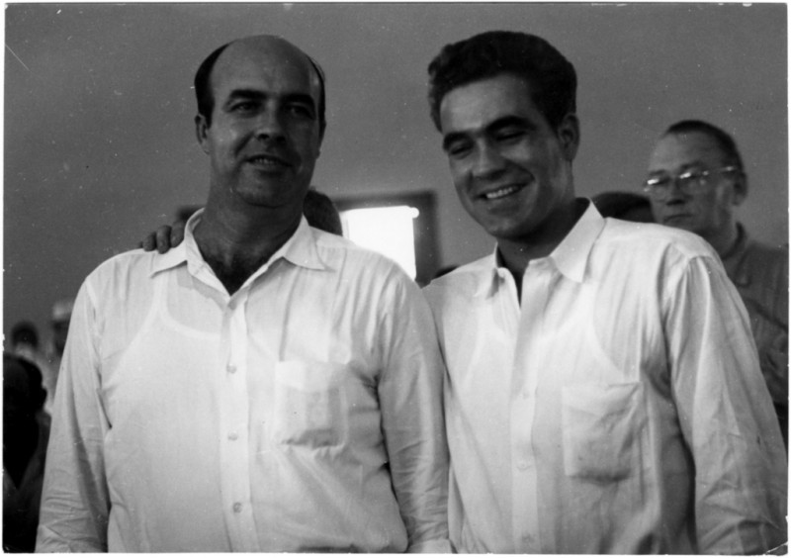
Milam and Bryant

Slide 8
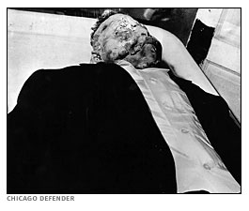
Till’s Body at Funeral

Slide 9
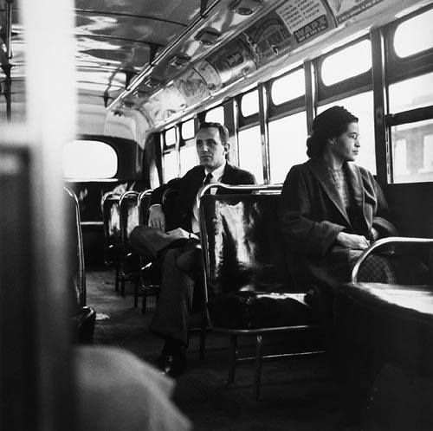
Rosa Parks, 1956

Slide 10
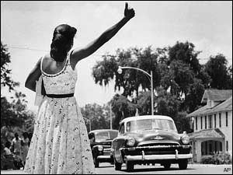
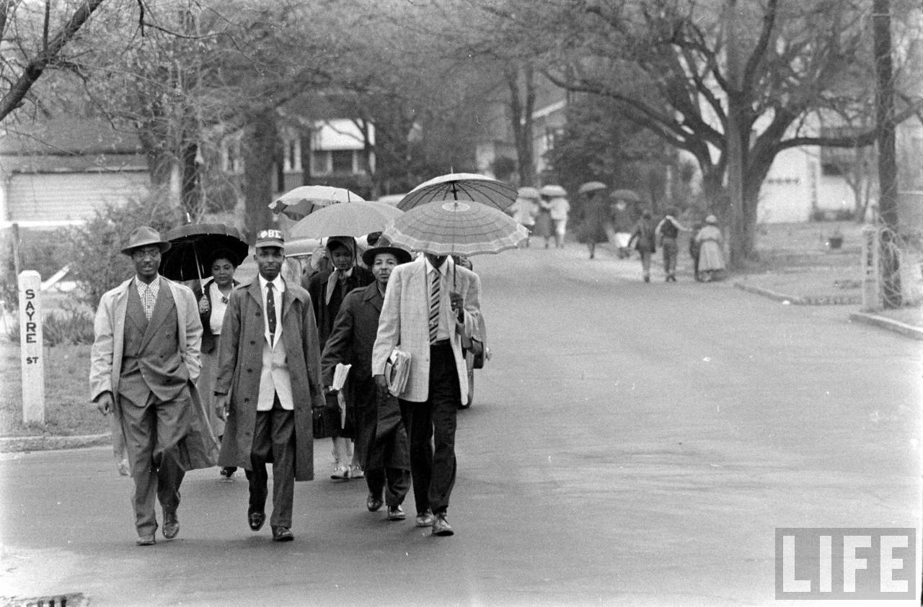

Slide 11
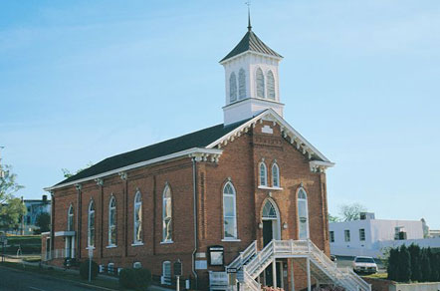
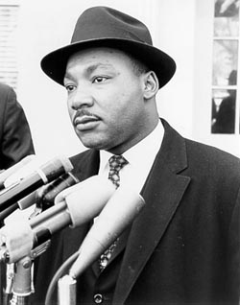

Slide 13
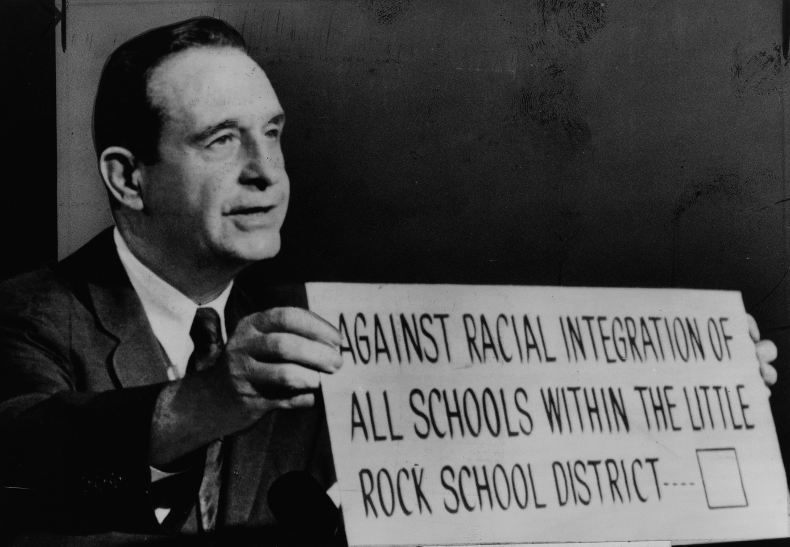
Arkansas Gov. Orval Faubus

Slide 14
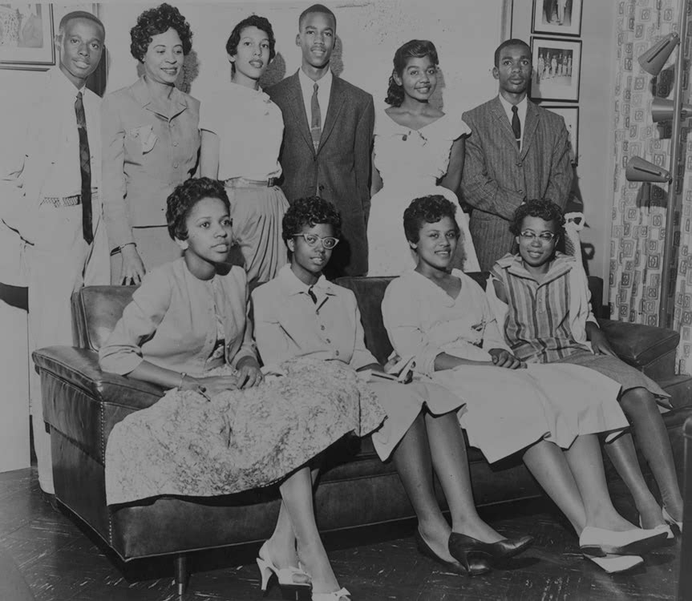
Little Rock Nine

Slide 15
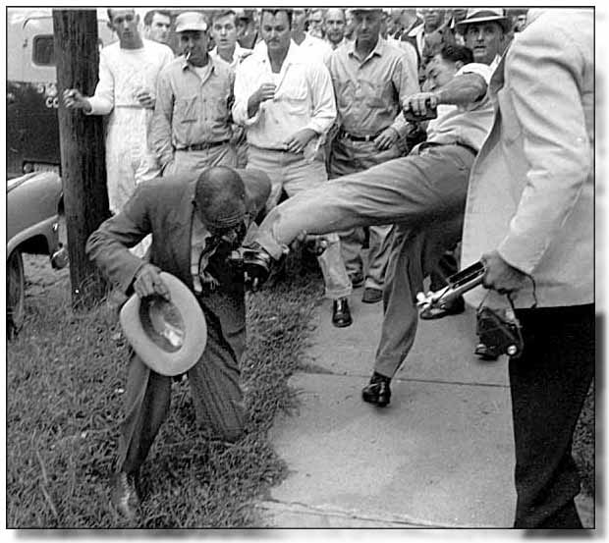

Slide 16
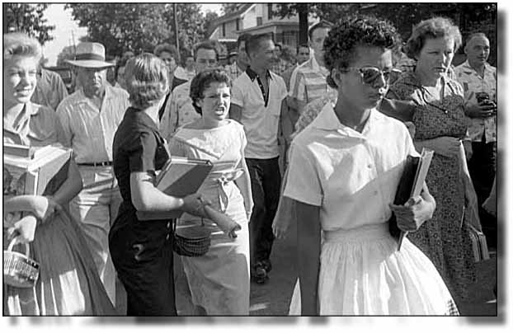

Slide 17
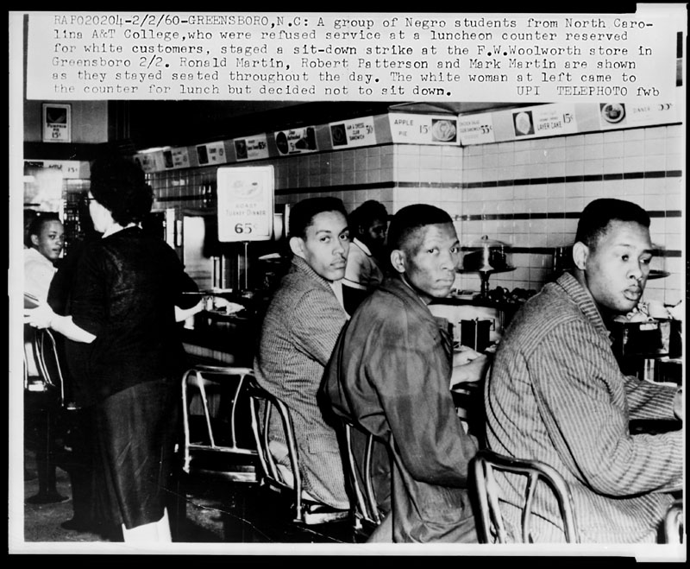

Slide 18
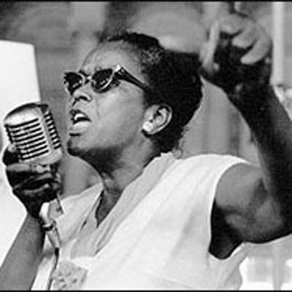
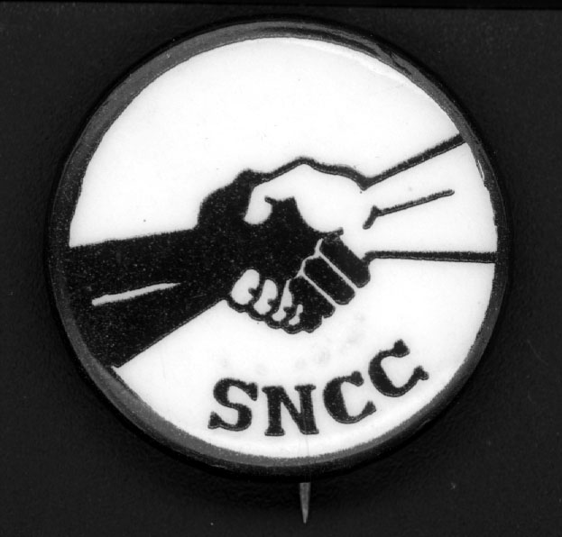

Slide 19
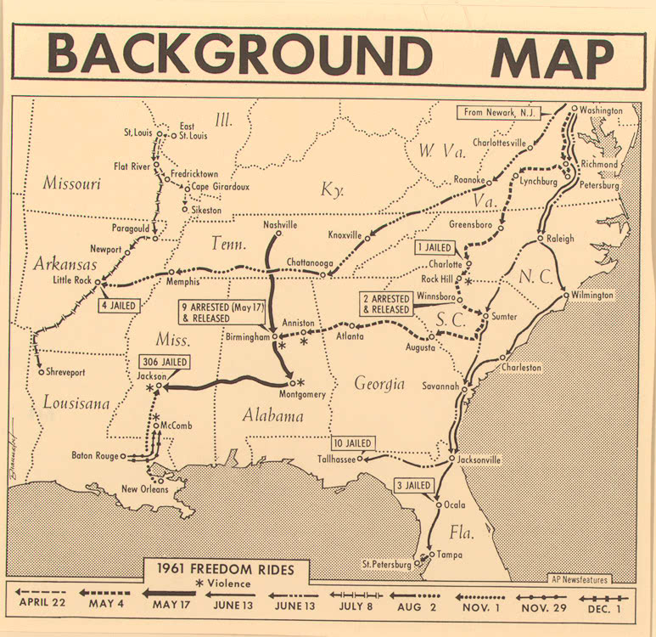

Slide 20
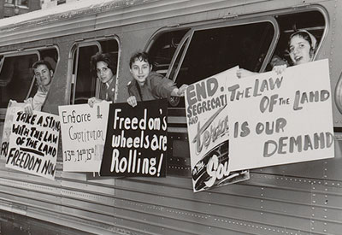

Slide 21
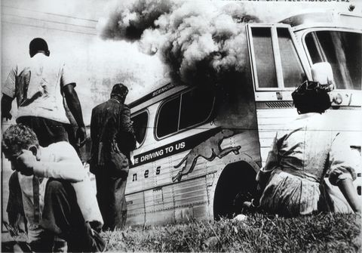
Freedom Riders
Anniston, Alabama

Slide 22
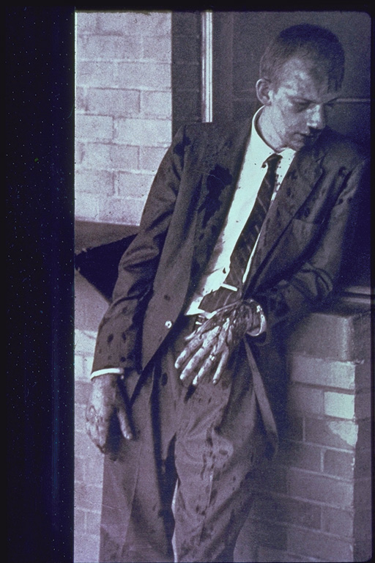

Slide 23
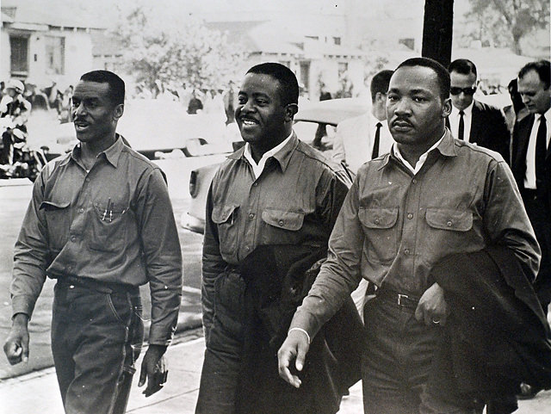
Revs. Shuttlesworth, Abernathy, and King

Slide 24
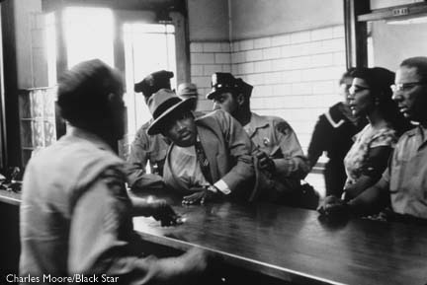

Slide 25
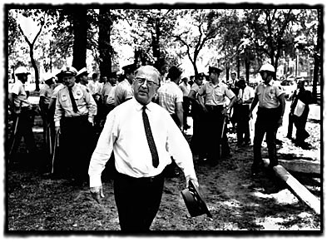
Sheriff Eugene “Bull” Connor

Slide 26
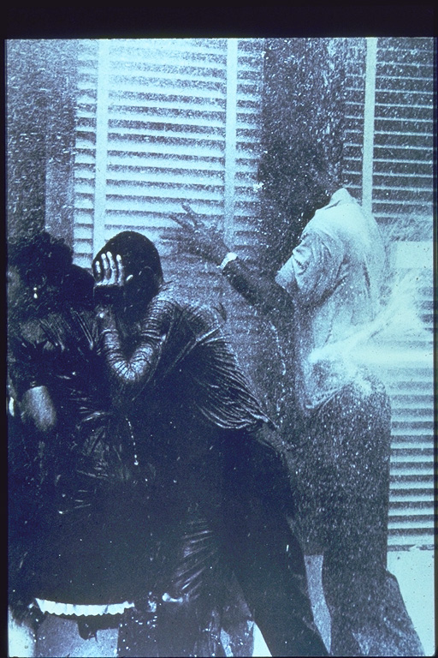

Slide 27
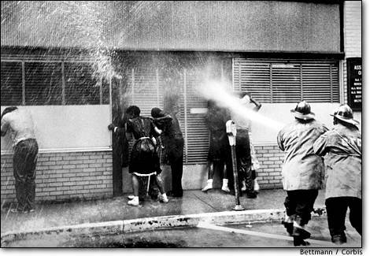

Slide 28
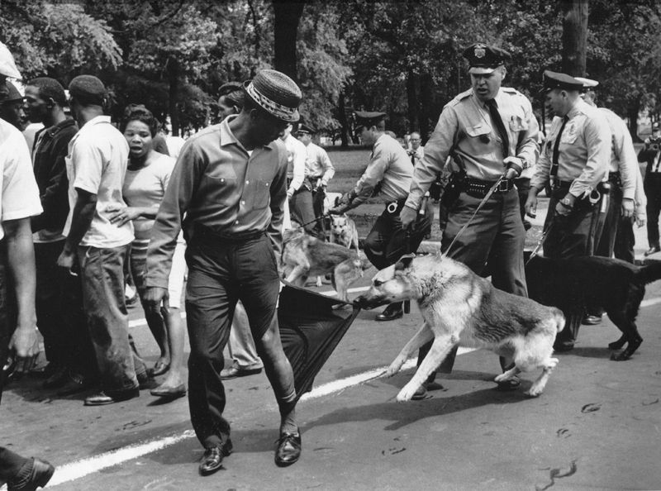

Slide 29
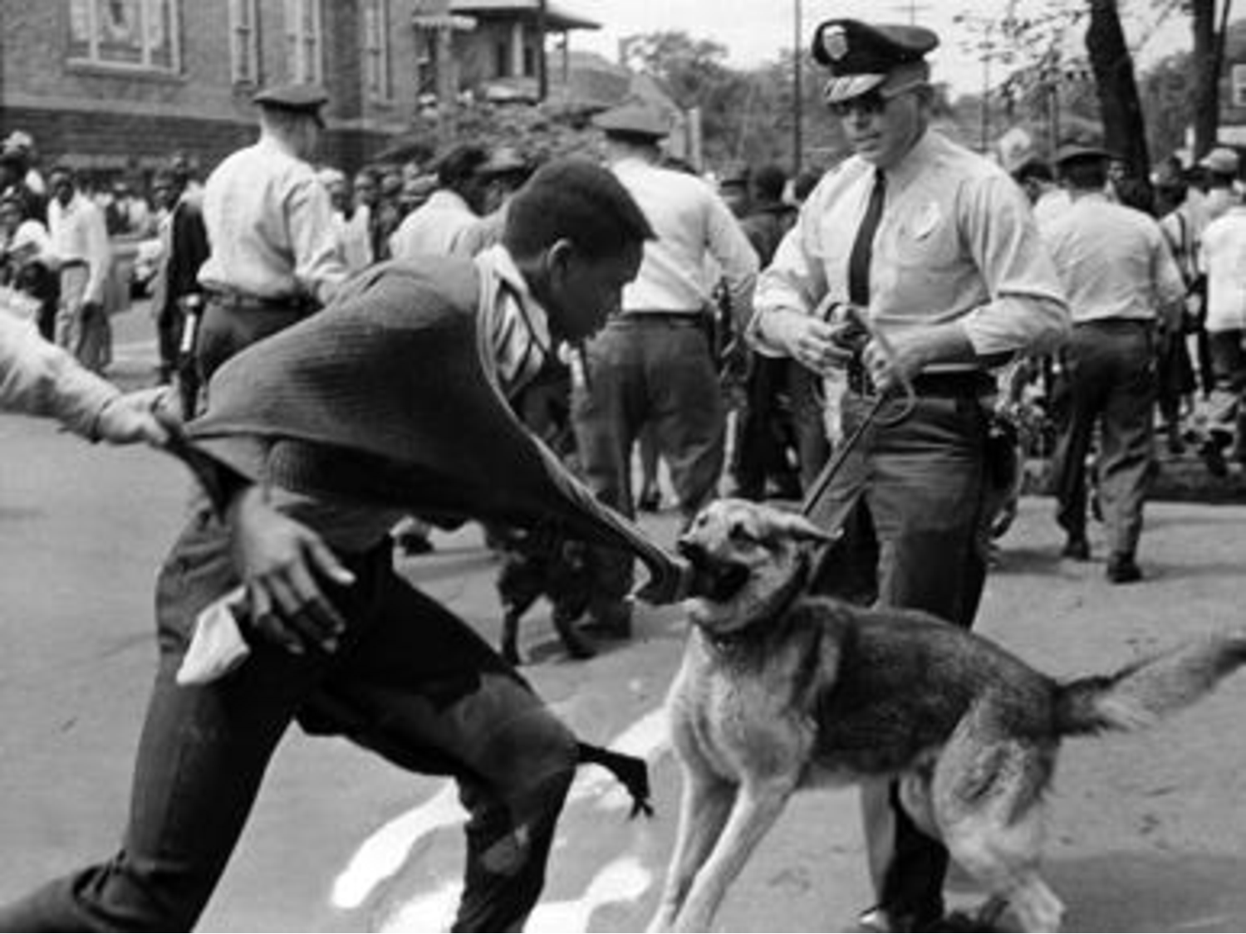

Slide 30
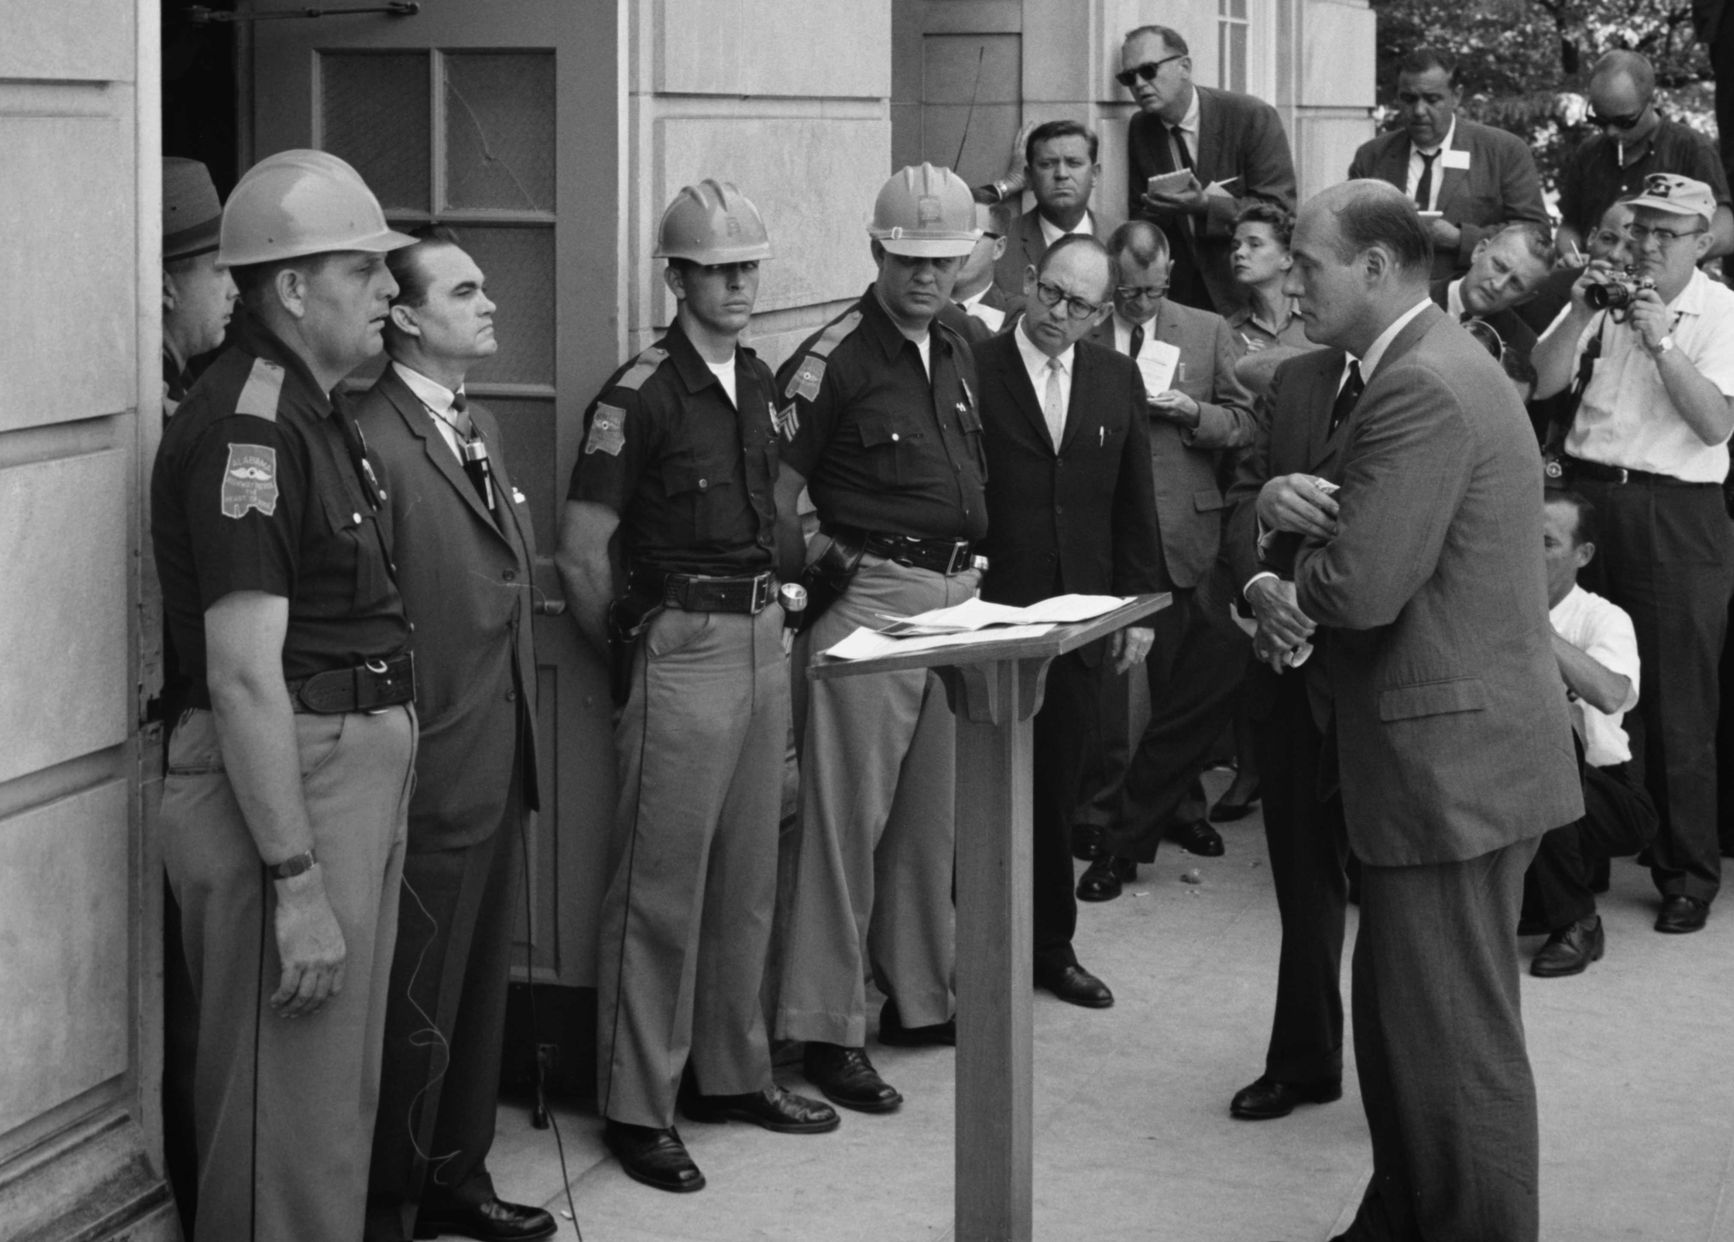

Slide 31
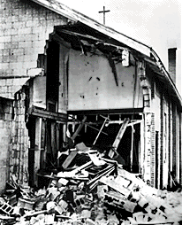
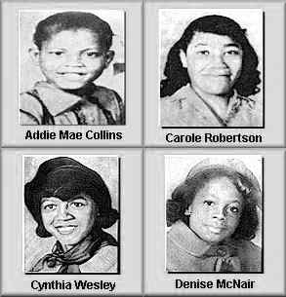

Slide 32
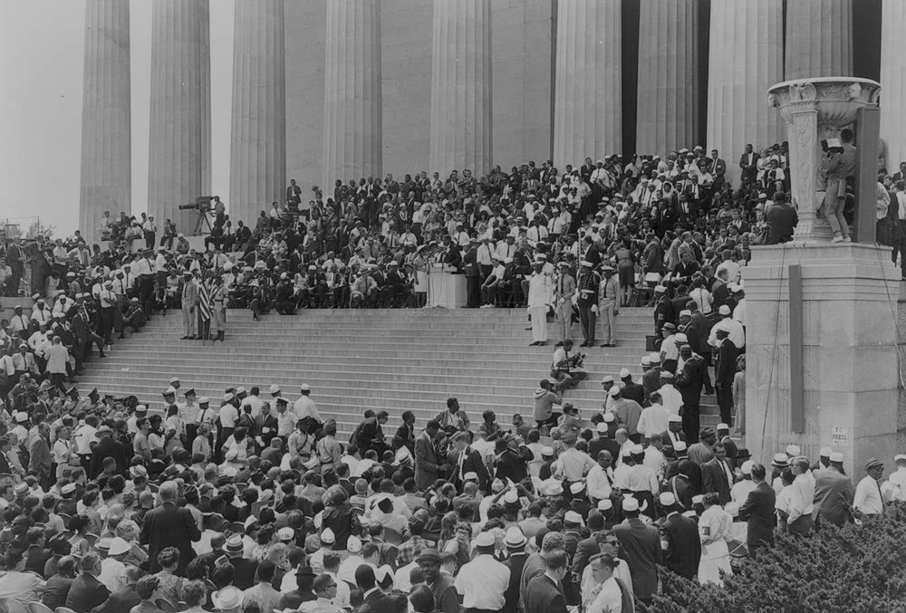

Slide 33
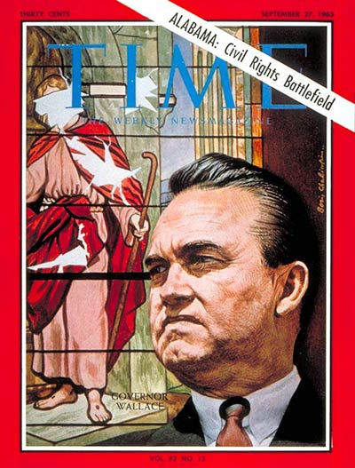

Slide 34
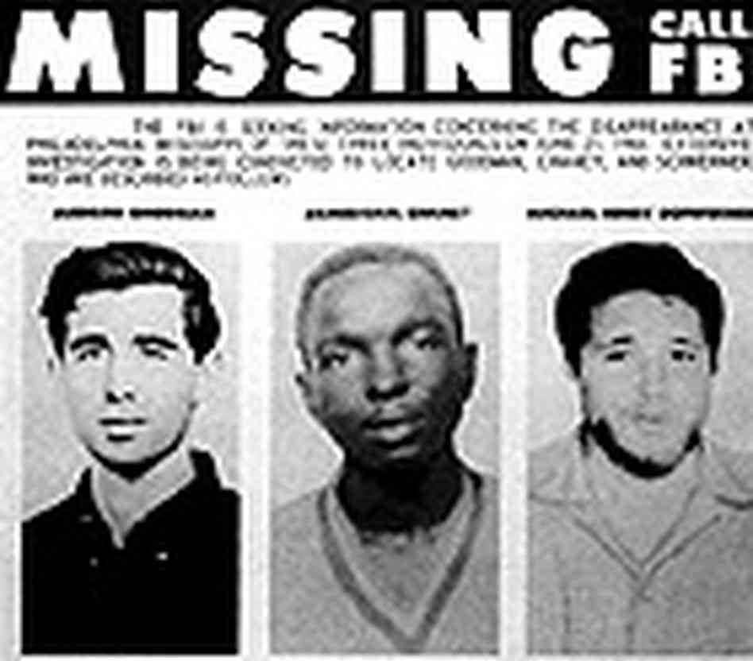

Slide 35
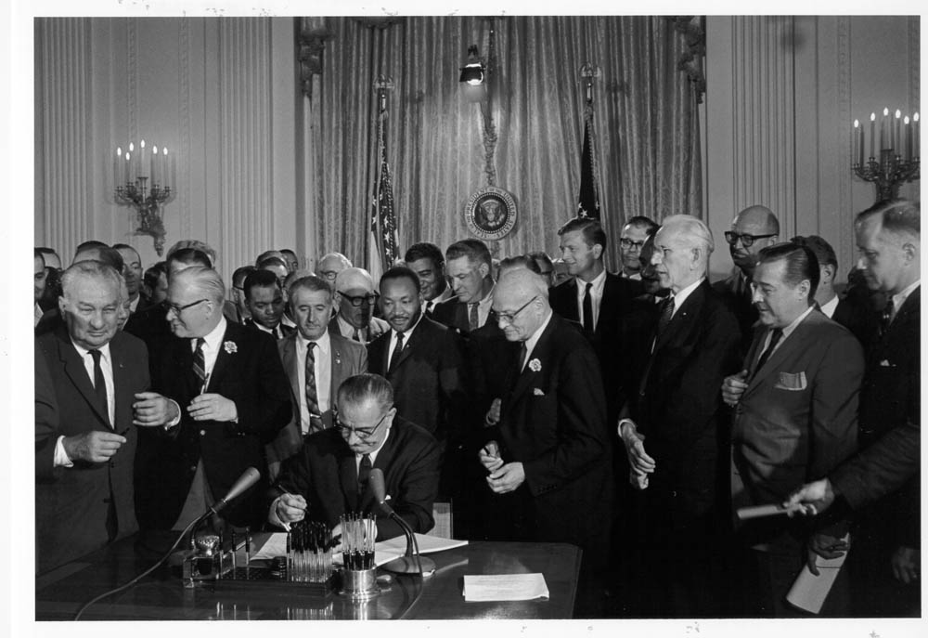

Slide 36
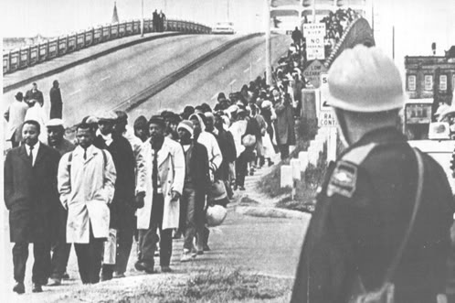
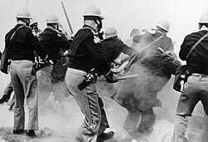

Slide 37
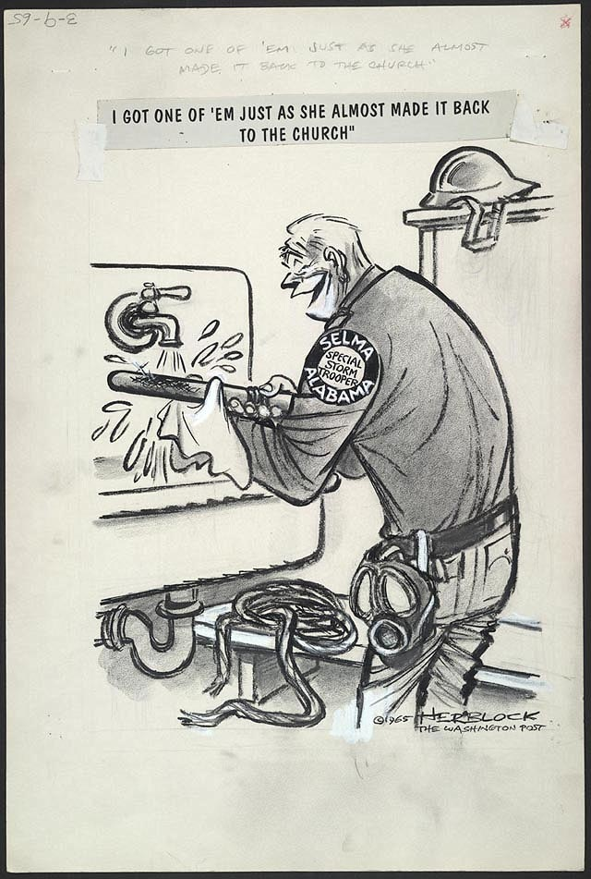
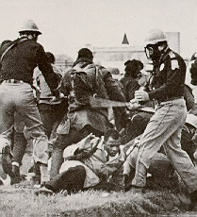

Slide 38
Kate Campbell, “Crazy in Alabama,” Visions of Plenty, 1998.
I heard Odessa’s mind was sick
That she was crazier than hell
The police caught her turning tricks
Down at the Blue and Gray motel
Odessa was the neighbor’s maid
She had ten mouths at home to feed
They bussed her kids to Birmingham
And put her in the county jail
Nobody seemed to give a damn
They say a white man posted bail
My dad said not to breathe a word
I told my brother all I heard
And the train of change
Was coming fast to my hometown
We had the choice to climb on board
Or get run down
It was crazy there were grown men fights
Over segregation and civil rights
Martin Luther King and the KKK
George C. Wallace and LBJ
And when the National Guard came in
I thought the world was gonna end
It was crazy in Alabama
Down at the corner Dairy Dip
They sold soft ice cream for a dime
White people ordered from the front
The side was for the colored line
We all were told they had their place
Because they were a different race
We spent hot summer afternoons
At the public swimming pool
Where the privileged and the few
Played on their island of cool blue
Brown children watched outside the fence
It never made one lick of sense
But the train of change
Was coming fast to my hometown
We had the choice to climb on board
Or get run down
My momma yelled child get inside
Drew the drapes and locked the doors
We watched the marchers passing by
Felt the rumble heard the roar
They all held hands they sang and wept
And freedom rang in every step
Cause the train of change
Was marching through my hometown
We had the choice to climb on board
Or get run down

