Slide 1
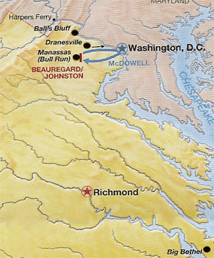
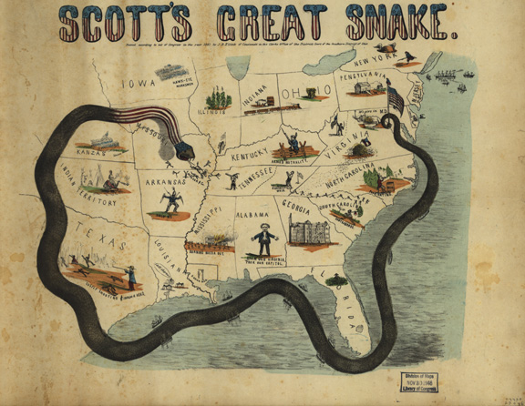
North vs. South: An Overview
John M. Sacher
University of Central Florida
john.sacher@ucf.edu

Slide 2
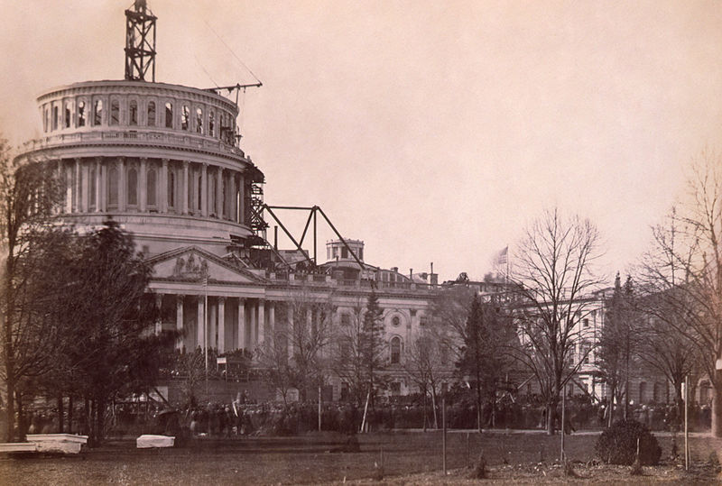
Lincoln’s Inauguration

Slide 3
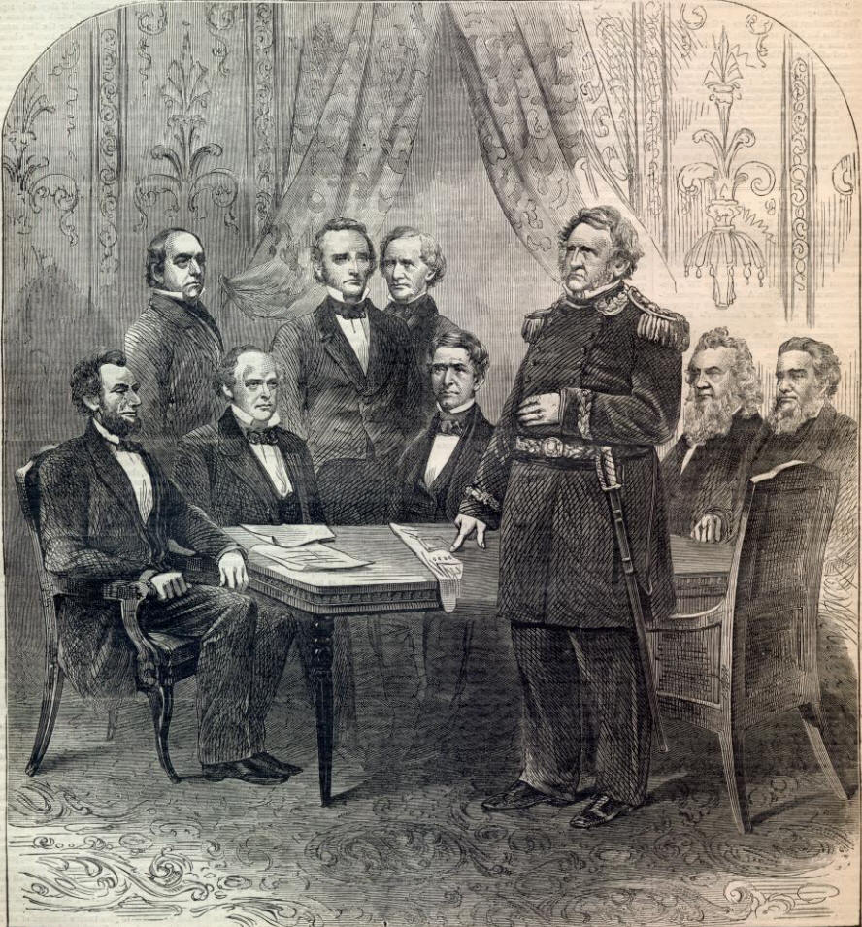
Winfield Scott

Slide 4
Anaconda Plan

Slide 5
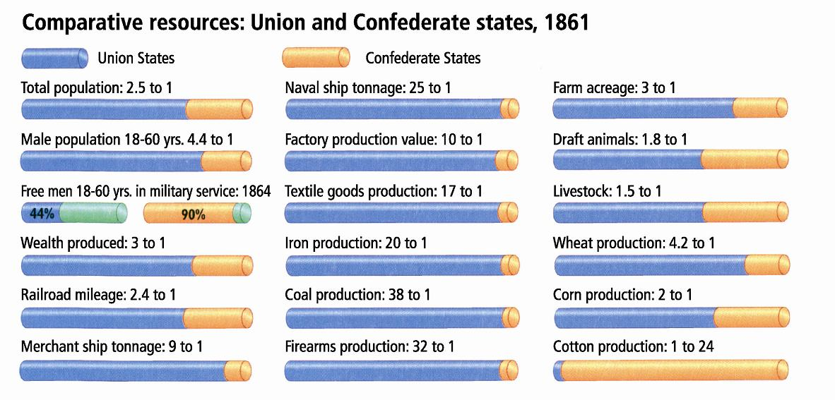

Slide 6
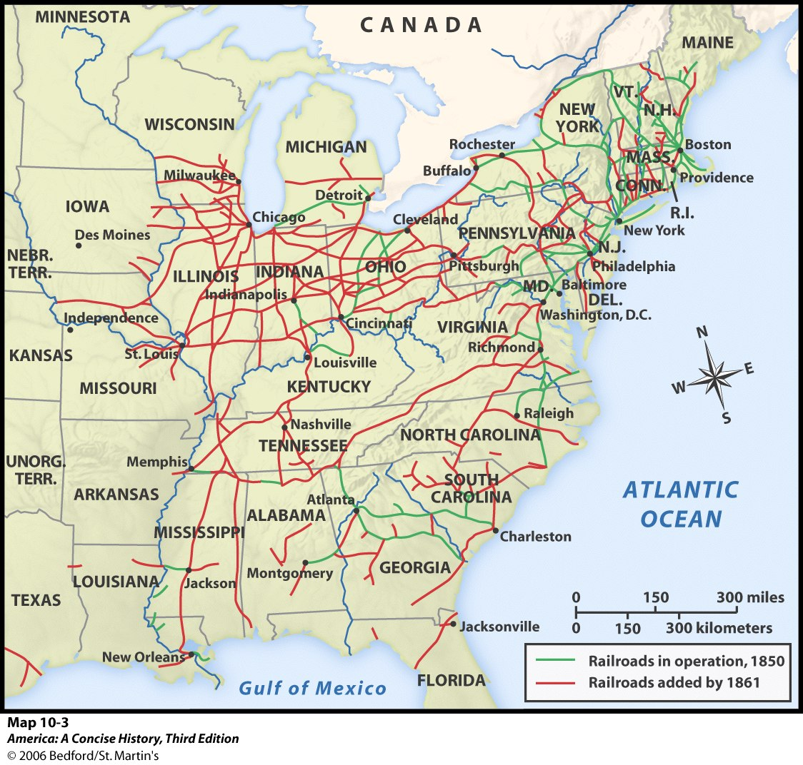

Slide 7
Jefferson Davis

Slide 8
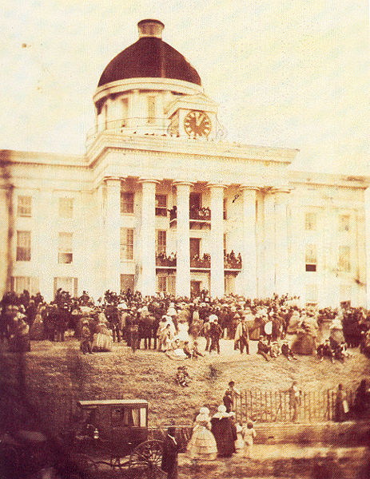
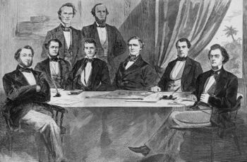
Confederate Government

Slide 9
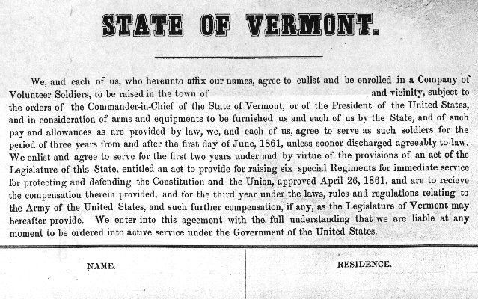
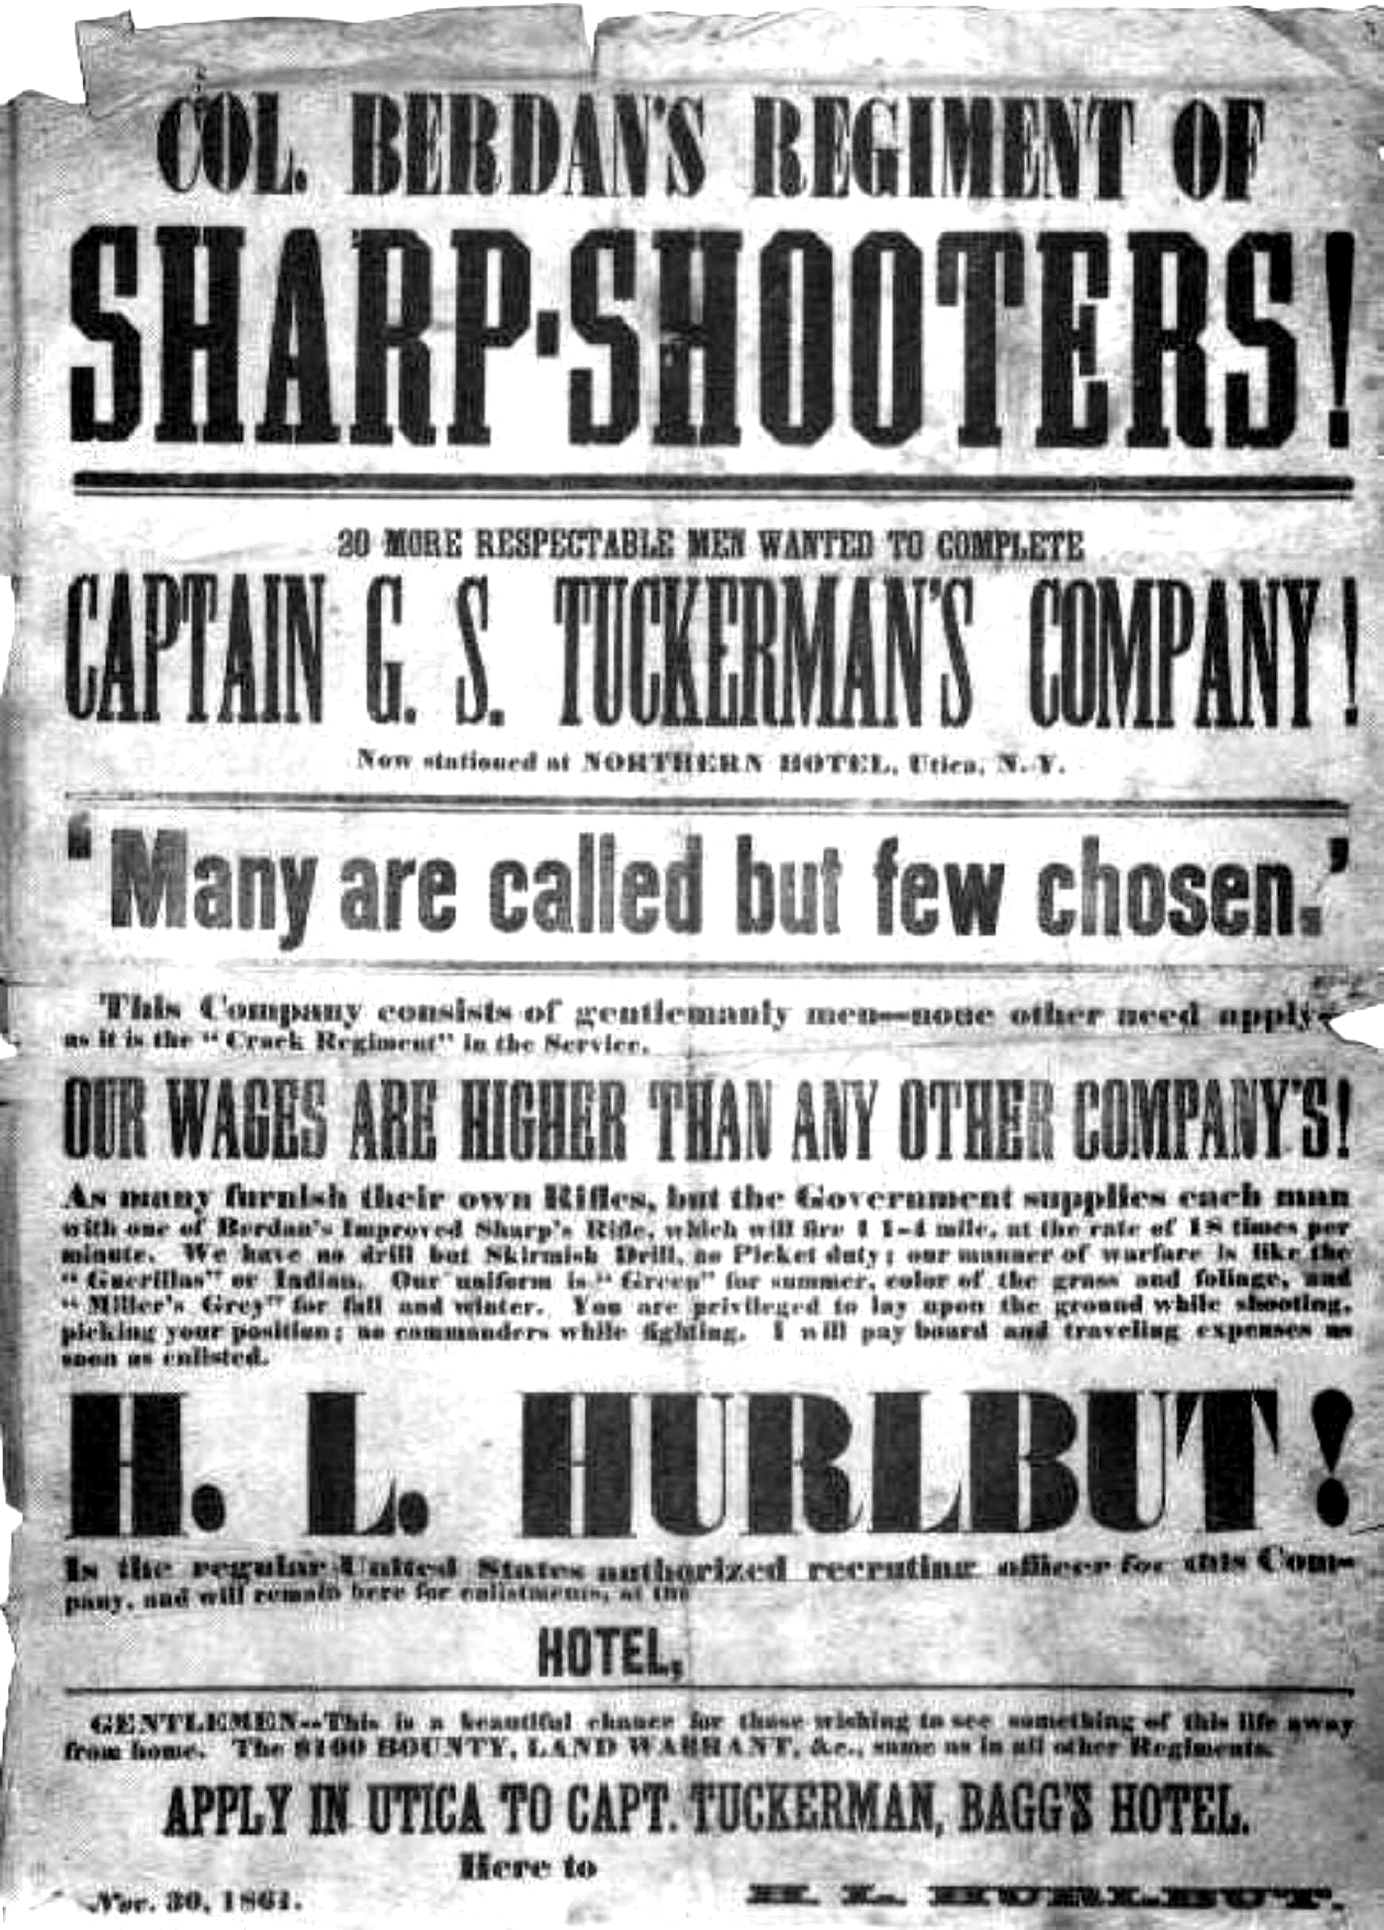
Recruiting

Slide 10
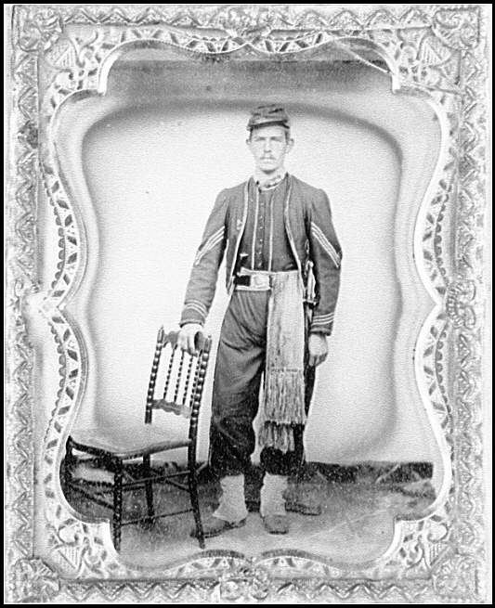
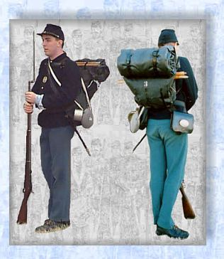
Soldiers

Slide 11
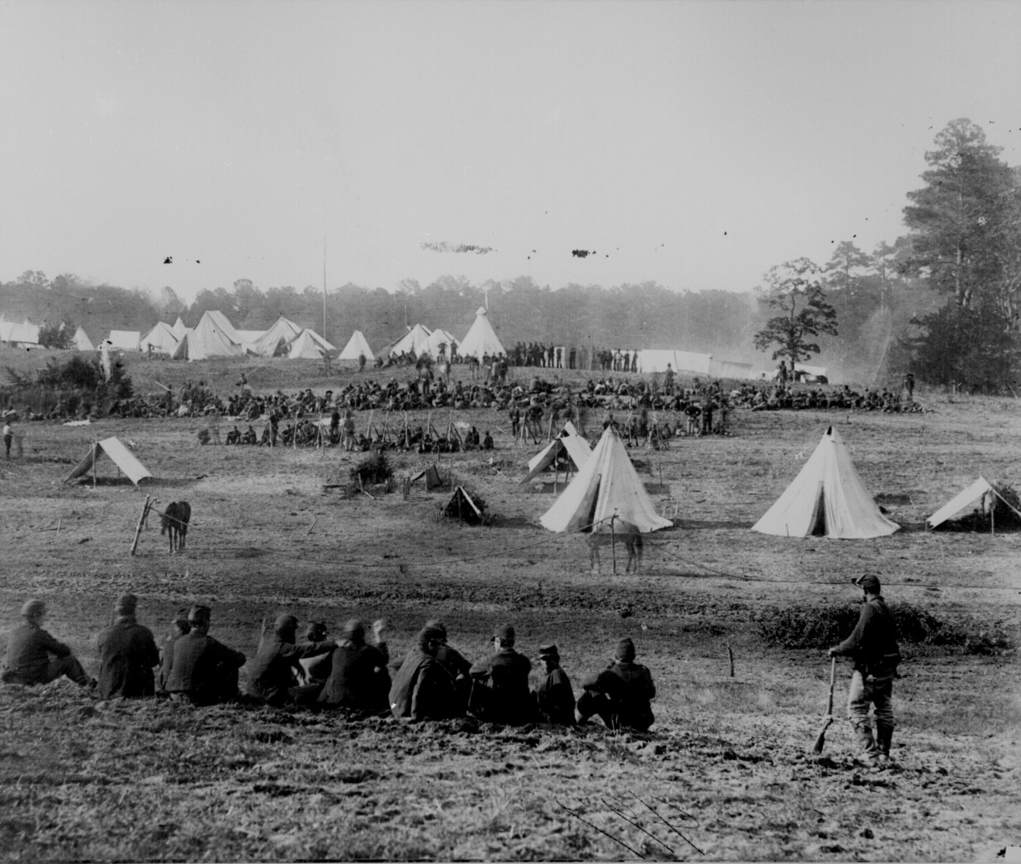
Civil War Camp

Slide 12
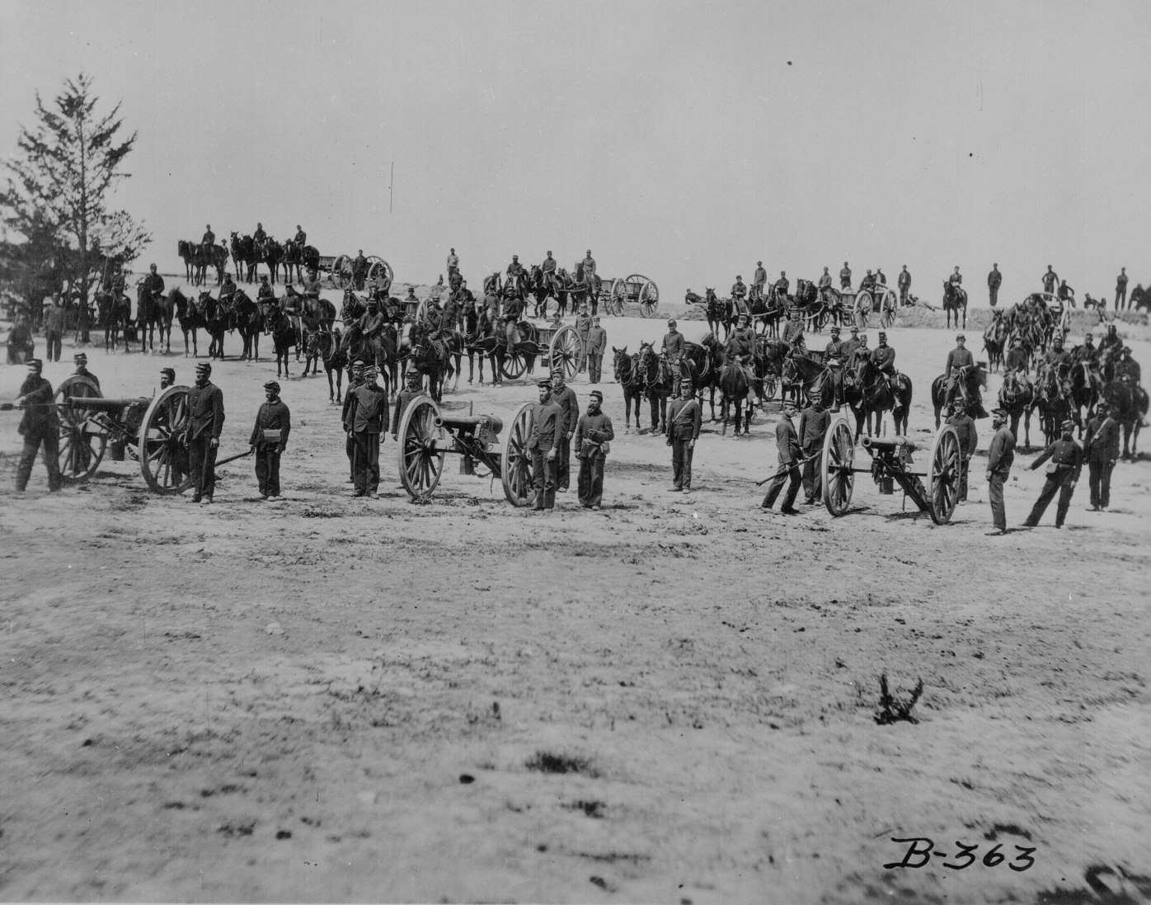
Civil War Drill

Slide 13
The Changing View of Soldiers
“We are the liveliest set of men you ever saw . . . Singing, whooping, talking, & laughing . . . All we have to do when not on drill is to cook and eat and do a little washing and the balance of time we lay flat on our back. . .”
“The first thing in the morning is drill then drill, then drill again, then drill, drill, and a little more drill. Then drill and lastly drill. Between drills, we drill and sometimes stop to eat a little and have roll call.”

Slide 14
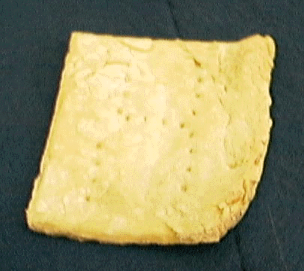
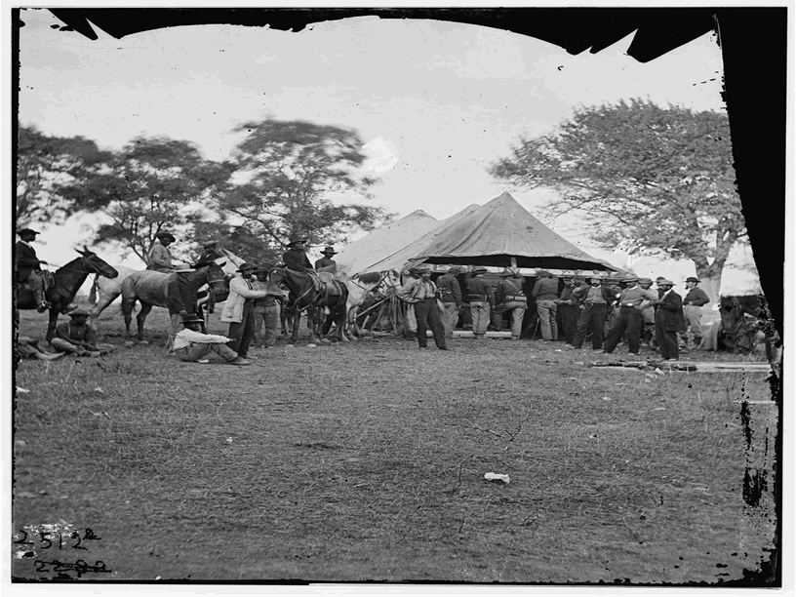
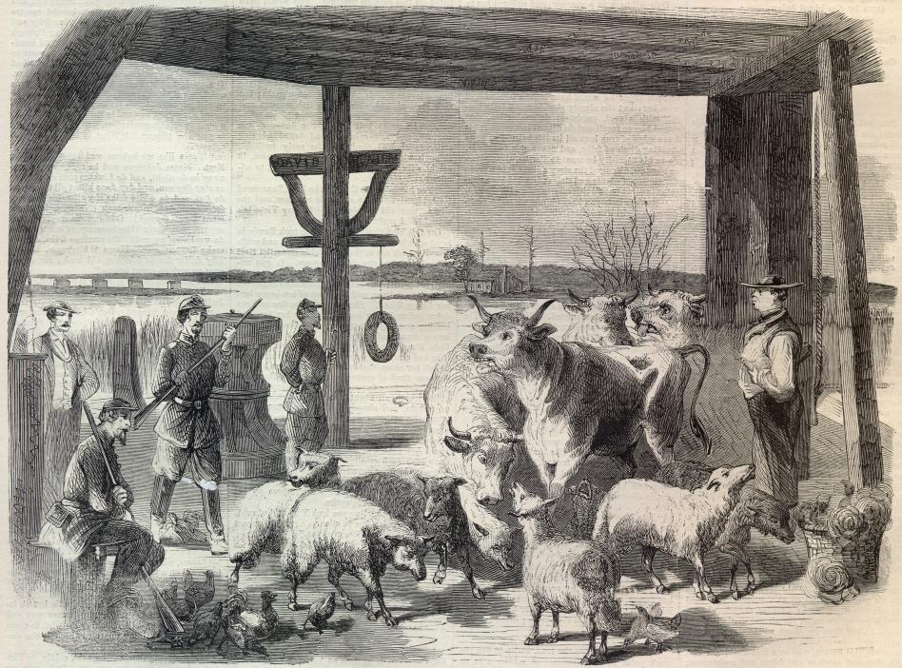
Civil War
Dining Options

Slide 15
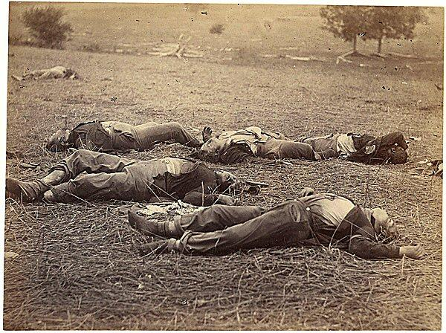
Civil War Deaths
Union Confederate
Battle deaths 110,000 94,000
Disease, etc. 250,000 164,000
Total s 360,000 258,000
All numbers are approximate

Slide 16
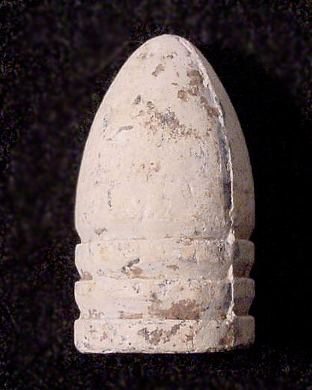
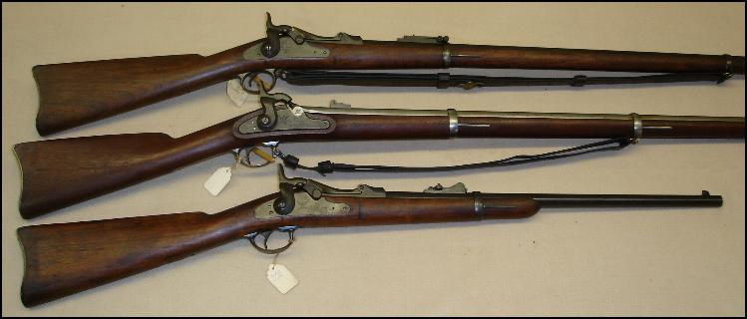
Springfield Rifle & Minié Ball
1.6 million Springfield Rifles, $14.93 each

Slide 17
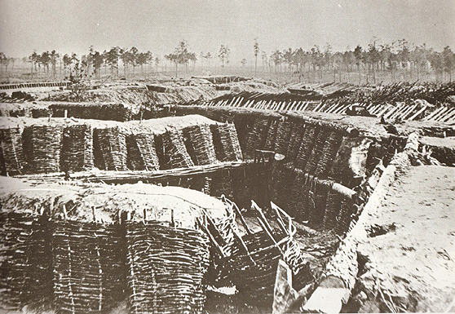
Civil War Trenches

Slide 18
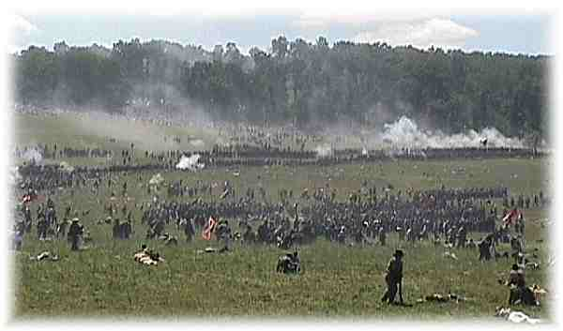
The Charge

Slide 19
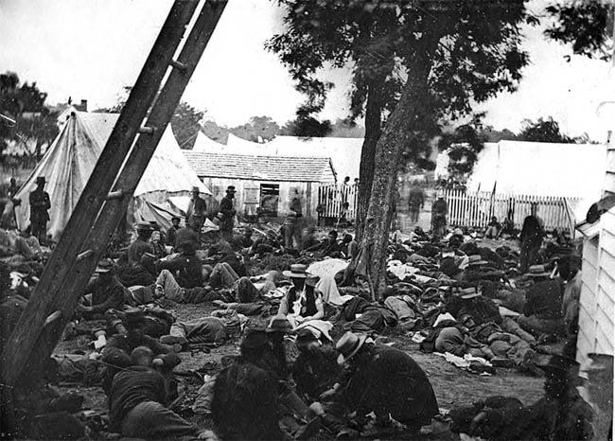
Civil War Field Hospital

Slide 20
The Civil War in 1861

Slide 21
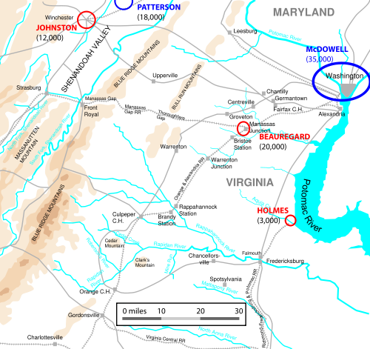
First Bull Run Campaign

Slide 22
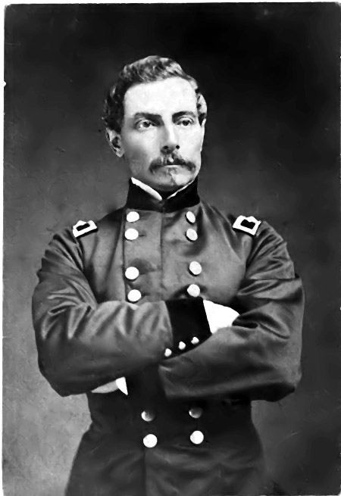
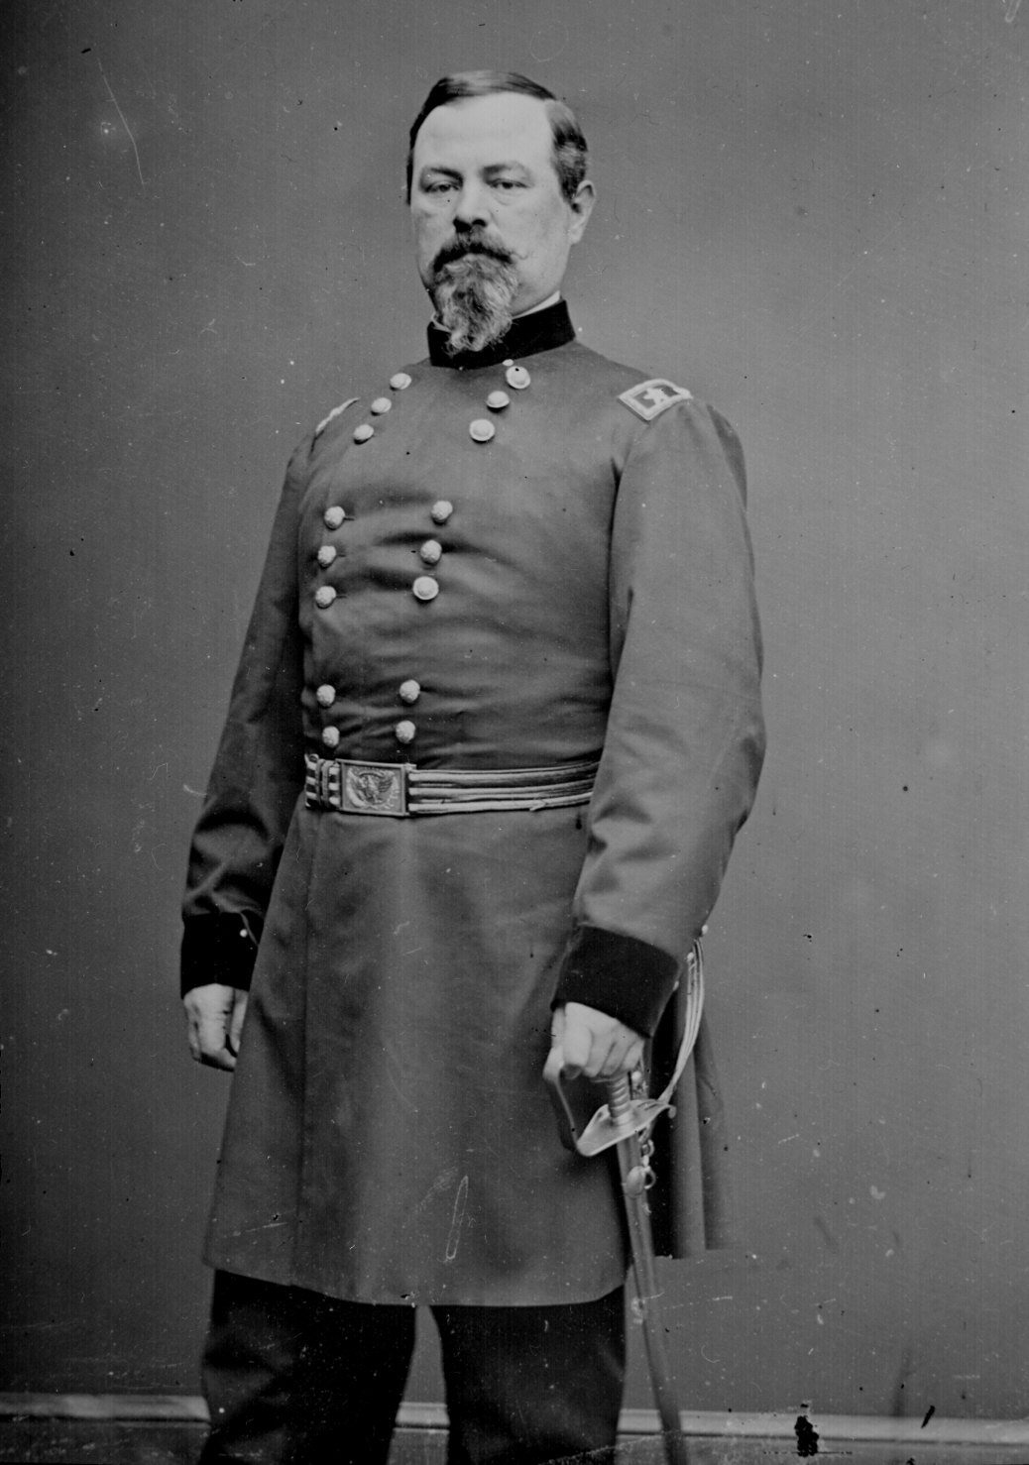
Irvin McDowell
P.G.T Beauregard

Slide 23
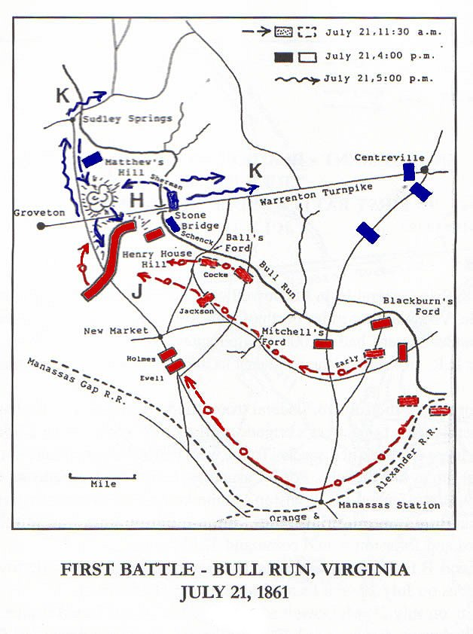
Bull Run

Slide 24
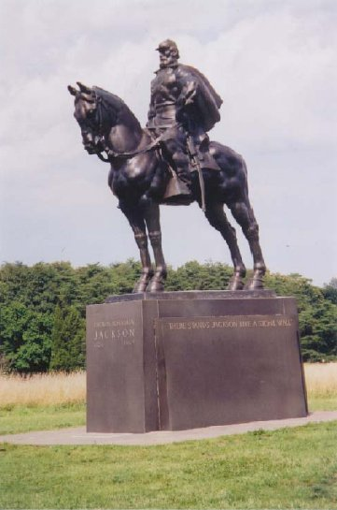
Stonewall Jackson

Slide 25
Bull Run serves as an example of. . .
Flanking Movement
Advantage of the Defense
Technology
Second Guessing (connection between war and politics)
Eastern Theater Bias

