Slide 1
Post 9/11
A long Road

Slide 2
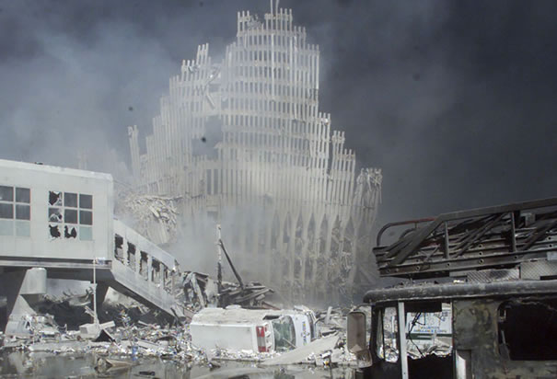
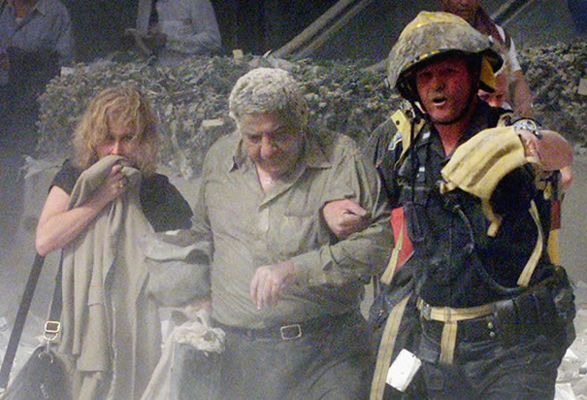
www.history.com

Slide 3
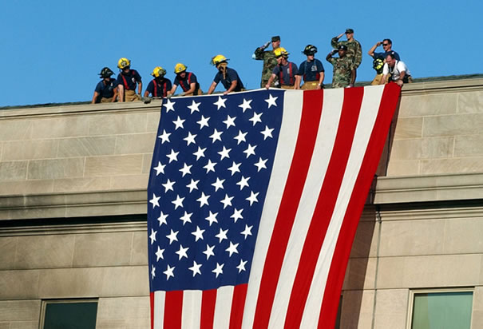
9.11.2001 Background
Morning of 9/11/2001 four planes hijacked by Islamic Extremists from al-Qaeda.
2 planes hit the World Trade Center buildings
1 plane hit the Pentagon
1 plane crashed in a field in Pennsylvania
More than 3000 people killed
Over 400 police/firefighters killed
Led by Osama bin Laden

Slide 4
Discussion Question 1
Given the background information on 9/11/01 what measures/changes do you feel should have gone in place to prevent a second attack?

Slide 5
Major Changes Post 9.11.01
U.S. Patriot Act
Department of Homeland Security
Nationalism/Patriotism
Civil Liberties v. National Security

Slide 6
U.S. Patriot Act Key Facts
Passed in October 2001 due to the attacks
Created new rules for the Legal System
Allows the government the same rights for fighting terrorists as they did for fighting the mob
Opened up a network for
agencies to communicate
Increased the penalties for
terroristic activities
www.wikispaces.psu.edu
Notes:
The federal government was now allowed to use wire tapping to learn about terroristic threats. This included the idea of roving wire taps which was originally reserved to mob activity. Roving wire taps are when they tap the person (multiple devices that they might use instead of a sing device.
One of the big issues brought up during the inquiries into the attacks was the fact that the FBI, CIA, and State Departments did not have an easy way to engage in open conversation.

Slide 7
U.S. Patriot Act Key Facts (Cont…)
The Federal Government claims that the Patriot Act has allowed the government to be much more proactive in stopping possible attacks prior to them happening.

Slide 8
Discussion Question 2
How would you feel if you found out the Federal government had been listening in on all of your families calls. Explain your answer.

Slide 10
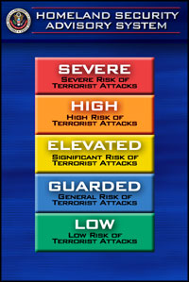
Department of Homeland Security Key Facts
The department was created within the Executive Branch 11 days after the terrorist attacks
The department was officially
made a Cabinet level position
under the homeland security act
of 2002
Notes:
Department of Homeland Security Act was enacted in November 2002.

Slide 11
Department of Homeland Security Key Facts (Cont.)
The creation of the department
of Homeland Security included a
combination of multiple other
groups such as:
Immigration and Naturalization
U.S. Customs
TSA
Federal Law Enforcement Training
Center.
Notes:
The addition of

Slide 12
Discussion Prompt 3
How could having multiple intelligence agencies and directors be both beneficial and harmful to the Unites States national security?

Slide 13
Nationalism/Patriotism
With a partner read the article on military recruiting post 9/11. Answer the following questions on a separate sheet of paper and be prepared to discuss with the class

Slide 14
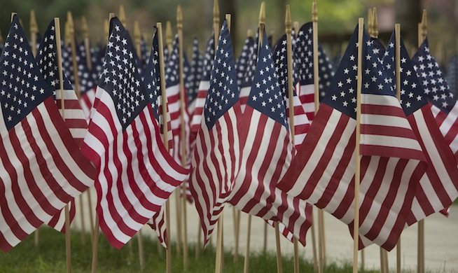
Nationalism
How is nationalism or patriotism exhibited in the article?
Why would a terrorist attack elicit these feelings?
What events besides an
attack or war could
cause the same type of
nationalism?
www.binghamton.edu

Slide 15
Discussion Prompt 4
How has airport security changed since 9.11.2001?

Slide 16
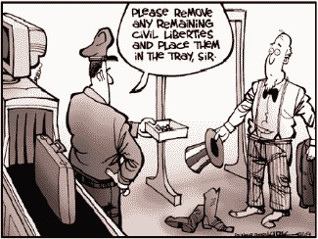
Civil Liberties v. National Security
Airport Searches (TSA)
Suspected Terrorists taken to Guantanamo Bay
Tighter Border control
with Mexico and
Canada

Slide 17
Discussion Prompt 5
Is national security worth losing rights?
Where do we draw the line?
When have we seen this happen in the past?

Slide 18
Research Assignment
Now that we have a basic overview of the different changes that affected the United States after 9/11, please complete the following research assignment with a partner.
Research at least (3) other changes in the U.S. post 9/11 and create a PowerPoint Presentation outlining how the changes impacted U.S. Citizens

Slide 19
Citations
9/11 Pictures/ Statistics:
www.history.com
Patriot Act Facts
http://www.justice.gov/archive/ll/highlights.htm
Department of Homeland Security Facts
http://www.dhs.gov/creation-department-homeland-security

