Slide 1
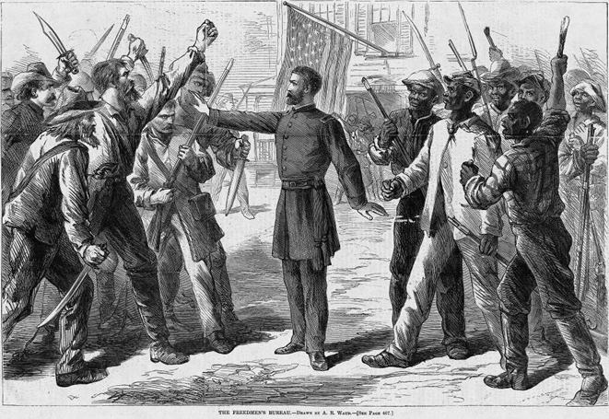
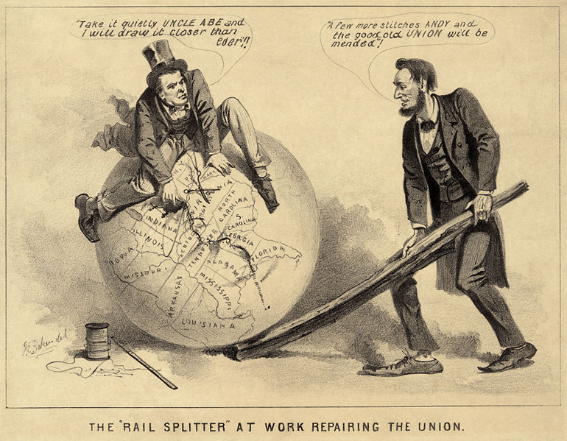
Presidential Reconstruction (1863-1867)
John Sacher
John.sacher@ucf.edu

Slide 2
Key Questions
What should happen to Confederate states and to ex-Confederates?
What should happen to the former slaves?

Slide 3
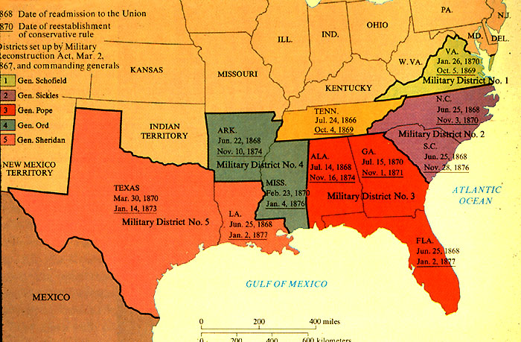
Reconstruction

Slide 4
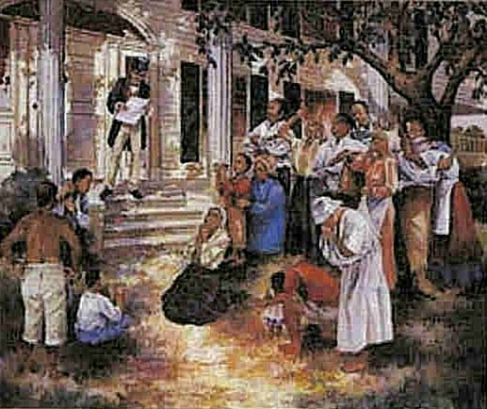
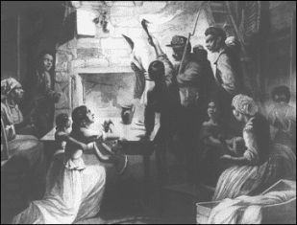
Former Slaves

Slide 5
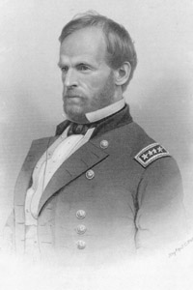
Sherman’s Special Field Order #15

Slide 6
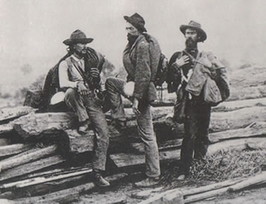
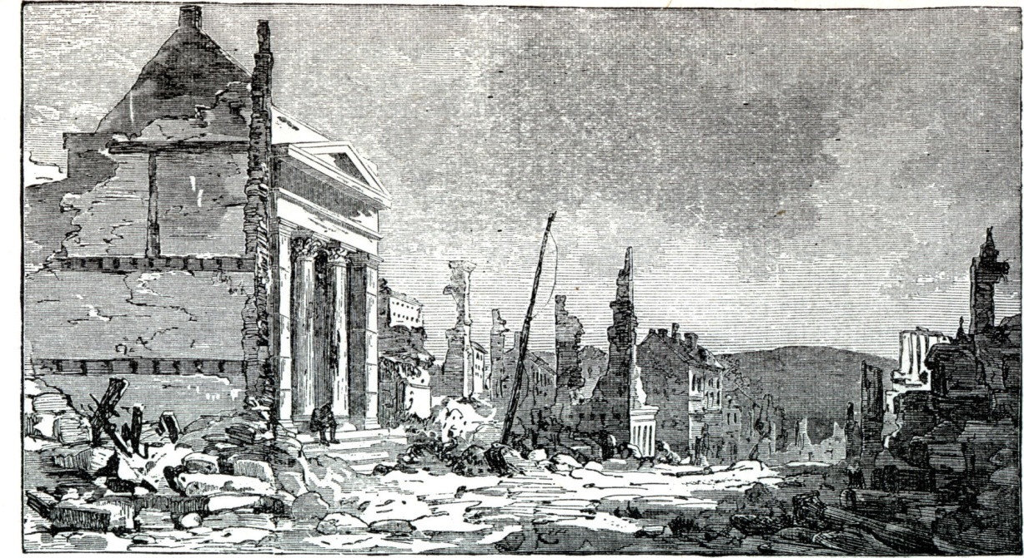
Southern Democrats

Slide 7
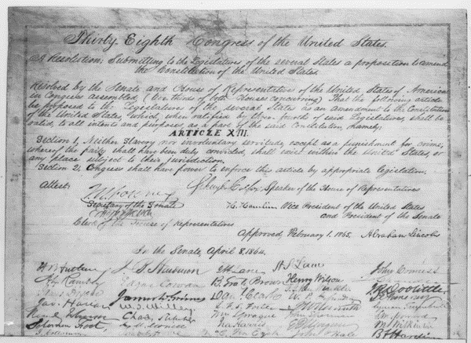
13th Amendment
Neither slavery nor involuntary servitude, except as a punishment for crime whereof the party shall have been duly convicted, shall exist within the United States, or any place subject to their jurisdiction.

Slide 8
Grand Review of the Union Army, May 1865

Slide 9
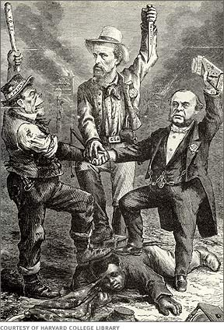
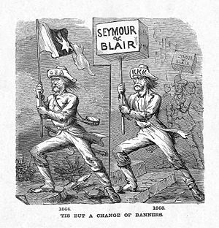
Waving the Bloody Shirt
“Soldiers, every scar you have on your heroic bodies was given you by a Democrat. Every scar, every arm that is lacking, every limb that is gone, is a souvenir of a Democrat. I want you to recollect it . . .”

Slide 10
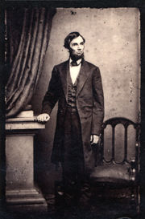
Abraham Lincoln
Proclamation of Amnesty and Reconstruction—The 10 Percent Plan

Slide 11
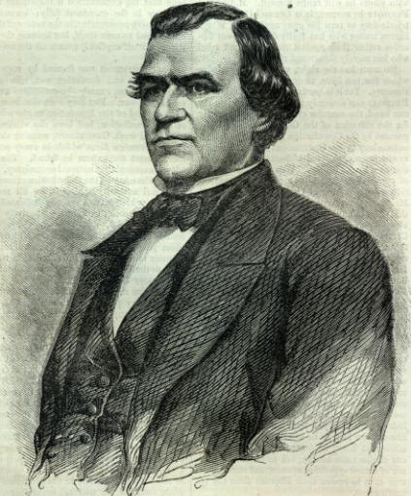
A New President
Andrew Johnson

Slide 12
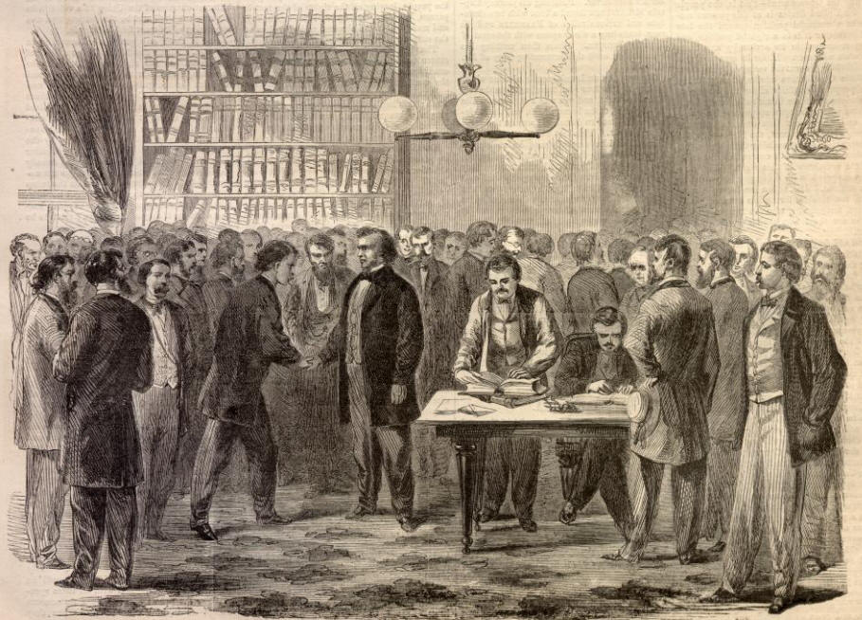
Andrew Johnson’s Pardons

Slide 13
Freedmen’s Bureau
“I fear you have Hercules task.”

Slide 14
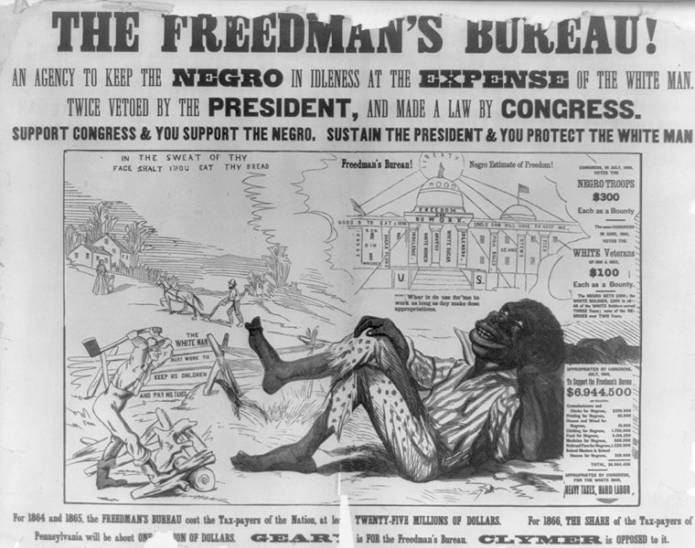
Opposition to the Freedmen’s Bureau

Slide 15
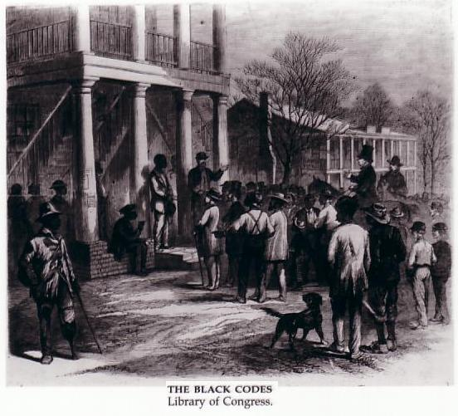
Black Codes

Slide 16
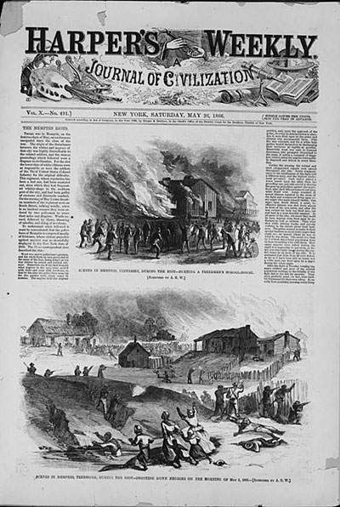
Memphis Riot, May 1-2, 1866

Slide 17
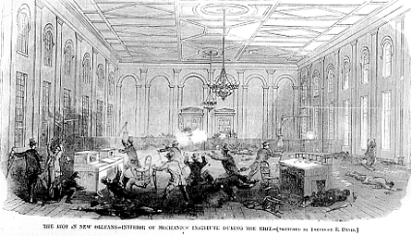
New Orleans Riot 1866
“The more information I obtain . . . the more revolting it becomes.
It was no riot; it was an absolute massacre by the police which was not
excelled in murderous cruelty by that of Fort Pillow.” Sheridan to Grant

Slide 18
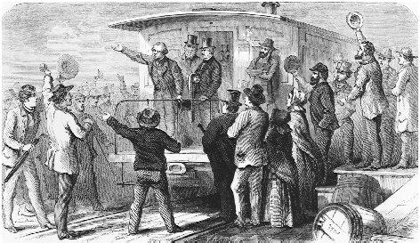
Swing Around the Circle

