Slide 1
Perfecting Society
A Concept-Based Approach
© 2010 AIHE

Slide 2
The American Landscape
Most women were not allowed to vote
Free blacks and slaves were excluded from the political process
The major parties of the period tried to avoid addressing controversial issues
Reform movements allowed the voiceless a chance to effect some form of meaningful change in society.
© 2010 AIHE

Slide 3
The American Mindset
Social problems were seen as clashes of good and evil
God was on the side of the good and Satan was on the side of the evil
The idea of the decisive battle between God and Satan, good and evil, was an outgrowth of the Second Great Awakening
While some Reformers did not subscribe to evangelical reform, almost all borrowed from it
© 2010 AIHE

Slide 4
An Outsider’s View
In France, I had almost always seen the spirit of religion and the spirit of freedom pursuing courses diametrically opposed to each other; but in America, I found that they were intimately united, and that they reigned in common over the same country… Religion was the foremost of the political institutions of the United States.
-- Alexis de Tocqueville, 1832
© 2010 AIHE

Slide 5
Essential Question
How did religious revivalism help spark social reforms in America, and what impact did the reforms have?
© 2010 AIHE

Slide 6
Impact of Second Great Awakening
Religious Revivalism
There are others, such as abolition and utopias, but we are leaving them out for the sake of time.
Social Reforms
Temperance
Women’s Rights
Deviancy
Education
© 2010 AIHE

Slide 7
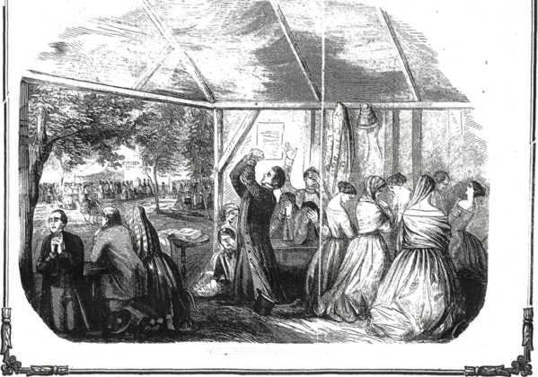
The Soul Shaking Conversion

Slide 8
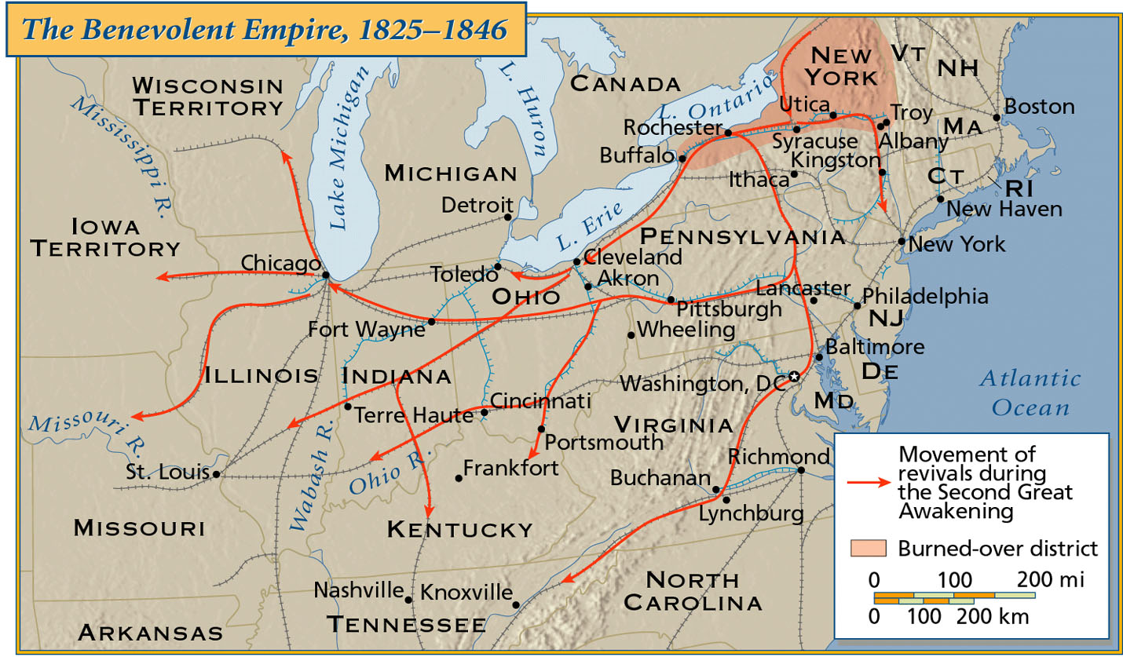
Map of 2nd Great Awakening

Slide 9
Revival Quote
There can be no revival when Mr. Amen and Mr. Wet-Eyes are not found in the audience
…the candles and lamps illuminating the encampment; hundreds moving to and fro…;the preaching, praying, singing, and shouting,…
© 2010 AIHE

Slide 10
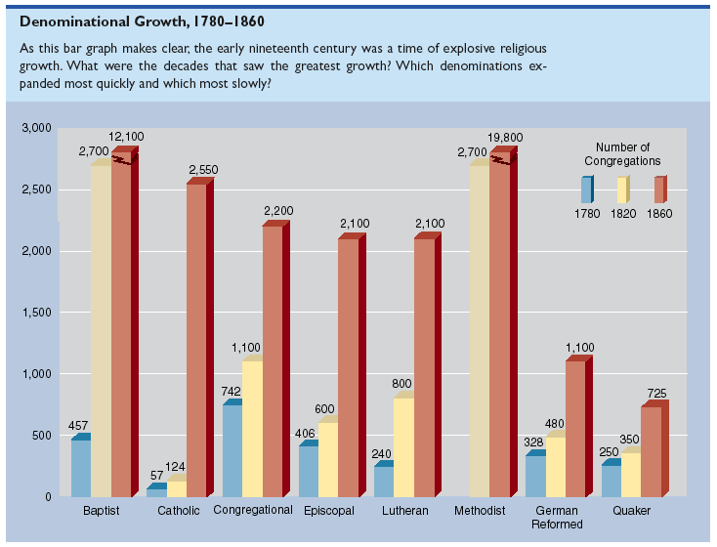

Slide 11
What is the lesson?
Man needs to become more God-like and that means attempting to improve and perfect himself as well as improve his society.
© 2010 AIHE

Slide 12
Temperance
The battle against Demon Rum!
© 2010 AIHE

Slide 13
The Problem
American per capita alcohol consumption was increasing
1830 = 7 gallons of hard liquor per year
1820’s = ½ pint of liquor per man per day
… but the decisions themselves were often made in private multi-course banquets over cases of madeira, port, and brandy. … most strove to be known as ‘two-bottle men’”
“Freedom Just Around the Corner”, p. 203
© 2010 AIHE

Slide 14
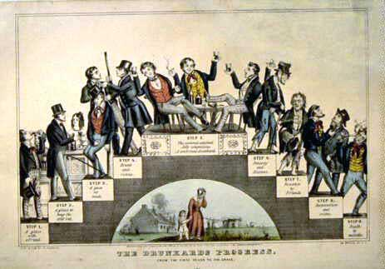
Consequences
Poverty
Abuse
Running around
Abandonment
Death
© 2010 AIHE

Slide 16
American Temperance Society
Founded in 1826
Moved toward radicalism
From a message of moderation to one of abstinence
Focused their energies on the laboring classes
Factory owners saw merit in the message and supported it
By 1840s the movement gained steam
Many workers had come onboard
Believed the drunkeness meant ruin in a bad economy (panic of 1837)
© 2010 AIHE

Slide 17
Gaining Traction
As the movement grew so did demands
Demanded that cities and even states pass legislation against booze
Shifted from a stance of moral persuasion to one of morality-based legislation
Was a controversial but effective effort
A number of localities and even one state passed laws against alcohol
© 2010 AIHE

Slide 18
?

Slide 19
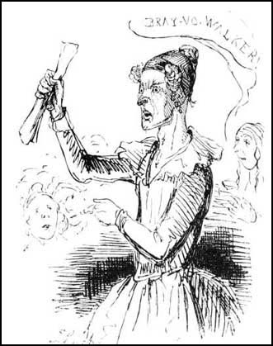
Women’s Rights
© 2010 AIHE

Slide 20
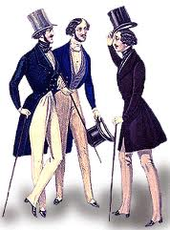
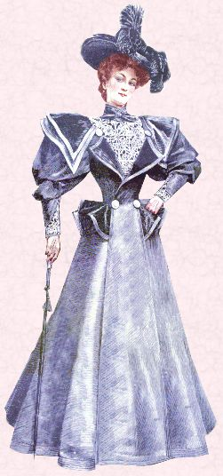
Separate Spheres
Men
Women

Slide 21
Worlds Collide

Slide 22
The Cult of Domesticity
The role of women is to be the homemaker
She was to be the guardian of the home, civilize the husband and family
Should stay out of the male sphere since it is not natural for them to do so
The power of woman is her dependence. A woman who gives up that dependence on man to become a reformer yields the power God has given her for her protection, and her character becomes unnatural!
© 2010 AIHE

Slide 23
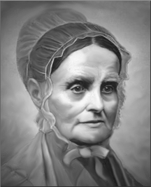
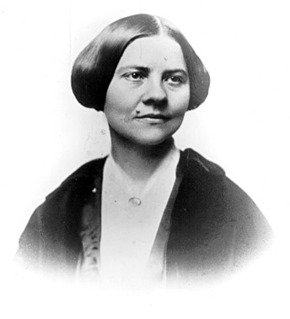
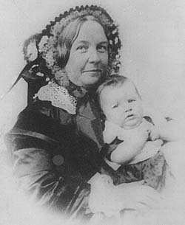
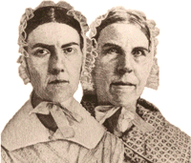
Rights
There were three socio-political rights that were almost universally lacking
Voting
Ownership of property if married
Couldn’t initiate divorce
Retaining earned wages

Slide 24
Engrained Inequality
Was simply an accepted part of society, much like slavery in the south
The Abolitionist movement is what jarred it to the forefront
Experienced discrimination in the Abolitionist ranks
Led some liberal women to split from the Abolitionists and concentrate on Women’s rights
© 2010 AIHE

Slide 25
Seneca Falls – 1848
Spawned by treatment in London
Many were Quakers – measure of equality
Was designed to
"to discuss the social, civil, and religious condition and rights of woman.“
Elizabeth Cady Stanton drew up the Declaration of Rights and Sentiments before the meeting
© 2010 AIHE

Slide 26
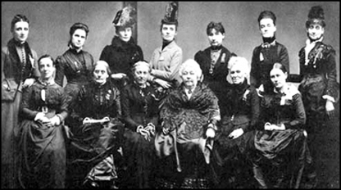
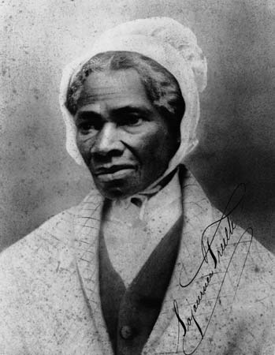
Seneca Falls Convention, 1848
Susan B. Anthony
Lucretia Mott
Elizabeth Cady Stanton
Sojourner Truth
Picture is from the 40th Anniversary

Slide 27
ARTIST Time!
Analysis of Primary Sources
© 2010 AIHE

Slide 28
What does A.R.T.I.S.T. stand for?
Author
Reason
To whom
Immediate effect
Subsequent effects
Time period
Painting history with BROAD STROKES!
© 2010 AIHE

Slide 29
What is R&B?
R&B is the logical extension of the ARTIST analysis.
R&B stand for Reliability and Big picture ideas respectively.
It is absolutely imperative that students have a grasp of the reliability of historical documents as well as the big picture ideas contained in them.
© 2010 AIHE

Slide 30
Reliability
After students have applied the A.R.T.I.S.T. process, ask them to draw conclusions from the document or source.
Ask leading questions to get your students to fully process the document and its place in history.
Attempt to determine the reliability of the document(s).
Should include possible biases and unique points of view
© 2010 AIHE

Slide 31
Big Picture Ideas
After students have applied the A.R.T.I.S.T. process –AND- have determined the reliability of the document, ask them to draw big picture conclusions from the document or source.
Ask leading questions to get your students to fully process the document and its place in the larger scope of American history.
Actively discuss the main ideas embodied in the document or source.
© 2010 AIHE

Slide 32
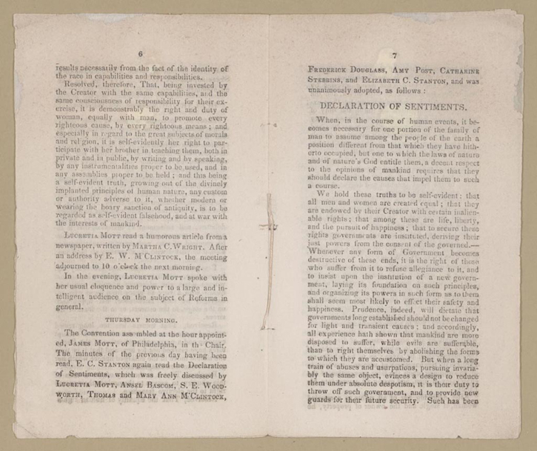

Slide 33
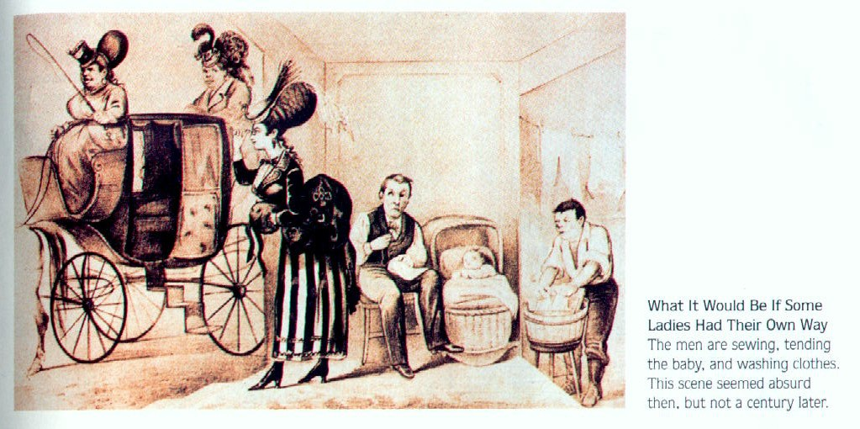

Slide 34
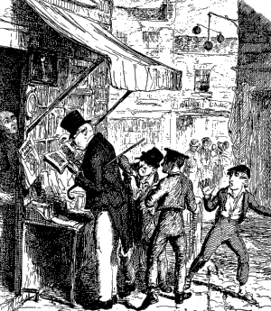
Deviancy
© 2010 AIHE

Slide 35
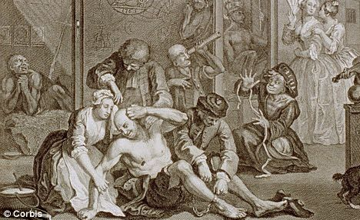
Societal Problems
Three major problems facing the burgeoning nation in the 1830’s – 1840’s
Poverty
Crime
Insanity
© 2010 AIHE

Slide 36
Solution
Reformers believed in the idea of the “institution” to help
The assumption was that a series of regimented and institutionalized processes could “cure” deviancy

Slide 37
Poverty and Crime
The big question was from whence did they spring? (study the cause, find the cure)
New Idea:
Cause of poverty and crime was from drunken fathers and failure of parental discipline
Colonial Ideas:
Defects in character, evil, and God’s will caused these deviancies
The premise was that you could alter human nature.

Slide 38
Crime
The institution here became known as the Penitentiary (as opposed to the prison)
The Penitentiary would serve as the substitute for parental discipline
Solitary confinement
Quiet
Little interaction
Heavily regimented schedule
© 2010 AIHE

Slide 39
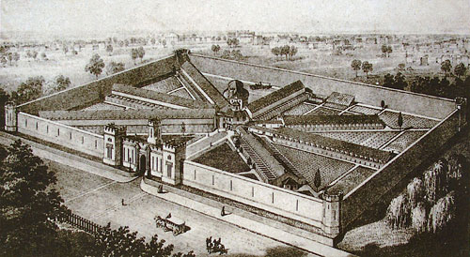

Slide 40
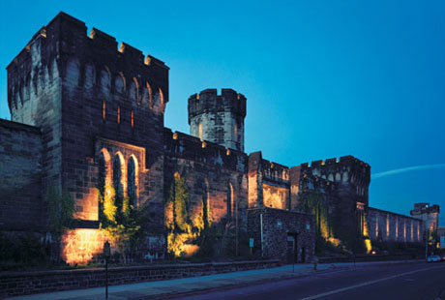
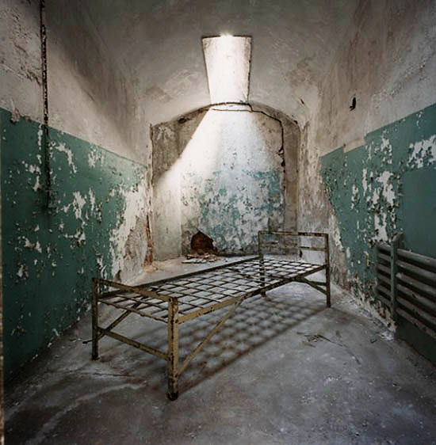

Slide 41
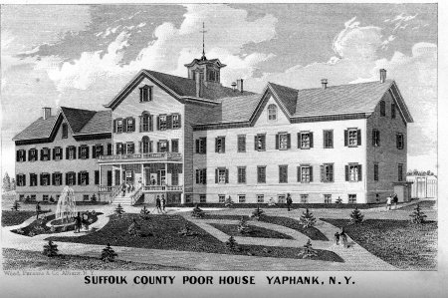
Poverty
Again, same causes and a philosophically similar solution
The Almshouse (or Poor House)
Physically take the poor out of their wretched conditions
Expose them to a regimented daily routine
© 2010 AIHE

Slide 42
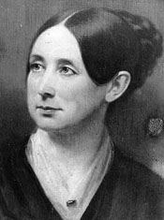
The Insane
The standard practice was to confine to prisons
1841 – Dorothea Dix
“Chained, naked, beaten with rods and lashed into obedience”
The answer
The Asylum – a place where the insane could be exposed to a regimented life that would hopefully cure their issues
© 2010 AIHE

Slide 43
What do we get out of this?
Four major commonalities:
A belief that deviancy can be “cured”
A change in environment is necessary to “cure” deviancy
Freedom is at the root of deviancy
Regimentation is needed to help “cure” deviancy
© 2010 AIHE

Slide 44
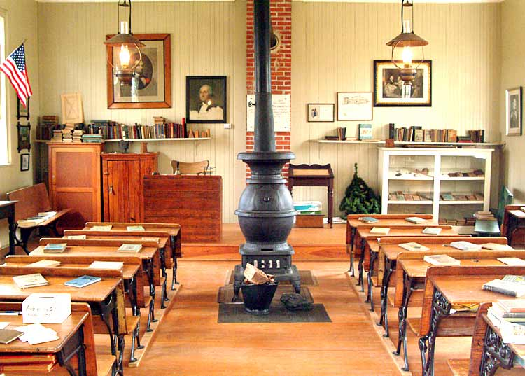
Education Reform
© 2010 AIHE

Slide 45
The Problem of Rural Schools
Not very rigorous and short terms
Taught an outdated curriculum
Not “graded”
Primitive conditions
The Other Problem → people liked them because they were microcosms of their communities
© 2010 AIHE

Slide 46
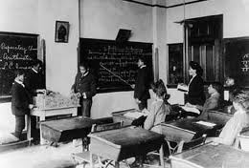
The Idea
Reform the educational system to:
Equip children for life in an increasingly industrial society
© 2010 AIHE

Slide 47
Goals
State supported as opposed to local
Graded
10 month term
Teacher training
Adequate texts and resources
Compulsory attendance
Structured to absorb idle time
© 2010 AIHE

Slide 48
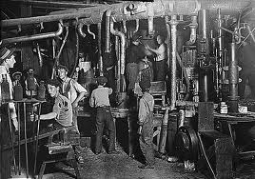
“Other” Goals
Spread a common culture and values
Industry, honesty, sobriety, and patriotism
All in name of the economy
Punctuality
Obedience
Competitiveness
Work ethic
© 2010 AIHE

Slide 49
Failure to Gain Ground
In South
Agrarian
Wealthy hired private tutors or sent away for school
Parochial schools
Were against the secularization of education
© 2010 AIHE

Slide 50
Gaining Traction
Working class liked the “free” part
Manufacturers and business leaders liked the values that were being taught
Reformers, such as women, saw opportunity
Nativists liked the homogenization
© 2010 AIHE

Slide 51
School as Melting Pot
Forged a common culture
Assimilated divergent groups into one common mass
Shared experiences helped cement a more common culture
© 2010 AIHE

Slide 52
Conclusion
Can we now answer our Essential Question?
How did religious revivalism help spark social reforms in America, and what impact did the reforms have?
© 2010 AIHE

