Slide 1
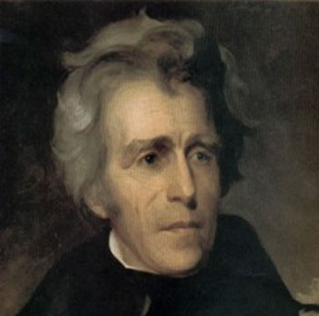
Teaching The Rise of the Common Man
This power point presentation is for educational purposes. It may contain copyrighted material. Please do not post, redistribute or copy without the permission of the author or Dr. Kevin Brady at the American Institute for History Education.
© 2010 AIHE

Slide 2
Goal(s) & Sequence
To demonstrate a way to teach the era of the common man through the use of multiple sources, visuals, timelines, and practicing critical thinking.
Begin with classic narrative history
Discuss the scope and sequence of the era
Examine geographic changes
Condense into bullet-points
Analyze electoral results
Use of period political cartoons
Boil information down into bare essentials
Corroborate
© 2010 AIHE

Slide 3
Directions
This is an interactive presentation i.e. you should pay attention and interact with me
You need to read any information on each slide and formulate answers to any questions that appear on the slide
Look for ways that you could use similar techniques in your own classroom
© 2010 AIHE

Slide 4
Change is Afoot
In 1821, American politics was still largely dominated by deference. Competing political parties were nonexistent and voters generally deferred to the leadership of local elites or leading families. Political campaigns tended to be relatively staid affairs. Direct appeals by candidates for support were considered in poor taste. Election procedures were, by later standards, quite undemocratic. Most states imposed property and taxpaying requirements on the white adult males who alone had the vote, and they conducted voting by voice. Presidential electors were generally chosen by state legislatures. Given the fact that citizens had only the most indirect say in the election of the president, it is not surprising that voting participation was generally extremely low, amounting to less than 30 percent of adult white males.
What is the main idea?
From www.digitalhistory.uh.edu – Jacksonian Democracy
© 2010 AIHE

Slide 5
Between 1820 and 1840, a revolution took place in American politics. In most states, property qualifications for voting and office holding were repealed; and voting by voice was largely eliminated. Direct methods of selecting presidential electors, county officials, state judges, and governors replaced indirect methods. Because of these and other political innovations, voter participation skyrocketed. By 1840 voting participation had reached unprecedented levels. Nearly 80 percent of adult white males went to the polls.
What is the Main Idea
From www.digitalhistory.uh.edu – Jacksonian Democracy
© 2010 AIHE

Slide 6
A new two-party system, made possible by an expanded electorate, replaced the politics of deference to and leadership by elites. By the mid-1830s, two national political parties with marked philosophical differences, strong organizations, and wide popular appeal competed in virtually every state. Professional party managers used partisan newspapers, speeches, parades, rallies, and barbecues to mobilize popular support. Our modern political system had been born.
What is the Main Idea
© 2010 AIHE
From www.digitalhistory.uh.edu – Jacksonian Democracy

Slide 7
The Scope and Sequence of the Period
1801
1820
1825
1828
1836
1814
1824
1829
Jackson wins election of 1828
Suffrage expands to include all white men
Thomas Jefferson becomes 3rd President
Jackson leaves office after two terms
Election of 1824
Jackson’s inauguration
Treaty of Ghent ends the War of 1812
The “corrupt bargain”
© 2010 AIHE

Slide 8
Causes of the “New Democracy”
© 2010 AIHE

Slide 9
Pressures on the One-Party System
Two Big Causes of Pressure
New England Industrializes
Cotton cultivation explodes in the south
Party Identification
Areas of the nation increasingly identified with the “old guard” parties
Northeast – Federalists
Belief in a strong central government
South – Jeffersonians
Suspicious of government’s powers

Slide 10
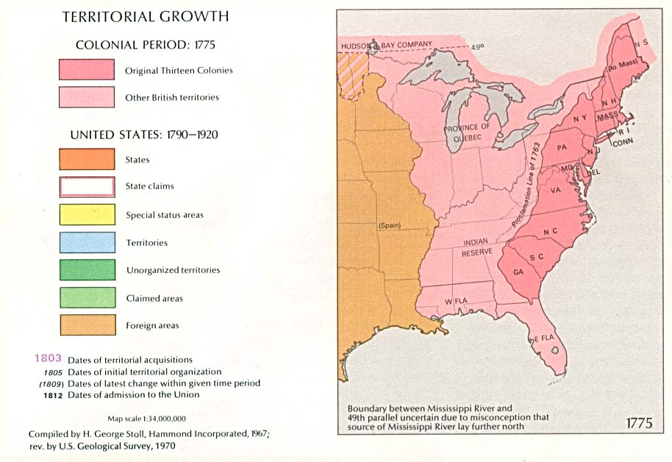
America 1783
Where was America?

Slide 11
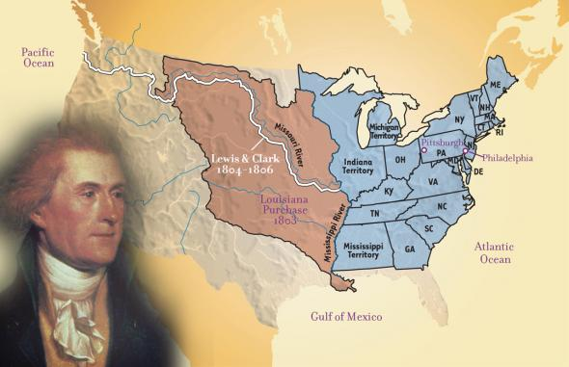
America 1802
What does this map tell us?

Slide 12
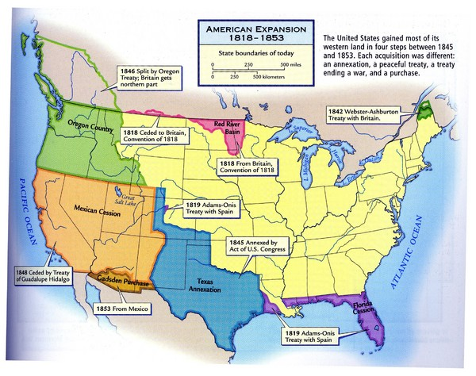
America 1820
What has been added?

Slide 13
Expansion of Voting Rights
The most significant political innovation of the early nineteenth century was the abolition of property qualifications for voting and office holding.
Hard times resulting from the panic of 1819 led many people to demand an end to property restrictions on voting and office holding.
By 1840, universal white manhood suffrage had largely become a reality. Only three states--Louisiana, Rhode Island, and Virginia--still restricted the suffrage to white male property owners and taxpayers.
What is the Main Idea
From www.digitalhistory.uh.edu – Jacksonian Democracy
© 2010 AIHE

Slide 14
Encouraging People to Vote
In order to encourage popular participation in politics, most states also instituted statewide nominating conventions, opened polling places in more convenient locations, extended the hours that polls were open, and eliminated the earlier practice of voting by voice.
Each party had a different colored ballot, which voters deposited in a publicly viewed ballot box, so that those present knew who had voted for which party.
Determining the Main Idea
From www.digitalhistory.uh.edu – Jacksonian Democracy
© 2010 AIHE

Slide 15
Who Could Vote?

Slide 16
Voting Eligibility
Most States
Some States
Generally all adult white men (by 1840 anyhow)
Immigrant males who claimed to intend to become citizens
Women
Only NJ and had to be unmarried and own property
Free blacks
New Hampshire, Maine, Massachusetts, Vermont only
Are we seeing an increase or decrease in democracy?

Slide 17
What Does this Mean?
A New Democratic Idea of Politics
Politics MUST express the will of the common man
(Politicians now had to cater to the masses) a man for the people
Campaigning
BBQ’s – free food and alcohol to woo the voters

Slide 18
Election of 1824

Slide 19
The Rise of Sectional Candidates
John Quincy Adams – North
Henry Clay – West
John Crawford – South
Andrew Jackson – Wild Card, combination of South and West
What does this tell us about the changing nature of politics?

Slide 20
The Jacksonian Appeal
From his “Memorandums” written in the early 1820’s
Believed that the National Bank and the national debt were corrupting influences
Believed that the government had become corrupt and was snuffing out liberty
Thought that a virtuous citizenry could fix the problems
Felt that the government should be subject to the will of the people

Slide 21
Who Won?
 | Popular Vote | Electoral Vote | House Vote
J Q Adams | 113,142 | 84 | 13
Andrew Jackson | 151,363 | 99 | 7
William Crawford | 41,032 | 41 | 4
Henry Clay | 47,545 | 37 | 0

Slide 22
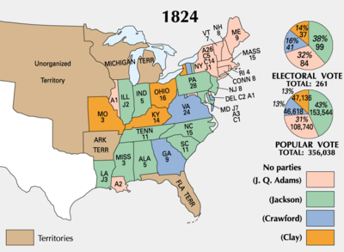

Slide 23
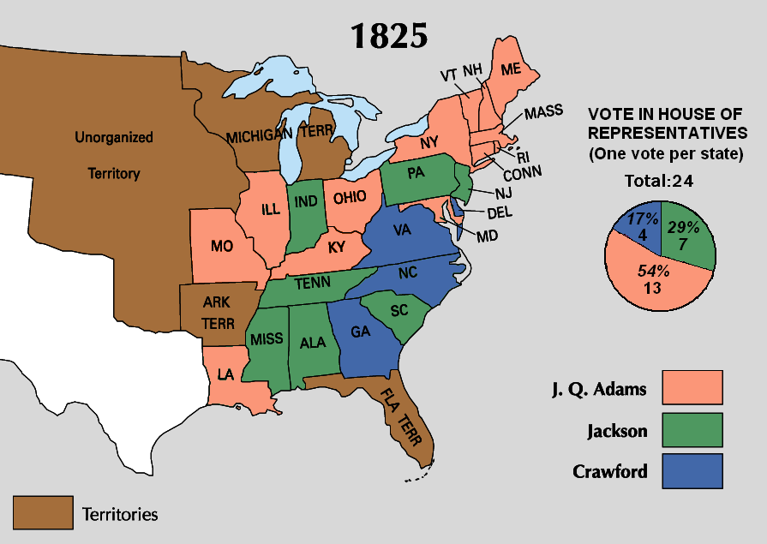

Slide 24
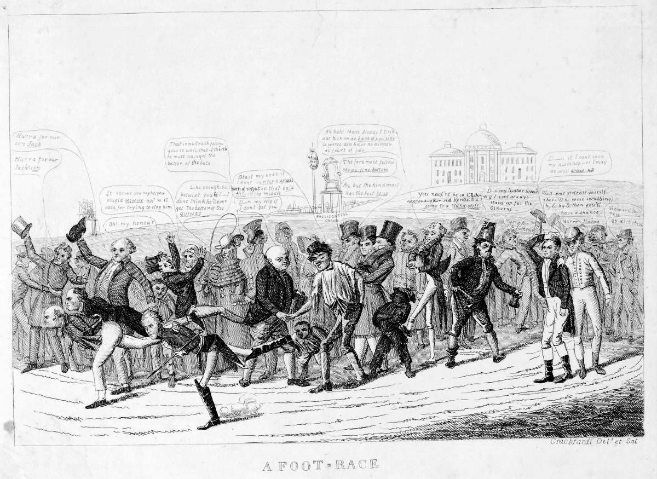

Slide 25
On the left, candidates John Quincy Adams, William Crawford, and Andrew Jackson (left to right) sprint for the finish line. On the right, the fourth candidate Henry Clay has pulled up short and stands, hand on head, exclaiming, ‘D--n it I cant save my distance – so I may as well draw up.’ A supporter, in riding clothes, consoles him, ‘Well dont distress yourself – there’ll be some scrubbing by & by & then you’ll have a chance.’
What does this cartoon reveal?

Slide 27
What were the values of the time

Slide 28
A Corrupt Bargain?
"Well it comes to the same thing," said Mr. Lowry, "it was Clay after all, for Scott was a mere emissary of his, and had previously by his arts secured the votes of this one too. Scott was irresolute, until Clay got hold of him, he had him with him until late last night. And altho his inclination led him to vote for us, Clay had power to persuade him to vote for Adams. 'Ah,' as John Randolph observed after counting the ballots, 'it was impossible to win the game, gentlemen, the cards were stacked.'" "And that," said Mr. Cobb, nodding his head, "is fact and the people have been tricked out of the man of their choice."
How does this humanize the period?
From the writings of Margaret Bayard Smith
© 2010 AIHE

Slide 29
A Corrupt Bargain? (part 2)
In early January 1824 John Quincy Adams invited Henry Clay to visit him at his residence and the two men spoke for several hours. It is unknown whether they reached some sort of deal, but suspicions were widespread.
On February 9, 1825, the House of Representatives held its election, in which each state delegation would get one vote. Henry Clay had made it known that he was supporting Adams, and thanks to his influence, Adams won the vote and was thus elected president.
What is the Main Idea
© 2010 AIHE

Slide 30
A Corrupt Bargain? (part 3)
From the beginning, Clay had decided to support Adams. Clay was fearful of what would happen if Jackson took office because of his strong military background. Although he and his supporters were aware that a vote for Adams would mean advancement for Clay's career, he claims to have voted solely for the good of the people. Harry L. Watson claims that "Despite differences in their personal styles, Clay easily realized that he and Adams shred similar goals for the country, while he saw little of value in the policies of Jackson and Crawford. Crawford, moreover, lay deathly ill and could not perform the duties of the presidency". Both Adams and Clay supported a high tariff, a national bank and a system for unifying the nation and disintegrating the sectional factions. Clay also felt that Jackson lacked the experience to hold the office. Clay also hesitated to support Jackson because he felt that Adams was less of a threat to his future political career than Jackson.
What does this tell us?
From Associated Content.com
© 2010 AIHE

Slide 31
Impact of the Election of 1824

Slide 32
An Illegitimate President?
The JACKSONIANS, of course, overstated their case; after all, Jackson fell far short of a majority in the general vote in 1824. Nevertheless, when the Adams administration continued to favor a strong federal role in economic development, Jacksonians denounced their political enemies as using government favors to reward their friends and economic elites. By contrast, Jackson presented himself as a champion of the common man and by doing so furthered the democratization of American politics.
Adams and company look guilty
=
What is non-essential?
From US History.org
© 2010 AIHE

Slide 33
Forging the Party Split
One-Party System replaced by a Two-Party System
Although both were Democratic-Republicans, Adams's political philosophy was closer to that of the Federalists, and during his term in office the party split into two main factions. When Jackson ran for president in 1828, he ran as a Democrat—and won handily. Adams's wing of the party became known as the National Republicans, many of whom later formed the Whig Party.
=
What is non-essential?
© 2010 AIHE

Slide 34
Case in Point: Gibbons v Ogden
This instrument contains an enumeration of powers expressly granted by the people to their government. It has been said that these powers ought to be construed strictly. But why ought they to be so construed? Is there one sentence in the Constitution which gives countenance to this rule? In the last of the enumerated powers, that which grants, expressly, the means for carrying all others into execution, Congress is authorized to make all laws which shall be necessary and proper for the purpose. But this limitation on the means which may be used is not extended to the powers which are conferred; nor is there one sentence in the Constitution, which has been pointed out by the gentlemen of the bar, or which we have been able to discern, that prescribes this rule. We do not, therefore, think ourselves justified in adopting it.
From John Marshal’s decision in Gibbons v Ogden
© 2010 AIHE

Slide 35
Case in Point: Gibbons v Ogden
What do gentlemen mean by a strict construction? If they contend only against that enlarged construction which would extend words beyond their natural and obvious import, we might question the application of the term, but should not controvert the principle. If they contend for that narrow construction which, in support of some theory not to be found in the Constitution, would deny to the government those powers which the words of the grant, as usually understood, import, and which are consistent with the general views and objects of the instrument; for that narrow construction, which would cripple the government, and render it unequal to the objects for which it is declared to be instituted, and to which the powers given, as fairly understood, render it competent; then we cannot perceive the propriety of this strict construction, nor adopt it as the rule by which the Constitution is to be expounded. As men whose intentions require no concealment generally employ the words which most directly and aptly express the ideas they in tend to convey, the enlightened patriots who framed our Constitution, and the people who adopted it, must be understood to have employed words in their natural sense, and to have intended what they have said.
From John Marshal’s decision in Gibbons v Ogden
© 2010 AIHE

Slide 36
Playing into Jackson’s Hand
Continued to criticize an “illegitimate” president
Continued to play the part of the “peoples choice”
Denounced a rule by the elite
Party split created an ineffective presidency
Rachel Jackson rumors created sympathy

Slide 37
Personalities or Issues?
The main problem with the election of 1824 was that personalities rather than issues dominated the campaigning. Newspapers glorified their favored candidates and scandalized their opponents. For example, Adams was criticized for dressing "slovenly" and marrying an English woman. Clay was presented as a worthless drunk that gambled away his money while Crawford was accused of official misconduct. Jackson was accused of being a murderer because he had executed mutineers in 1813. There were no dominant issues surrounding the campaign, even though some had feared that slavery would become a deciding factor in the election. The fact that there was only one party running in the election caused further problems. Because all candidates were from the same party, the issues at hand were blurred and the electors were forced to rely on personal preference rather than a candidate's stance on any one issue.
Is there corroboration here?
From Associated Content.com

Slide 38
The Adams Administration
Many congressmen were outspoken in their criticism of Adams; Martin Van Buren, a senator from New York, and John Randolph, a senator from Virginia, were among the worst.
In fact, Randolph was so outspoken in his criticism of the Adams administration following the political campaign, and of Secretary of State Clay in particular, that Clay eventually challenged Randolph to a duel. The senator and the secretary of state fired at each other, but Randolph's cloak received the only damage from this exchange of gunfire.
Adam's presidency in the days after the political campaign was marked by such intense disagreement among members of his own party that his single term in office can be viewed today as the end of an era.

Slide 39
Conclusion
The era is typically called the Age of Jackson because Jackson is an apt symbol for the period. However the increased democracy that occurred at the beginning of the period helped spur a change in American politics from a rule by a quasi-elite to a system where politicians have to respond to the will of the people.

