Slide 1
DeShaney V. Winnebago County Social Services (1989)

Slide 2
Background Info
In 1984 the mother of Joshua DeShaney sued the Winnebago County Social services. This was for the neglect of her son who was repeatedly beaten by his father. Joshua became comatose and later pronounced legally retarded after years of abuse from his father.

Slide 3
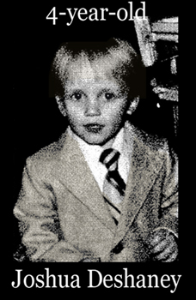
Joshua DeShaney

Slide 4
Background
This case originated in the district court in Wyoming the courts verdict was “Respondents' failure to provide petitioner with adequate protection against his father's violence did not violate his rights under the substantive component of the Due Process Clause.” This decision was also agreed on by the court of appeals.

Slide 5
The Question
Does a state's failure to protect an individual against private violence constitute a violation of the Due Process Clause of the Fourteenth Amendment?

Slide 6
The Answer
The answer of SCOTUS was the Due Process Clause does not impose a special duty on the State to provide services to the public for protection against private actors if the State did not create those harms. "The Clause is phrased as a limitation on the State's power to act, not as a guarantee of certain minimal levels of safety and security; while it forbids the State itself to deprive individuals of life, liberty, and property without due process of law, its language cannot fairly be read to impose an affirmative obligation on the State to ensure that those interests do not come to harm through other means."

Slide 7
Dissenting opinion given by Justice Brennan
“My disagreement with the Court arises from its failure to see that inaction can be every bit as abusive of power as action, that oppression can result when a State undertakes a vital duty and then ignores it. Today's opinion construes the Due Process Clause to permit a State to displace private sources of protection and then, at the critical moment, to shrug its shoulders and turn away from the harm that it has promised to try to prevent. Because I cannot agree that our Constitution is indifferent to such indifference, I respectfully dissent.”

Slide 8
Reasoning
The decision was split 6-3. the reasoning was that the state cannot deny anyone of life, liberty, or property, but it also states that its not the job of the state to protect its inhabitants from every possible harm, unless created by the state.

Slide 9
My Opinion
In my opinion the court made the right decision. As horrible as this case is, its not the obligation of the state to protect everyone from every harm. The social services organization took the proper precautions, to try to help the boy be safe. The rest has to come from the parent. If the mother knew that the child was being abused they have to take the proper measures to remove the child from that environment.

