Slide 1
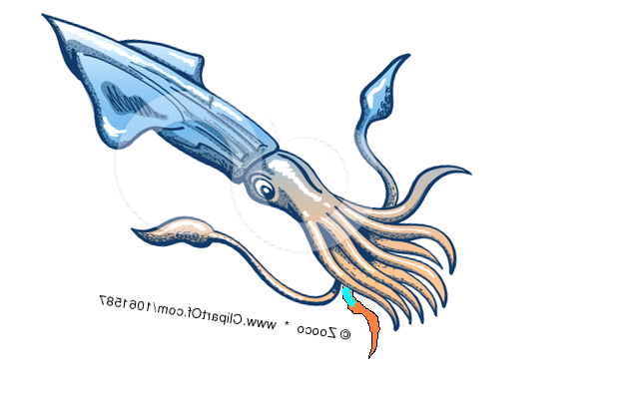
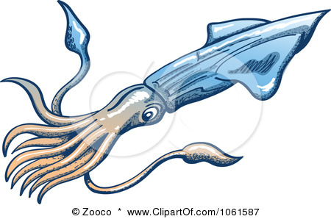
The Inking
By Henry Meinstereifel
And Nicholas Doan

Slide 2
Once in the depths of the sea,
Lived a convent of squids in harmony.
These cephalopods brandished tentacles in eights,
It was a peaceful time in their city state.
8

Slide 3
These squids with a set of eight tentacles,
All of their endeavors were quite memorable
They kept to themselves and to themselves did they keep
Only sights of the norm did they see in the streets
8
8

Slide 4
On the outskirts of town, lived the freaks
The losers, the psychos, the outcasts, the geeks
For these were the squids with one extra leg
They were the city’s batch of old spoiled eggs
9

Slide 5
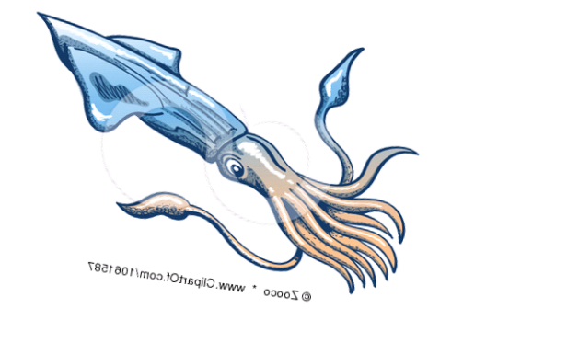
Inside of the city, everyone felt bliss
Outside the walls, something was amiss
The “eights” inside were so safe in their homes
The “nines” outside were sad to their bones
No 9’s allowed

Slide 6
The eights and the nines hated each other
Some of these squids came from the same mothers
They inked at each other until the day’s end
For one another, they refused to fend

Slide 7
Then came days that were dark and were dreary
Things for the squids began to get eerie
The nines were full of hope, the eights full of fear
For the incredible changes that would soon be here
Equal Rights!

Slide 8
The nines demanded changes
Which threw the eights into rages
The eights and the nines were all but at war
Not one really knowing what was in store

Slide 9
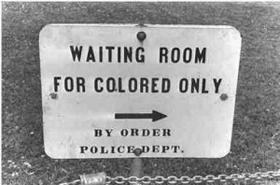
As to who should receive what kind of treatment
They fought and they fought to come to some sort of agreement
Slowly they moved, and without much zeal
To a system they called “separate but equal”
The nines wanted to get rid of this policy, for they said it was quite a fallacy
9 legs

Slide 10
Slowly both sides began to see
Slowly both sides came to agree
That the only way to end all the fights
Was to give every squid
The same equal rights.

Slide 11
Fin
The
End

