Slide 1
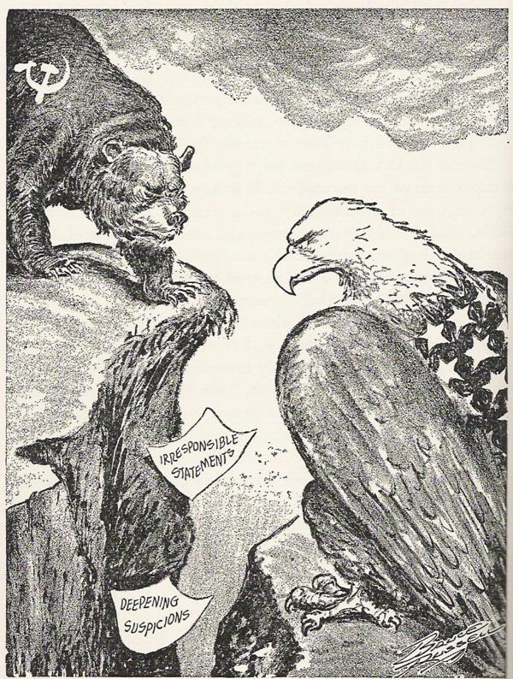
Silent Debate: 1946
Nancy Taylor
AIHE
Blast, Pennsylvania
April 2013
Bruce Russell 1945
http://multimedialearningllc.wordpress.com

Slide 3
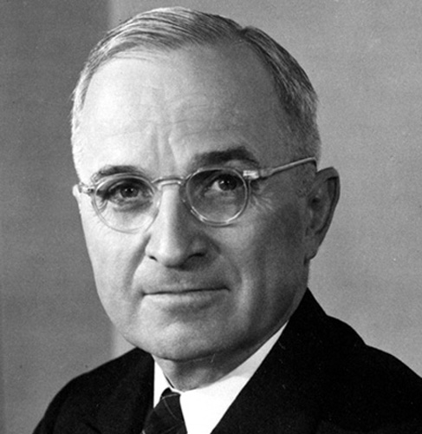
1946
If you were an advisor to President Truman where would you stand on policy, tactics and strategies for Soviet and
International relations?
Impose peace with force
Contain Soviet Communism
Co-exist and Compromise
Avoid Foreign Entanglements
The Origins of the Cold War: U.S. Choices After World War II by Choices for the 21st Century Education Program, Watson Institute for International Studies, Brown University, Providence, Rhode Island.
http://www.visitingdc.com/president/harry-truman-picture.htm

Slide 4
Stalin Speech February 1946
Joseph Stalin lashes out at the Western powers and proclaims his confidence in the eventual triumph of the Soviet system.
He argues that communism and capitalism are on a collision course and that a series of crisis will tear the capitalist world apart.
The Cold War A History in Documents, Alan Winkler, Oxford University Press, New York, 2003.

Slide 5
“Iron Curtain Speech” by Winston Churchill,
“A shadow has fallen… an iron curtain has descended across the Continent. Behind that line lie all the capitals of the ancient states of Central and Eastern Europe… the populations around them lie in what I must call the Soviet sphere, and all are subject, in one form or another, not only to Soviet influence but to a very high and in some cases increasing measure of control from Moscow…”
From the “Iron Curtain Speech” by Winston Churchill, March 5, 1946
http://www.emersonkent.com/speeches/iron_curtain.htm

Slide 6
Joseph Stalin’s response to the “Iron Curtain Speech,”
“…what can there be surprising about the fact that the Soviet Union, anxious for its future safety, is trying to see to it that governments loyal in their attitude to the Soviet Union should exist in these countries?
How can anyone who has not taken leave of his senses describe these peaceful aspirations of the Soviet Union as expansionist tendencies …?”
From Pravda, Joseph Stalin’s response to the “Iron Curtain Speech,” March 14 1946
http://www.world-war-2-diaries.com/joseph-stalin-biography.html
Peasants reading Pravda in the 1930s. Stalin is pictured on the front.

Slide 7
1946
http://makedonika.wordpress.com/2008/07/22/macedonia-disputed-by-yugoslavia-and-greece-new-york-times-1946/

Slide 8
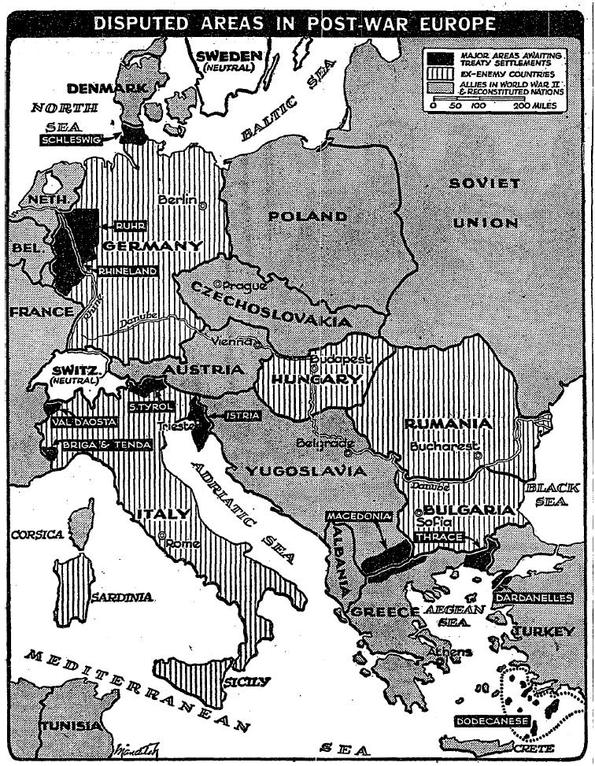
http://makedonika.wordpress.com/2008/07/22/macedonia-disputed-by-yugoslavia-and-greece-new-york-times-1946/

Slide 9
Iran
The Soviet Union withdraws its occupying forces after strong United States protest.
Iranian armed forces disband communist governments.
The Origins of the Cold War: U.S. Choices After World War II by Choices for the 21st Century Education Program, Watson Institute for International Studies, Brown University, Providence, Rhode Island.
http://homepage.mac.com/oldtownman/20th/truman46.html

Slide 10
Greece
Civil war is being waged between communist led forces and right wing government.
Massive financial aid from Great Britain and the United States prevents collapse of Greek Government
The Origins of the Cold War: U.S. Choices After World War II by Choices for the 21st Century Education Program, Watson Institute for International Studies, Brown University, Providence, Rhode Island.
http://users.humboldt.edu/ogayle/hist111/coldwar.html
http://popartmachine.com/item/pop_art/LOC+1158544/%5BGROUP-PORTRAIT-OF-ARMED-GREEK-MALE-AND-FEMALE-GUERRILLA-FIGHTERS%5D...

Slide 11
Poland
Communist parties consolidate, use propaganda, and reprisals. They send political opponents to labor camps murdering many.
New boundaries set up for protection against a feared rebuilding of Germany allows for placing Poland’s boundaries more dependent upon the Soviet Union.
http://thepeoplescube.com/peoples-tools/red-primer-for-children-and-diplomats-t2223.html
The Origins of the Cold War: U.S. Choices After World War II by Choices for the 21st Century Education Program, Watson Institute for International Studies, Brown University, Providence, Rhode Island.

Slide 12
Turkey
Soviets want control of the straits that would connect the Black Sea and the Mediterranean Sea plus territorial concessions from Turkey.
The Turkish government seeks aid to modernize its army.
The Origins of the Cold War: U.S. Choices After World War II by Choices for the 21st Century Education Program, Watson Institute for International Studies, Brown University, Providence, Rhode Island.
http://users.humboldt.edu/ogayle/hist111/coldwar.html

Slide 13
Czechoslovakia
In elections (1946) the communist party obtains 1/3 of the vote. The coalition government is dominated by the communist party which rules the national police and armed forces.
American business interest have been nationalized and the U.S. is holding up aid because the issue of compensation has not been settled.
http://en.wikipedia.org/wiki/File:Czechoslovak_Communist_Party_-_1_Maj.jpg
The Origins of the Cold War: U.S. Choices After World War II by Choices for the 21st Century Education Program, Watson Institute for International Studies, Brown University, Providence, Rhode Island.

Slide 14
Great Britain
The British government is facing a severe financial crisis even after being given a large aid package from the United States.
The British discuss with the United States a desire to have them assumes some of their worldwide commitments.
The coming winter, Cartoon by Illingworth, October 1, 1945. Dark clouds over Britain. The storm clouds are 'Lend-Lease End', 'Food Shortage', 'Balkans', 'Russian Demands', 'Fuel Shortage' and U.S. Strikes'.
http://2ndlook.wordpress.com/2009/12/30/1945-britain-imperial-ambitions-of-a-starving-nation/

Slide 15
Soviet Union
The Soviet Union asks the United States to act on their requests (made during the war) for aid to help rebuild.
The Truman administration declines.
The Origins of the Cold War: U.S. Choices After World War II by Choices for the 21st Century Education Program, Watson Institute for International Studies, Brown University, Providence, Rhode Island.
http://shs.umsystem.edu/famousmissourians/presidents/truman/trumancoldwar.html

Slide 16
United States (Military)
The United States armed services demobilizes from a peak of 16 million during the war to just 5 million.
The Origins of the Cold War: U.S. Choices After World War II by Choices for the 21st Century Education Program, Watson Institute for International Studies, Brown University, Providence, Rhode Island.
http://fineartamerica.com/featured/world-war-two-american-soldier-aloysius-patrimonio.html

Slide 17
Nuclear Weapons
Most believe the U.S. will retain its monopoly on atomic weapons for 5 to 10 years.
The Origins of the Cold War: U.S. Choices After World War II by Choices for the 21st Century Education Program, Watson Institute for International Studies, Brown University, Providence, Rhode Island.
http://aminz1234.blogspot.com/2011/03/atomic-bomb-world-war-2.html

Slide 18
Setting
The year is 1946. You are an advisor to President Truman. It is the night before you and other advisors will meet the president to share your ideas on U.S. policy, tactics, and strategies for Soviet and International relations. You are at a dinner party in a crowded room. You meet a fellow advisor. You both want to share your views on what should be America’s foreign policy. You fear that you will be overheard. Knowing you will only have a short time together you move to a small table on the far side of the room.
You take part in a silent debate. During the debate you argue to persuade your fellow advisor to your policy views. You are convinced that your policy considerations are best for the United States in this post war time and you want his support when you speak to the president in the morning. Of course, the other advisor believes strongly in his views and will try to persuade you to his policy beliefs.
http://myhotellife.blogspot.com/2010_11_01_archive.html

Slide 19
Silent Debate
During the “silent debate” you may not talk at any time. You will write to each other on the same sheet of paper that will be passed back and forth when you are told to pass it. In the roles of presidential advisors you will address each other’s questions, concerns, answers and opinions on possible U.S. policies toward the Soviet Union and other countries.
You will be given a set amount of time to write (about two minutes each time the paper is passed – this may vary.) After the first person writes a note to his or her debate partner - he or she will pass the paper to the partner who will write a response. The student who is not writing will sit quietly and think of what he or she might want to write next.

Slide 20
Preparations for Debate
You want to perceive past events and issues as they were experienced by people at the time, to develop historical empathy as opposed to present-mindedness.
In this debate you do not know the rest of the story!
It is 1946. You do not know what policy will be taken -or- what the results will turn out to be in the future.
Study and analyze the background information (based on primary sources) for your assigned policy option.
Prepare to take part in a “silent debate” with a partner who will defend an opposing policy.
Take a moment to review the Option in Brief Overview so you will be familiar with the other three possible view points.

