Slide 1

The Federalist Era
1789 - 1801
BLAST
Summer 2011

Slide 2


This power point presentation is for educational purposes. It may contain copyrighted material. Please do not post, redistribute or copy without the permission of the author or Dr. Kevin Brady at the American Institute for History Education.

Slide 3
Some BIG Issues
Unless teachers consciously identify the essential understandings related to a topic, they focus on fact-based content as the endpoint in instruction, and the conceptual level of understanding usually is not addressed.
When students arrive at content classes reading below grade level, teachers are challenged to deliver complex content. In many classes, students often study facts without reaching larger concepts.
Source: McCoy, J.D., & Ketterlin-Geller, L.R. (2004). Rethinking Instructional Delivery for Diverse Student Populations: Serving All Learners with Concept-Based Instruction. Intervention in School and Clinic, 40(2).

Slide 4
Other Issues
In the absence of grade-to-grade coherence, the social studies curriculum is needlessly splintered and needlessly repetitive at the beginning levels of understanding.
Conceptual understanding requires a higher-level, integrative thinking ability that needs to be taught systematically through all levels of schooling.
Source: Erickson, H.L. (2002). Concept-Based Curriculum and Instruction: Teaching Beyond the Facts. p. 8.

Slide 5
What is a concept and why should we use them?
A concept is an idea that is timeless, abstract, broad and can be shown through a variety of examples.
Well… why should we use them?
Two jobs that concepts have are to focus the study of topics and integrate the overall curriculum. Looking at a topic through a concept gives the study a focus. Without the focus of a concept, only factual learning takes place.

Slide 6



Role of a Concept

Slide 7
Problem and Possible Solution
Many ideas are introduced but few are elaborated and deepened. (1)
Conceptual understanding requires a higher-level, integrative thinking ability that needs to be taught systematically through all levels of schooling. (2)
Source: Parker, W.C. (1991). Renewing The Social Studies Curriculum.
Source: Erickson, H.L. (2002). Concept-Based Curriculum and Instruction: Teaching Beyond the Facts. p. 8.

Slide 8
Impact of Concept-Based Instruction

Slide 9
Conceptual Flow
Students take Concept Down
Students draw on prior knowledge
Students add new learning
We cannot confuse amassing information with learning.

Slide 10
Macro and Micro Concepts
These are BIG concepts that can be traced across scope of US History no matter the time or era.
Macro
Micro
These are smaller concepts generally found in one area or era of US History.

Slide 11
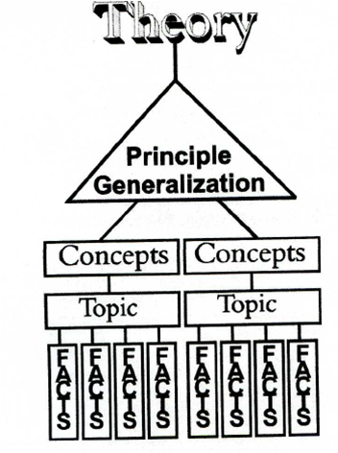
Concept-Based Instruction in Action
ESSENTIAL QUESTION
TOPIC
CONCEPT
CONCEPT
F
A
C
T
F
A
C
T
F
A
C
T
F
A
C
T
F
A
C
T
FACT

Slide 12
Let’s go see if we can put this in action …

Slide 13
The Federalist Era
In 1789, it was an open question whether the Constitution was a viable plan of government. It was unclear to the people of the time whether the new nation could establish a strong national government, a vigorous economy, or win the respect of foreign nations. For just over a decade, the nation battled threats to its existence, including serious disagreements over domestic (and foreign) policy and European interference with American commerce.
1789
1801
Whiskey Rebellion
Proclamation of Neutrality
Election of 1800
XYZ Affair
Election of 1796 and Washington’s Farewell Address
Va. & Ky. Resolutions
Bill of Rights Adopted

Slide 14
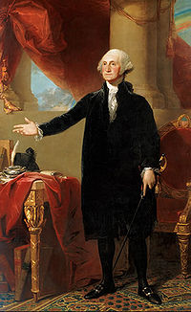
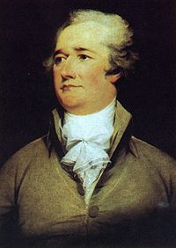
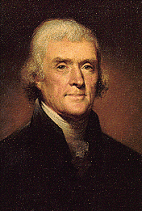
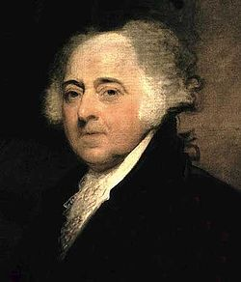
Establish a Strong National Government
Established the judiciary with the Judiciary Act of 1789
Washington created his cabinet and executive departments
  With authority over specific areas of the new government
Fought and overcame the Native Americans in the Northwest Territory
Washington’s Farewell Address

Slide 15
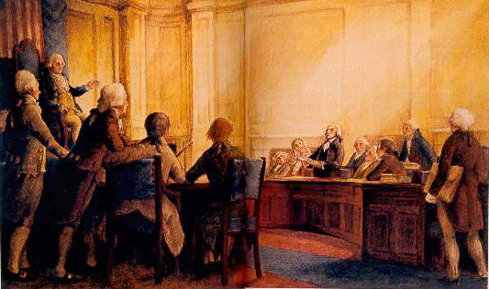
Establish a Strong National Government
1791

Slide 16
Establish a Strong National Government
Peacefully transferred power in 1796 and 1800
Revolution of 1800

Slide 17
Develop a Vigorous Economy
The American economy was in duress prior to the adoption of the Constitution
Hamilton given the job of securing the government finances
Hamilton’s Financial Plan
  Protective Tariff
  Excise Tax
  Assumption of State Debts
  National Bank
  Establishment of DC
  National debt as glue

Slide 18
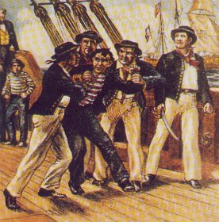
Respect of Foreign Nations
French Revolution
Genet Affair
Proclamation of Neutrality
Jay Treaty
Pinckney’s Treaty
Quasi-War with France
XYZ Affair

Slide 19
Disagreements over Domestic Policy
Rise of Parties
Role of Federal Government
Whiskey Rebellion
Alien and Sedition Acts
Virginia and Kentucky Resolutions
Midnight Justices
FOCUS

Slide 20
The Virginia and Kentucky Resolutions
James Madison and Thomas Jefferson, respectively, wrote the Va. and Ky. Resolutions
Were written in response to the Alien and Sedition Acts
Argued that the United States was a compact style of government between STATES
Since the nation was a compact between states, the states that powers not granted to the federal government were given to the states
States therefore had the power to nullify federal laws they felt were unconstitutional

Slide 21
The Va. and Ky. Resolutions
A modern historian’s opinion
“Historians have been too eager to hand 1798 to the Federalists, accepting their claims of unanimity at face value. The Virginia and Kentucky Resolutions, the most visible opposition to the Alien and Sedition Acts, have never been placed in their true context: as part of a broader movement of petitioning and remonstrance, the concerted effort of numerous local communities not only in Virginia and Kentucky but also in Pennsylvania, New Jersey, New York, Vermont, and elsewhere. The overwhelming focus on Thomas Jefferson and James Madison as the originators of ideas and the organizers of any and all formal protest against the Alien and Sedition Acts is mistaken and ultimately misleading.”
Douglas Bradburn
William and Mary Quarterly, Vol. 65, No.3, July 2008

Slide 22
The BIG Question
Douglas Bradburn states that historians “…have been too eager to hand 1798 to the Federalists ...” He then goes on to give the quantifier “… accepting their claims of unanimity at face value.”
If historians, as Bradburn states, have indeed handed 1798 to the Federalists, why have they done so?

Slide 23
The Virginia Resolution
That this assembly most solemnly declares a warm attachment to the Union of the States, to maintain which it pledges all its powers; and that for this end, it is their duty to watch over and oppose every infraction of those principles which constitute the only basis of that Union, because a faithful observance of them, can alone secure it's existence and the public happiness.
That this Assembly doth explicitly and peremptorily declare, that it views the powers of the federal government, as resulting from the compact, to which the states are parties; as limited by the plain sense and intention of the instrument constituting the compact; as no further valid that they are authorized by the grants enumerated in that compact; and that in case of a deliberate, palpable, and dangerous exercise of other powers, not granted by the said compact, the states who are parties thereto, have the right, and are in duty bound, to interpose for arresting the progress of the evil, and for maintaining within their respective limits, the authorities, rights and liberties appertaining to them.
That the General Assembly doth also express its deep regret, that a spirit has in sundry instances, been manifested by the federal government, to enlarge its powers by forced constructions of the constitutional charter which defines them; and that implications have appeared of a design to expound certain general phrases
- James Madison, December 1798

Slide 24
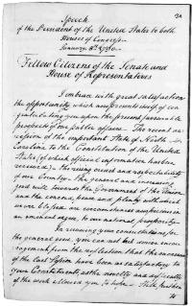
A.R.T.I.S.T. Method of Document Analysis
Author
Reason
To whom
Immediate effect
Subsequent effects
Time Period

Slide 25
The Virginia Resolution
That this assembly most solemnly declares a warm attachment to the Union of the States, to maintain which it pledges all its powers; and that for this end, it is their duty to watch over and oppose every infraction of those principles which constitute the only basis of that Union, because a faithful observance of them, can alone secure it's existence and the public happiness.
That this Assembly doth explicitly and peremptorily declare, that it views the powers of the federal government, as resulting from the compact, to which the states are parties; as limited by the plain sense and intention of the instrument constituting the compact; as no further valid that they are authorized by the grants enumerated in that compact; and that in case of a deliberate, palpable, and dangerous exercise of other powers, not granted by the said compact, the states who are parties thereto, have the right, and are in duty bound, to interpose for arresting the progress of the evil, and for maintaining within their respective limits, the authorities, rights and liberties appertaining to them.
That the General Assembly doth also express its deep regret, that a spirit has in sundry instances, been manifested by the federal government, to enlarge its powers by forced constructions of the constitutional charter which defines them; and that implications have appeared of a design to expound certain general phrases
- James Madison, December 1798

Slide 26
A.R.T.I.S.T. Method of Document Analysis
Author
Reason
To whom
Immediate effect
Subsequent effects
Time Period
_____________________
_____________________
_____________________
_____________________
_____________________
_____________________

Slide 27
Impact
Federalist Logic:
  Government has the inherent power to protect itself.
Entered the idea of Nullification and Secession into the national political landscape
Resolutions were presented in other states but without success

Slide 28
Rhode Island’s Response
Certain resolutions of the legislature of Virginia, passed on the twenty-first day of December last, being communicated to this Assembly,
1. Resolved, That in the opinion of this legislature, the second section of the third article of the Constitution of the United States, in these words, to wit: The judicial power shall extend to all cases arising under the laws of the United States, vests in the federal courts exclusively, and in the Supreme Court of the United States ultimately, the authority of deciding on the constitutionality of any act or law of the Congress of the United States.
2. Resolved, That for any state legislature to assume that authority would be,
1st. Blending together legislative and judicial powers.
2d. Hazarding an interruption of the peace of the states by civil discord, in case of a diversity of opinions among the state legislatures; each state having, in that case, no resort for vindicating its own opinion, but to the strength of its own arm.
3d. Submitting most important questions of law, to less competent tribunals; and
4th. An infraction of the Constitution of the United States, expressed in plain terms.
3. Resolved, That although, for the above reasons, this legislature, in their public capacity, do not feel themselves authorized to consider and decide on the constitutionality of the sedition and alien-laws (so called), yet they are called upon by the exigency of this occasion, to declare, that in their private opinions, these laws are within the powers delegated to Congress, and promotive of the welfare of the United States.
4. Resolved, That the Governor communicate these resolutions to the supreme executive of the state of Virginia, and, at the same time, express to him, that this legislature cannot contemplate, without extreme concern and regret, the many evil and fatal consequences which may flow from the very unwarrantable resolutions aforesaid of the legislature of Virginia, passed on the twenty-first day of December last

Slide 29
A.R.T.I.S.T. Method of Document Analysis
Author
Reason
To whom
Immediate effect
Subsequent effects
Time Period
_____________________
_____________________
_____________________
_____________________
_____________________
_____________________

Slide 30
Kentucky Resolution
RESOLVED, That the General Assembly of Virginia, doth unequivocably express a firm resolution to maintain and defend the Constitution of the United States, and the Constitution of this State, against every aggression either foreign or domestic, and that they will support the government of the United States in all measures warranted by the former.
That this assembly most solemnly declares a warm attachment to the Union of the States, to maintain which it pledges all its powers; and that for this end, it is their duty to watch over and oppose every infraction of those principles which constitute the only basis of that Union, because a faithful observance of them, can alone secure it's existence and the public happiness.
That this Assembly doth explicitly and peremptorily declare, that it views the powers of the federal government, as resulting from the compact, to which the states are parties; as limited by the plain sense and intention of the instrument constituting the compact; as no further valid that they are authorized by the grants enumerated in that compact; and that in case of a deliberate, palpable, and dangerous exercise of other powers, not granted by the said compact, the states who are parties thereto, have the right, and are in duty bound, to interpose for arresting the progress of the evil, and for maintaining within their respective limits, the authorities, rights and liberties appertaining to them.

Slide 31
A.R.T.I.S.T. Method of Document Analysis
Author
Reason
To whom
Immediate effect
Subsequent effects
Time Period
_____________________
_____________________
_____________________
_____________________
_____________________
_____________________

Slide 32
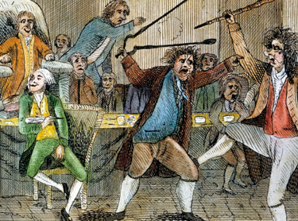
Raising Cane: A Fight In Congress Over the Sedition Acts

Slide 33
The BIG Question … one more time!
Douglas Bradburn states that historians “…have been too eager to hand 1798 to the Federalists ...”
If historians, as Bradburn states, have indeed handed 1798 to the Federalists, why have they done so?
Let’s go see the “answer”.

Slide 34
What did the Federalists Win?
Won …
Didn’t Win …
Hamiltonian economic policy
Stronger central government
Powerful judiciary
Failure of Nullification principle to germinate
Maintained a neutral foreign policy
Election of 1800 *
Nullification and Secession became the bulwark of southern politics for 60 years
* - but Jefferson ultimately did little to dismantle many Federalist programs already in place

Slide 35
The End
If you have any questions, comments, or ways that I could make this presentation better please send me an email at:
rbrown@aihe.info

