Slide 1
Imagine one of the following scenarios
Imagine if your parents lost their job.
Imagine if your parents business went bankrupt
Imagine if your family lost its farm

Slide 2
Now imagine..
Your family lost all of their money because their bank closed
Your school closed (maybe you like that one!)

Slide 3
Write a 2 paragraph response
Write about how this would effect your family. How would it effect them emotionally?
What types of services exist today that may help you during this time?
1’s share your response with 2’s

Slide 4
Watch the link below
http://www.youtube.com/watch?v=VpKmfjf5tUk

Slide 5
The Great Depression and the New Deal

Slide 6
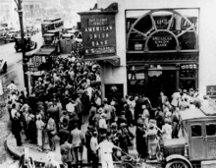
Causes of the Crash
Uneven distribution of income…
Stock market speculation…
Excessive use of credit…
Overproduction in factories and farms…
Government Policies…
Global economics…

Slide 7
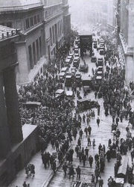
The Great Crash
October 29,1929
“Black Tuesday”
Within 3 weeks…
Over time…

Slide 8
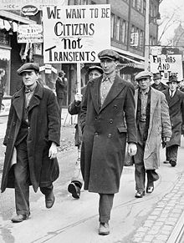
Effects of the Crash
Gross National Product…
20%…
25%..

Slide 9
President Hoover
Unable to effectively communicate with the common man…
Tries the “trickle down” method….
Hawley-Smoot Tariff…
Debt moratorium…

Slide 10
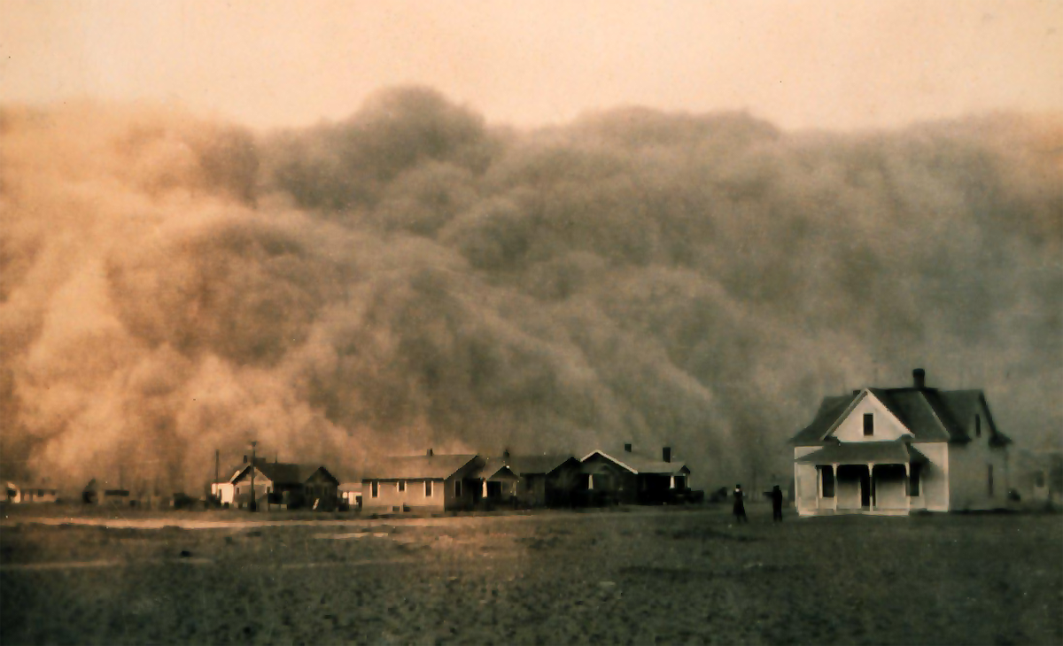
“Dust Bowl”

Slide 11
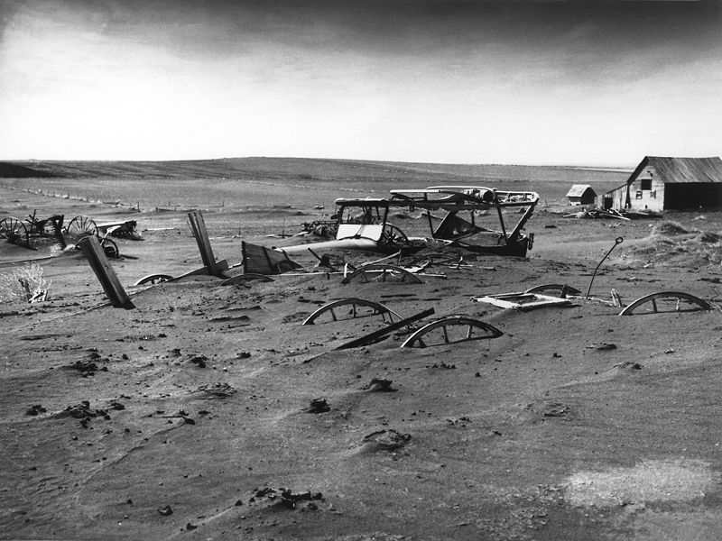

Slide 12
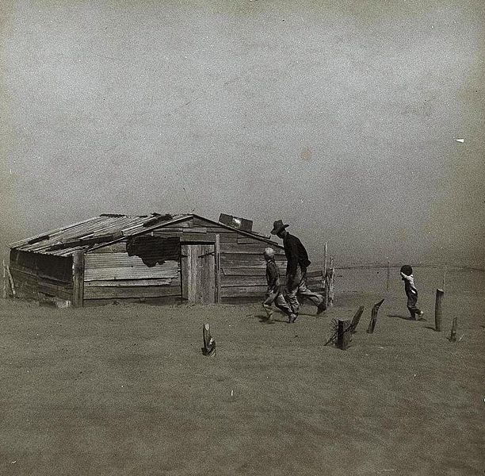

Slide 13
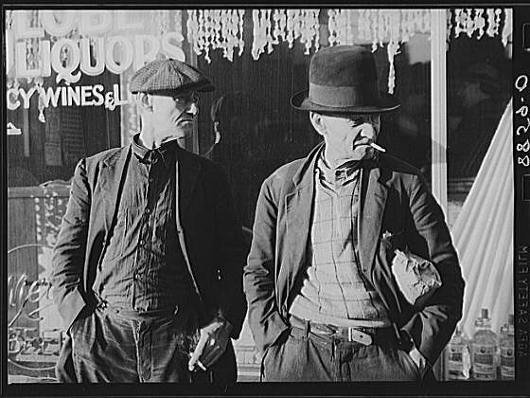
Images of the Depression
Hobos

Slide 14
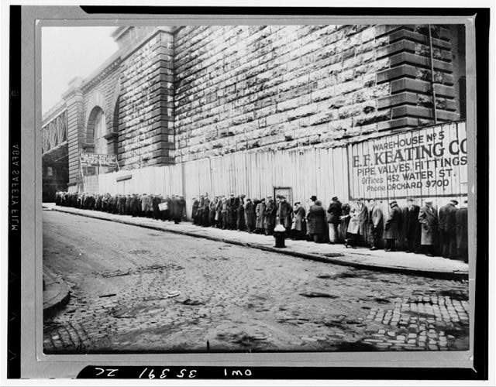
Bread Lines

Slide 15
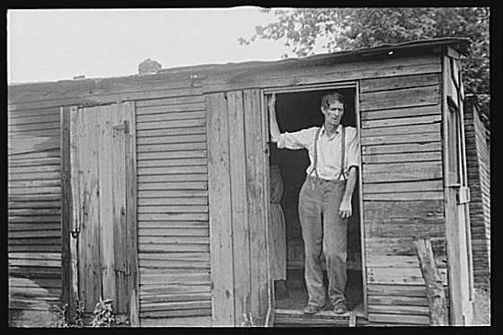
“Hoovervilles”

Slide 16
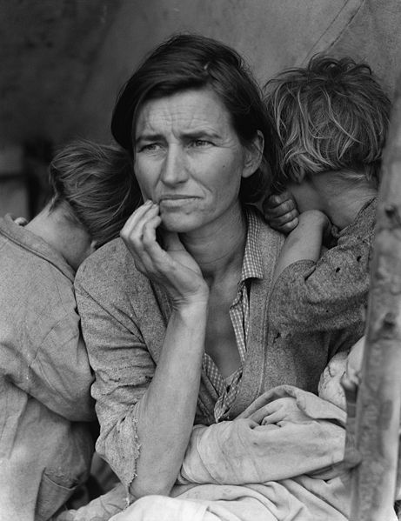
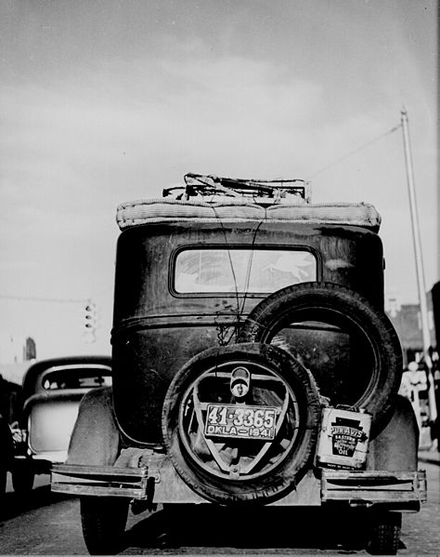
“Okies”

Slide 17
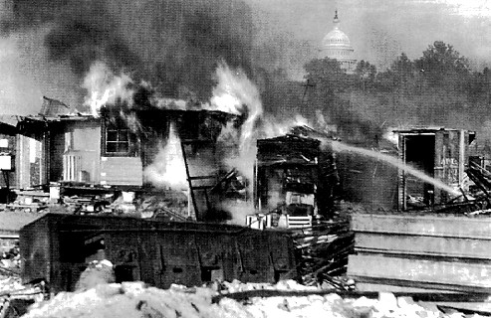
“Bonus Army”

Slide 18
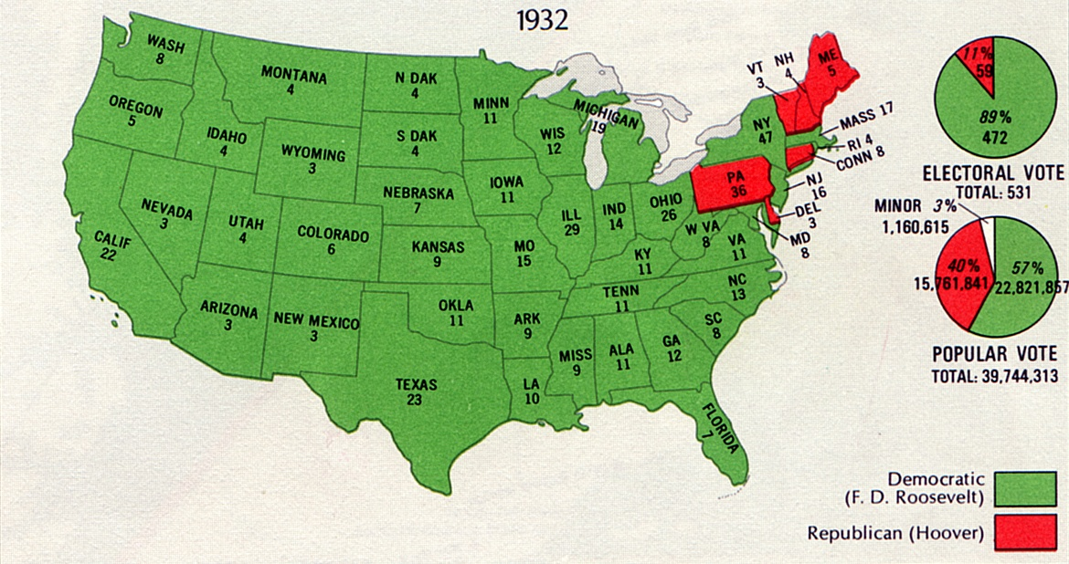
Election of 1932

Slide 19
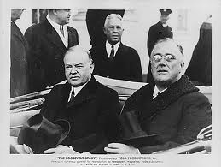
Twentieth Amendment

Slide 20
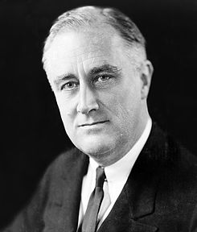
F.D.R. & Eleanor

Slide 21
The “New Deal”
Three “R”s…
Brain Trust…
“Hundred Days”…
Bank Holiday…
Repeal of Prohibition…
Alphabet Soup Agencies…

Slide 22
PWA
Public Works Administration

Slide 23
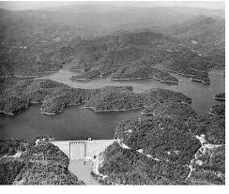
TVA
Tennessee Valley Authority

Slide 24
CCC
Civilian Conservation Corps

Slide 25
AAA
Agricultural Adjustment Act

Slide 26
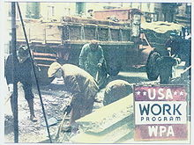
WPA

Slide 27
SEC
Securities and Exchange Commission

Slide 28
NRA
National Recovery Administration

Slide 29
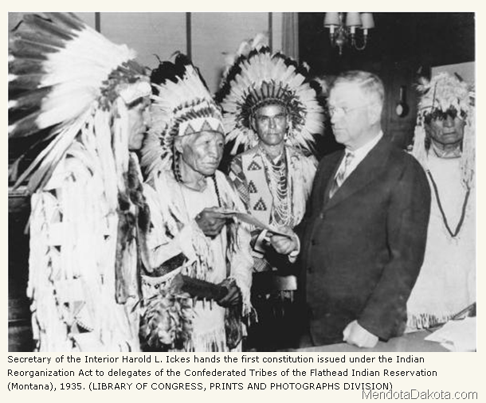
Indian Reorganization Act

Slide 30
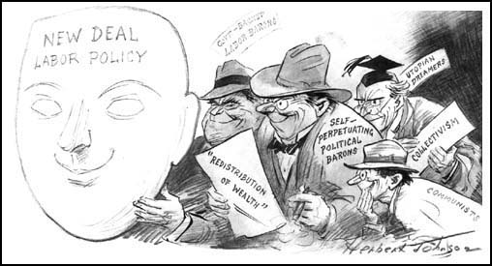
National Labor Relations (Wagner) Act

Slide 31
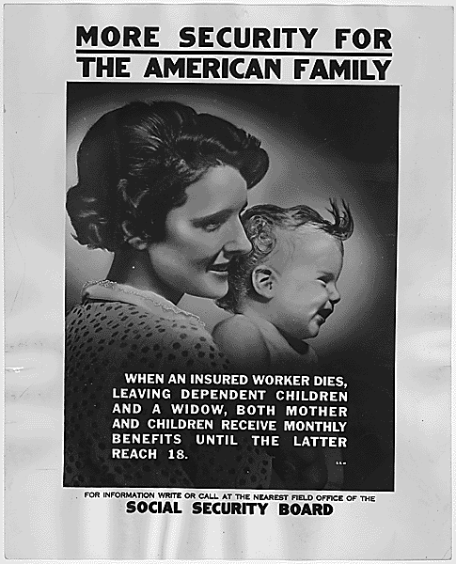
Social Security Administration

Slide 32
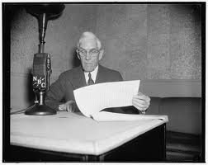
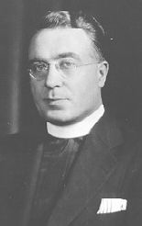
Opponents of the New Deal
Father Charles Coughlin
Dr. Francis Townsend

Slide 33
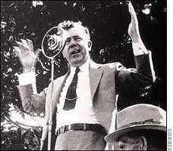
Huey Long
The “Kingfish”
Share our Wealth Society

Slide 34
Court Packing Plan

Slide 35
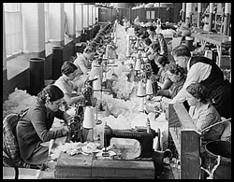
Fair Labor Standards Act

Slide 36
Keynesian Economics
John Maynard Keynes
Deficit spending…
“priming the pump”

Slide 37
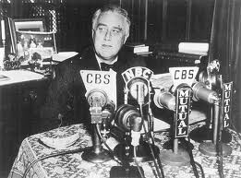
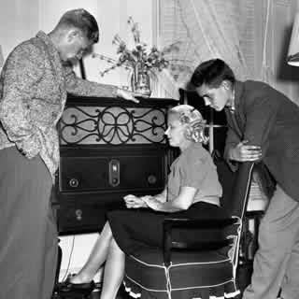
Fireside Chats

Slide 38
Newsreels

Slide 39
Consider
Women…
African Americans…
Native Americans…
Mexican Americans…

