Slide 1
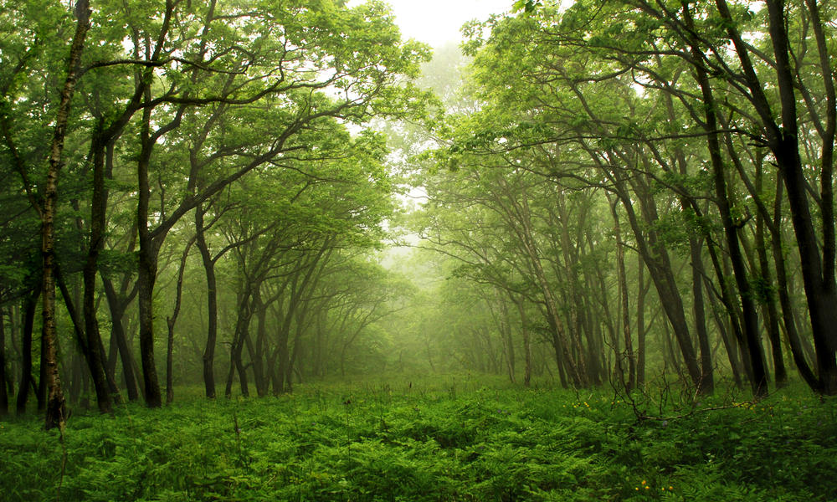
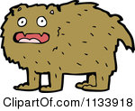
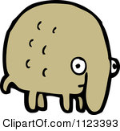
The Hairs and The Bares
By: Sierra Magnotta, Anna Copp, and Caitlin Chaffee

Slide 2
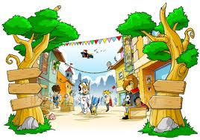
In a land far away
Where the grass was green and dewy,
Was a small, secluded town
By the name of McPhooey.

Slide 3
In the town of McPhooey
Lived the Hairs and the Bares.
Their story is quite complicated;
Proceed if you dares.

Slide 4
The Hairs despised the Bares
Because they had no hairs
And the Bares despised the Hairs
Because they were not bares.

Slide 5
The town of McPhooey
Was divided into twooey
To keep the Bares and Hairs apart
Because they had hate deep in their hearts.

Slide 6
The Hair’s shedding season began
In late spring of every year.
The Bares did not like it;
Their disgust was clear.

Slide 7
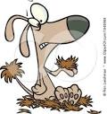
The Bares kept fretting
Because The Hairs kept shedding.
All over town
Hair fell to the ground.

Slide 8
The Bares, in a rage,
Ran to the Hairs and said,
“You bloodsucking mashers,
What’s wrong with your head?!”

Slide 9

“Your hair is all over,
In our gardens and houses!
In our food and our water,
And our pretty new blouses!”

Slide 10
To the Bares’ remarks,
The Hairs said in reply,
“We need to shed!
If not, we would die!”

Slide 11
Then came the war,
A great and terrible battle.
The ruckus was heard
All the way in Goo-Grattle.

Slide 12
It went on for weeks,
People shouting and fighting.
Except for the kids,
Who started uniting.

Slide 13
“What’s the point in this fighting?”
They all asked each other.
“It’s silly and useless,
Why even bother?”

Slide 14
The Hair and Bare children,
United in their cause,
Went up to the adults,
Who came to a pause.

Slide 15

“Please stop this fighting!”
The children said.
And at that very moment,
The war came to an end.

Slide 16

The Hairs and Bares realized
From the children’s care,
How silly it was
To be fighting over hair.

Slide 17

From that day on
There were no more Hairs or Bares.
They became one big group
Known as the Pears.

