Slide 1
The Korean War

Slide 2
The Korean War
At the conclusion of World War II in 1945 the Allies agreed to divide Korea temporarily into a Soviet-occupied northern zone and an American-occupied southern zone.
Soon after 1945 a pro-American government was formed in S. Korea and a Communist regime was formed in N. Korea.
Occupying forces withdrew from both zones in 1948 and 1949.
In June 1950, the Korean War broke out when North Korean troops streamed across the 38th parallel which divided North and South Korea.
The United Nations would act by creating a force that would help protect S. Korea.

Slide 3
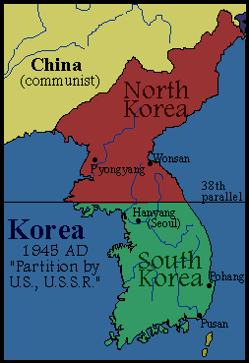
Divided Korea

Slide 4
General Douglas MacArthur would be chosen to lead the United Nations force in Korea.
A stalemate would eventually develop in Korea with the Chinese becoming involved in the conflict.
General MacArthur would eventually be fired for insubordination because of criticism toward Truman’s Korean policies.
A truce would be signed in 1953 leaving Korea divided at the 38th parallel.
The end result of the war confused many Americans since Communism still existed on the Korean peninsula.

Slide 5
PARTICIPANTS IN THE KOREAN WAR
United Nations: Republic of Korea, Australia, Belgium, Canada, Colombia, Ethiopia, France, Greece, Luxembourg, Netherlands, New Zealand, Philippines, South Africa, Thailand, Turkey, United Kingdom, United States, Japan
North Korea: Democratic People’s Republic of Korea, People’s Republic of China, Soviet Union

