Slide 1
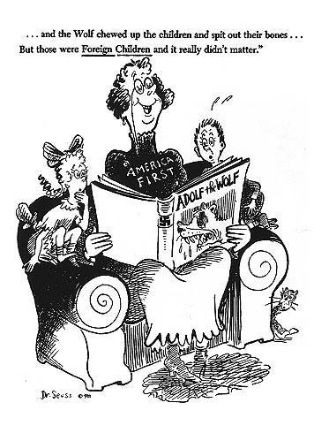
Notes:
America First
Dr. Seuss
PM October 1, 1941

Slide 2
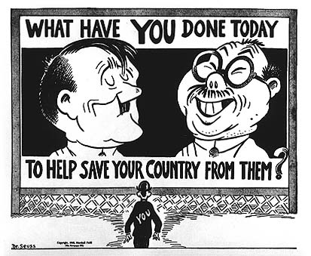
Notes:
What have you done today to help save our country from them?
Dr. Seuss
PM-March 5, 1942

Slide 3
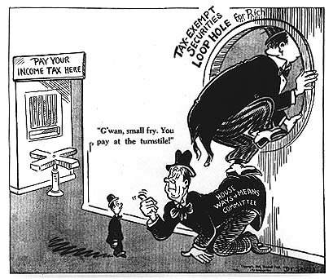
Notes:
Pay your Income Tax Here
Dr. Seuss
PM May 27, 1942

Slide 4
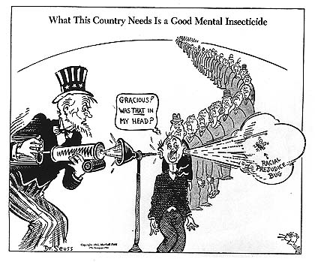
Notes:
What this country needs is a good mental insecticide.
Dr. Seuss
PM-June 11, 1942

Slide 5
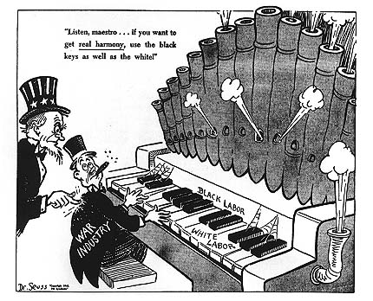
quo
Notes:
Listen, maestro…if you want to get real harmony, use the black keys as well as the white!
Dr. Seuss
PM-June 29, 1942

Slide 6
Cartoons by Theodor Seuss Geisel
PM newspaper
1941-1942
Dr. Seuss Goes To War: The Editorial Cartoons of Theodor Seuss Geisel
Richard H. Minear
PM newspaper was a leftist daily newspaper bankrolled by Marshall Field, III from 1940-1948. PM stood for ‘Picture Magazine”
http://www.catinthehat.org/history.htm

Slide 7
DR. SEUSS AND THE COLD WAR
Students will determine the message of Dr. Seuss’ books
Using the graphic organizer provided explain which of the 5 themes is being outlined by the book
Add a quote from the book to that illustrates it’s message
Regroup (if needed)and teach about the message
Cold War Themes:
Rise of Dictators
Racial Issues
Power of Democracy
Nuclear Proliferation
The Environment

