Slide 1
American WWII Posters

Slide 2
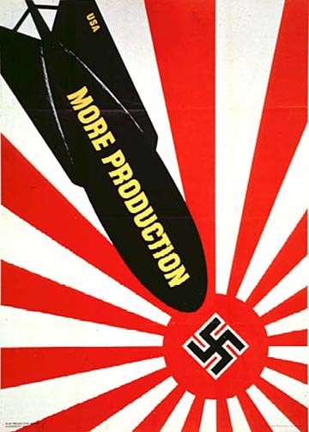

Slide 3
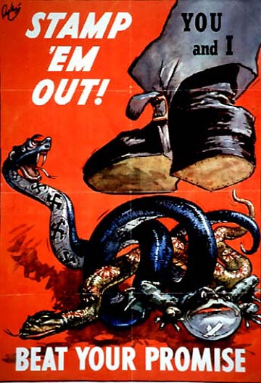

Slide 4
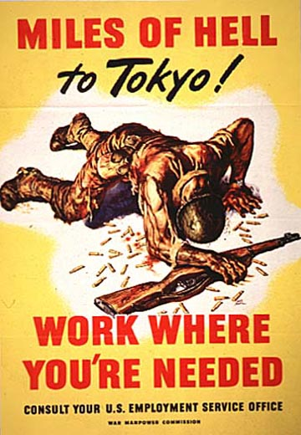

Slide 5
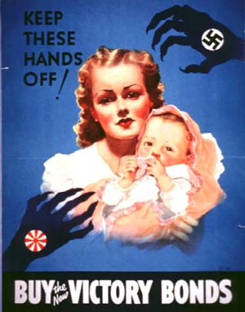

Slide 6
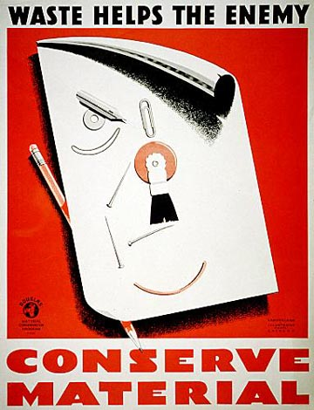

Slide 7
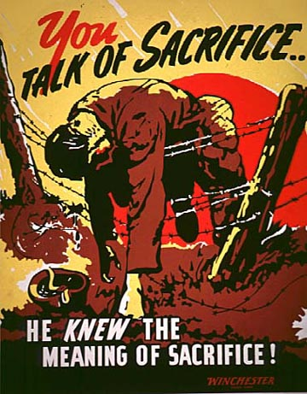

Slide 8
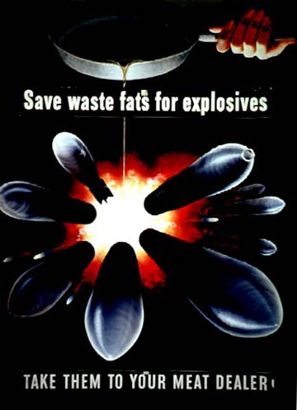

Slide 9
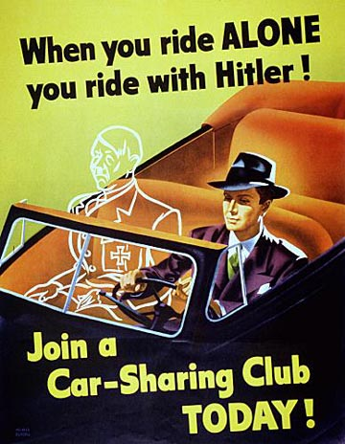

Slide 10
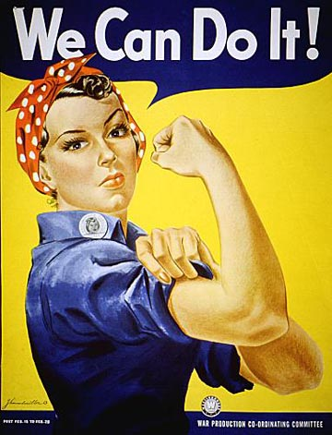
Notes:
We Can Do It! by J. Howard Miller
Of all the images of working women during World War II, the image of women in factories predominates. Rosie the Riveter--the strong, competent woman dressed in overalls and bandanna--was introduced as a symbol of patriotic womanhood. The accoutrements of war work--uniforms, tools, and lunch pails--were incorporated into the revised image of the feminine ideal. Produced by Westinghouse for the War Production Co-Ordinating Committee NARA Still Picture Branch (NWDNS-179-WP-1563)

Slide 11
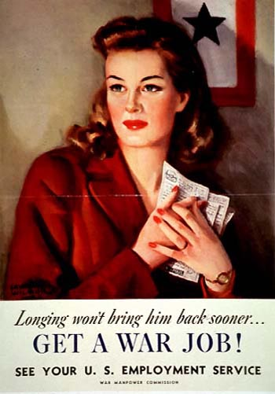

Slide 12
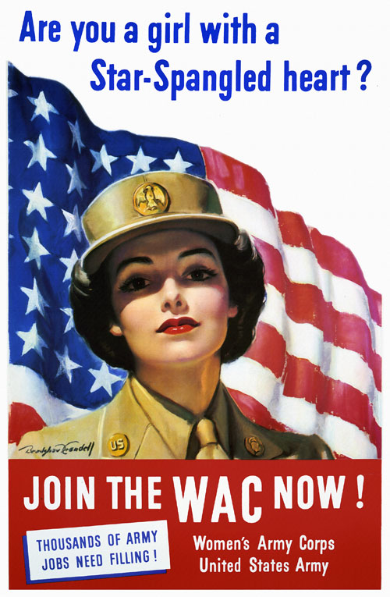

Slide 13
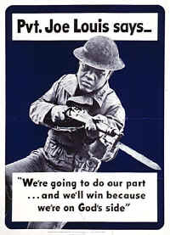

Slide 14
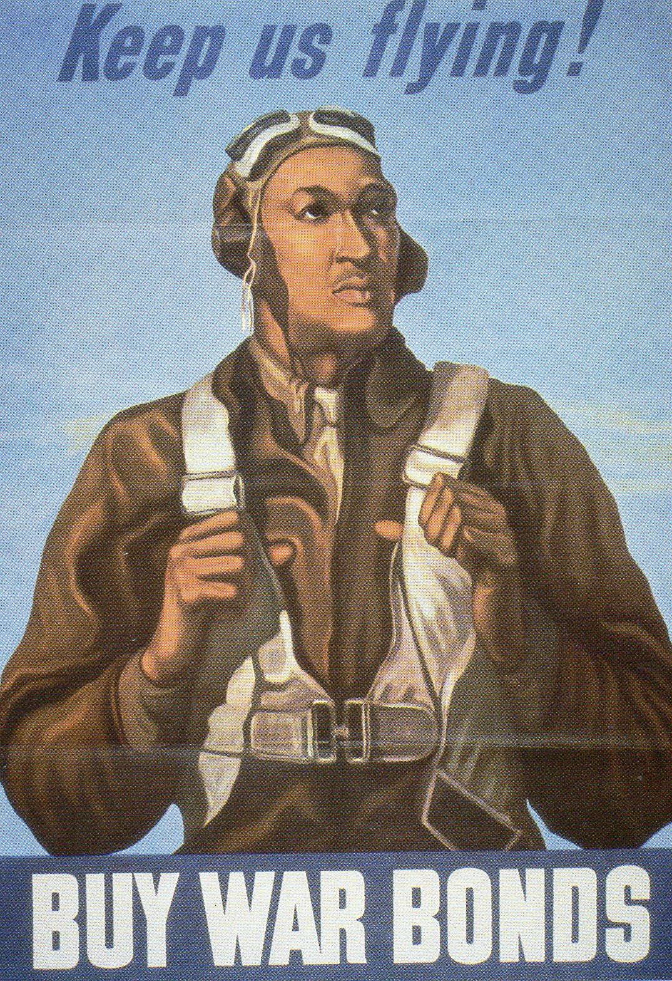

Slide 15
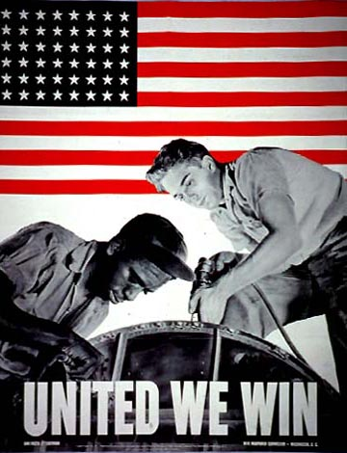

Slide 16
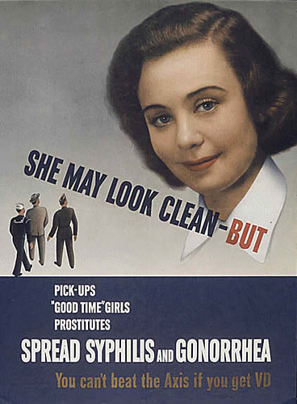

Slide 17
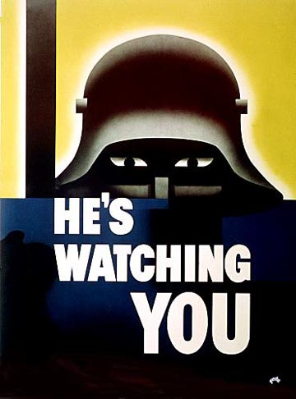
Notes:
Concerns about national security intensify in wartime. During World War II, the Government alerted citizens to the presence of enemy spies and saboteurs lurking just below the surface of American society. "Careless talk" posters warned people that small snippets of information regarding troop movements or other logistical details would be useful to the enemy. Well-meaning citizens could easily compromise national security and soldiers` safety with careless talk.

Slide 18
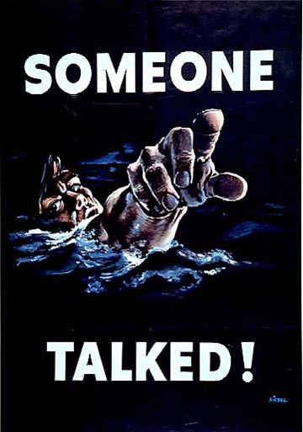

Slide 19
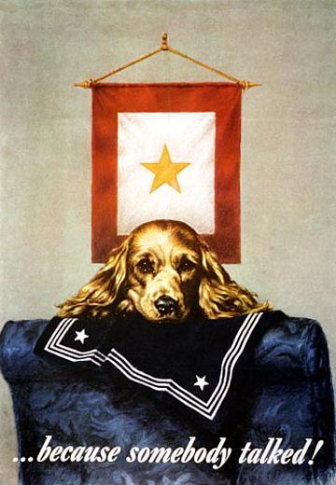

Slide 20
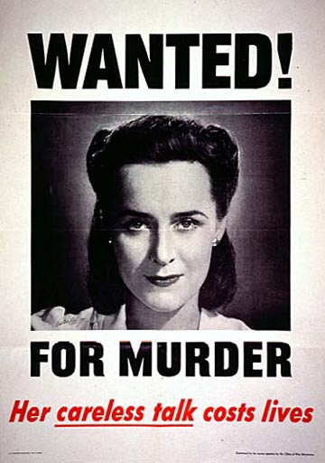
Notes:
Wanted! For Murder by Victor Keppler, 1944 A woman--someone who could resemble the viewer`s neighbor, sister, wife, or daughter--was shown on a "wanted" poster as an unwitting murderess.At least one viewer voiced objection to the choice of a female model. A letter from a resident of Hawaii to the Office of War Information reads, in part, "American women who are knitting, rolling bandages, working long hours at war jobs and then carrying on with `women`s work` at home--in short, taking over the countless drab duties to which no salary and no glory are attached, resent these unwarranted and presumptuous accusations which have no basis in fact, but from the time-worn gags of newspaper funny men." NARA Still Picture Branch (NWDNS-208-PMP-91)(Click on poster for high-resolution image)

