Slide 1
The War on Poverty-Johnson’s Winnable War
Tuesday, June 18, 2013
David Keller Trevaskis, Esquire

Slide 2
Would you go to war with these guys?

Slide 3
How Do We Define Poverty?
Following the Office of Management and Budget's (OMB) Statistical Policy Directive 14, the Census Bureau uses a set of money income thresholds that vary by family size and composition to determine who is in poverty. The official poverty thresholds do not vary geographically, but they are updated for inflation using Consumer Price Index (CPI-U). The official poverty definition uses money income before taxes and does not include capital gains or noncash benefits (such as public housing, Medicaid, and food stamps).
This is the World Bank‘s definition of poverty:
Poverty is an income level below some minimum level necessary to meet basic needs. This minimum level is usually called the “poverty line”. What is necessary to satisfy basic needs varies across time and societies. Therefore, poverty lines vary in time and place, and each country uses lines which are appropriate to its level of development, societal norms and values. But the content of the needs is more or less the same everywhere. Poverty is hunger. Poverty is lack of shelter. Poverty is being sick and not being able to see a doctor. Poverty is not having access to school and not knowing how to read. Poverty is not having a job, is fear for the future, living one day at a time. Poverty is losing a child to illness brought about by unclean water. Poverty is powerlessness, lack of representation and freedom.

Slide 4
Dr. Ruby Payne, in her book A Framework for Poverty,
defines poverty as the varying degrees to which a person lacks any one of following nine resources:
Financial Language (ability to speak in formal register) Emotional Mental Spiritual Physical Support systems Relationships/role models Knowledge of middle class hidden rules

Slide 5
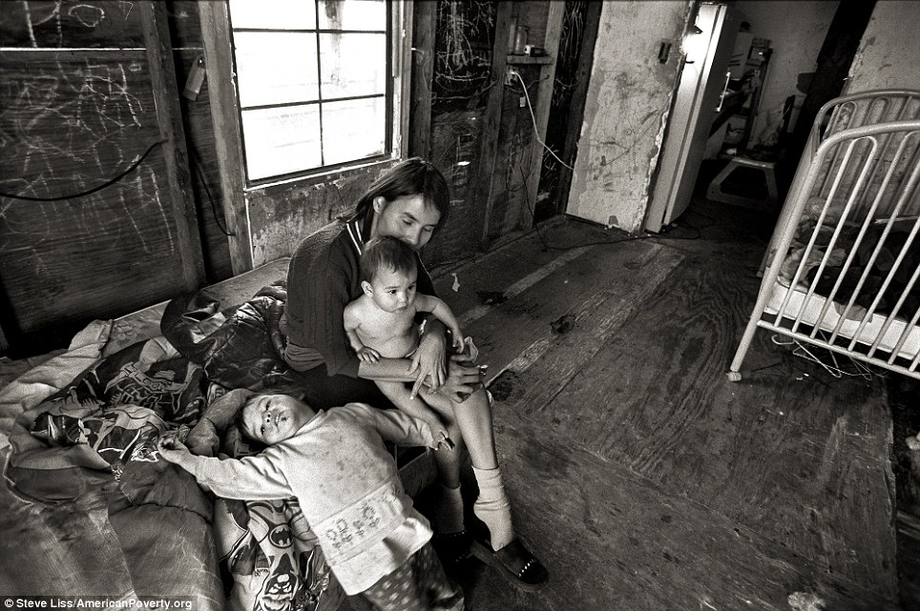
However we define it…Poverty in the United States is often seen as a matter of choice and personal responsibility – we work hard, and they don’t. In reality, the difference between “us” and “them” can often be as random as a layoff, divorce, death in the family, medical emergency, or natural disaster. Nevertheless, the belief that “I’ll never be in that position” runs deep and this mindset, along with issues associated with class culture, and diversity, can pose a range of challenges for even the most well-meaning and sensitive leader.

Slide 6
Our nation has been struggling with poverty for a long time and some poverty experts suggest that the American Dream was borne from the fear of poverty. The AMERICAN DREAM of each generation materially surpassing the previous generation is rooted in the anti-poverty mantra of “you can succeed if you work hard.” Europeans were locked in a rigid feudal system with little upward mobility possible; America offered a chance to start over, with cheap or free land everywhere for more than 250 years until the closing of the frontier in the 1890’s. There was no aristocracy in the United States. Rampant capitalism and a political system that articulated a belief in freedom, opportunity and equality created an opportunity for upward mobility here which drew tens of millions of immigrants.

Slide 7
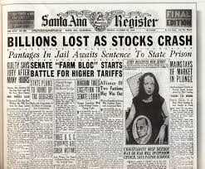
The Great Depression of 1929-1939 eroded the belief that all Americans could achieve the American Dream and led to President Franklin Delano Roosevelt proposing an economic bill of rights in his presidential campaign of 1932.

Slide 8
“Freedom is no half and half thing.” FDR
An economic bill of rights proposed key rights, including these rights: a job paying a decent wage, health care, education, home ownership, recreation, and protection from fear of accident, unemployment and accident. By 1944, Roosevelt had articulated his four freedoms: 1) Freedom of Speech, 2) Freedom of Religion, 3) Freedom from Want, and 4) Freedom from Fear.

Slide 9
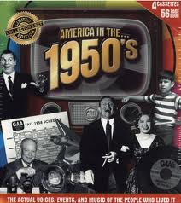
By the 1950’s, FDR’s 3rd Freedom (Freedom from Want) was being tested for some…
Minority poverty, poor schools feeding the school-to-prison pipeline, inadequate job training systems that failed to train citizens for the jobs that existed, limited foundation funding targeted for social change activities, suburbanization and its accompanying white flight from urban areas, the development of interstate highways, interest paid on mortgage payments qualifying as an income tax deduction, the decline of the family farm and the moving of industries away from population centers-all of this and more contributed to the economic distress of both urban and rural areas.

Slide 10
The build up to war…
The 1960s
January 8, 1964
Kennedy and Johnson
Dallas
Johnson and Civil Rights
President Lyndon B. Johnson's
Annual Message to the Congress on the State of the Union
“unconditional war on poverty”

Slide 11
Unfortunately, many Americans live on the outskirts of hope--some because of their poverty, and some because of their color, and all too many because of both. Our task is to help replace their despair with opportunity.
This administration today, here and now, declares unconditional war on poverty in America. I urge this Congress and all Americans to join with me in that effort.
It will not be a short or easy struggle, no single weapon or strategy will suffice, but we shall not rest until that war is won. The richest Nation on earth can afford to win it. We cannot afford to lose it. One thousand dollars invested in salvaging an unemployable youth today can return $40,000 or more in his lifetime.
Poverty is a national problem, requiring improved national organization and support. But this attack, to be effective, must also be organized at the State and the local level and must be supported and directed by State and local efforts.
For the war against poverty will not be won here in Washington. It must be won in the field, in every private home, in every public office, from the courthouse to the White House.

Slide 12
Many successes by July 1964…
A major tax-cut bill, a budget that included cost savings and that came in under the psychologically significant $100 billion limit that Johnson had set, a farm bill, a long-overdue pay increase for federal employees, and, not least, the Civil Rights Act, all passed during Johnson’s first eight months in office.
The civil rights legislation required Johnson and his congressional allies to overcome a fifty-seven-day Senate filibuster by southern Democrats and to hold together a tenuous alliance with moderate Republicans.

Slide 13
Vietnam…
During the spring of 1964, American reconnaissance planes had been shot down over Laos, where Communist insurgents had made military gains against the country’s unstable right-wing government. Next door in South Vietnam, the administration struggled with a corrupt and often incompetent government that seemed incapable of fighting off the Communist Vietcong guerrillas, much less military incursions from Communist North Vietnam. In June, Johnson had replaced the American ambassador, Henry Cabot Lodge, who had proved unwilling to implement administration policy directives and remained interested in a last-minute bid for the Republican presidential nomination.
As the economic opportunity bill moved at last toward a vote in the House of Representatives, the situation flared into crisis when a North Vietnamese vessel fired on the USS Maddox, a destroyer in the Gulf of Tonkin. As a series of confused reports filtered back to Washington regarding a possible second attack on the Maddox and another U.S. ship—reports that later proved false—Congress passed the administration-sponsored Gulf of Tonkin resolution. This measure gave the president broad authority to conduct military operations in Vietnam.

Slide 14
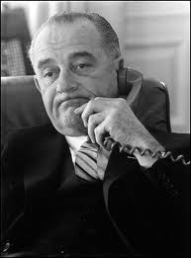
Lyndon B. Johnson…
Johnson the Master Politician
Johnson the Accidental President
Not Kennedy
Democratic Convention Coming
Southern Roots/Texan Roots

Slide 15
Why a war on poverty?
The civil rights movement had focused attention on economic inequality, particularly as it related to the nation’s pervasive patterns of racial discrimination. The August 1963 March on Washington had captured this dynamic relationship, as its formal title was the “March on Washington for Jobs and Freedom.”
Martin Luther King frequently addressed the relationship between poverty and discrimination.

Slide 16
Johnson had grown up in the hardscrabble Texas Hill Country, taught the children of migrant workers as a schoolteacher in the Rio Grande Valley, and come to political prominence as a protégé of Franklin D. Roosevelt and as a New Deal loyalist.
This was the continuation of FDR…

Slide 17
The Social Security Act of 1935 under FDR created the core of the multilayered welfare state that persists in the United States to the present day, but its exclusion of key employment categories and its deference to local administration insured that many Americans, and especially African Americans, would be left out during its early years of implementation.
It also made no guarantees of employment (or health care, another issue that the Kennedy and Johnson administrations would take up). These limitations would have profound implications for how Americans conceived of social and economic rights in the postwar world and thus for how the War on Poverty would be structured.
FDR’s efforts to add the right to employment had ultimately failed. During the 1950s, liberal economists and policymakers continued to push for policies that would support full employment through relatively direct federal job creation efforts such as targeted investments in depressed areas. Congressional Democrats twice passed relatively strong “area redevelopment” bills during the 1950s, but President Dwight D. Eisenhower vetoed both bills.

Slide 18
How to end poverty?
New ideas in the lead up to the bill…the idea of “community action,” based on the concept of “opportunity theory,” which had been developed by Columbia University sociologists Richard Cloward and Lloyd Ohlin. Opportunity theory had originated as a strategy for addressing the problem of youth gangs in low-income urban neighborhoods—an issue that had been a prominent concern in major cities during the 1950s and early 1960s. Cloward and Ohlin’s core insight was that members of such gangs did not entirely reject the norms and aspirations of mainstream society. Like most Americans, they sought social status, personal security, material comfort, even wealth, but they lacked access to the normal range of opportunities for achieving such goals. As a result, such young people turned to the gang as an alternative social structure that would meet these basic needs. The solution to gangs and juvenile delinquency thus lay in opening the blocked avenues of opportunity in such communities, thereby reducing the allure of the gang. The best way to do this, Ohlin and Cloward argued, was to involve both gang members and others in their communities in planning social services and educational and vocational programs that responded to the needs of the individuals involved.

Slide 19
Johnson’s two poverty themes
The first consisted of equipping the poor to take advantage of opportunity while demanding that they then help themselves. On the morning of the State of the Union speech, he explain to former Eisenhower Treasury Secretary Robert Anderson that
What we’re trying to do—instead of people getting something for nothing, we’re going to try to fit them where they can take care of themselves. . . . That’s our program. We don’t want them to get something for nothing. We want to get them where they can carry their own weight
Johnson’s second recurring theme lay in his own experiences as Texas director of the National Youth Administration (NYA) during the New Deal. The NYA was a New Deal program that provided work-study jobs for high school and college students and work experience jobs for unemployed young people. Johnson first came to national notice through his innovative projects and efficient implementation of the Texas program. “I am an old NYA man”.

Slide 20
The role of Peace Corps Director Sargent Shriver…
Despite initial hesitance, Shriver threw himself into the planning work and quickly became the public face of the War on Poverty. After an initial briefing from the task force on the existing plans, Shriver and his top deputy, Adam Yarmolinsky (borrowed from the Department of Defense), quickly concluded that community action alone would not provide a sufficient programmatic base for what Johnson had already promised.
Yarmolinsky later recalled that “the first impressions were the ones that we [Yarmolinsky and Shriver] exchanged with each other when we were standing at the stalls in the men’s room after we had had the briefing from Heller and [Budget Director] Kermit Gordon at that very first meeting. We had independently reached agreement that the program they were presenting to us made no political sense.”

Slide 21
Shriver pushed the planners to come up with a series of additional programs.
Over the following six weeks, an expanded task force engaged in a frenzied flurry of legislative drafting and program development, conducted in a series of makeshift offices around Washington.
At one point, the task force had to hastily abandon offices in the Clerk of Claims building when an engineer discovered that nearby construction had created a dangerous crack in the building’s foundation.
An official history of the War on Poverty recalled the drafting period as “a time of chaos and exhaustion when energies were fueled by excitement and exhilaration—itself, at times, the product of a kind of hysteria—‘the beautiful hysteria of it all,’ as one participant put it.

Slide 22
By mid-March, the legislation had been drafted and a presidential message to Congress had been prepared. Now known as the (proposed) Economic Opportunity Act of 1964, the legislation included a range of training, educational, and service programs, along with community action. The newly added programs included the Job Corps, which would provide educational and vocational training for poor young people in residential camps; the Neighborhood Youth Corps, which would offer work-training and work-study programs for high school and college students; programs of loans for low-income farm families and for small businesses; the Volunteers in Service to America (VISTA) program, which would recruit volunteer antipoverty workers as a kind of domestic parallel to the Peace Corps; and new or expanded programs for adult basic education, job training for unemployed fathers, and aid to migrant workers and dependent children

Slide 23
Most of the programs would be overseen by a new Office of Economic Opportunity (OEO), which would be located in the Executive Office of the President.
The Department of Labor (DOL) and the Department of Health, Education, and Welfare (HEW) had both lobbied to control some or all of the War on Poverty programs.
Shriver, however, wanted a separate agency, vested with presidential authority, and he received the backing of a number of Cabinet members and, eventually, the president.
In the end, the bill gave DOL authority over the Neighborhood Youth Corps, while HEW would implement the Adult Basic Education program. OEO managed the remaining programs and had overall oversight of the War on Poverty.

Slide 24
Legislation is like making scrapple…
March 16th
Representative Phil Landrum Leads Fight
Johnson delivered his message on poverty to Congress, and with it officially submitted the antipoverty bill. In the message, the president noted that the War on Poverty would be “a struggle to give people a chance . . . to allow them to develop and use their capacities, as we have been allowed to develop and use ours, so that they can share, as others share, in the promise of the nation.”
Under the direction of New York Congressman Adam Clayton Powell, the House Labor and Education Committee began hearings the following day
Johnson chose Representative Landrum of Georgia as the floor leader for the bill in the House.
A conservative southern Democrat, Landrum had gained a reputation as a crusader against labor unions by sponsoring the 1959 Landrum-Griffith anticorruption bill that weakened labor’s ability to organize and recruit new members. This had earned him the enmity of union leaders—key parts of the Democratic coalition—and many northern liberals.
In the midst of the civil rights struggle, however, Johnson believed that he needed a southern floor leader who could reassure his regional colleagues that the bill was not simply an extension of the Civil Rights Act.

Slide 25
Final Vote on the Bill
Senate
Party | For | Against
Republicans | 10 | 22
Northern Democrats | 40 | 1
Southern Democrats | 11 | 11
Total | 61 | 34
House
Party | For | Against
Republicans | 22 | 145
Northern Democrats | 144 | 0
Southern Democrats | 60 | 40
Total | 226 | 185

Slide 26
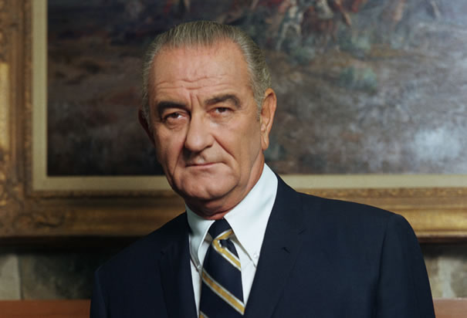
Economic Opportunity Act
My fellow Americans:
On this occasion the American people and our American system are making history.
For so long as man has lived on this earth poverty has been his curse.
On every continent in every age men have sought escape from poverty's oppression.
Today for the first time in all the history of the human race, a great nation is able to make and is willing to make a commitment to eradicate poverty among its people.
Whatever our situation in life, whatever our partisan affiliation, we can be grateful and proud that we are able to pledge ourselves this morning to this historic course. We can be especially proud of the nature of the commitments that we are making.

Slide 27
Did we win the war?
Scholars have emphasized that despite its numerous flaws, its imperfect implementation, and its frequent subjection to existing local power structures, the War on Poverty managed to provide unprecedented resources and authority to poor people, and especially poor women. These individuals in many cases developed new programs and services that met their very real need for jobs, for better housing, for health care, and for political power.

Slide 28
Did we win the war?
The impact of the War on Poverty is debated. In the decade following the program's introduction, poverty rates in the U.S. dropped to their lowest level since comprehensive records began in 1958, from 17.3% in 1964 to 11.1% in 1973.
Since 1973, the rate has fluctuated between 11 and a little over 15%.

Slide 29
Did we win the war? A look at poverty today in Pennsylvania…

Slide 30
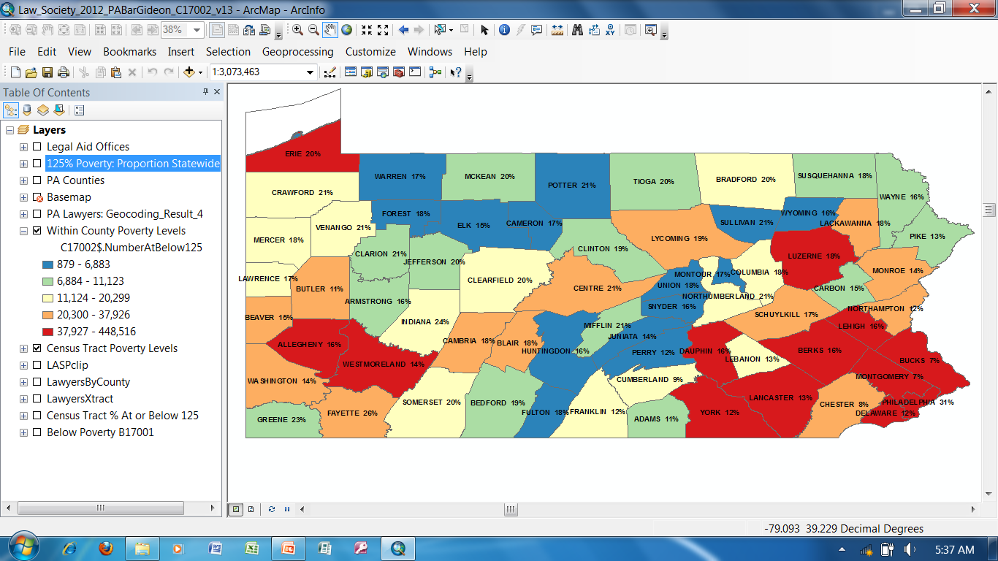
Number and % of Poor within each County

Slide 31
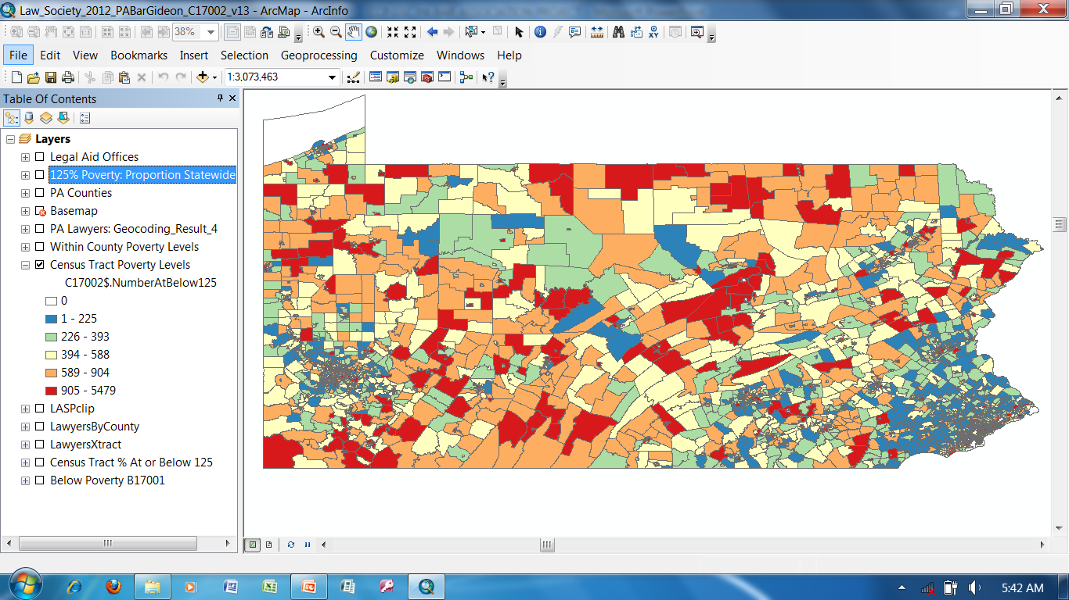
Number of Poor within each Census Tract

Slide 32
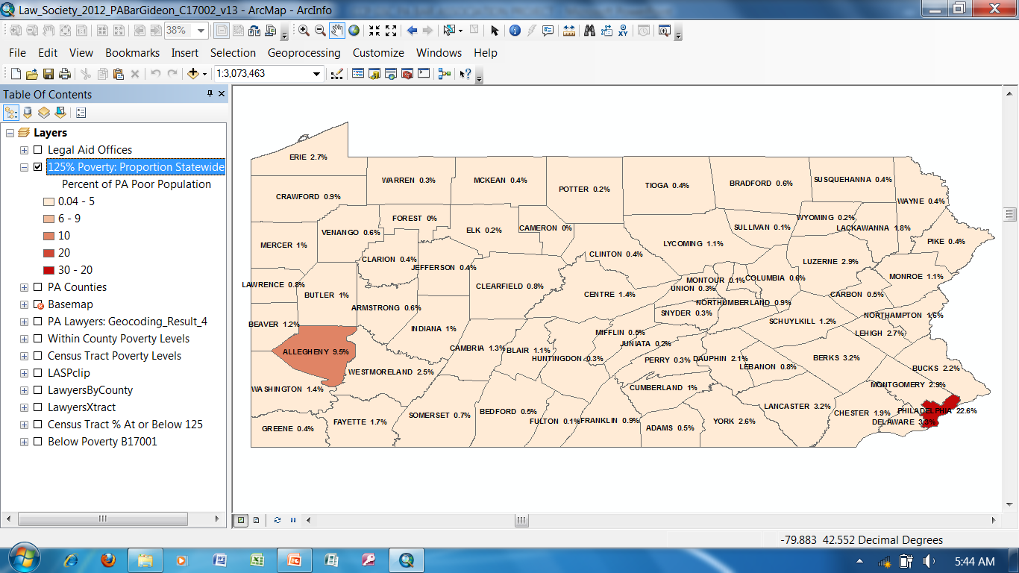
Proportion of PA Poor by County

Slide 33
For more information…
David Keller Trevaskis, Esquire
PBA Pro Bono Coordinator
717-571-7414 (cell)
dkt@pabar.org
david@leapkids.com

