Slide 1
White Out! A detective approach to improve historical literacy
Anthony Fitzpatrick: VP of Professional Development

Slide 3
What is White Out
White Out is a method of document analysis for students designed to help them develop a sense of historical literacy through the use of primary sources.
White Out allows students to compare and contrast historical events utilizing the following skills:
Sorting out contestable and non-contestable facts and interpretations
Understanding language as a transmitter of culture.
Creating connecting relations between similar concepts and figures throughout history.

Slide 4
How it works
Select a document that makes reference to historical content. The document can involve an event covered in class or one that will be covered in the future. You can also select a personality central to the content.

Slide 5
How it works
Choose a passage that raises a historically significant issue that applies to United States History over a wide span of time. For example: issues concerning labor, gender equality, civil rights, and political factions etc.

Slide 6
In simple terms . . .
Use a quote from the 1770s. Can you “hear” the 1960s if you closed your eyes?
Is this a quote, cartoon, concept that could be used over time?

Slide 7
Setting up a White Out
Next, choose a passage from the document that could apply to other periods or episodes in US History in order to help students make comparisons. Remove all bibliographic material that would reveal the author and date of the source. Here is an example:

Slide 8
Collaborating to Find an Answer
The key is in the conversation.
Students will bring differing opinions as to which facts within the sources make sense.
They will incorporate historical knowledge and prior knowledge from other disciplines.

Slide 9
What document is this?
When, in the course of human events, …but one to which the laws of nature and of nature's God entitle them, a decent respect to the opinions of mankind requires that they should declare the causes that impel them to such a course.
We hold these truths to be self-evident: that all … are created equal; that they are endowed by their Creator with certain inalienable rights; that among these are life, liberty, and the pursuit of happiness; that to secure these rights governments are instituted, deriving their just powers from the consent of the governed. Whenever any form of government becomes destructive of these ends, it is the right of those who suffer from it to refuse allegiance to it, and to insist upon the institution of a new government, laying its foundation on such principles, and organizing its powers in such form, as to them shall seem most likely to effect their safety and happiness.

Slide 10
What’s the Problem?
We have missing text.
How can we collaborate to find a logical solution?

Slide 11
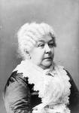
Let’s narrow it down to two:
The Declaration of Independence
JULY 4, 1776
The Declaration of Sentiments
1848
Thomas Jefferson Elizabeth Cady Stanton

Slide 12
White Out Revealed:

Slide 13
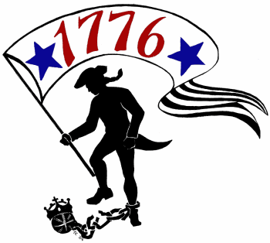
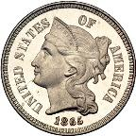
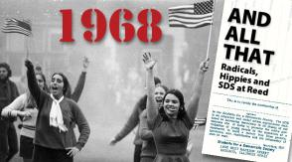
Setting up a White Out (continued)
Have students contextualize the document by asking questions about the author’s language and the issues discussed. Do the issues raised by the authors reveal anything about when the document was created? How about the language?

Slide 14
Advantages of the White Out Approach: Embedded Principles
“We hold these truths to be self evident . . .
Certain basic American values are reflected in historical documents. Identifying these and exposing them to students can be a fruitful intellectual exercise.

Slide 15
White Out in the Intermediate Classroom.
You may be thinking to yourself – No Way will my kids have the background knowledge to even take a wild guess . . .
GOOD POINT!
So how can the intermediate teacher modify this strategy, get the most out of it, and prepare students for when they encounter this type of activity later?

Slide 16
How About?
Turn it into a memory game with the author/ context on one card and the quote on another. It can be the base concept for a wonderful lesson! Any other ideas???
Remember – just by starting an exercise like this, you are making a HUGE difference! Can you imagine your students walking into a high school classroom knowing the author and context for some of American history’s best quotes and concepts!

Slide 17
Use the Founding Fathers:
Ideally, we are learning what makes each founding father unique – (otherwise, it’s just a bunch of guys that make a government)
Only use the big names:
Washington, Franklin, Adams, Henry, Madison, Jefferson, Hamilton

Slide 18
Tap into that Cultural Literacy!
Is life so dear, or peace so sweet, as to be purchased at the price of chains and slavery? Forbid it, Almighty God! I know not what course others may take; but as for me, give me liberty or give me death!
James Madison
Federalist 10
Patrick Henry
Speech to Virginia Commonwealth
George Washington
Farewell Address
Notes:
Why do students know this? Because they just do. This quote is part of our cultural DNA. I want the answer to be immediately recognizable. Would they know the document name? Probably not – but since they know the name – I can lead them into the document and the context.

Slide 19
This one was easy for us:
Patrick Henry’s “Treason” Speech. March 23 1775.

Slide 20
Scaffold the activity
First time out – use a famous quote that they know: “I cannot tell a lie.” Etc.
Make sure the “negative” answers are decently obvious.
The kids should be justifying why they know their answer to be right. In time – their explanations will become more sophisticated.

Slide 21
But where do I begin?
Look at your themes (SPECs as an example)
Do a search for speeches and/or quotes
Also these are broad areas with LOTS of stuff–
American Foreign Policy
Expansion of rights
Economic policy (look at Boom and Bust times)

Slide 22
As you do this more . . .
They will have to think more specifically using context clues.
This, like other things, is an acquired skill.
You can begin to make it tougher as the year goes on and they have more content to draw from.
And you’ll be able to employ other great strategies

Slide 23
The American Revolution?
"We must all hang together, or assuredly we shall all hang separately." --
Benjamin Franklin at the signing of the Declaration of Independence
King George III at the notion that the American colonists wanted independence
Franklin Roosevelt at the Yalta Conference
Notes:
Ben Franklin is referring to the colonies – but there is a resonance with FDR as well. King George should be thrown out. For elementary students, they should guess Ben Franklin out of sheer familiarity – and that is the point when doing this early on.

Slide 24
White Out Revealed

Slide 25
One more practice . . .
"There! His Majesty can now read my name without glasses. And he can double the reward on my head!" --
Abigail Adams after signing her name in large letters on the Declaration of Independence
King George III after signing his name in large letters on the Declaration of Independence
John Hancock after signing his name in large letters on the Declaration of Independence
Crispus Attucks after signing his name in large letters on the Declaration of Independence.
Notes:
A large name – most will know that it is John Hancock. This quote can be extended into a discussion of why Abigail Adams (as a woman) or Crispus Attucks (as an African American) wouldn’t have their names on such a document.

Slide 26
White Out Revealed!

Slide 27
Let’s add some color:
Once you’ve established the big name figures and their quotes and “personalities” – you can extend into other areas!!!!

Slide 28
Political Cartoons!!
Notes:
Using a term they all know – students can then enjoy the not-so-subtle use of cultural literacy to make a point that speaks to the American narrative.

Slide 29
Revealed

Slide 30
OK OK OK
I know – Maybe that isn’t one for elementary students. (But funny as the day is long)

Slide 31
Maybe this one . . .
Notes:
Based on the visual cues – students will guess “George Washington and Lie” – By then using the new context clues – students will then try to fill in the 3rd blank. It will produce some interesting discussion is we’ve generated a list of things that George did – based on the ESP discussion.

Slide 32
Revealed

Slide 33
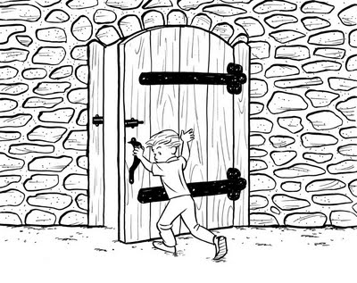
Or . . . “Cloze the door”!
Cloze procedure is a technique in which words are deleted from a passage according to a word-count formula or various other criteria. The passage is presented to students, who insert words as they read to complete and construct meaning from the text. This procedure can be used as a diagnostic reading assessment technique.
There are many resources online to assist in using the Cloze procedure,
including online worksheet generators!

Slide 34
Now some for us!

Slide 35
HMMMMM . . .
No man, nor number of men upon earth hath power or authority to rule over men’s consciences in religious matters,
The First Amendment to the United States Constitution.
Thomas Jefferson, Virginia Statute of Religious Freedom, 1786
Charter of West Jersey, 1677

Slide 36
Revealed

Slide 37
The other finalists’ words
Thomas Jefferson:
1st Amendment
Congress shall make no law respecting the establishment of religion, or prohibiting the free exercise thereof; or abridging the freedom of speech, or of the press; or the right of the people peaceably to assemble, and to petition the Government for a redress of grievances.
All men shall be free to profess, and by argument to maintain, their opinions in matters of religion.

Slide 38
Hhhmmmm
Notice how we used a document from the exemplar text section of the Common Core Standards and brought in similar documents to expand our learning and understanding!

Slide 39
Who said this?
The question you propose, whether circumstances do not sometimes occur, which make it a duty in officers of high trust, to assume authorities beyond the law, is easy of solution in principle, but sometimes embarrassing in practice. A strict observance of the written laws is doubtless one of the high duties of a good citizen, but it is not the highest. The laws of necessity, of self-preservation, of saving our country when in danger, are of higher obligation. To lose our country by a scrupulous adherence to written law, would be to lose the law itself, with life, liberty, property and all those who are enjoying them with us; thus absurdly sacrificing the end to the means.
Abraham Lincoln, 1862 Proclamation suspending the Writ of Habeus Corpus
Thomas Jefferson September 20, 1810 Letter to John B. Colvin regarding the Louisiana Purchase
Alexander Hamilton’s Opinion as to the Constitutionality of the Bank of the United States : 1791
Henry Clay in Response to the Nullification Crisis, 1833
Notes:
All four would be considered pragmatic. Students would recognize the Life-liberty and pursuit. But then the document adds complexity that I may have to walk my students through. The complexity of something that super cedes constitutional authority. I can use this example as an entry to any of the four. Students will be interested in the pragmatic nature of Jefferson (even hypocrisy). Introduce Jefferson that way – they’ll find out about Sally Hemings soon enough.

Slide 40
Abraham Lincoln was pragmatic and assumed tremendous authority by doing this.
Abraham Lincoln suspended the writ of Habeus Corpus – but it is not bending the rules due to Article I Section 9 of the Constitution
Jefferson was a point where a decision on expansion and security needed to be made
Thomas Jefferson was unclear as to whether he had the constitutional authority to expand.
Clay was a compromiser and was known to make accommodations to preserve the union
The writing of this letter is a reflection – so it seems as if it isn’t one of the compromises.
Hamilton interpreted the constitution loosely with regard to the Bank.
Hamilton would never have believed that he was bending the rules

Slide 41
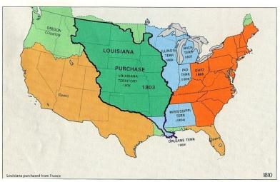
Revealed: Thomas Jefferson

Slide 42
White Out
As the government of the United States of America is not in any sense founded on the Christian Religion,-as it has in itself no character of enmity against the laws, religion or tranquility of ---------and as the said States never have entered into any war or act of hostility against any --------- nation, it is declared by the parties that no pretext arising from religious opinions shall ever produce an interruption of the harmony existing between the two countries.
Treaty of Peace and Friendship, Signed at Tripoli November 4, 1796 .
Television Address to the People of Pakistan From Islamabad, Pakistan Bill Clinton 1998.
William McKinley addresses the annexation of the Philippines. August 12, 1898.
Notes:
Some students may be disturbed by the Christian religion portion. They will want to make it more contemporary – Because of the media – Bill Clinton could never get away with a statement like this. Consequently – Barack Obama used a portion of this quote in his speech to Cairo – but he left out Christian religion segment.

Slide 43
Survey Says . . .
Treaty of Peace and Friendship, Signed at Tripoli November 4, 1796
Picture is the burning of the Frigate Philadelphia, 16 February 1804. Note the picture was a representation of the Barbary Wars – but was of an event that occurred after this treaty.

Slide 44
Let’s try this one . . .
"The government does not want to and should not want to own banks. I think nationalizing the banks is an absolutely wrong thing to do.”
Thomas Jefferson in response to Alexander Hamilton’s proposal.
Senator Mitch McConnell in anticipation of TARP funds going to banks.
George HW Bush responding to a proposed bailout of Savings and Loan institutions

Slide 45
And our winner?
Senator Mitch McConnell
You’re going to find SO many articles referencing the nationalization of banks – maybe more so with Andrew Jackson. The challenge will be to find worthy sources from the present-day.

Slide 46
How about real Thomas Jefferson?
“The incorporation of a bank, and the powers assumed by this bill have not, in my opinion, been delegated to the United States by the Constitution.”
Remember that earlier letter concerning the Louisiana Purchase?
Notes:
Really add some depth to Thomas Jefferson!

Slide 47
Setting up a White Out: Who Said . . .
“a revolt has arisen all over our country, from Mississippi on the shores of the Gulf-kissed coast in the South to the stony crags of Maine in the North, and from the Atlantic to the Pacific Oceans, by southern Democrats and those freedom-loving Americans everywhere, at this attempt to destroy the true civil rights of the citizens of our great and common country? For, I again call to the attention of my northern colleagues what I have often repeated upon the floor of this House, namely, that the South is not the only section aggrieved by those proposed unconstitutional laws, the same sharp resentment at the interference by a powerful Federal Government with their individual liberties as the people of the South.”
Confederate Vice President Alexander Stephens, 1861 in response to outbreak of the Civil War.
William M. Colmer, Democratic representative from Mississippi, 1948 in response to President Harry Truman’s Civil Rights Speech
Governor Orval Faubus 1957 in response to the Supreme Court’s decision in Brown v. Board of Education and the announcement that nine Black students would attempt to integrate Little Rock High School.

Slide 48
William Colmer
Signed the Southern Manifesto in protest of the Brown v Board of Education Decision and objected to the integration of the armed forces and much of the Truman Administration Civil Rights initiatives.

Slide 49
Who said this?
At the present moment in world history nearly every nation must choose between alternative ways of life. The choice is too often not a free one.
One way of life is based upon the will of the majority, and is distinguished by free institutions, representative government, free elections, guarantees of individual liberty, freedom of speech and religion, and freedom from political oppression.
The second way of life is based upon the will of a minority forcibly imposed upon the majority. It relies upon terror and oppression, a controlled press and --------------------; fixed elections, and the suppression of personal freedoms.
I believe that it must be the policy of the United States to support free peoples who are resisting attempted subjugation by armed minorities or by outside pressures.
I believe that we must assist free peoples to work out their own destinies in their own way.
Barack Obama Speech on Libya – March 28, 2011
Harry Truman The Truman Doctrine – March 12, 1947
George H.W. Bush statement on UN Resolution 688 calling for an end to dictatorship in Kurdistan from Saddam Hussein – April 6, 1991
Ronald Reagan Statement in response to the People Power Movement that overthrew Ferdinand Marcos in the Philippines – February 26, 1986.
Notes:
The Blank is Radio

Slide 50
There he is again ☺

Slide 51
Another White Out example: Who said . . .
“the crushing burdens which now oppress both races in the South will cause each to make an effort to cast them off. They will see a similarity of cause and a similarity of remedy. They will recognize that each should help the other in the work of repealing bad laws and enacting good ones. They will become political allies, and neither can injure the other without weakening both. It will be to the interest of both that each should have justice. And on these broad lines of mutual interest, mutual forbearance, and mutual support the present will be made the stepping-stone to future peace and prosperity.”
Martin Luther King, “I Have a Dream Speech, 1963.
Booker T. Washington, The Atlanta Compromise Speech, 1895.
Tom Watson, “The Negro Question in the South,” 1892.
Abraham Lincoln, “The Gettysburg Address, “1863.

Slide 52
White Out Revealed
Source: Thomas E. Watson, “The Negro Question in the South,” The Arena, VI (October 1892): 540–550. Reprinted in George Brown Tindall, ed., A Populist Reader: Selections from the Works of American Populist Leaders (New York: Harper & Row, 1966), 118–128.

Slide 53
Let’s try another one: Who Said . . . ?
“Our country is a theatre, which exhibits, in full operation, two radically different political systems; the one resting on the basis of servile or slave labor, the other on voluntary labor of freemen. The laborers who are enslaved are all negroes, or persons more or less purely of African derivation. But this is only accidental. The principle of the system is, that labor in every society, by whomsoever performed, is necessarily unintellectual, grovelling and base; and that the laborer, equally for his own good and for the welfare of the State, ought to be enslaved. The white laboring man, whether native or foreigner, is not enslaved, only because he cannot, as yet, be reduced to bondage.”
Notes:
Have the students create a profile of the person – Male-Female; young-old, white-black, rich-poor, North or south. At first they may guess South. (they probably haven’t read it well enough – ask them to go back and look again at the main point. They will be gin to associate it with the character they created to try to make it fit. They will read more closely.
Then I give a few hints – Team of Rivals (a hard clue – but certainly something associated with Lincoln’s Cabinet). Then I tell them a cold folly.

Slide 54
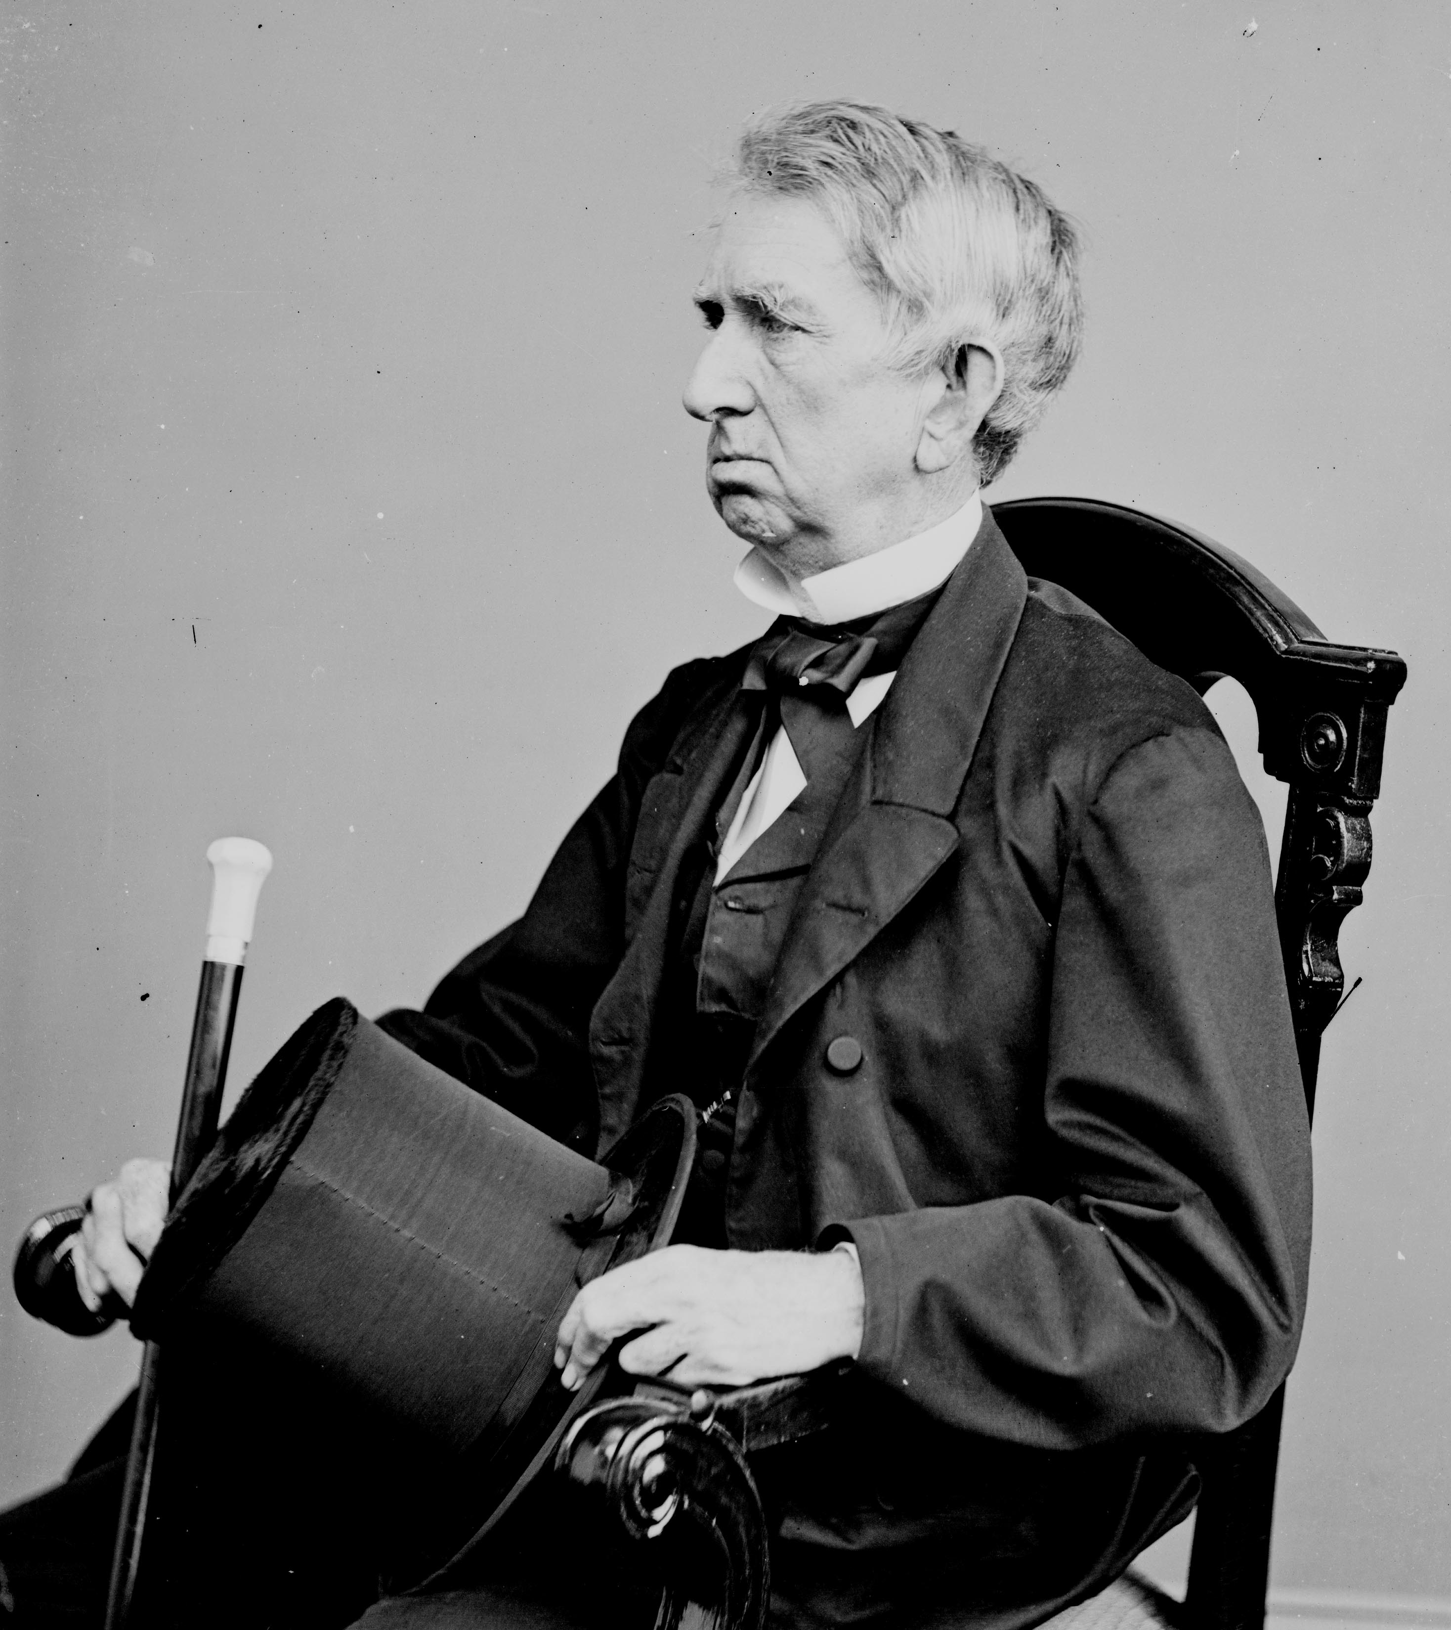
White Out Revealed
William Seward. What makes him S.P.E.C.ial?
In what was arguably the most famous Republican speech of the 1850s, Seward foretold "an irrepressible conflict" between slave and free states. He asserted that either the North would succumb to slavery or the South would succumb to freedom.
Notes:
Little do people realize that Seward is a powerful member of the Republican Party.

Slide 55
Who said this?
It may be asked, "Why do you want it? Some men have got along very well without it. Women have not this right." Shall we justify one wrong by another? That is a sufficient answer. Shall we at this moment justify the deprivation of the negro of the right to vote, because some one else is deprived of that privilege? I hold that women, as well as men, have the right to vote (applause), and my heart, and my voice go with the movement to extend suffrage to woman; but that question rests upon another basis than that on which our right rests. We may be asked, I say, why we want it. I will tell you why we want it. We want it because it is our right, first of all.
Submitted by: Joe Russell – Moorestown Public Schools

Slide 56
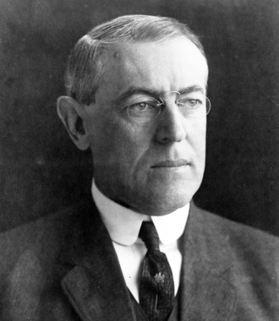
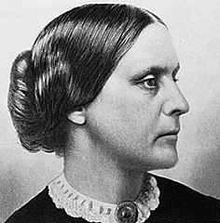
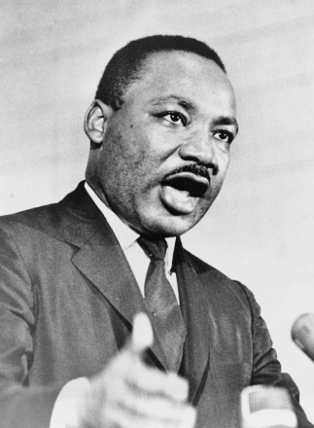
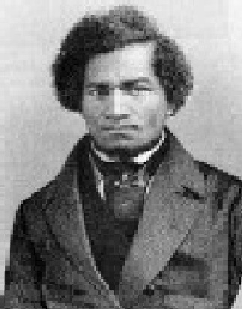
Who said this?
Woodrow Wilson’s
1918 Speech to Congress
Susan B. Anthony in her speech after attempting to vote in an election in 1872
It may be asked, "Why do you want it? Some men have got along very well without it. Women have not this right." Shall we justify one wrong by another? That is a sufficient answer. Shall we at this moment justify the deprivation of the negro of the right to vote, because some one else is deprived of that privilege? I hold that women, as well as men, have the right to vote (applause), and my heart, and my voice go with the movement to extend suffrage to woman; but that question rests upon another basis than that on which our right rests. We may be asked, I say, why we want it. I will tell you why we want it. We want it because it is our right, first of all.
Martin Luther King, Jr. in
his Letter from a Birmingham Jail in 1963
Frederick Douglass in his April 1865 speech, What the Black Man Wants

Slide 57
Revealed: Frederick Douglass
While the passage references Civil Rights and the Women’s Suffrage Movement
Actually a passage from Douglass’ speech, What a Black Man Wants, to a Boston Anti-Slave Society just days before the end of the Civil War and the assassination of Abraham Lincoln
Frederick Douglass in his April 1865 speech, What the Black Man Wants

Slide 58
Who said this?
It is one of the greatest acts on record to have brought 4,000,000 people into freedom. The career of free industry must be fairly opened to them, and then their future prosperity and condition must, after all, rest mainly on themselves. If they fail, and so perish away, let us be careful that the failure shall not be attributable to any denial of justice. In all that relates to the destiny of the freedmen we need not be too anxious to read the future; many incidents which, from a speculative point of view, might raise alarm will quietly settle themselves.
Submitted by: Joe Russell – Moorestown Public Schools

Slide 59
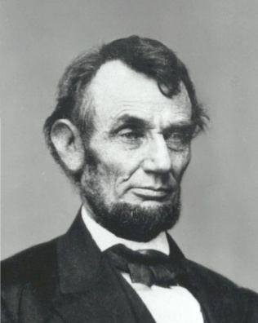
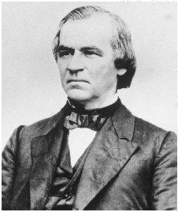
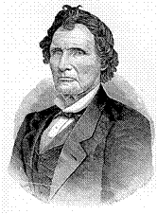
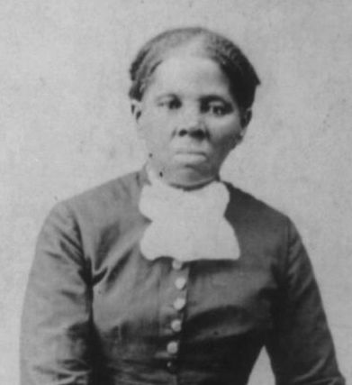
Who said this?
Abraham Lincoln in
January 1863 in his Emancipation Proclamation
Andrew Johnson’s First Annual Message on December 4, 1865
It is one of the greatest acts on record to have brought 4,000,000 people into freedom. The career of free industry must be fairly opened to them, and then their future prosperity and condition must, after all, rest mainly on themselves. If they fail, and so perish away, let us be careful that the failure shall not be attributable to any denial of justice. In all that relates to the destiny of the freedmen we need not be too anxious to read the future; many incidents which, from a speculative point of view, might raise alarm will quietly settle themselves.
Harriet Tubman’s 1896 speech to the National Association of Colored Women
Thaddeus Stevens in his Speech to Congress, 1867
Notes:
Andrew Johnson
First Annual Message December 4, 1865

Slide 60
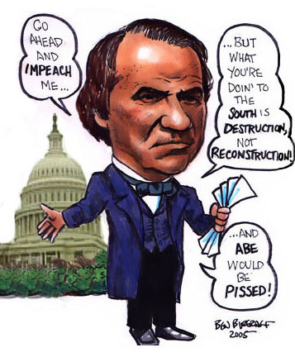
Revealed: Andrew Johnson
While these words could have come from Harriet Tubman, Thaddeus Stevens, or even Lincoln himself
Andrew Johnson’s First Annual Message on December 4, 1865
It was actually a passage from Andrew Johnson’s first speech to Congress involving the reconstruction of the South and the transition from slaves to freedmen

Slide 61
Who said this?
All, too, will bear in mind this sacred principle, that though the will of the majority is in all cases to prevail, that will to be rightful must be reasonable; that the minority possess their equal rights, which equal law must protect, and to violate would be oppression. Let us, then, fellow-citizens, unite with one heart and one mind. Let us restore to social intercourse that harmony and affection without which liberty and even life itself are but dreary things.
Submitted by: Joe Russell – Moorestown Public Schools

Slide 62
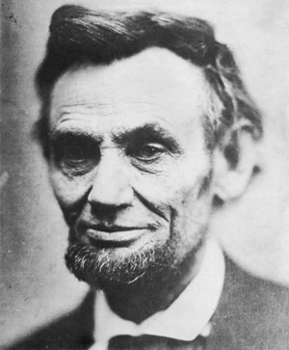
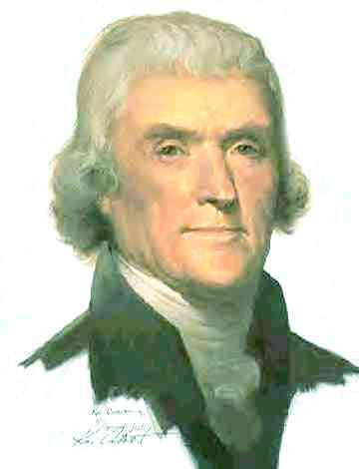
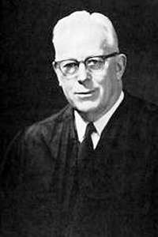
Who said this?
Abraham Lincoln’s Second Inaugural Address on
March 4, 1865
Thomas Jefferson’s First Inaugural Address on
March 4, 1801
All, too, will bear in mind this sacred principle, that though the will of the majority is in all cases to prevail, that will to be rightful must be reasonable; that the minority possess their equal rights, which equal law must protect, and to violate would be oppression. Let us, then, fellow-citizens, unite with one heart and one mind. Let us restore to social intercourse that harmony and affection without which liberty and even life itself are but dreary things.
Martin Luther King, Jr.’s
“I Have a Dream” speech
in August 1963
Earl Warren’s majority
opinion in Brown v. Board
of Education of Topeka,
Kansas decision in 1954

Slide 63
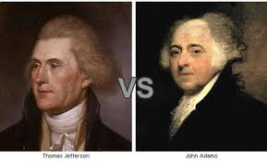
Revealed: Thomas Jefferson
Thomas Jefferson’s
First Inaugural Address on
March 4, 1801
While it sounded like:
Martin Luther King, Jr. (Civil Rights) or Abraham Lincoln (Equality)
Actually a passage from Jefferson’s speech referring to his efforts to reunite the country after the controversial election of 1800.

Slide 64
Whiting out America’s emergence in the world!
“Our objectives in ------ are clear, our goals defined and familiar: -------- withdraw from -------- completely, immediately, and without condition. --------- legitimate government must be restored. The security and stability of ----------- must be assured. And American citizens abroad must be protected.”
Who said this?
President Cleveland in reference to Hawaii.
President George H.W. Bush in reference to Kuwait.
President Lyndon Johnson in reference to Vietnam.
What are the context clues?
What are some common themes that connect these events?
What separates them?

Slide 65
And the winner is . . .
George H. W. Bush's Address to Congress on the Persian Gulf Crisis (1990) .

Slide 66
Another Try . . .
The people to whom your fathers told of the living God, and taught to call 'Father,' and whom the sons now seek to despoil and destroy, are crying aloud to Him in their time of trouble; and He will keep His promise, and will listen to the voices of His --------- children lamenting for their homes.
Yasser Arafat in reference to the founding of the Palestinian Liberation Organization.
Queen Liliuokalani of Hawaii in the face of being deposed.
Barak Obama referencing Darfur in 2006.

Slide 67
And the winner . . .
Queen Liliuokalani in the face of revolution and military incursion in Hawaii.

Slide 68
How about Woodrow Wilson?
But I had a greater obligation than to think only of the years of my administration and of the next election. I had to think of the effect of my decision on the next generation and on the future of peace and freedom in America and in the world.
Let us all understand that the question before us is not whether some Americans are for peace and some Americans are against peace.
Woodrow Wilson April 2, 1917
Richard Nixon, November 3, 1969
George W. Bush September 7, 2003
Barack Obama August 20,2010

Slide 69
hhmmm
Woodrow Wilson would be an altogether bad pick – just after an election where he was the guy that kept us out of war. The date coincides with his declaration of war which served as the basis for the 14 points
(open diplomacy, freedom of the seas, creation of an international organization, national self-determination etc)
Nixon works as well. Clearly we are referencing the Vietnam War and his actions with regard to the conflict there.
Bush works from a syntax approach – his language is often very cut and dry with little equivocation.
Obama probably is the biggest outlier and the easiest for your students to disqualify.

Slide 70
Barack Obama?
We have adopted a plan which we have worked out in cooperation with the ------ for the complete withdrawal of all U.S. combat ground forces, and their replacement by ------ forces on an orderly scheduled timetable. This withdrawal will be made from strength and not from weakness.
Woodrow Wilson April 2, 1917
Richard Nixon, November 3, 1969
George W. Bush September 7, 2003
Barack Obama August 20,2010
Notes:
This one may boil down to Obama and Nixon. Withdrawal and timetable were big buzzswords of the 2008 election. Also – The Obama date is of the withdrawal.

Slide 71
Richard Nixon
The “Silent Majority” Speech.
And although he references withdrawal from Vietnam – we hear the reverberations today!
Can we see the use of these principles over time?
Let’s also look at the notion of political pragmatism throughout time.
Notes:
Same speech – two different ideologies of sorts. A great example to showcase political pragmatism in a modern context.

Slide 72
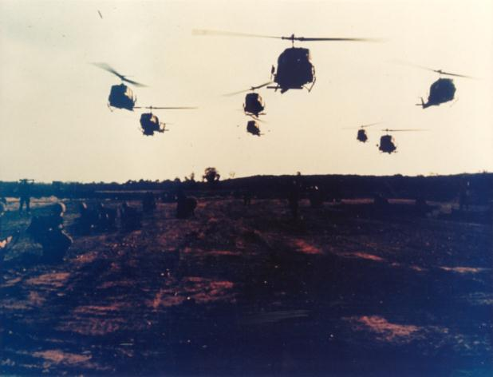
http://tapes.millercenter.virginia.edu/clips/1963_1002_jfk_withdrawal/index.htm

Slide 73
But wait! The Kennedy Administration wasn’t a choice?? !!
You can link the principles of many administrations – left, right, moderate and indifferent through various means.
Multimedia provided by the Miller Center at the University of Virginia. – WONDERFUL FREE RESOURCE!
(American Rhetoric is another great place)

Slide 74
Any Guesses?
…nameless, unreasoning, unjustified terror which paralyzes needed efforts to convert retreat into advance. In every dark hour of our national life a leadership of frankness and vigor has met with that understanding and support of the people themselves which is essential to victory. I am convinced that you will again give that support to leadership in these critical days.
George W. Bush – Address to Congress 9/20/2001
Lyndon Baines Johnson – Inaugural Address – 1/20/65
Franklin Delano Roosevelt – Inaugural Address – 3/4/33

Slide 75
How about if I add the beginning?
So first of all, let me assert my firm belief that the only thing we have to fear is fear itself -nameless, unreasoning, unjustified terror which paralyzes needed efforts to convert retreat into advance. In every dark hour of our national life a leadership of frankness and vigor has met with that understanding and support of the people themselves which is essential to victory. I am convinced that you will again give that support to leadership in these critical days.
Notes:
They all now the beginning – but we never hear the ending! We can apply this ending over time.

Slide 76
Immigration
"Unless the stream of these people can be turned away from their country to other countries, they will soon outnumber us so that we will not be able to save our language or our government."
Henry Bowers, founder of the Protective Association (1894)
Henry Wilson, Member of the Know-Nothing Party and former Vice President. (1854)
Benjamin Franklin, (we know who he is) (1751)
Tom Tancredo, American Politician speaking about the Arizona immigration law. (2010)

Slide 77
Survey Says . . .

Slide 78
Two Ben Franklin Quotes:
“Why should the Palatine boors be suffered to swarm into our settlements, and by herding together establish their language and manners to the exclusion of ours? Why should Pennsylvania, founded by the English, become a colony of aliens, who will soon be so numerous as to germanize us instead of our anglifying them, and will never adopt our language or customs, any more than they can acquire our complexion.”
“… these people are a matter of great concern to us. … The ones who come here are usually the most stupid of their nation. Few understand our language, so we cannot communicate with them through our newspapers. They are not used to freedom and do not know how to use it properly. … They bring in much of their own reading from their homeland and print newspapers in their own language. In some parts of our state, ads, street signs, and even some legal documents are in their own language and allowed in courts. Unless the stream of these people can be turned away from their country to other countries, they will soon outnumber us so that we will not be able to save our language or our government.”

Slide 79
Who Said It?
It would be inconsistent on the part of a free nation to take measures against a people who had availed themselves of the only means they had to throw off the yoke of the most atrocious …; if one treats the insurrection of the … as rebellion, what name can be given to that insurrection of Americans which secured their independence?
George HW Bush in response to criticism of American intervention in the Iraq invasion of Kuwait.
Barack Obama in explanation of the rationale for involvement in support of those in Libya challenging the rule of Gaddafi
A Pennsylvania legislator highlighting the complexity of supporting Napoleon over the Haitian rebels.
Grover Cleveland insinuating support for the restoration of Queen Lilioukalani.

Slide 80
That obscure PA legislator!
It would be inconsistent on the part of a free nation to take measures against a people who had availed themselves of the only means they had to throw off the yoke of the most atrocious slavery; if one treats the insurrection of the negroes as rebellion, what name can be given to that insurrection of Americans which secured their independence?
Winthrop Jordan White Over Black-1968

Slide 81
What about Political Cartoons?
Notes:
Fables are a great way of delivering content and context to students.
Short words – students will then generate historical situations where we have asked for help and it has punished us in the end. I then give them the geographic hint of a scorpion – this should point students to the desert – then to the Middle East. They’ll get Iran and Iraq but won’t be sure about the specific incident. A great way to show ideas that span specific content.

Slide 82
Revealed

Slide 83
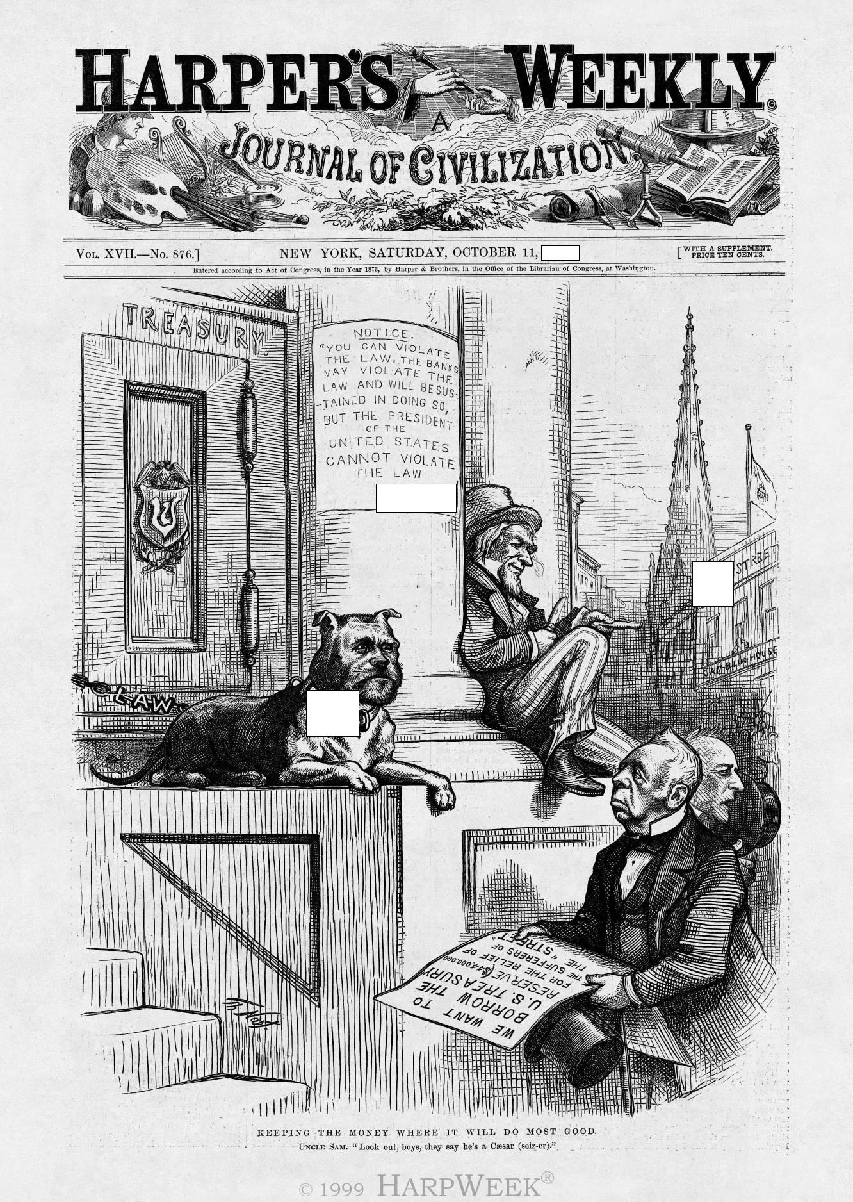
Notes:
The explanation:
Published in the midst of the Panic of 1873, this cartoon portrays President Ulysses S. Grant as a watchdog guarding the U.S. Treasury from Wall Street speculators who are seeking a bailout from the federal government. Lawyer Reverdy Johnson (left) presents a brief for financier Cornelius Vanderbilt (right), as Uncle Sam warns the two men not to provoke the Grant bulldog.

Slide 84
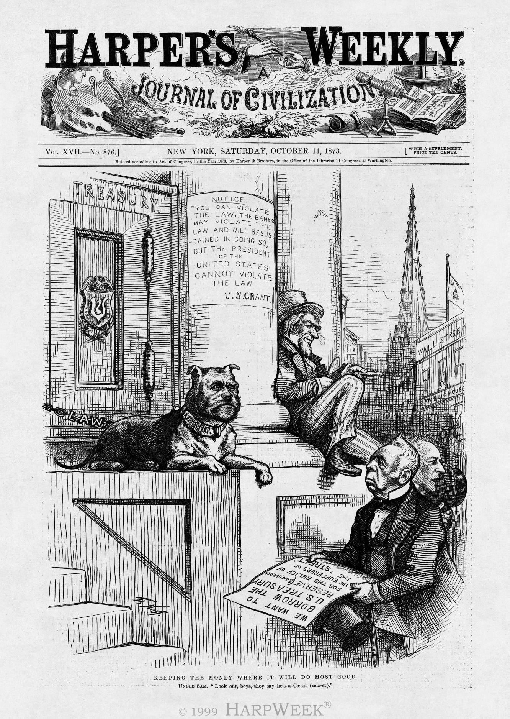

Slide 85
The Grant Administration remixed?
___ has lighted the spark which is resulting in a moral uprising and will end only when the whole sorry mess of twisted, warped ____ are swept from the national scene so that we may have a new birth of honesty and decency in government.
William A. Wheeler – Vice President during the Hayes Administration writing about civil service reform.
Joseph McCarthy during the Cold War “The Enemies Within” speech.
Newt Gingrich speaking about the Republican Revolution in 1993. The Contract for America

Slide 86
Joseph McCarthy
Here’s what I did:
Took a quote from “The enemies Within”
Activated prior knowledge – knowing there HAD to be government scandal and mismanagement resulting in big change.
Created some answers.
It took 7 minutes.

Slide 87
Change Over Time
Notes:
Great use of color and trends. They’ll get the dates pretty easily.

Slide 88
Revealed

Slide 89
One last cartoon . . .

Slide 90
Revealed

Slide 91
Extension for the plain old curious student . . .
CHANGE OVER TIME!
In disqualifying answers and understanding what makes even similar historical circumstances unique, students will begin practicing change over time.
How can we categorize the change over time? S.P.E.C.ulate . . .

Slide 92
21st Century Application Samples
Begin with the end in mind
– Predict how a student may dissect the White Out! (making sure they highlight the similarity of the choices via the provided concept.)
Create podcast, online, visual clues.
Have students track the many paths they can use to arrive at the right answer

Slide 93
21st Century Skills Extension
Have student groups construct White Outs!
Have them follow the steps.
Find the broad theme and quote.
Map out the dissection
Create technologically rich examples.

Slide 94
Where else does this fit into my classroom?
I think it’s a wonderful “Do Now”, warm-up, Anticipatory Set, Closure Activity.

Slide 95
One last quote (just because it is SO wonderful)
In each generation, with toil and tears, we have had to earn our heritage again. If we fail now then we will have forgotten in abundance what we learned in hardship: that democracy rests on faith, that freedom asks more than it gives, and the judgment of God is harshest on those who are most favored.
If we succeed it will not be because of what we have, but it will be because of what we are; not because of what we own, but rather because of what we believe.
For we are a nation of believers. Underneath the clamor of building and the rush of our day's pursuits, we are believers in justice and liberty and in our own union. We believe that every man must some day be free. And we believe in ourselves.
And that is the mistake that our enemies have always made. In my lifetime, in depression and in war they have awaited our defeat. Each time, from the secret places of the American heart, came forth the faith that they could not see or that they could not even imagine. And it brought us victory. And it will again.
For this is what America is all about. It is the uncrossed desert and the unclimbed ridge. It is the star that is not reached and the harvest that is sleeping in the unplowed ground. Is our world gone? We say farewell. Is a new world coming? We welcome it, and we will bend it to the hopes Of man.
Notes:
Narrow down the date using context clues – post wwii and depression. Then generate a list of presidents that are regarded as the most eloquent. Usually left off the list – Ike, Johnson, Ford and Carter. This is a great opportunity to dispel myths – and just a really fun quote!

Slide 96
Inaugural Address (January 20, 1965) Lyndon Baines Johnson

Slide 97
For more information . . .
afitzpatrick@aihe.info
My Book: Social Studies Can Be SPECtacular.

