Slide 1
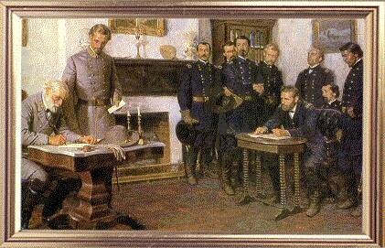
Why the North Won (or Why the Confederacy Lost)
John Sacher
University of Central Florida
John.sacher@mail.ucf.edu

Slide 2
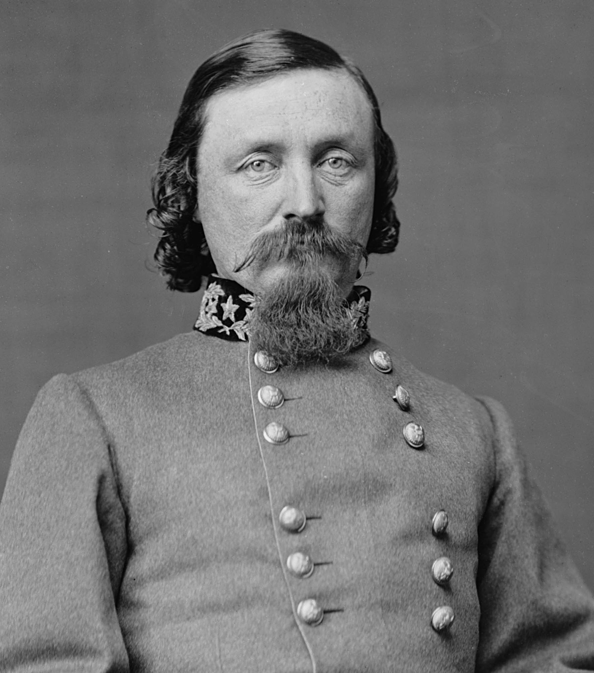
1. Union Strength
"I always thought the Yankees had something to do with it."
Quote attributed to George Pickett when asked why the Confederates lost at Gettysburg

Slide 3
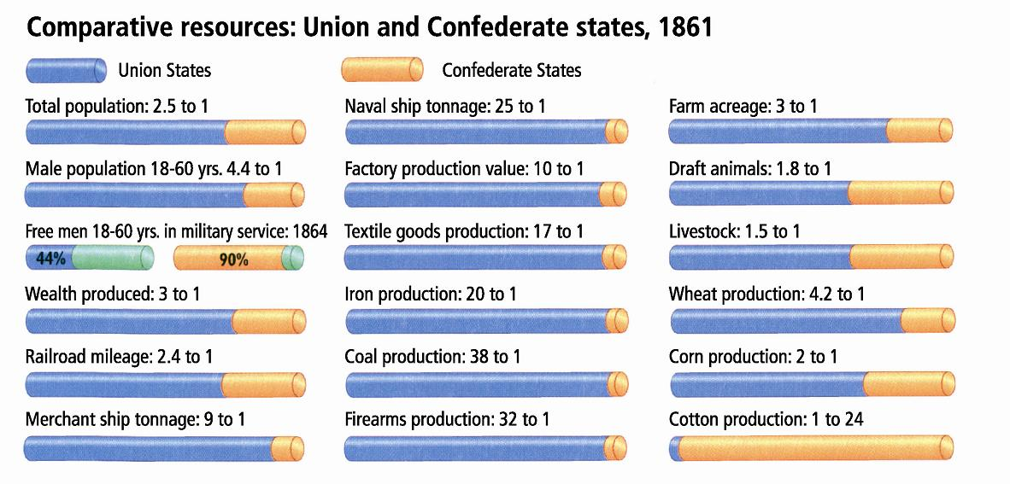
“The Army of Northern Virginia has been compelled to yield to overwhelming numbers and resources." Robert E. Lee
"God is always on the side of the heaviest battalions"

Slide 4
Financial Strength Sources of Revenue
CSA USA
Bonds 35% 66%
Taxation 5% 21%
Paper Money 60% 13%

Slide 5
Indices of Prices and Real Wages During the Civil War(1860=100)
Union Confederate
Year Prices Real Wages Prices Real Wages
1860 100 100 100 100
1861 101 100 121 86
1862 113 93 388 35
1863 139 84 1,452 19
1864 176 77 3,992 11
1865 175 82 9,200 approx.

Slide 6
Problems with the “Union too Strong” argument
The stronger side doesn’t always win, and besides the South does not have to win.
CSA not suicidal; “No people ever warred for independence with more relative advantages than the Confederates.” Pierre G. T. Beauregard
In an intelligent view of the precedents of history, it might safely [have been] predicted that the South . . . would be victor in the contest, however unequally matched in men and the materials of war, unless the management of her affairs should become insane, or her people lose the virtue of endurance.” Edward A. Pollard, editor of the Richmond Examiner

Slide 7
2. Lack of Confederate Nationalism
What is nationalism?
Two definitions:
a country with an army, a treasury, a foreign policy, integrity of its borders, etc.
a sense of belonging to a country (sometimes referred to as identity)

Slide 8
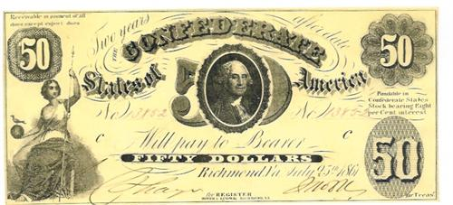
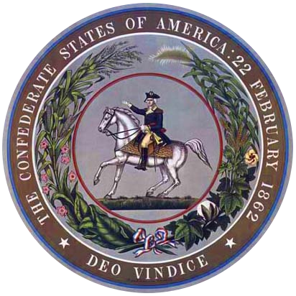
Confederate Symbols

Slide 9
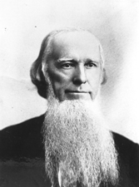
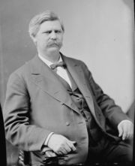
“Died of States’ Rights”
z
←Joseph Brown, Georgia Governor
Zebulon Vance, North Carolina →

Slide 10
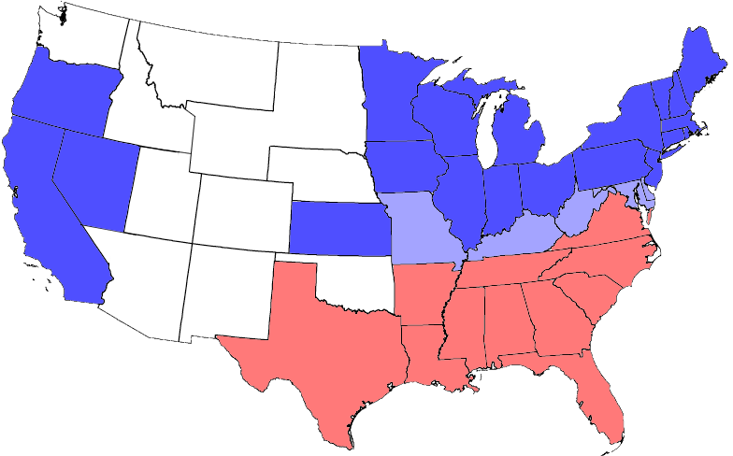
All Southerners were not Confederates

Slide 11
How many southerners fought for the Union?
Southern slaves 150,000
Border state whites 200,000
Confederate state whites 100,000
Total 450,000
1/3 of all southerners who fought in the Civil War fought for the Union

Slide 12
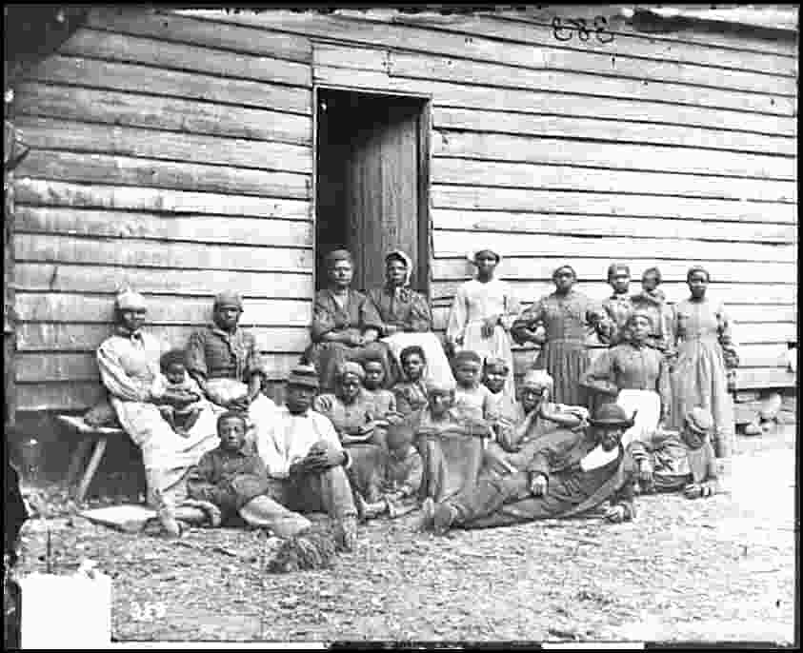
3. Slavery

Slide 13
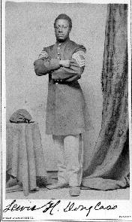
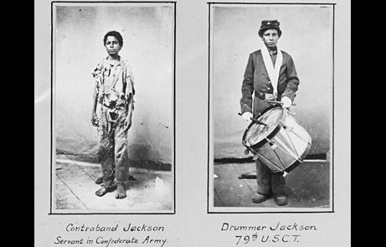
United States Colored Troops

Slide 14
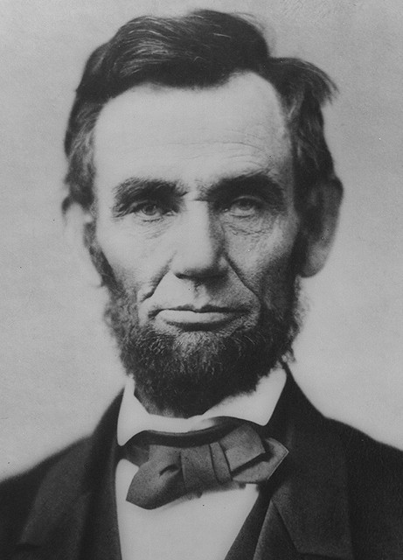
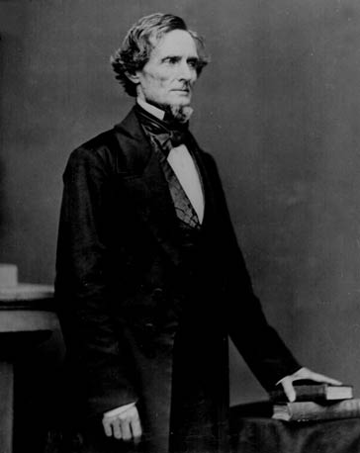
4. Leadership
“If the Union and the Confederacy had exchanged presidents with one another, the Confederacy might have won its independence.” Historian David Potter

Slide 15
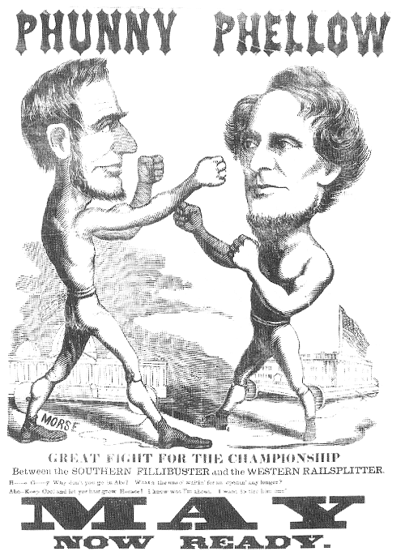
Lincoln vs. Davis
Management styles
Attitude toward opponents
Types of opposition
As politicians
Counterview
Historians Ludwell Johnson, “even a brief
systematic comparison reveals [Davis]
was clearly superior to Lincoln.”

Slide 16
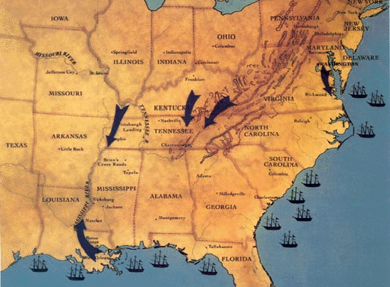
Foreign Policy

Slide 17
Cotton Exports
1860 4.5 million bales
During the Civil War:
2.5 million bales destroyed
1 million bales exported
?? million bales smuggled into the North

Slide 18
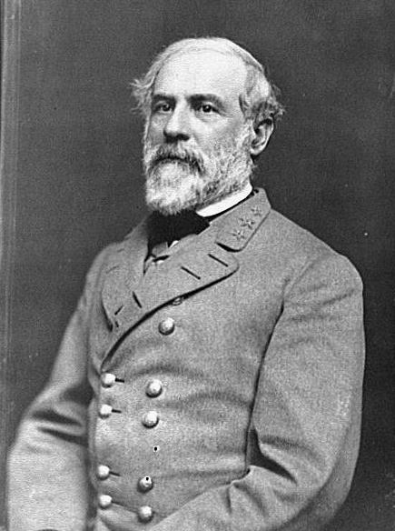
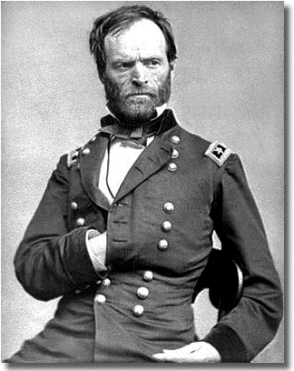
Leading Generals
Sherman
Grant
Lee

Slide 19
Sherman regarding his March to the Sea, “This might not be war but rather statesmanship.”
Grant “The art of war is simple enough. Find out where you enemy is. Get at him as soon as you can. Strike at him as hard as you can , and as often as you can, and keep moving on.”

Slide 20
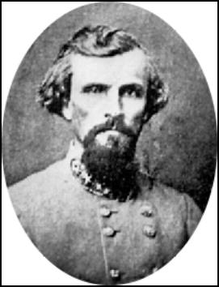
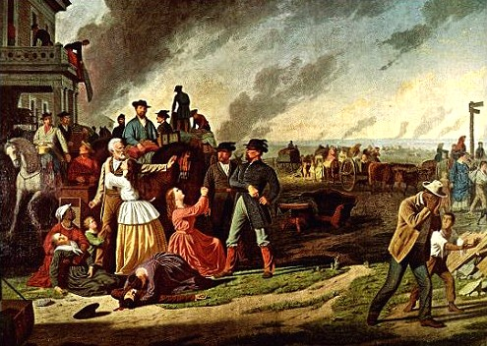
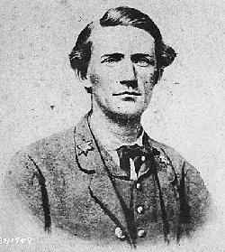
Flawed Strategy—Guerrilla Warfare

Slide 21
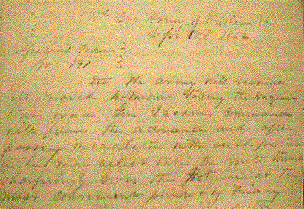
5. Contingency (or Didn’t the Battles Matter?)
Lee’s Lost Order
Antietam--1862

Slide 22
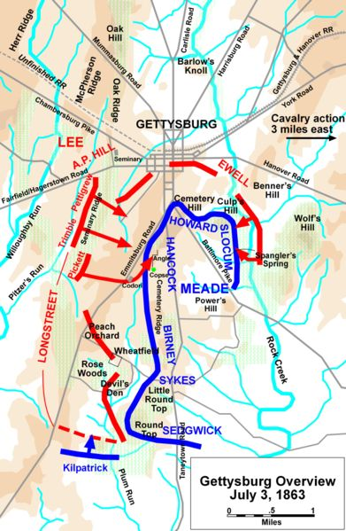
Gettysburg (what if Stonewall Jackson was there?)

Slide 23
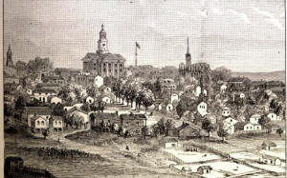
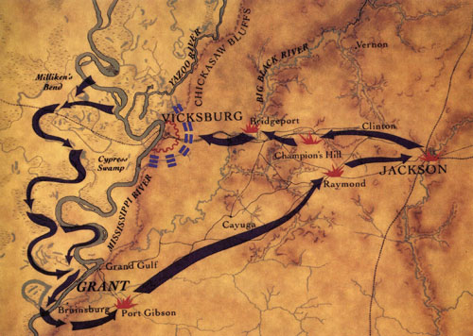
Vicksburg

Slide 24
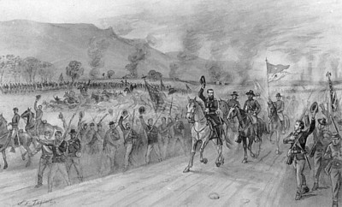
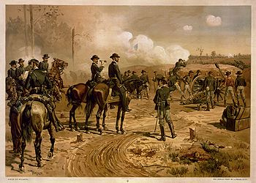
1864
Sherman Outside Atlanta
Sheridan in the Valley

