Slide 1
WORLD WAR II THE HOMEFRONT
World War II ends the Great Depression and creates the framework for the next thirty years of economic prosperity
John Maynard Keynes: deficit spending (US national debt goes from $43 million in 1940 to $259 million in 1945)—Keynesian Economics
Economic policy of war years maintained in postwar era

Slide 2
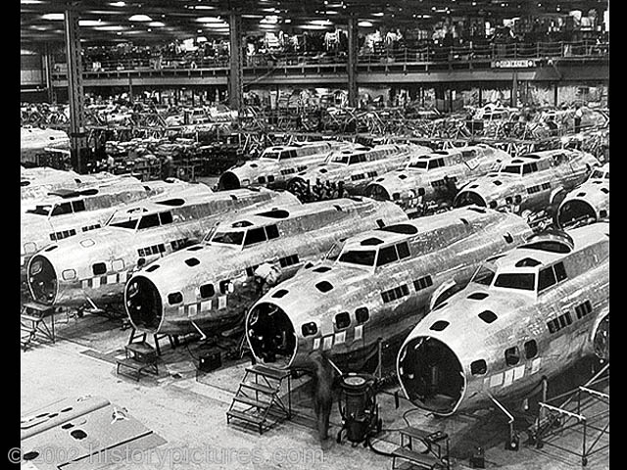

Slide 3
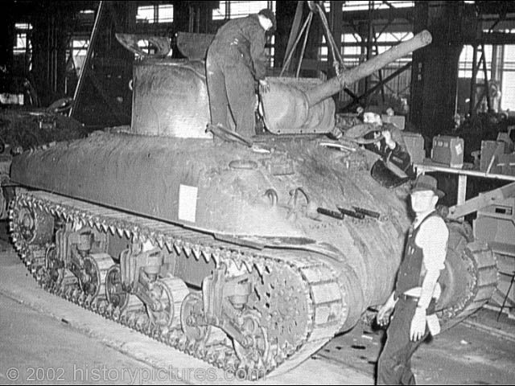

Slide 4
WORLD WAR II THE HOMEFRONT
Economic Mobilization and the South
Hastens the decline of southern agriculture
South becomes both a campground and an arsenal during the war

Slide 5
Andrew Jackson Higgins – New Orleans

Slide 6
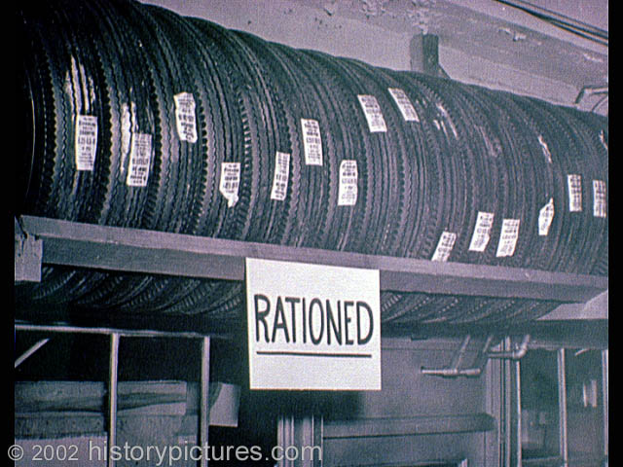
Wage and Price Controls
Rationing

Slide 7
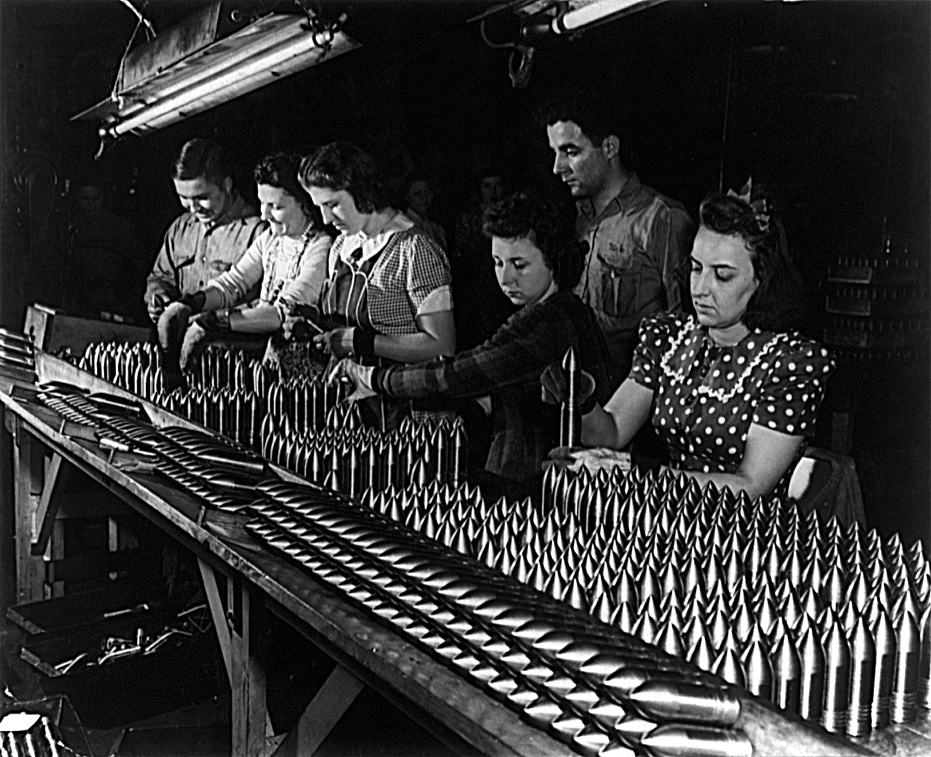
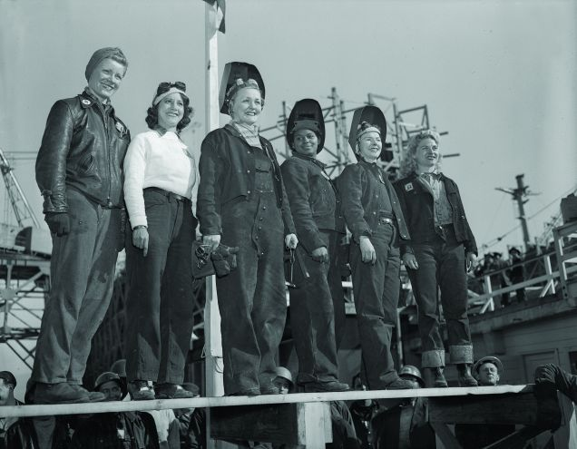
WORLD WAR II THE HOMEFRONT
Women and World War II

Slide 8
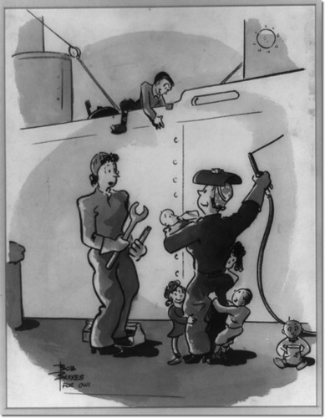
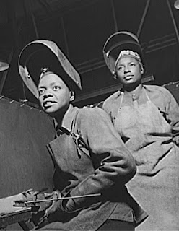

Slide 9
Hair Style for Safety

Slide 10
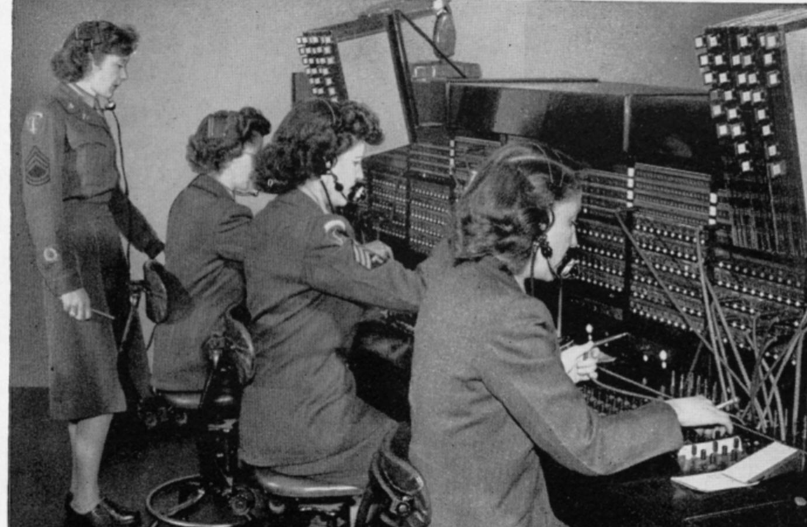
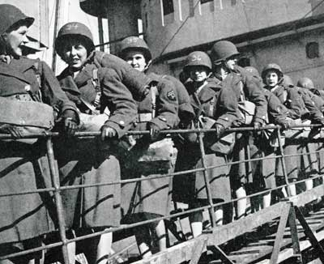
Women in Military
Service

Slide 11
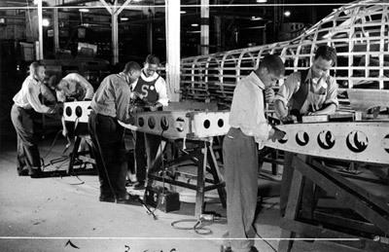
WORLD WAR II THE HOMEFRONT
African Americans and World War II
An even greater migration
More than 1 million blacks leave the South for the North and West (twice the number of migrants during the “Great Migration” during the WWI years)

Slide 12
Double-V
Campaign
Smith v. Allwright
(1944)

Slide 13
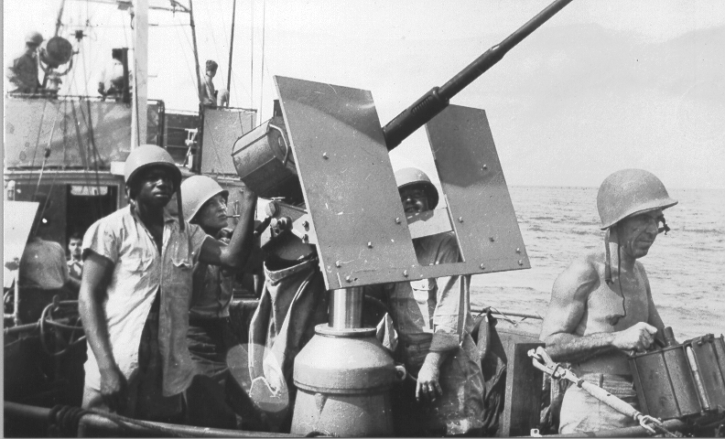
A segregated military

Slide 14
Tuskegee Airmen
Benjamin Davis

Slide 15
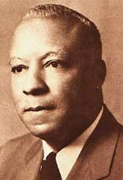
WORLD WAR II THE HOMEFRONT
Black Protest
A. Philip Randolph (March on Washington)
Fair Employment Practices Committee (FEPC)

Slide 16
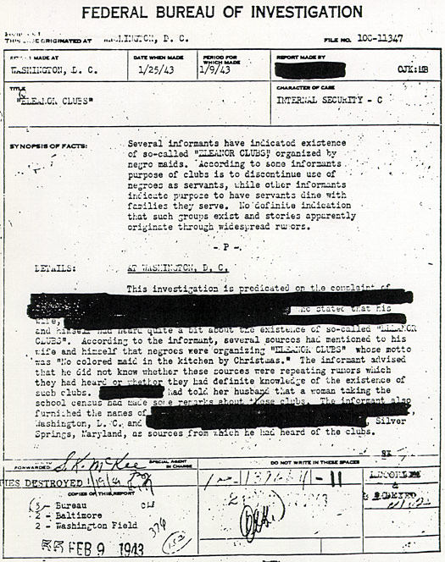
Eleanor Clubs

Slide 17
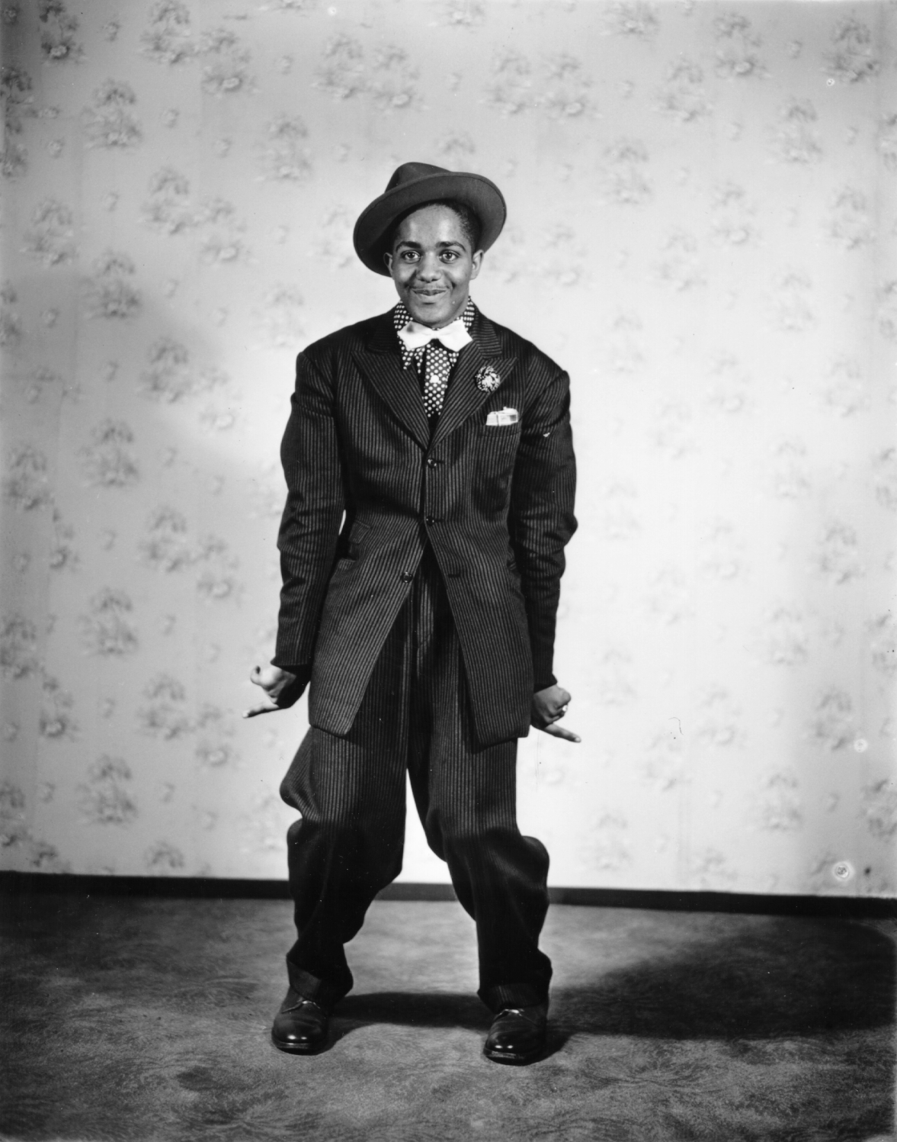
Zoot-Suit Riots - 1943

Slide 18
WORLD WAR II THE HOMEFRONT
Birth of Teen Culture
Weakening of family ties and authority of the schools
Prosperity and enhanced job opportunities
Changes in high school
Increase in teen gangs and juvenile delinquency

Slide 19
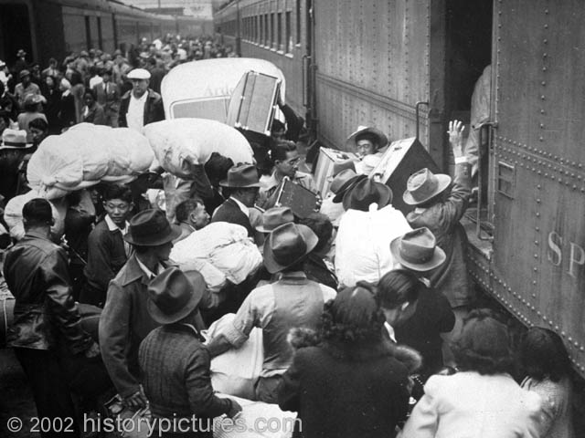
Concerns about National Security
Forced relocation of 120,000
Japanese Americans (1942)

Slide 20
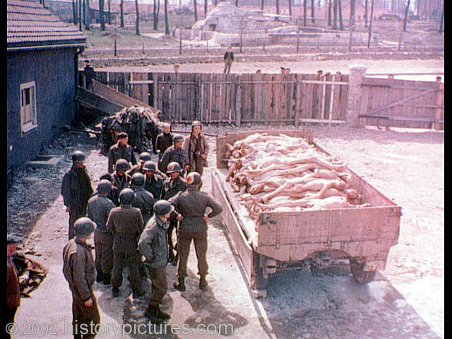
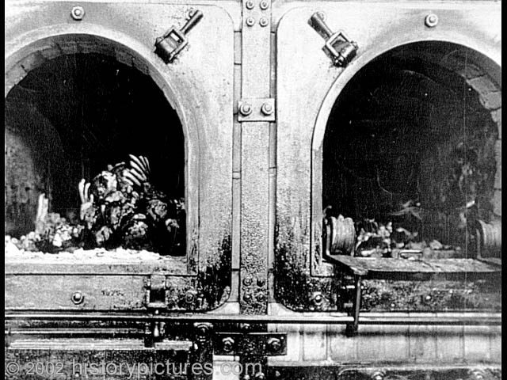
America and the
Holocaust
Anti-Semitism

