Slide 1
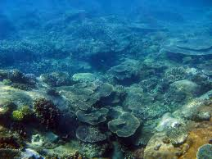
The Race for the Pearl

Slide 2
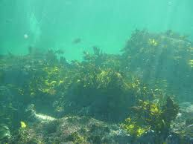
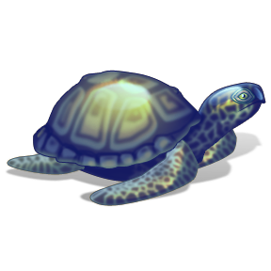
There was three friends. Well I guess that all depends. They were always challenging each other. In fact they two of them were brothers. They always were fighting on who was better. But only one of them could write just a simple letter.

Slide 3
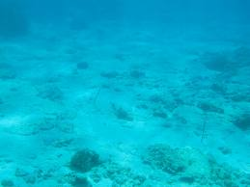
Marco
Darco
As Marco, Darco, and Narco were swimming they were trying to think on what they should do today. So they all went for a swim in the bay. As they were swimming they soon became bored. So they ventured off where the others have never explored.
Narco

Slide 4
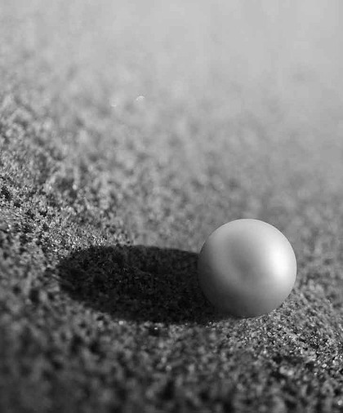
As they were swimming they came across a shiny ball. Everyone was excited to play with the new ball, but Marco said it was too small. That didn’t stop him from wanting it all to himself. So he said “ I want it for myself.” but the others didn’t agree with him. So they thought why not a race.

Slide 5
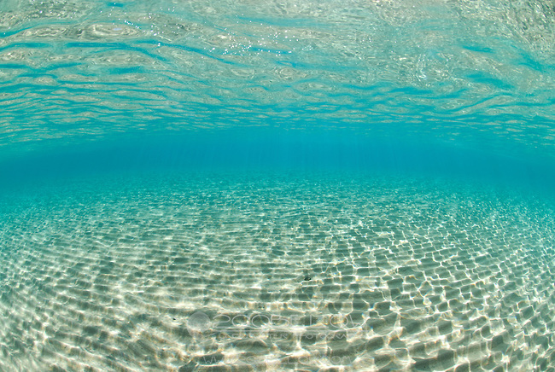

So they all went to their starting line. Still Marco said that the shiny ball was mine. But Narco said “ You will have to beat me first!” after that they all took off in a huge burst. So they were off and the race started. Not everyone stuck to the same path they began to depart.

Slide 6
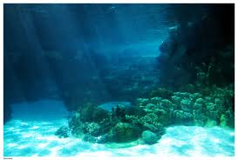
Marco takes off like a rocket. Leaving Narco and Darco in a air pocket. Narco popped the bubble and Darco took off like a bull in a cage. Narco began to go on a rage.

Slide 7
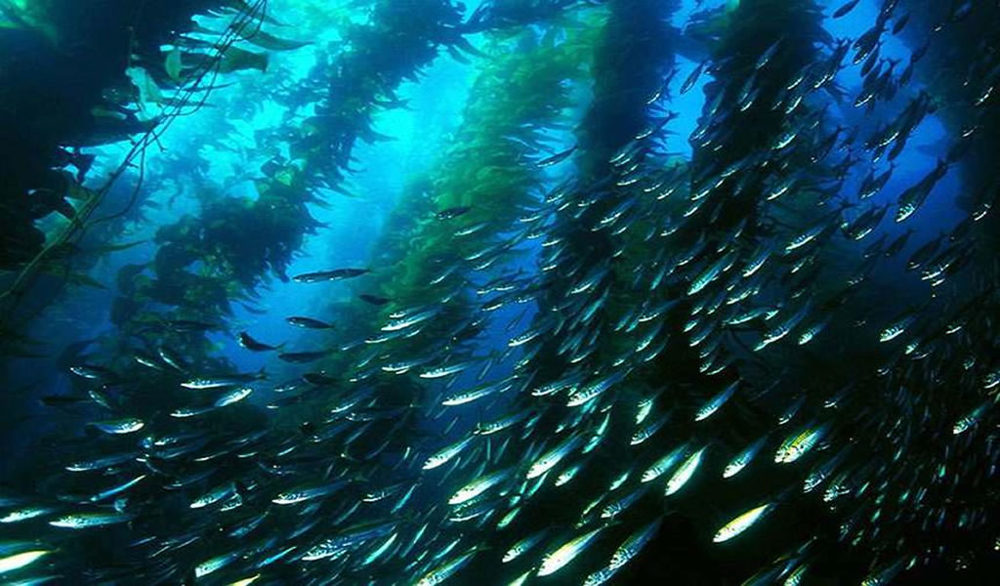
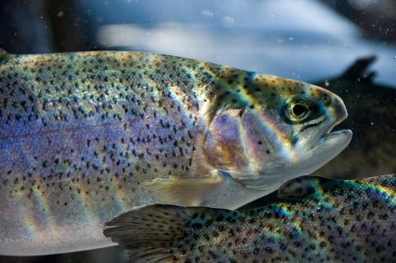
Narco gets lost in the sea weed with fish. He got cought in the serving dish. After getting out, he was chased by a sea trout.

Slide 8
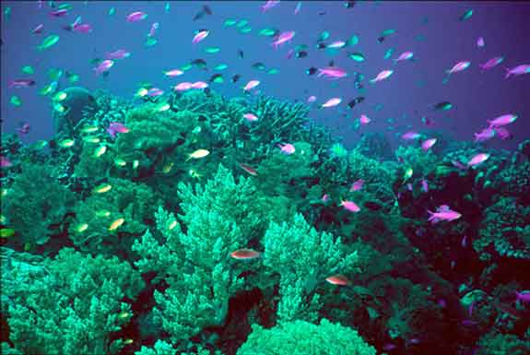
Darco can not be found. No where to be seen around. He is soon spotted in the coral, feeling so soral.

Slide 9
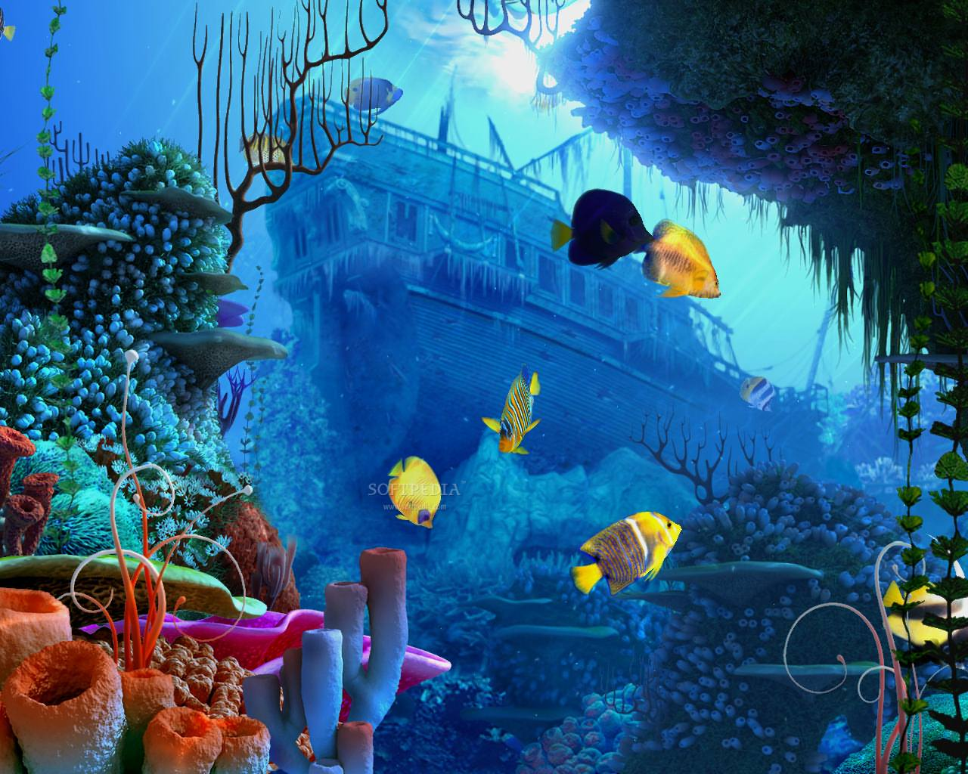
Marco is the last. Even though he is fast. He is in the ship, he got Hungary so he snipped.

Slide 10
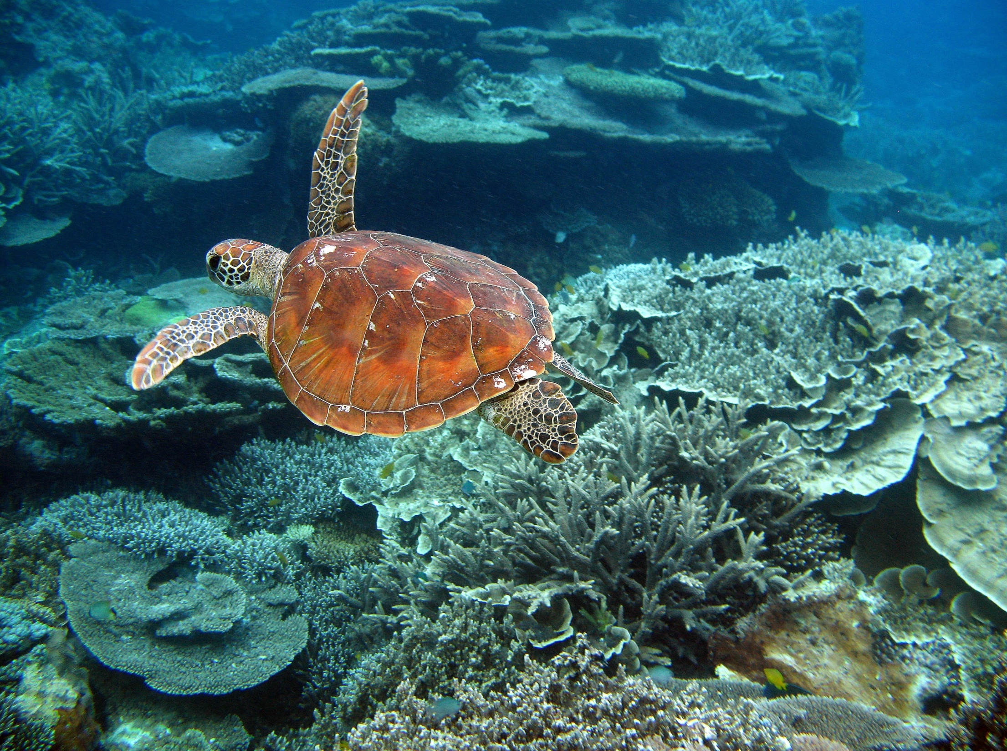
So in the end, there was a trend. Narco came in first, then marco came in with a burst.

Slide 11
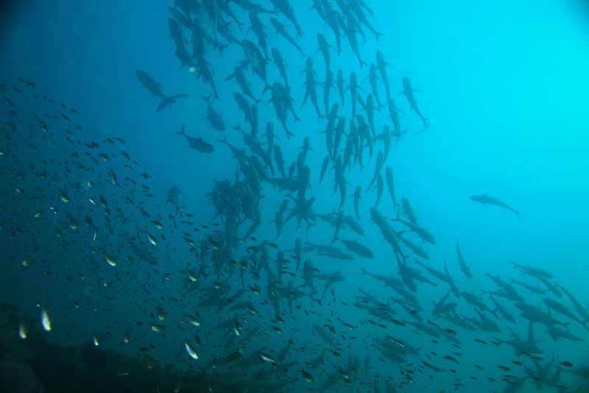
The end

